Slide 1
IoT Air Quality System
Uli Raich (uli.raich@gmail.com)
Introduction to the hardware
Presented at the Workshop – IoT4AQ
March 2024, Bambey, Sénégal

Slide 2
Resources
The slides and the code of all demo programs are available for download
at https://github.com/uraich/IoT4AQ/tree/main/workshop
Please also have a look at the Wiki pages:
https://github.com/uraich/IoT4AQ/wiki

Slide 3
What is IoT?
Wikipedia:
The Internet of Things (IoT) describes physical objects (or groups of such objects) with sensors, processing ability, software and other technologies that connect and exchange data with other devices and systems over the internet or any other communication networks

Slide 4
IoT
The name “Internet of Things” already suggests that there are two distinct components to it:
Things, which are represented by sensors and actuators. We therefore must have a means to read out these sensors and to control the actuators. Hardware interfaces are needed for this.
Internet, we must be able to send data read from the sensors to the Internet and receive commands for the actuators from it. This means that we need a network interwork and the software to run the network protocols.

Slide 5
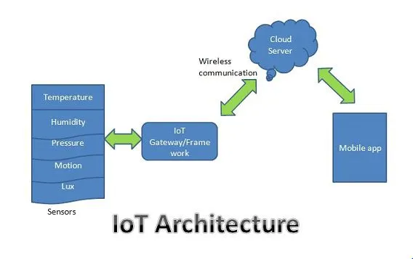
IoT system architecture

Slide 6
What is an IoT system composed of?
We need:
Sensors and actuators
A processor powerful enough to run the network protocol layers
A network interface: either Ethernet of WiFi
Interfaces to the sensors and actuators:
General Purpose I/O (GPIO) lines
I2C, I2S, SPI, serial interfaces
The cost for the controller should be in a good relation with the cost of the things

Slide 7
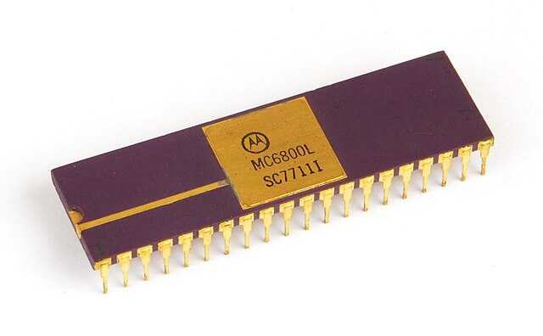
Micro-processors
Up to the 1970’s computers filled cupboards or even rooms.
Then the micro-processor came onto the market integrating a CPU (Central Processing Unit) onto a single silicon chip.
These devices had no on-chip memory nor on-chip interfaces.
A bus system allowed to connect peripherals.

Slide 8
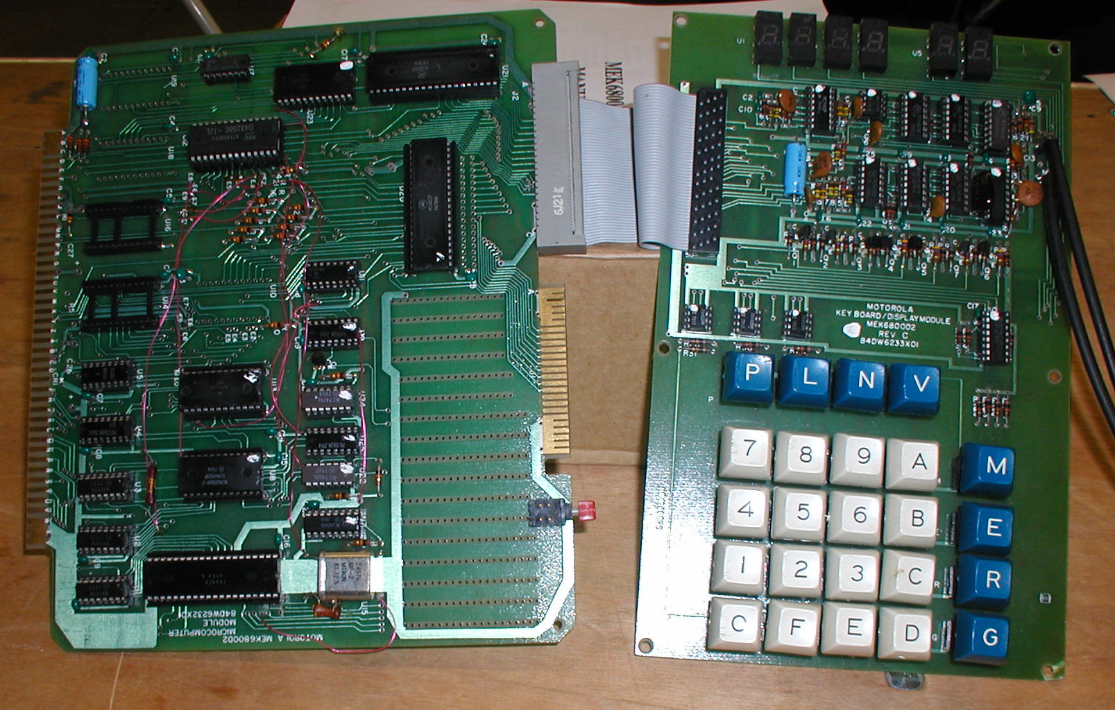
A Micro-processor system
This is how a micro-processor system looked like in the end 1970’s:
1 MHz clock
~ 2 kB of ROM (EPROM) memory
128 bytes of RAM
Keyboard to enter hex instruction code
Audio tape to save programs

Slide 9
Arduino
Micro-processor only understand binary instruction code and the instruction set differs from one machine to another
High level languages abstract programming and compilers translate the high level code to machine instructions
Since resources on the micro-computer are limited the compiler runs on a different machine (PC).
This is called cross-compilation in contrast to native compilation
The Arduino Software Development Kit (SDK) integrates
Source code editor
Compiler
Up-loader
into a single system (Integrated Development Environment IDE)

Slide 10
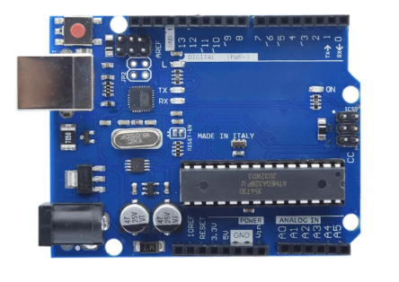
Arduino Uno
The Arduino SDK was developed for the Arduino board (e.g. Arduino Uno) featuring the Atmel
ATMeg328P processor
32kB Flash memory
2kB SRAM
1kB EEPROM
a number of interfaces
GPIO, SPI, I2C, ADC
and a standardized connector for piggy back “shields”

Slide 11
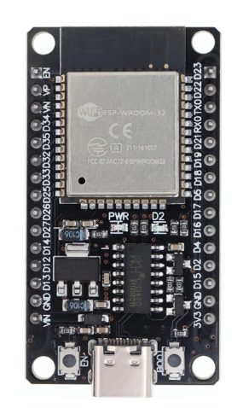
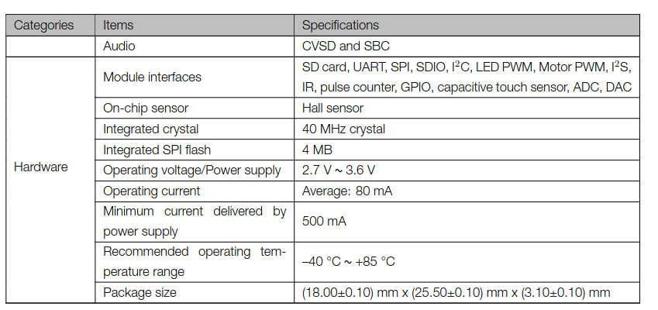
The micro-controller

Slide 12
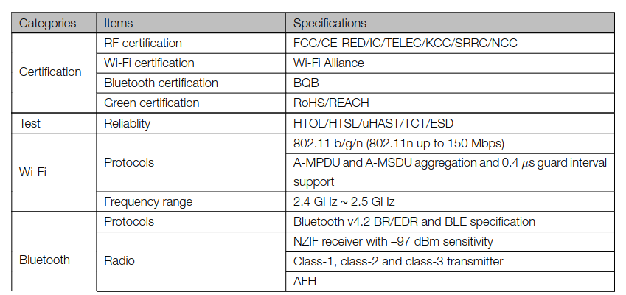
ESP32 network connection

Slide 13
which micro-controller?
Question of
Needs (how much memory, which speed, which interfaces …)
Budget
Software environment and programming language
Previous experience
Taste
Because of its computing power, its interfaces, its network connectivity and its low price we selected the ESP32

Slide 14
Programming the micro-controller
Depending on the processor used, several programming environments are available. For the ESP32 you have:
esp-idf (ESP integrated development framework) provided by Espressif (not recommended for a beginner programmer)
The Arduino SDK (Software Development Kit) originally developed for the Atmel Atmega chips but today available for many micro-controllers including the ESP32.
MicroPython. A stripped down Python-3 interpreter with additional features needed by micro-controllers available for several chips including the ESP32.
In these lectures we use the Arduino SDK

Slide 15
Interfacing to the “things”
The ESP32 has a big number of interfaces implemented on the chip:
GPIO pins
PWM
Capacitive touch sensor
I2C (Inter Integrated Circuit) interface
SPI (Serial Peripheral Interface) interface
Analogue to digital converter
Digital to analogue converter
Timer

Slide 16
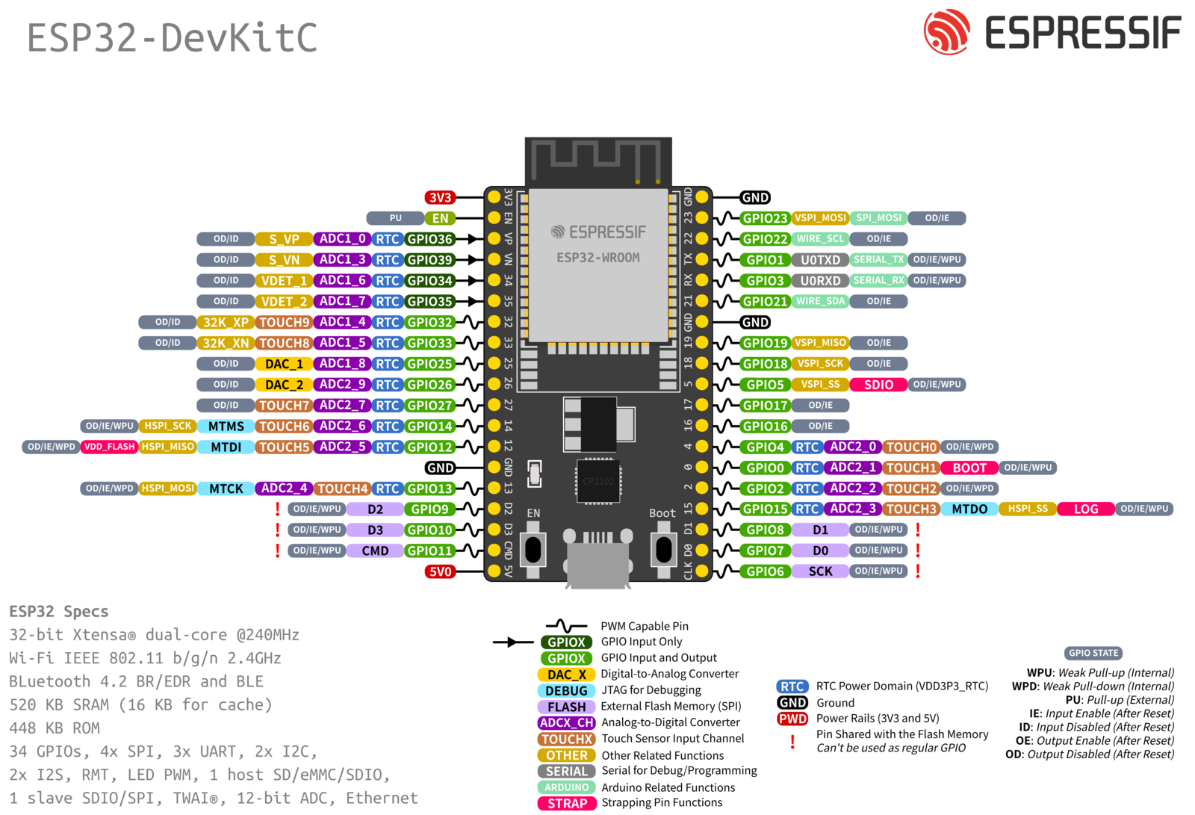
ESP32 pinout

Slide 17
Checking the system
In C the ubiquitous “hello world” program checks if
You can edit a program
You can compile and link it
You can run it
On embedded systems the simplest program possible is often the “blinking led” program
It shows that you can access the system and that interfacing works

