Slide 1
IoT Air Quality System
Uli Raich (uli.raich@gmail.com)
Two lectures on Hardware and Software for
the Internet of Things applied to Air Quality measurement
Lecture 1: Introduction to the hardware
and development environment and access to the “things”
Presented online at the Seminar – Air Quality and
IoT based Air Sensors Nov. 2023

Slide 2
What is IoT?
Wikipedia:
The Internet of Things (IoT) describes physical objects (or groups of such objects) with sensors, processing ability, software and other technologies that connect and exchange data with other devices and systems over the internet or any other communication networks

Slide 3
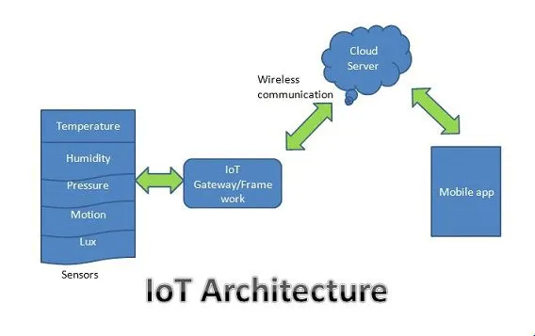
IoT system architecture

Slide 4
What is an IoT system composed of?
We need:
Sensors and actuators
A processor powerful enough to run the network protocol layers
A network interface: either Ethernet of WiFi
Interfaces to the sensors and actuators:
  General Purpose I/O (GPIO) lines
  I2C, I2S, SPI, serial interfaces
The cost for the controller should be in a good relation with the cost of the things

Slide 5
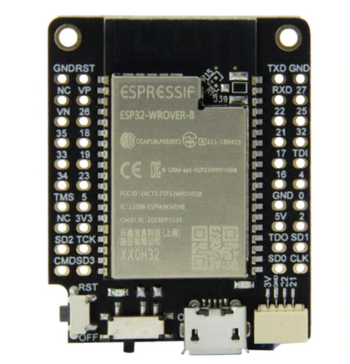
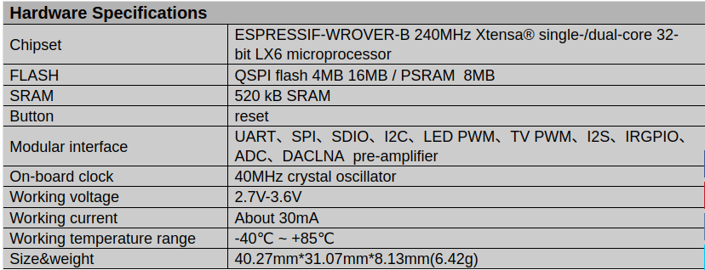
The micro-controller

Slide 6
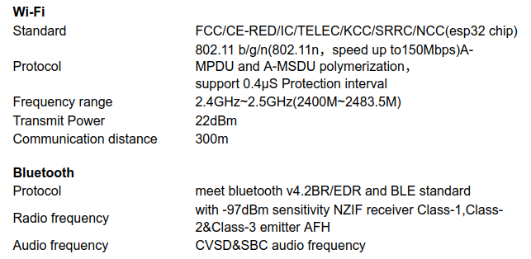
ESP32 network connection

Slide 7
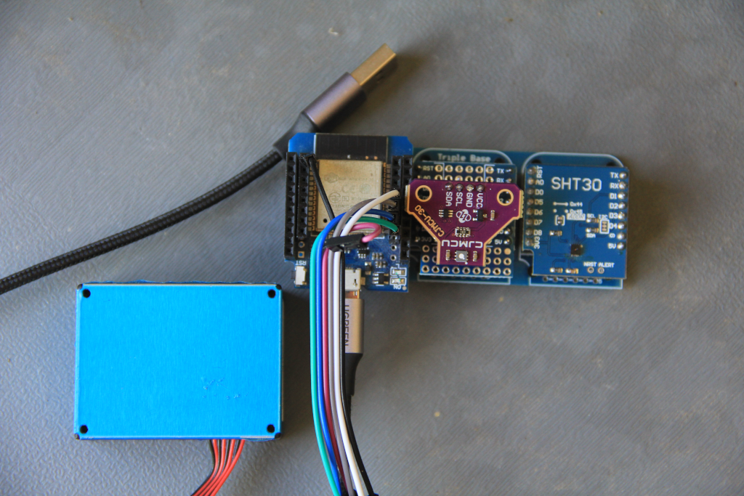
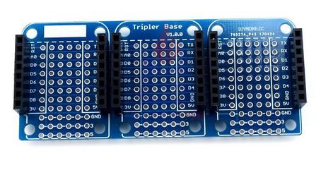
The system with AQ sensors
From left to right:
The ESP32 CPU card with serial
connections to the
PlanTower PMS5003 dust sensor
The SGP30 air quality sensor
The SHT30 temperature and
humidity sensor

Slide 8
Programming the micro-controller
Depending on the processor used, several programming environments are available. For the ESP32 you have:
esp-idf (ESP development framework) provided by Espressif (not recommended for a beginner programmer)
The Arduino SDK (Software Development Kit) originally developed for the Atmel Atmega chips but today available for many micro-controllers including the ESP32.
MicroPython. A stripped down Python-3 interpreter with additional features needed by micro-controllers available for several chips including the ESP32.

Slide 9
Communication tools
Serial communication (the PC :
minicom
Interaction with the file system:
ampy
IDE:
Thonny
Several other tools are available, I listed only those that will be demonstrated during the presentation

Slide 10
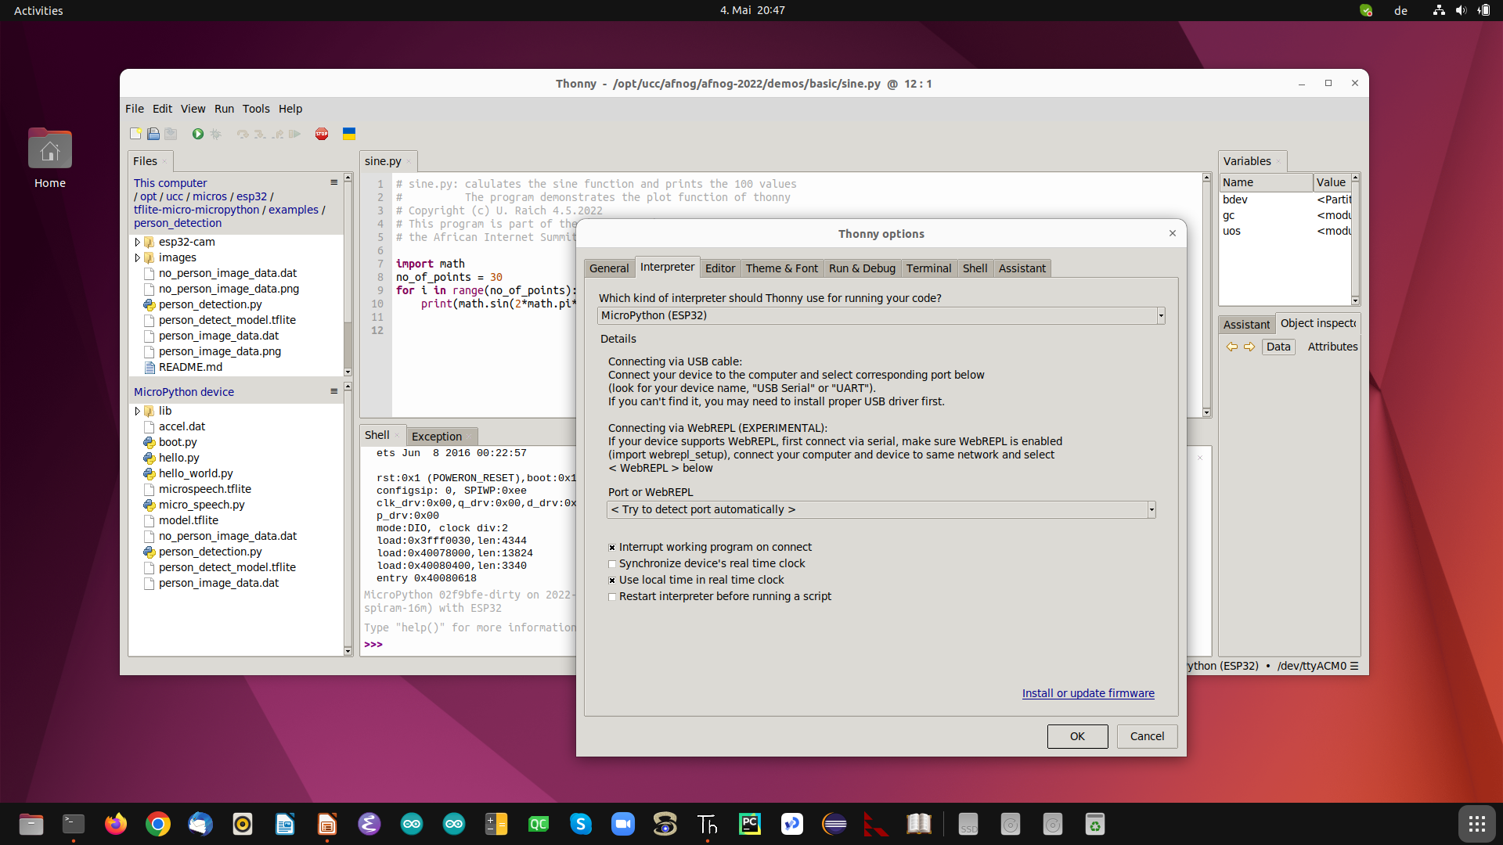
thonny
d

Slide 11
Interfacing to the “things”
The ESP32 has a big number of interfaces implemented on the chip:
GPIO pins
PWM
Capacitive touch sensor
I2C (Inter Integrated Circuit) interface
SPI (Serial Peripheral Interface) interface
Analogue to digital converter
Digital to analogue converter
Timer

Slide 12
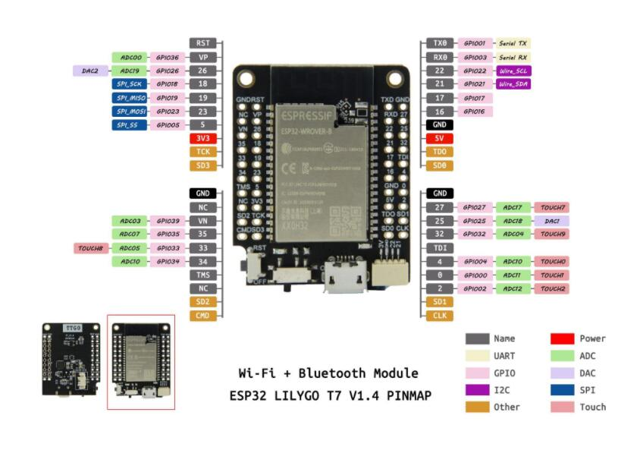
ESP32 pinout

Slide 13
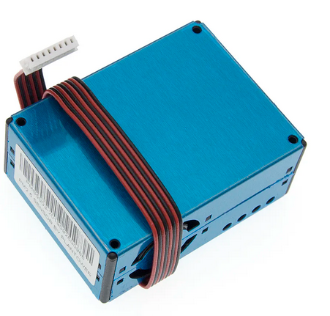
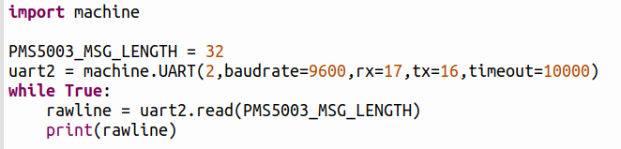

The PMS5003 dust sensor
The PMS5003 sends its measurements to the micro-controller over a simple serial line.

Slide 14
Meaning of the serial message
Bytes | meaning
0,1 | Magic word: ‘BM’
2,3 | Frame length: data + checksum = 28
4,5 | PM1.0 concentration [µg/m³]
]6,7 | PM2.5 concentration [µg/m³]
7,9 | PM10 concentration [µg/m³]
...
16,17 | No of particles <0.3 µm in 0.1 L of air
...
30,31 | checksum

Slide 15
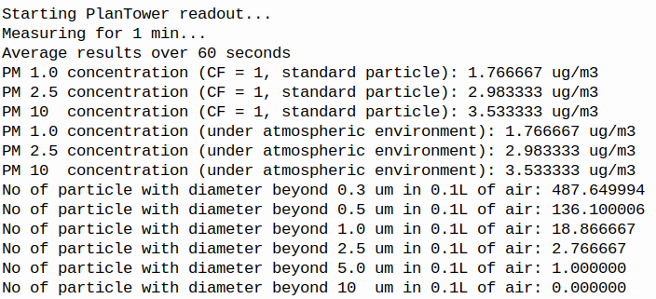
Results from the dust measurement

Slide 16
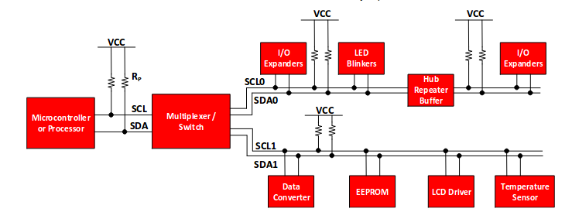
The I2C bus
The Inter-Integrated Circuit (I2C) bus was invented by Philips in the early 1980. It is used by many sensors to communicate their data to the CPU.

Slide 17
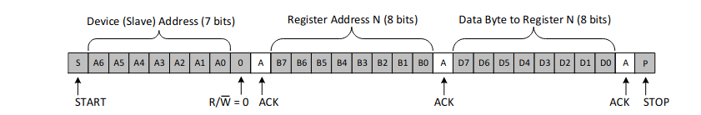
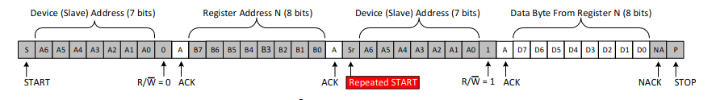
The I2C protocol
Write to the bus
Read from the bus
7 bit device address + R/W bit

Slide 18
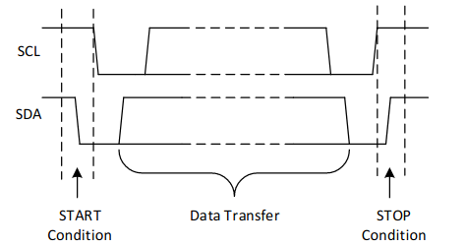
Start and stop conditions

Slide 19
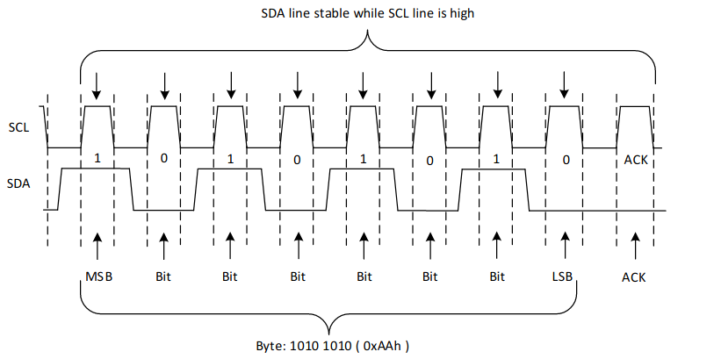
Data transfers

Slide 20
I2C addressing
The I2C bus uses the master/slave paradigm. The CPU acts as the master and the sensors as slaves.
The I2C bus uses 7 address bits (the 8th bit is the R/W line). A maximum of 128 slaves can therefore be connected to a single master.
The ESP32 has two hardware I2C buses, but MicroPython also provides a software I2C implementation using bit-banging on any GPIO line.
The pins for SCL (the I2C clock line) and SDA (the I2C data line) are
SCL: GPIO 22
SDA: GPIO 21
Control and readout of an I2C based sensor requires a driver accessing it using the MicroPython I2C driver calls. An example for the SHT30 temperature and humidity sensor is explained here.

Slide 21
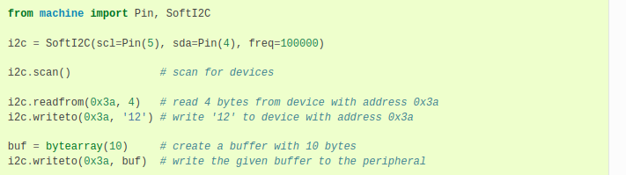

MicroPython’s I2C driver
From the MicroPython doc on the I2C bus for the ESP32
On the ESP32 CPU:
scl : GPIO 22
sda: GPIO 21

Slide 22
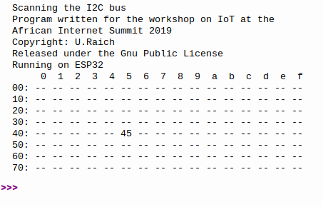

Scanning the I2C bus
d

Slide 23
Drivers are classes
Drivers are often implemented as Python classes
When an instance of a class is created the __init__ method its called
This method initializes the I2C bus and performs any initialization that the device may need.
The ESP32 has 2 hardware I2C interfaces and I2C bus 1 is reserved for users.
MicroPython includes a driver for the I2C bus whose methods are used to communicate with the specific I2C device.

