Slide 1
IoT Air Quality System
Uli Raich (uli.raich@gmail.com)
The RTCs (Real Time Clocks)
Presented at the Workshop – IoT4AQ
March 2024, Bambey, Sénégal

Slide 2
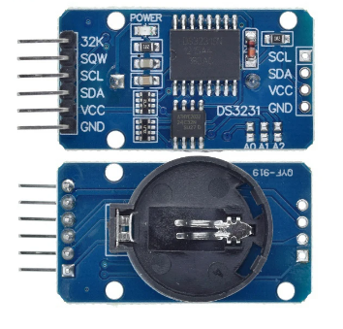
The DS3231
Our system has two Real Time Clocks:
The external DS3231, with battery backup
The ESP32 internal RTC
When the ESP32 is reset, the RTC will show
1. Jan. 1970 00:00:00
If it is connected to the Internet, date and time can be recuperated through the NTP (Network Time Protocol) and the ESP32 RTC can be set
If it has no Internet access, time and date must be retrieved from the battery backed DS3231, which must be previously set.

Slide 3
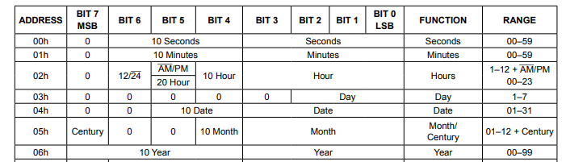
DS3231 registers
The alarm registers are not shown

