Slide 1
IoT Air Quality System
Uli Raich (uli.raich@gmail.com)
WiFi
Presented at the Workshop – IoT4AQ
March 2024, Bambey, Sénégal

Slide 2
The ESP32 WiFi interface
In addition to the sensor interfaces the ESP32 provides network interfaces in form of
BlueTooth and BlueTooth Low Energy (BLE)
WiFi
It can act as a WiFi access point allowing communication without necessity of the internet or it can be configured as a WiFi station interface with Internet access.
This permits to run a WEB server on the ESP32 giving access to measured parameter or it can act as a client to cloud services like ThingSpeak.

Slide 3
The ESP32 WiFi library
We will only look at the WiFi station interface as this will give access to the Internet.
The WiFi library is part of the ESP32 Arduino infrastructure and you do not need to load a separate library.
To get connected to your router, all you need to know is the Service Set Identifier and the router password.

Slide 4
Scanning the network
Several routers may be visible to the ESP32 and you may have to scan networks to find the correct SSID to connect to.
Scanning the network gives you information about
SSIDs visible
Encryption type
RSSI: received signal strength
BSSID: MAC address
Channel number

Slide 5
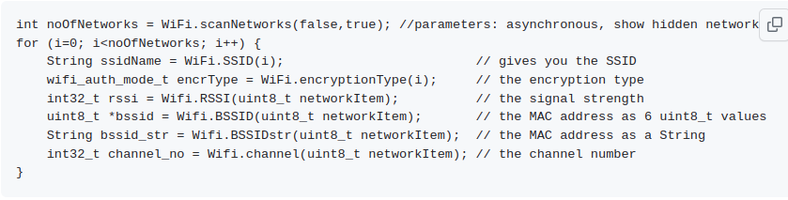
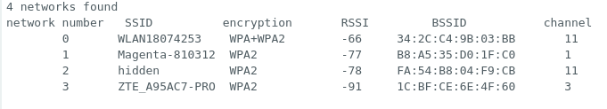
Network parameters

Slide 6
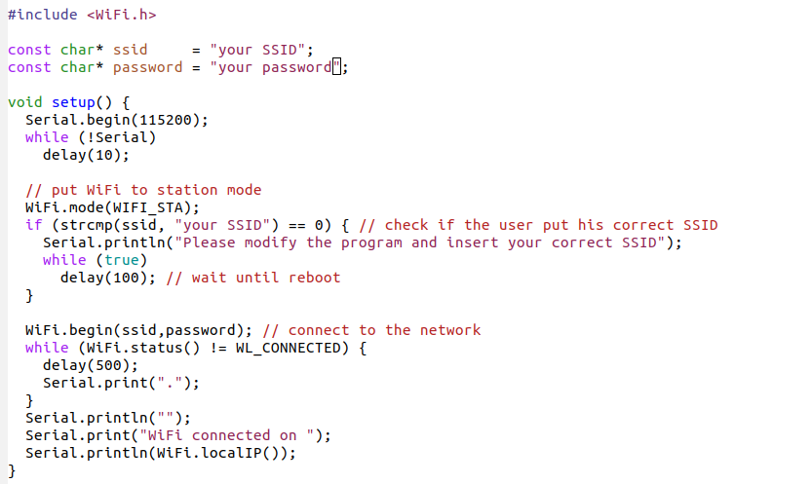
Connecting to your router

Slide 7
What’s next?
Once we are connected to the router we can use Internet services:
Get date and time from NTP (Network Time Protocol)
Run TCP and/or UDP protocols
Use the socket interface to implement a TCP client or server
Implement a WEB server
Run the REST (HTTP) or MQTT protocol (on top of TCP) to connect to cload services like ThingSpeak

