Slide 1
IoT Air Quality System
Uli Raich (uli.raich@gmail.com)
The PlanTower PMS5003 dust sensor
Presented at the Workshop – IoT4AQ
March 2024, Bambey, Sénégal

Slide 2
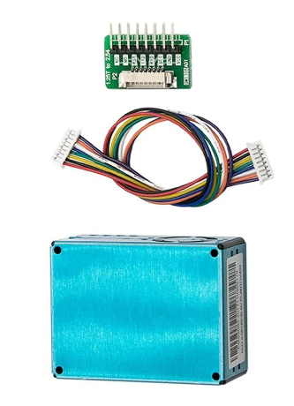
PMS5003 dust sensor
The PMS5003 measures dust concentration in air.
It contains a processor, calculating the
pm 1.0, pm 2.0, pm 10 (pm1 particles smaller than 1 µm) concentration in µg/m³
Using the Mie algorithm
It sends the values to the controlling CPU through an asynchronous serial protocol

Slide 3
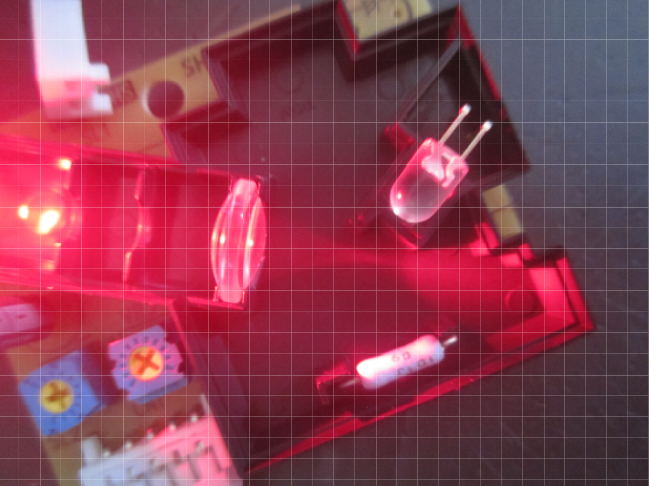
How does it work?
A Laser (or LED) shines into a volume of air, which is continually recycled through a fan or convection (using a heating element) .
The light scattered from the dust particles is collected with a lens and sent to a photo element.
The amount of light collected determines the dust concentration.

Slide 4
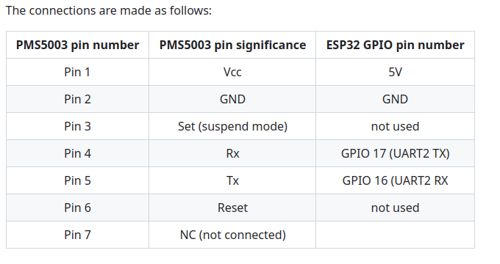
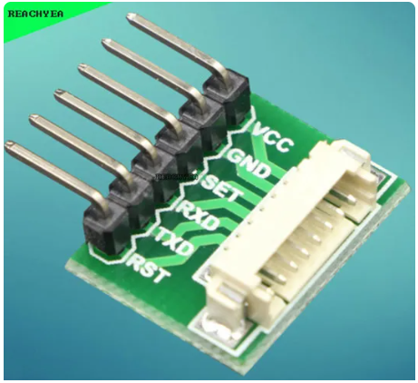
Connections

Slide 5
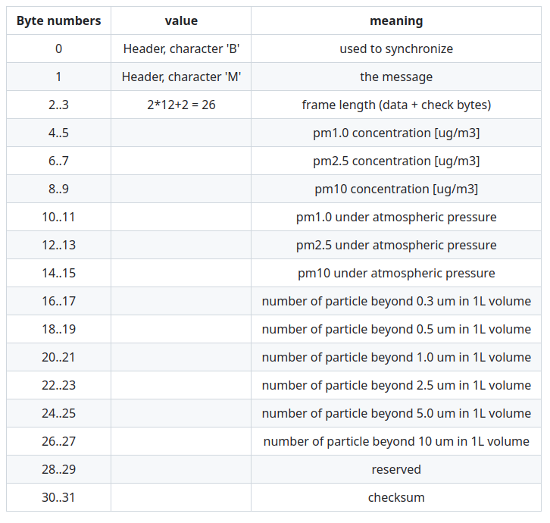
The PMS5003 protocol
For details read the data sheet
To calculate the checksum:
Add all values up to byte number 27

Slide 6
PMS5003 library
It is not particularly difficult to decode the PMS5003 protocol:
int result; for (int i=2;i<32,i++) { result = (rawData[i] << 8) | rawData[i+1];
// the library uses pointers to accomplish this // but the principle is the same }
Then you must calculate the checksum

Slide 7
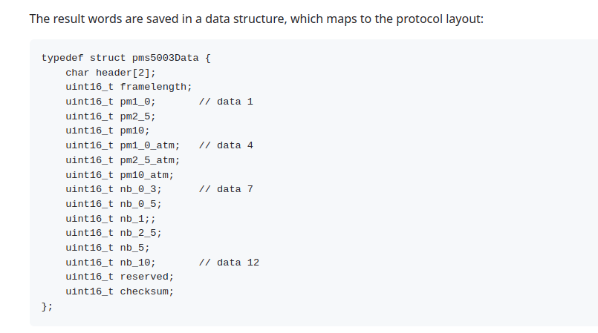
PMS5003 Result Data Structure

Slide 8
PMS5003 Result Data Structure

Slide 9
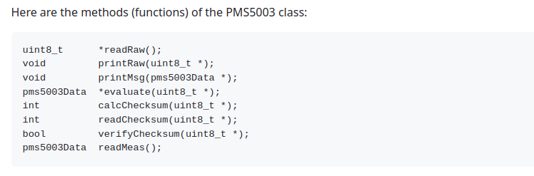
Library Functions

Slide 10
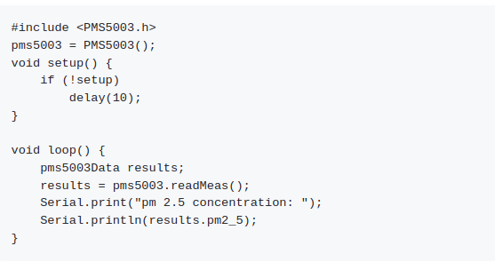
Getting the results

