Slide 1
IoT4AQ
Uli Raich (uli.raich@gmail.com)
Basic C++ programming
Presented at the Workshop – IoT4AQ
March 2024, Bambey, Sénégal

Slide 2
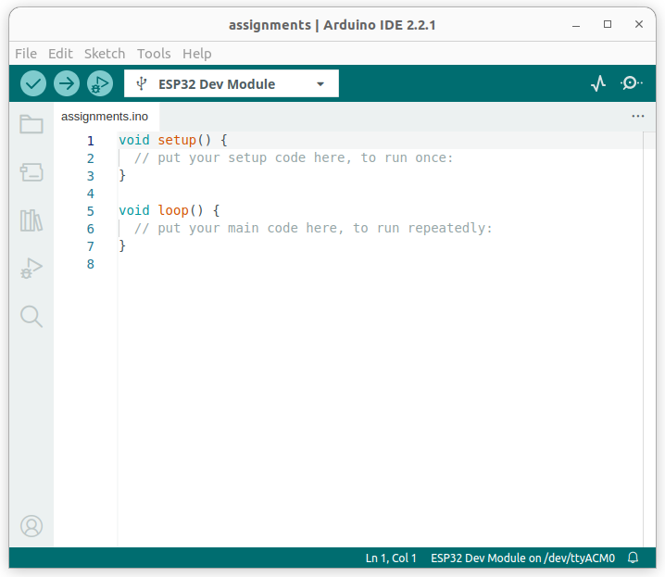
Arduino Template
When you create a new program: File → New Sketch this is what you get
The setup() function is executed once at startup (initialization)
Loop() is executed repeatedly
Set ESP32 Dev Module with Tools → Board → ESP32
Select the correct serial port with Tools → Port

Slide 3
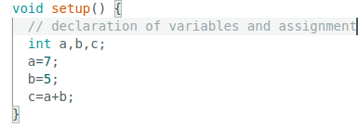
Variable definition
Before using a variable it must be declared: type variable name
Type can be
int for integers (or int8_t, int16_t, uint8_t, uint16_t)
float or double for real numbers
bool for boolean variables
char for characters

Slide 4
Comments
Comments are not executed but they are very important to explain to the reader what you are doing
// this is a comment
Everything after the // until the end of the line is considered a comment
/* This is a multi-line comment when it takes a little more to explain your extraordinary ideas */

Slide 5
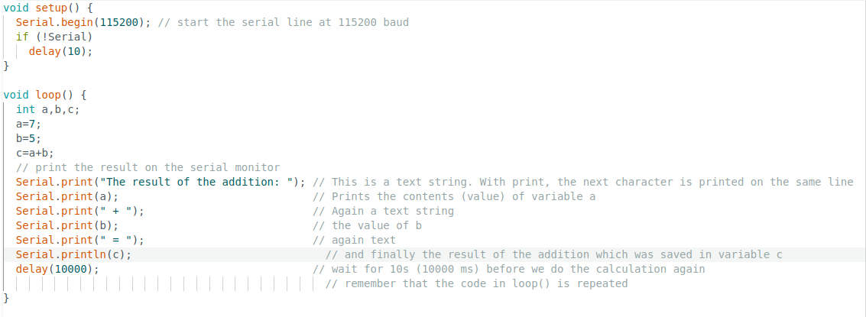
Serial port
How to see the result of the calculation? Send the data to the serial interface and observe it on the serial monitor:

Slide 6

Compile and execute
The button with the tick mark compiles you program and checks for syntax errors
The arrow button
Compiles the program
Uploads it to the ESP32 if no syntax errors are found
Resets the CPU to start the program

Slide 7
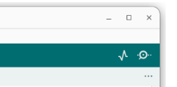
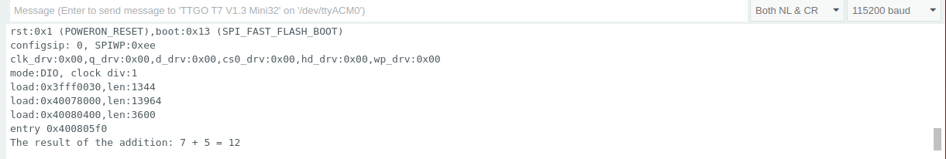
The Serial Monitor
The baud rate must comply to what you set in Serial.begin()

Slide 8
Assignments
c = a+b is not a mathematical equation ! ”=” is the assignment operator:
a = a+3 makes no sense as an equation but is a valid assignment get the value of a, add 3 to it, store it back into a
abbreviation:
a += 3, same for the other operators: - * /
a++ increments a by 1,
a-- for decrement

Slide 9
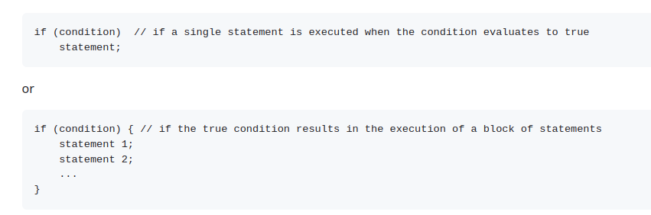
Conditions

Slide 10
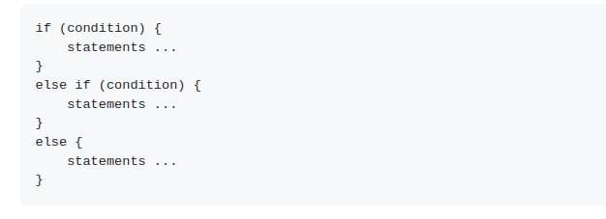

Conditions (2)
In case of
Serial is a boolean variable which becomes true when the port is ready.
Condition often imply comparison:
<, <=, >, >=, ==, !=

Slide 11

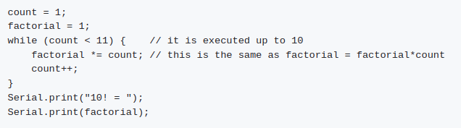
while loop
An example calculating factorial of 10:

Slide 12
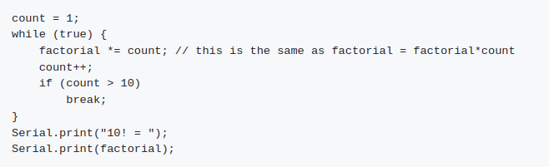
Breaking out of a while loop

Slide 13

for loops

Slide 14
functions
Functions are blocks of code that can be called. They usually have a number of parameters on which they work and a return value. They are therefore declared with a type.
Often the function is declared in an include file:
float line(float, float, float); // a function taken 3 floats as pars // and returning a float
Here is a function that calculates the y values of a straight line: y = mx + b
float line(float m, float b, float x) { // calculates a straight line return (m*x + b); }

Slide 15
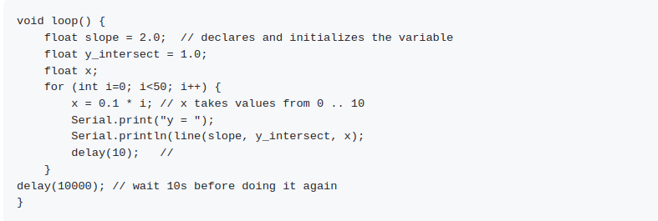
Calling the function

Slide 16
void functions
We have seen the functions
void setup()
void loop()
These are functions taking no parameters and returning no values. Variables declared in functions are only valid within the function.
If you want to have a variable visible anywhere (a global variable) it must be declared outside of functions.

Slide 17
arrays
If you have a number of values of the same type, you can assemble them in an array:
int my_array[10]; // defines an array of 10 integer values
After declaration you can access the elements of the array through an index:
for (int i=0; i<10;i++) // indices usually start with zero my_array = 2*i + 3;
You can also recuperate the values from the array with:
int a = array[3]; // what will be the value of a?

Slide 18
C-type character strings
In C a string is an array of characters coded in 8 bits and terminated be a zero
There is a series of functions in the C library acting in strings:
strlen(charString) : determines the number of chars in the string (excluding the zero)
strcpy(destination, source) : Copies a string
strncpy(destination, source,n) : same as strcpy but does not copy more than n chars
strcmp(str1, str2) compares two strings

Slide 19
Pointers
A pointer to a variable does not contain the value of the variable but the position in memory where to find the value
int a= 5; declaration of a variable int *aPtr: declaration of a pointer variable aPtr = &a; the pointer is initialized with the address of variable a int b = *aPtr;

Slide 20
Pointers with strings
char hello[] = "Hello World";
char *helloPtr; // declaration of the pointer variable (it is not initialized yet)
char c;
helloPtr = hello; // helloPtr now contains the memory address of the first character of the hello[] string
c = *helloPtr; // get the character that is pointed to by helloPtr and put it into the variable c
// c will now have the value 'H'
Serial.print(c);
// if you now increment the pointer, it will point to the next element in the character array, which is 'e'
helloPtr++; // The pointer is incremented, the string that it points to is not modified
*helloPtr = 'a'; // We modify the memory location where helloPtr points to. // This means the 'e' is replaced by 'a'

Slide 21
Traversing a string
We can also easily use the pointer to traverse all the character array, print all the characters and stop, when the terminating zero is found:
char *hello = "Hello World!"; // This time we define a pointer to a constant character array
// We could also define it as we did before
char *helloPtr = hello; // hello and helloPtr now point to the same memory location, // they are equal
while (*helloPtr != 0)
Serial.print(*helloPtr++); // print the character that helloPtr points to and increment the pointer afterwards
// it now points to the next character
// the while loop stops when the terminating zero is seen

Slide 22
To be tried
What will be the result of the following code:
char h1[] = "Hello World!"; char h2[] = "Hello World!";
if (h1 == h2) Serial.println("The strings are equal"); else Serial.println("The strings are not equal);
What happens when you replace char h1[] by char *h1, same for h2?
What will be the the size of char *h and char c[]
Try the function sizeof(variable) to find out

