Slide 1
IoT Air Quality System
Uli Raich (uli.raich@gmail.com)
The DHT11 temperature and humidity sensor
Presented at the Workshop – IoT4AQ
March 2024, Bambey, Sénégal

Slide 2
A bit more on C++ programming
We have seen arrays, which assembles elements of the same type. The C struct allows to collect elements of different type into a new structure and name each element:
struct mystruc { float a; int b; }
To declare a variable of this new datatype we would write:
struct mystruct s; s.a = 7.5; s.b = 5;

Slide 3
typedef
If we define this data structure as a new data type, access becomes easier:
typedef struct mystruc { int a; int b; } mystruct s;
We can also define a pointer to this data structure:
mystruct *structPtr; structPtr -> a = 7.5; structPtr -> b = 5;

Slide 4
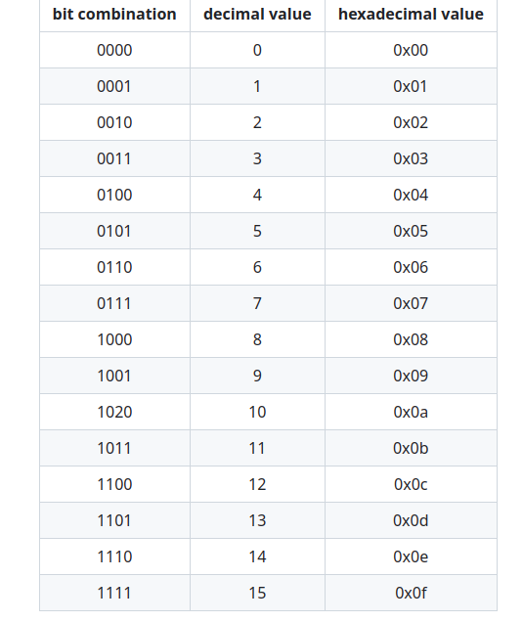
Data Encoding
As we said in the chapter on CPUs, computers only understand digital data, which is nothing but bit combinations.
Memory locations can be 32 or even 64 bits wide, but access to single bytes is usually possible. A single byte stores 8 bits of data.
Let's have a look at 4 bits only. How many combinations of zeros and ones can we construct from 4 bits?
The hexadecimal number system uses a base of 16 instead of 10. Hex numbers are indicated be “0x” in front of them

Slide 5
Hex calculations
What is the result of
0x18 + 0x18?
Calculate as you would do in the decimal number system, only that the carry over is at 16 instead of 10.

Slide 6
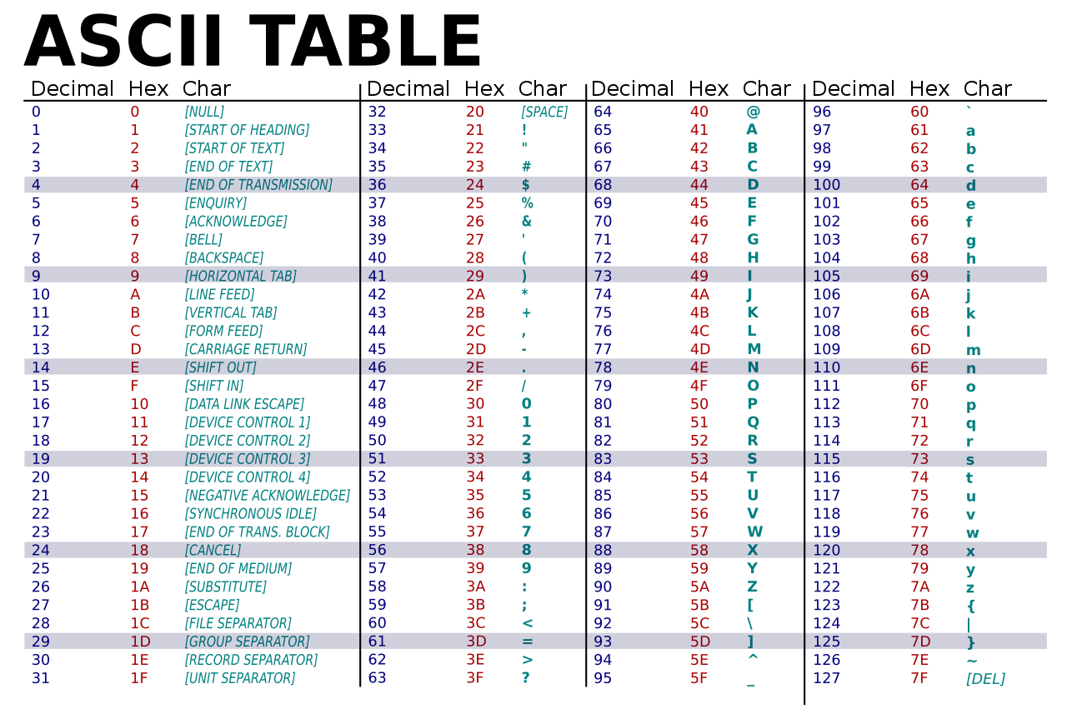
Character encoding

Slide 7
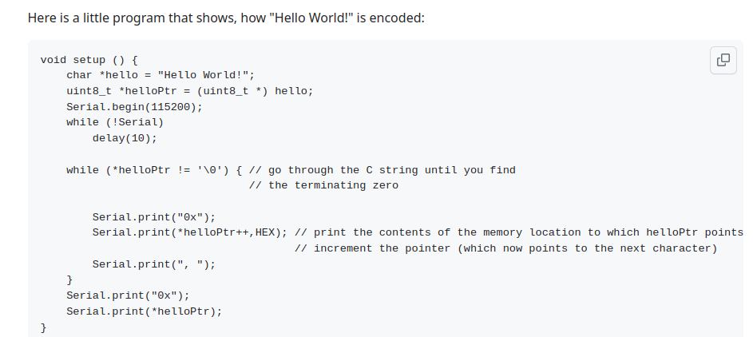
A demo

Slide 8
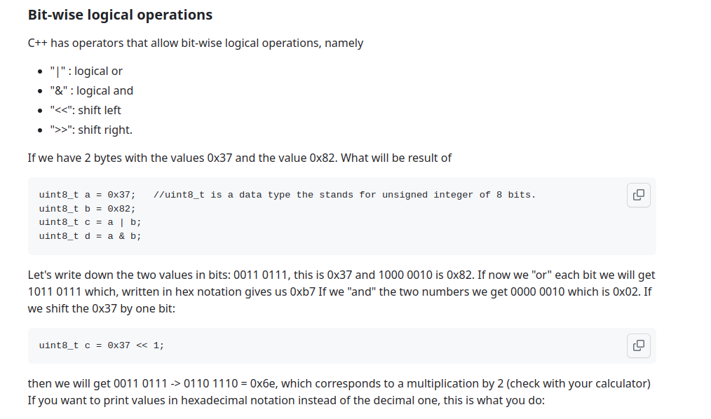
Bitwise logical operations

Slide 9
Printing hex numbers
int a = 0x1ac4;
Serial.print("a in hex notation: ");
Serial.println(a,HEX);

Slide 10
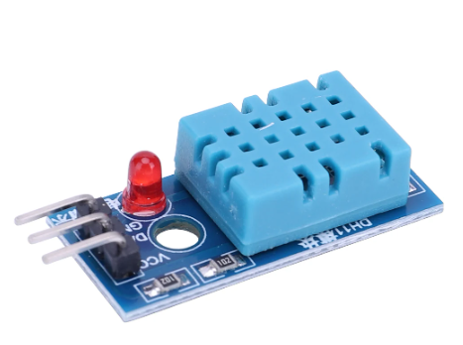
DHT11 sensor
The DHT11 is a popular temperature and humidity sensor
It contains the sensors, analogue to digital conversion and a processor sending the measurement results over its own proprietary serial protocol
It uses only 3 pins:
Vcc (3.3V)
GND
Data

Slide 11
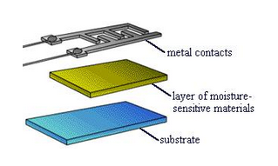
The humidity sensor
Variations in relative humidity produce a change of resistivity, which is measured.
The resistance of certain hygroscopic materials such as hygroscopic salts have such a property
These materials are mounted as thin films on the substrate with metal contacts
The devices can be very small

Slide 12
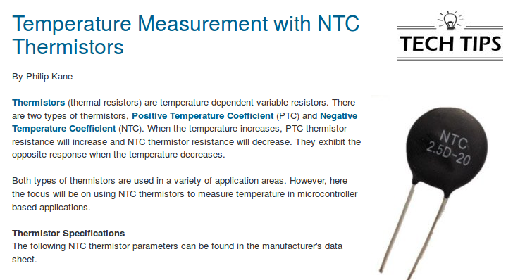
The temperature sensor

Slide 13
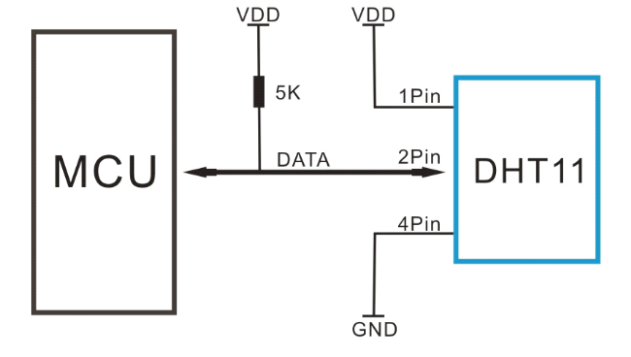
The connections

Slide 14
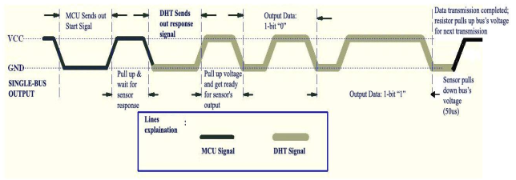
Communication process
The processor initiates a measurement cycle pulling the data line down for 18 ms (data line is output to the CPU)
It releases the line and waits for 20-40 µs (data line now input)
The DHT11 sends a 80 µs start signal
40 data bits follow: 26-28 µs : zero, 70 µs one

Slide 15
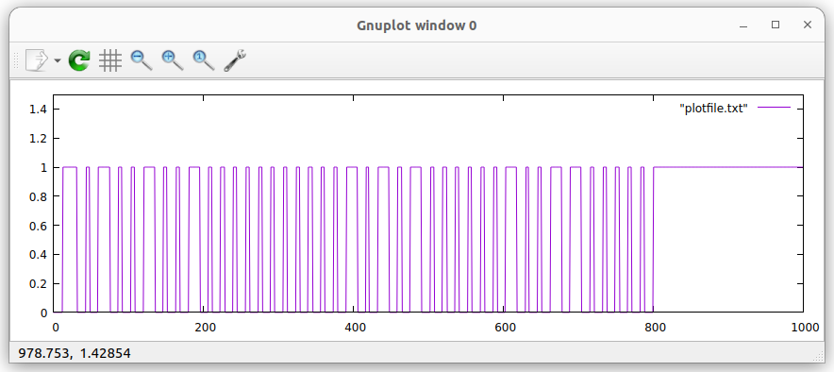
The full protocol
Humidity integral
Humidity decimal
Temperature integral
Temperature decimal
Checksum

Slide 16
DHT11 Arduino Library
Getting the DHT11 measurements looks difficult. However, it is possible to write libraries that hide all the protocol details and that provide a small number of functions needed to easily access temperature and humidity values.
The DHT11 library implements DHT11 access as a C++ class.
A class is a data type incorporating data and functions into a single object.
To access the library a definition file must be included.
#include <DHT11.h>
is treated by the gcc pre-processor.

Slide 17
Arduino Library Structure
Arduino libraries usually contain
The source code ( in the src folder) + include file
A library.properties file specifying
its name
its author
version number
on which hardware it runs
examples

Slide 18
DHT11 class methods
DHT11 DHT11(int data_pin); // the object constructor
void setDelay(ms_delay); // sets the delay between 2 measurements (default 500 ms) I need at least 1.2s.
int readHumidity()
int readTemperature() These methods return the measured values or DHT11::ERROR:TIMEOUT (253) or DHT11:ERROR:CHECKSUM (254)
int readTemperatureHumidity(int &temperature, int &humidity) returns 0 if ok, DHT11::ERROR:TIMEOUT (253) or DHT11:ERROR:CHECKSUM (254) otherwise
static String getErrorString(int errorCode): prints a humanly readable error message

Slide 19
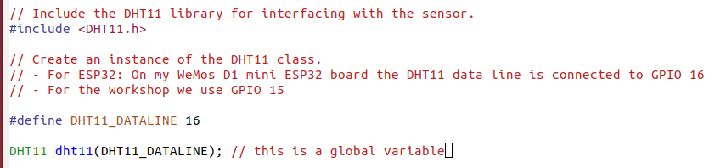
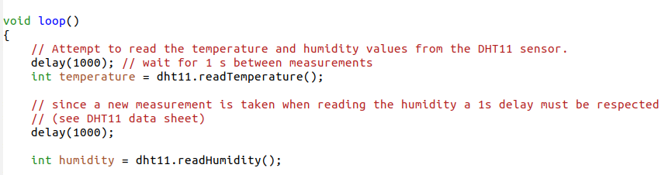
An example

Slide 20
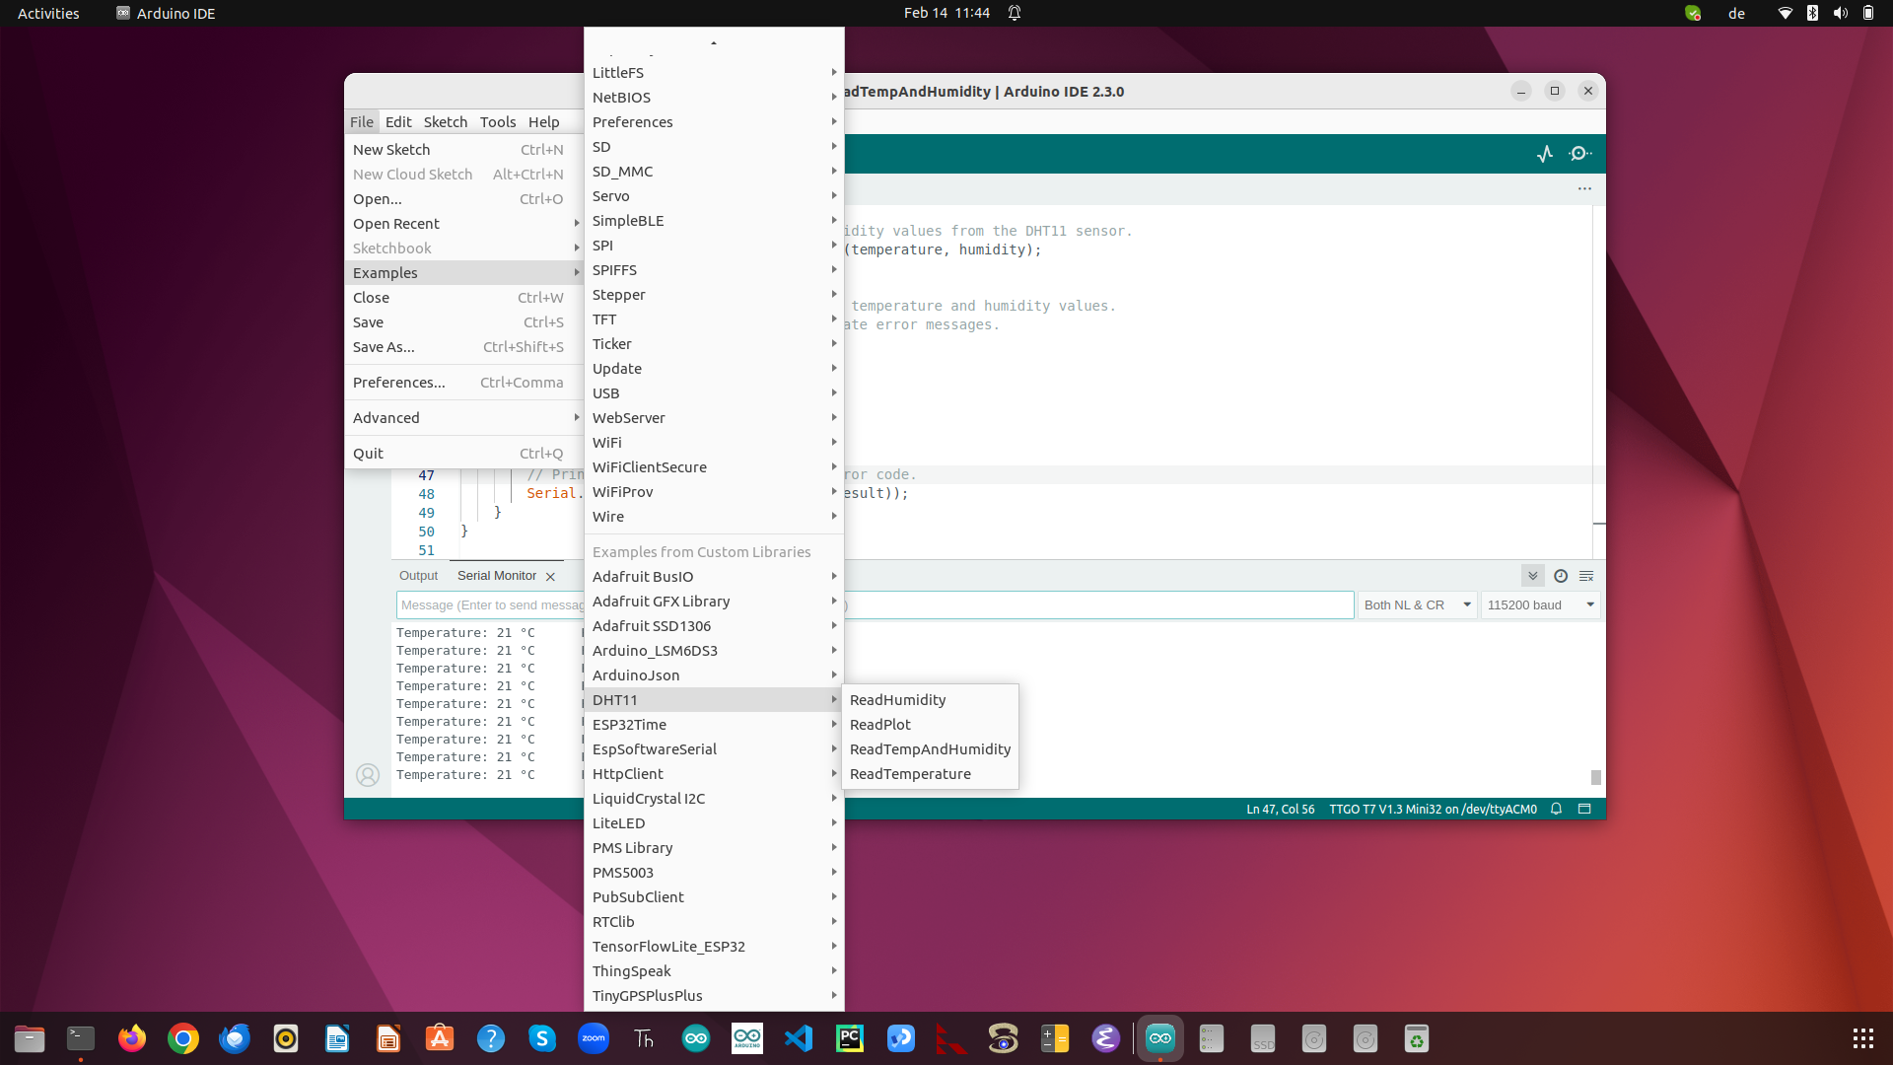
examples

