Slide 1
IoT Air Quality System
Uli Raich (uli.raich@gmail.com)
General Purpose Input Output (GPIO)
Presented at the Workshop – IoT4AQ
March 2024, Bambey, Sénégal

Slide 2
GPIO lines
General Purpose Input Output (GPIO) lines carry digital signals (0V or 3.3V)
The signals can be driven by the CPU (the GPIO line is programmed output) or it can be driven by external hardware (the GPIO line is programmed input)
Several functions controlling these lines are available in the Arduino SDK:
pinMode(gpio_nr, OUTPUT); // sets the gpio line to output
pinMode(gpio_nr, INPUT); or pinMode(gpio_nr, INPUT_PULLUP);
digitalWrite(gpio_nr, HIGH); // or LOW

Slide 3
Some timing
Often we have to wait for a fixed amount of time.
When blinking a LED, we
switch on the LED
wait for e.g. 500 ms
switch off the LED
wait for another 500 ms
delay(500); // waits for 500 ms delayMicroseconds(500); // you guess!

Slide 4
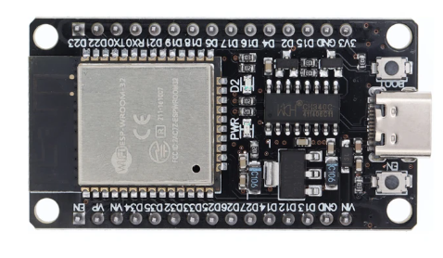
User programmable LED
The ESP32 DevKit CPU has 2 LEDs:
Power LED
User programmable LED
The user programmable LED is connected to GPIO 2.
A constant LED_BUILTIN is defined with the correct GPIO line.

Slide 5
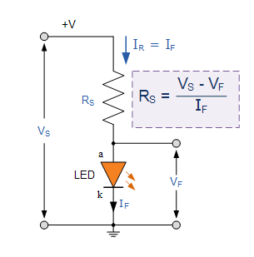
Accessing the builtin LED
void setup() { // initialize digital pin LED_BUILTIN as output pinMode(LED_BUILTIN, OUTPUT) }
void loop() { digitalWrite(LED_BUILTIN,HIGH); delay(500); digitalWrite(LEED_BUILTIN,LOW); delay(500); }

Slide 6
Dimming the LED
Dimming the LED seems impossible since we can only set the values GND or 3.3V.
However, it is possible to send a frequency instead of a steady signal to the GPIO line. If the frequency is high enough and with a non-zero persistence time, the human eye does not see the LED switching on and off.
The time the signal is high compared to the time it is low, determines the average current flowing through the LED and hence its brightness.
This is called Pulse Width Modulation (PWM) and the up-time its duty cycle. Often a 1 kHz frequency is used.
The function analogWrite(gpio_no, duty_cycle) writes a PWM signal with duty_cycle: 0..255

Slide 7
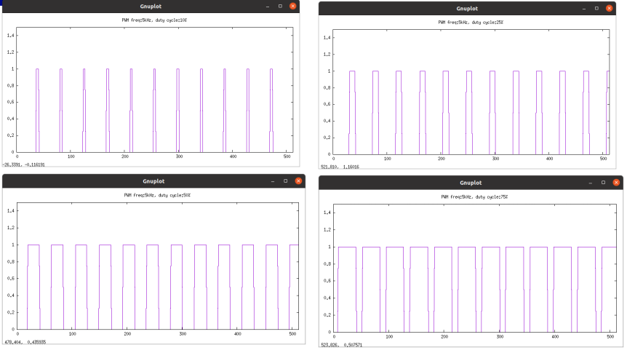
Pulse Width Modulation

Slide 8
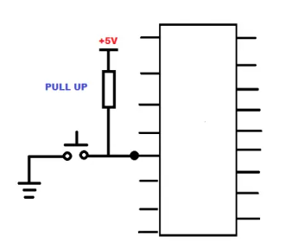
GPIO input
There are two push buttons on the ESP32 DevKit CPU:
EN: the reset button
BOOT: connected to GPIO 0 allow to put the CPU into flash programming mode. When a program is running it can be used as an input device
When programmed as input, a pull-up resistor can be added by program.

Slide 9
Reading the button
# define PUSH_BUTTON 0 / preprocessor instruction
pinMode(PUSH_BUTTON,INPUT_PULLUP); value = digitalRead(PUSH_BUTTON); // returns 1 if switch is open // zero if closed

