Slide 1
IoT Air Quality System
Uli Raich (uli.raich@gmail.com)
The I2C bus
Presented at the Workshop – IoT4AQ
March 2024, Bambey, Sénégal

Slide 2
The I2C bus
The Inter Integrated Circuit (IIC or I2C) bus was invented by Philips in the early 1980s.
It uses a synchronous master slave protocol with only 4 lines:
Vcc and GND
SCL: a system clock
SDA: a data line
We have 2 I2C slaves: The DS3231 Real Time Clock (RTC) module and the PCF8574 remote 8.bin I/O expander used by the LCD display.

Slide 3
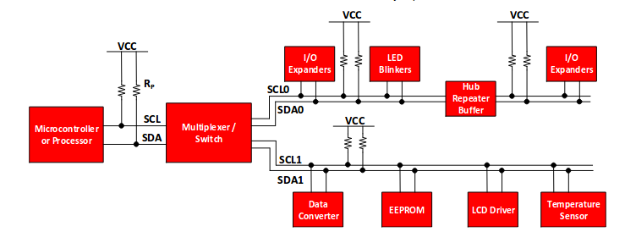
The I2C bus
The Inter-Integrated Circuit (I2C) bus was invented by Philips in the early 1980. It is used by many sensors to communicate their data to the CPU.

Slide 4
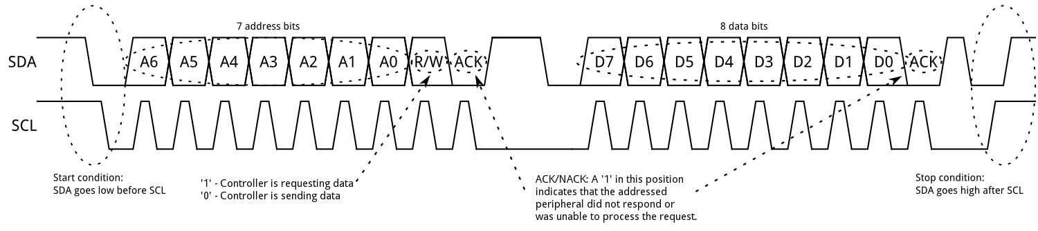
The I2C protocol
The bus transmits 7 bits of slave address information + the R/W bit. ~ 128 I2C slaves can be connected to the bus

Slide 5
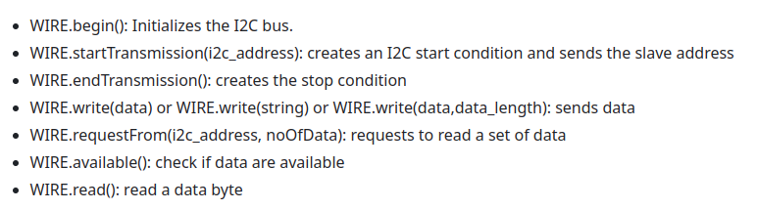
The Wire library
The Arduino SDK provides the Wire library giving access to the I2C bus. The most important functions are:

Slide 6
Scanning the I2C bus
It is possible to find out, which I2C slaves are connected to the bus.
We send addresses 0..127 onto the bus and check it a slave responds on this address (ACK pulled low).
#include <Wire.h> WIRE.begin() for (int addr=0; addr < 128; addr++) { WIRE.beginTransmission(addr); if (!WIRE.endTransmission()) // returns zero if ACK is received // found a slave on this address
}

Slide 7
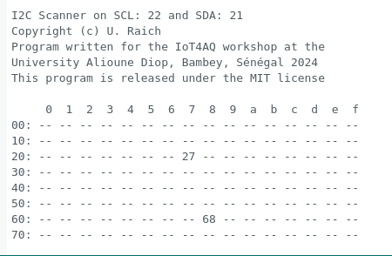
A bus scan
0x68: DS3231 RTC
0x27: PCF8574 I/O extender

