Slide 1
IoT Air Quality System
Uli Raich (uli.raich@gmail.com)
The PlanTower PMS5003 dust sensor
Presented at the Workshop – IoT4AQ
March 2024, Bambey, Sénégal

Slide 2
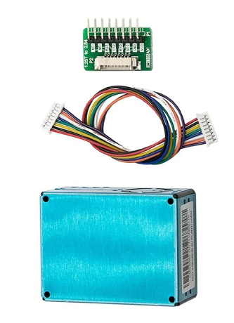
PMS5003 dust sensor
The PMS5003 measures dust concentration in air.
It contains a processor, calculating the
pm 1.0, pm 2.0, pm 10 (pm1 particles smaller than 1 µm) concentration in µg/m³
Using the Mie algorithm
It sends the values to the controlling CPU through an asynchronous serial protocol

Slide 3
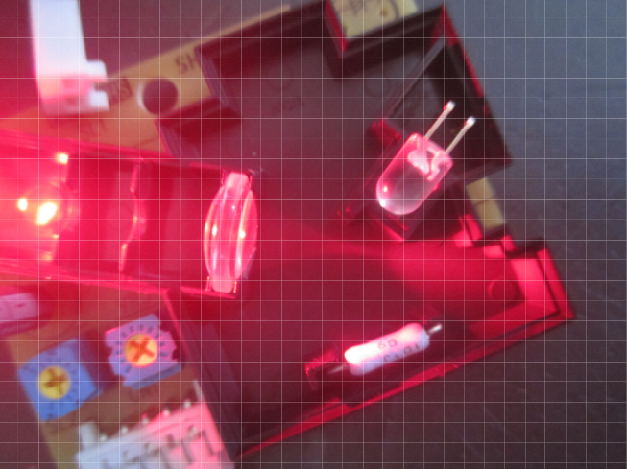
How does it work?
A Laser (or LED) shines into a volume of air, which is continually recycled through a fan or convection (using a heating element) .
The light scattered from the dust particles is collected with a lens and sent to a photo element.
The amount of light collected determines the dust concentration.

Slide 4
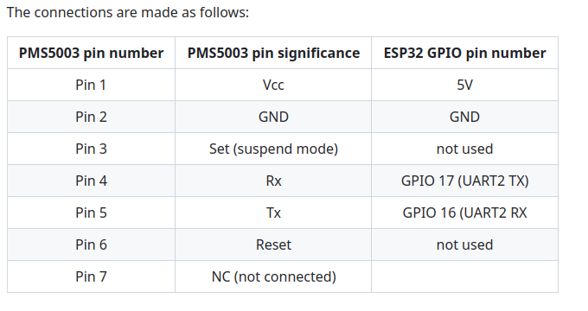
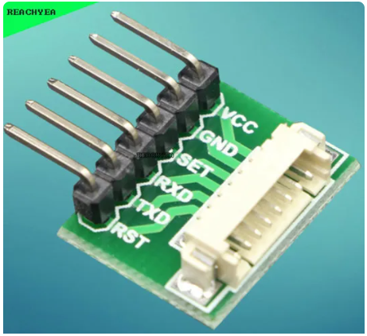
Connections

Slide 5
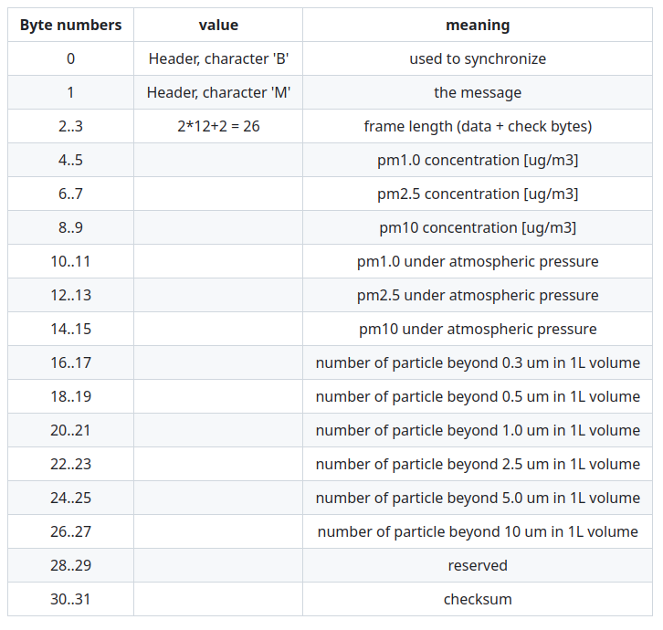
The PMS5003 protocol
For details read the data sheet
To calculate the checksum:
Add all values up to byte number 27

Slide 6
A bit more on C++ programming
We have seen arrays, which assembles elements of the same type. The C struct allows to collect elements of different type into a new structure and name each element:
struct mystruc { float a; int b; }
To declare a variable of this new datatype we would write:
struct mystruct s; s.a = 7.5; s.b = 5;

Slide 7
typedef
If we define this data structure as a new data type, access becomes easier:
typedef struct mystruc { int a; int b; } mystruct s;
We can also define a pointer to this data structure:
mystruct *structPtr; structPtr -> a = 7.5; structPtr -> b = 5;

Slide 8
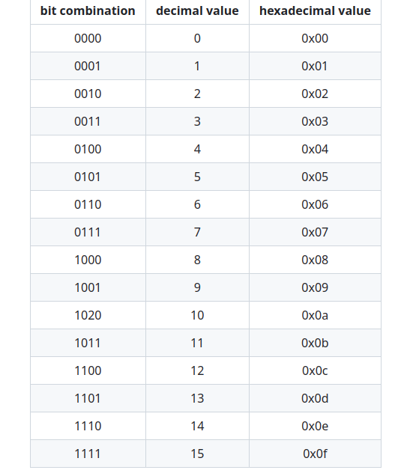
Data Encoding
As we said in the chapter on CPUs, computers only understand digital data, which is nothing but bit combinations.
Memory locations can be 32 or even 64 bits wide, but access to single bytes is usually possible. A single byte stores 8 bits of data.
Let's have a look at 4 bits only. How many combinations of zeros and ones can we construct from 4 bits?
The hexadecimal number system uses a base of 16 instead of 10. Hex numbers are indicated be “0x” in front of them

Slide 9
Hex calculations
What is the result of
0x18 + 0x18?
Calculate as you would do in the decimal number system, only that the carry over if at 16 instead of 10.

Slide 10
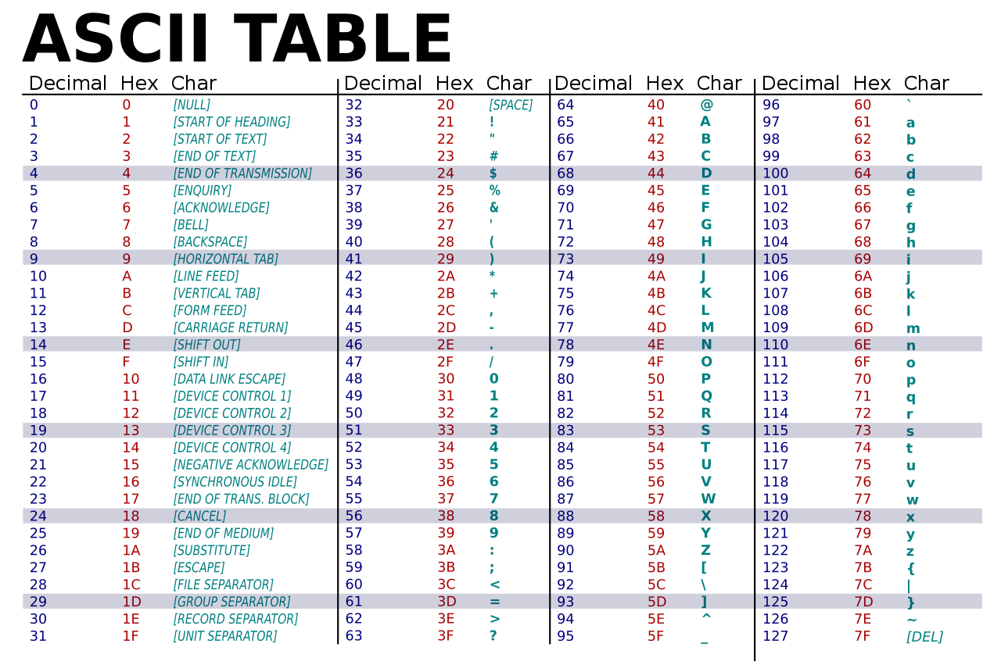
Character encoding

Slide 11
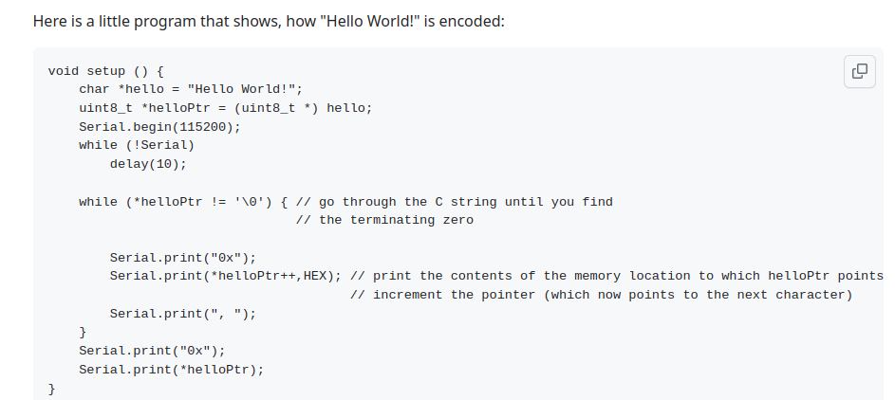
A demo

Slide 12
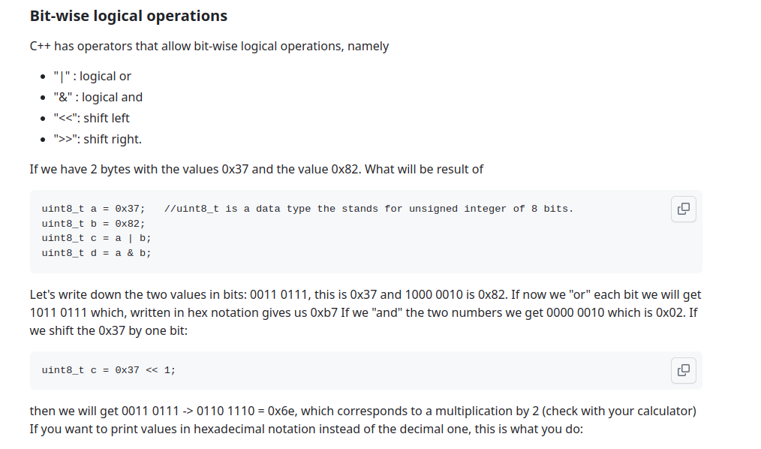
Bitwise logical operations

Slide 13
Printing hex numbers
int a = 0x1ac4;
Serial.print("a in hex notation: ");
Serial.println(a,HEX);

Slide 14
PMS5003 library
It is not particularly difficult to decode the PMS5003 protocol:
int result; for (int i=2;i<32,i++) { result = (rawData[i] << 8) | rawData[i+1];
// the library uses pointers to accomplish this // but the principle is the same }
Then you must calculate the checksum

Slide 15
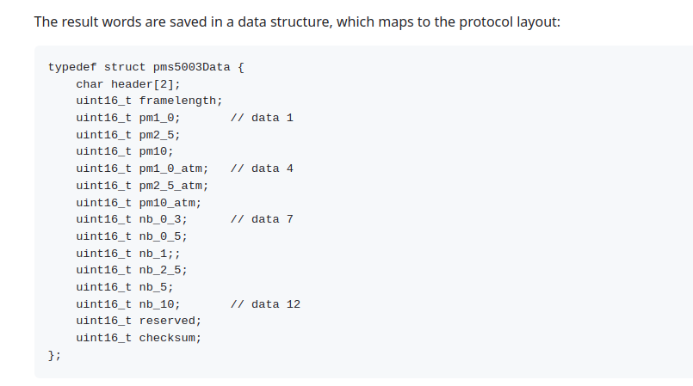
PMS5003 Result Data Structure

Slide 16
PMS5003 Result Data Structure

Slide 17
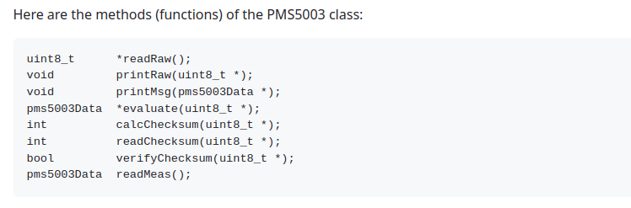
Library Functions

Slide 18
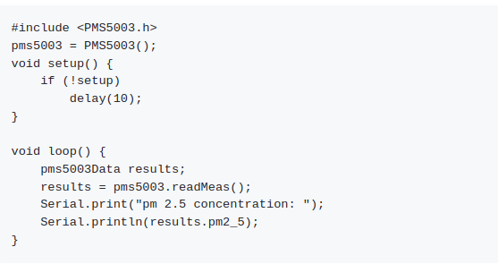
Getting the results

