Slide 1
IoT4AQ
Uli Raich (uli.raich@gmail.com)
Basic C++ programming
Presented at the Workshop – IoT4AQ
March 2024, Bambey, Sénégal

Slide 2
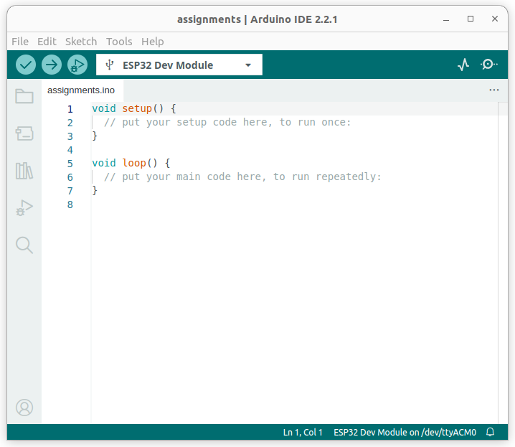
Arduino Template
When you create a new program:
File → New Sketch
this is what you get
The setup() function is executed once
at startup (initialization)
Loop() is executed repeatedly
Set ESP32 Dev Module with
Tools → Board → ESP32
Select the correct serial port with
Tools → Port

Slide 3
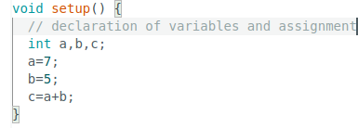
Variable definition
Before using a variable it must be declared: type variable name
Type can be
int for integers (or int8_t, int16_t, uint8_t, uint16_t)
float or double for real numbers
bool for boolean variables
char for characters

Slide 4
Comments
Comments are not executed but they are very important to explain to the reader what you are doing
// this is a comment
Everything after the // until the end of the line is considered a comment
/*
This is a multi-line comment
when it takes a little more to explain your
extraordinary ideas
*/

Slide 5
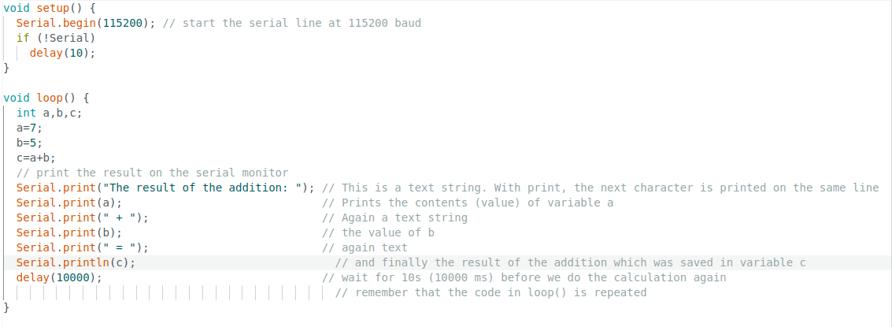
Serial port
How to see the result of the calculation?
Send the data to the serial interface and observe it on the serial monitor:

Slide 6

Compile and execute
The button with the tick mark compiles
you program and checks for syntax errors
The arrow button
Compiles the program
Uploads it to the ESP32 if no syntax errors are found
Resets the CPU to start the program

Slide 7
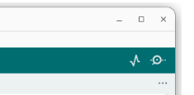
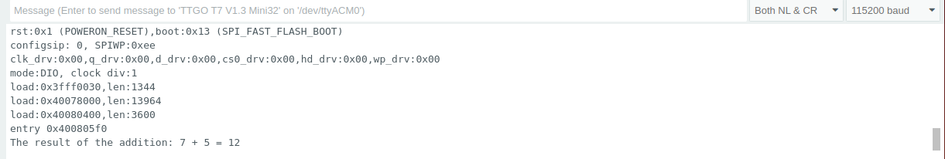
The Serial Monitor
The baud rate must comply to what you set in Serial.begin()

Slide 8
Assignments
c = a+b is not a mathematical equation !
”=” is the assignment operator:
a = a+3 makes no sense as an equation but is a valid assignment
get the value of a, add 3 to it, store it back into a
abbreviation:
a += 3, same for the other operators: - * /
a++ increments a by 1,
a-- for decrement

Slide 9
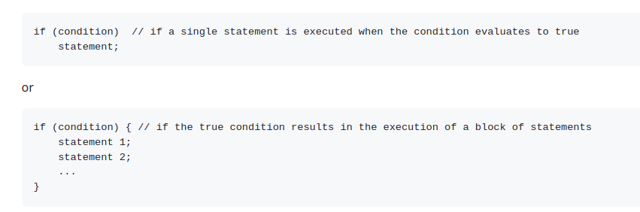
Conditions

Slide 10
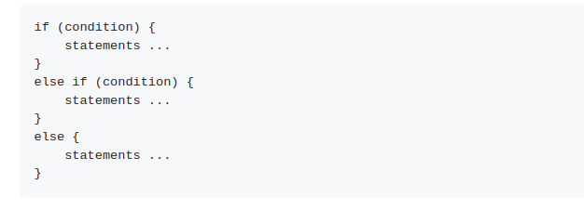

Conditions (2)
In case of
Serial is a boolean variable which becomes true when the port is ready.
Condition often imply comparison:
<, <=, >, >=, ==, !=

Slide 11

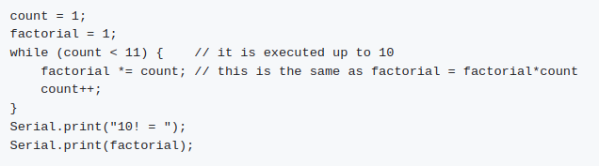
while loop
An example calculating factorial of 10:

