Slide 1
Developing an IoT System
Uli Raich
Two lectures on Hardware and Software for
the Internet of Things applied to Air Quality measurement
Lecture 2: Accessing the “things” through the Internet
Presented online at the Seminar – Air Quality and
IoT based Air Sensors Nov. 2023

Slide 2
The “I” in IoT
To communicate with the IoT node over we Internet we must
Connect the Node to the WiFi network
Provide a TCP or WEB server (which is a particular type of TCP server!)
We may need additional protocols like “server side events” or WEB sockets accessed through JavaScript
or
Communicate to an MQTT broker, which in turn sends or receives data from an MQTT publish or subscribe client

Slide 3
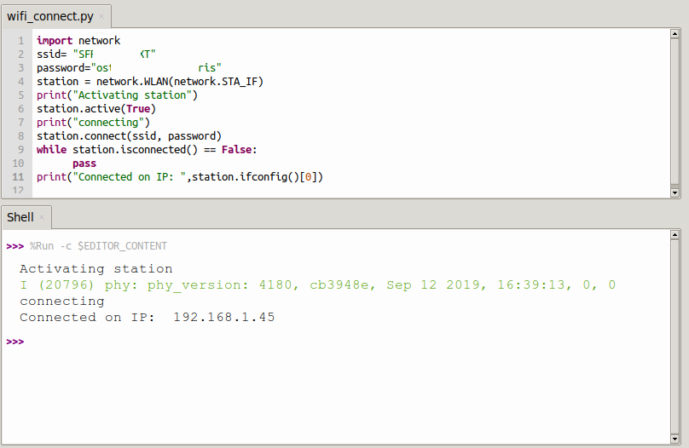
Connecting to the WiFi network
Micropython provides the
WLAN class giving access to methods to
Activate the WiFi station
and check the activation
Scan for nodes in the neighborhood
connect/disconnect
Get the network status
Get/set IP level information

Slide 4
A WiFi connection class
When working on IoT you must connect to the network very often.
I therefore wrote and integrated a module named wifi_connect
This makes connecting to the network super-simple:
from wifi_connect import *
connect()
connect also gets the current time from ntp and sets the real time clock on the ESP32
You can get the IP address with
getIPAddress()
or the current time with
gmtTime() or
cetTime()
d

Slide 5
A simple TCP server/client example
The server:
create a socket
bind the host address to a port
listen for connection requests
accept the connection
receive data from the connection
send data to the connection
Close the connection

Slide 6
A simple TCP server/client example
The client:
create a socket
connect to the server
send data
receive data
Let’s try it on the PC first!
d

Slide 7
TCP server on the ESP32
There is no difference with respect to the code on the PC
Except prior connection to the WiFi network.
Now we can create a TCP server on the ESP32 that reads some sensors and sends the results to the PC
d

Slide 8
TCP server on the ESP32
There is no difference with respect to the code on the PC
Except prior connection to the WiFi network.
Now we can create a TCP server on the ESP32 that reads some sensors and sends the results to the PC
d

Slide 9
A simple WEB server
As we have seen, MicroPython contains a socket class for network access and that is all that is needed to implement a simple WEB server.
To make things even simpler a basic framework name picoweb is available on github.
I integrated this framework into the MicroPython binary to make it globally accessible

Slide 10
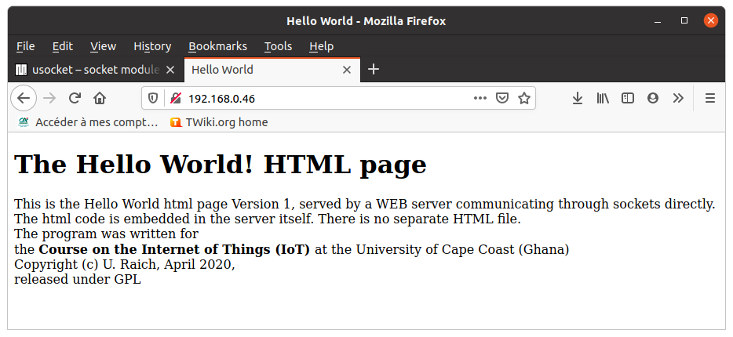
The first WEB page
d

Slide 11
picoweb
The picoweb module is a framework for writing WEB servers
If contains functionality to
Create and listen to HTTP requests on a socket
Handling routing
Parse HTTP requests
Prepare HTTP responses by sending the necessary header
Send HTTP pages stored in files
Handle templates
d

Slide 12
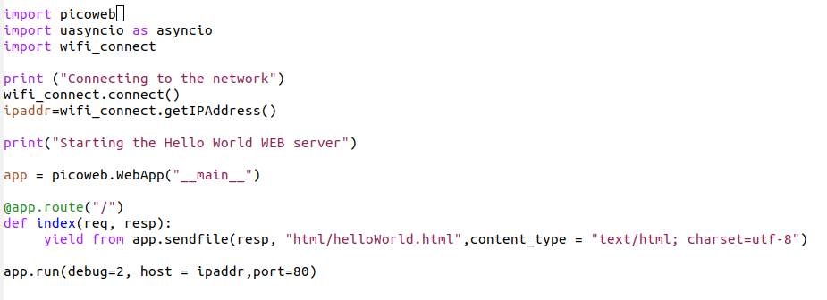
Hello World WEB server

Slide 13
Integrating measurements into the WEB page
That is already not too bad!
However, we want to integrate measurements into the WEB page.
This can be done through templates
We define a HTML table and fill the entries with measurements made by the PMS5003 and the SHT30
A dictionary with the fields to be replaced as keys and the values to be put into the fields as values
picoweb’s method render_template will do the job.
d

Slide 14
Server Side events
This is still not perfect because we have to update the whole HTML page if we want to get new measurements
We would like the WEB server make periodic measurements, which update the page on the browser (client) side whenever they are sent
This can be achieved through server side events
d

Slide 15
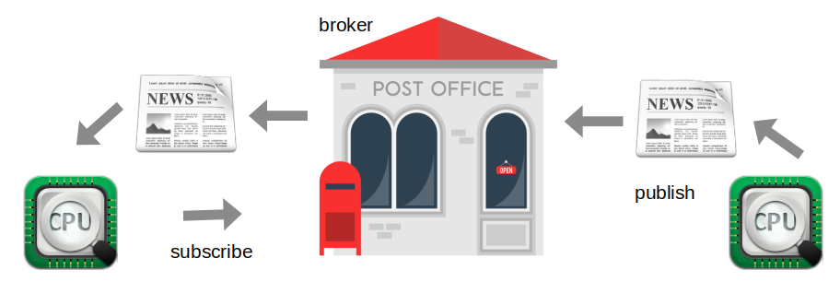
MQTT, another way to go online
Message Queuing Telemetry Transport: a publish-subscribe Protocol for IoT

Slide 16
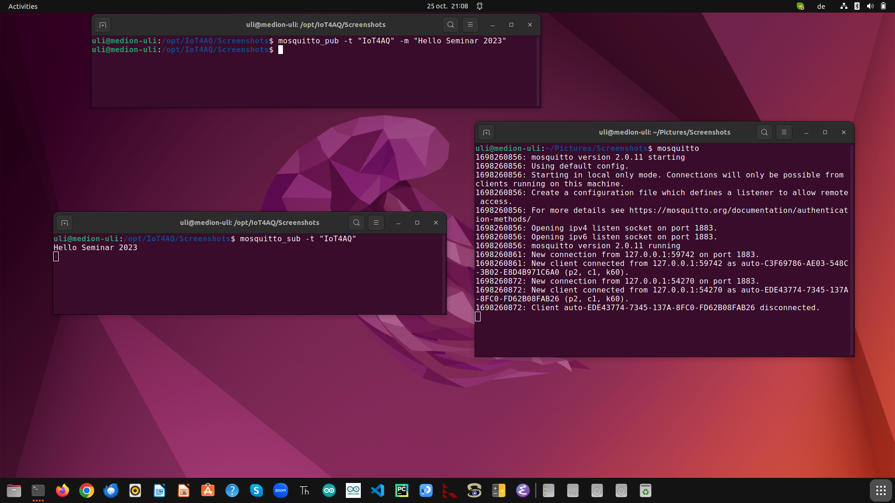
The mosquitto broker
This works only
on the local
machine
d

Slide 17
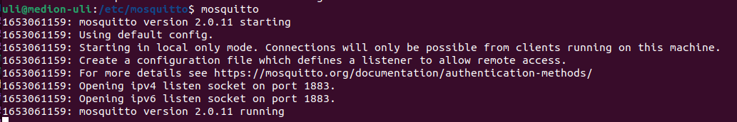
Setting up mosquitto
When starting mosquitto you see that we have to define a listener and an authentication method if we want to access the broker from a remote machine like the ESP32
The easiest way to accomplish this is a password file

Slide 18
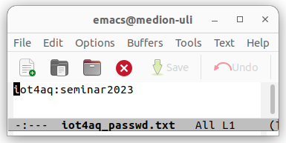
mosquitto password file
First we create a simple text file with a user name (iot4aq) and a password (seminar2023)

Slide 19
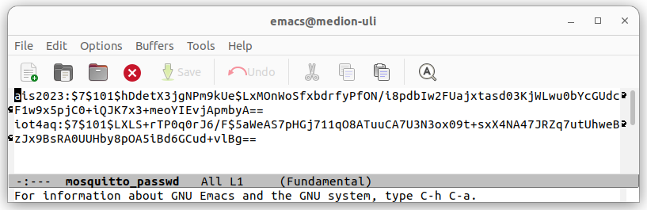
Encode password file
Then we encode it with mosquitto_passwd:
cp iot4aq_passwd.txt iot4aq_passwd # the file will be overwritten by the encoded password file
mosquitto_passwd -U iot4aq_passwd
… and we copy it to /etc/mosquitto/

Slide 20
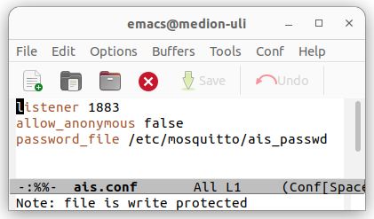
Adapting the config file
Finally we create a custom mosquitto config file, which is located in /etc/mosquitto/conf.d enabling the password file.

Slide 21
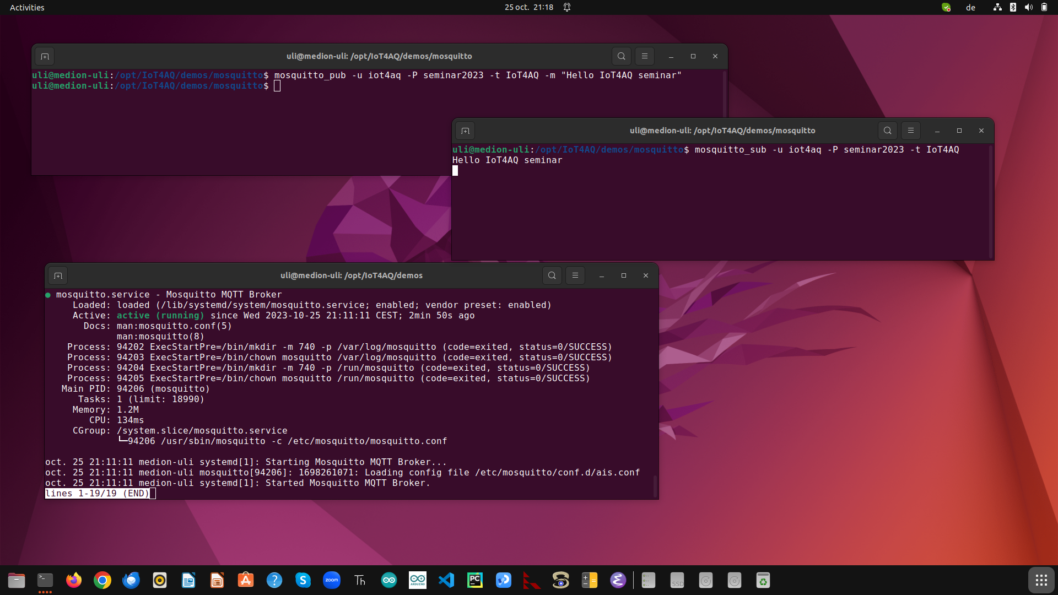
The mosquitto broker with password
This works also
with a remote
subscriber or
publisher
d

Slide 22
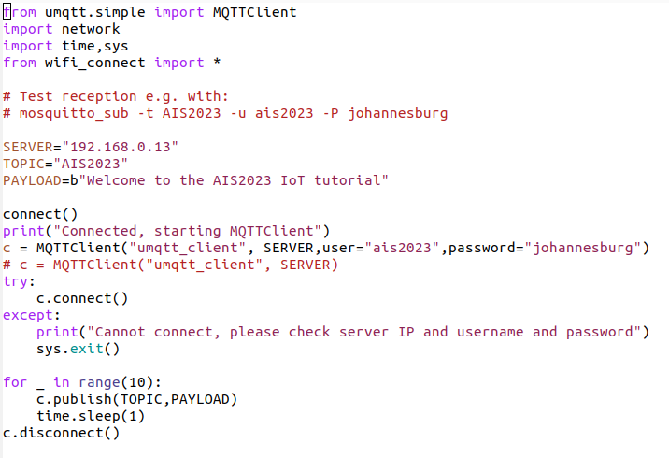
MQTT client on the ESP32
… and if I could have the MQTT client on the ESP32.
If it was the publishing client it could send measurements to the broker and thus to any subscribed client
If it was the subscribing client it could receive commands from the broker and thus from any publishing client
micropython-lib supplies the umqtt library giving us access to MQTT
d

Slide 23
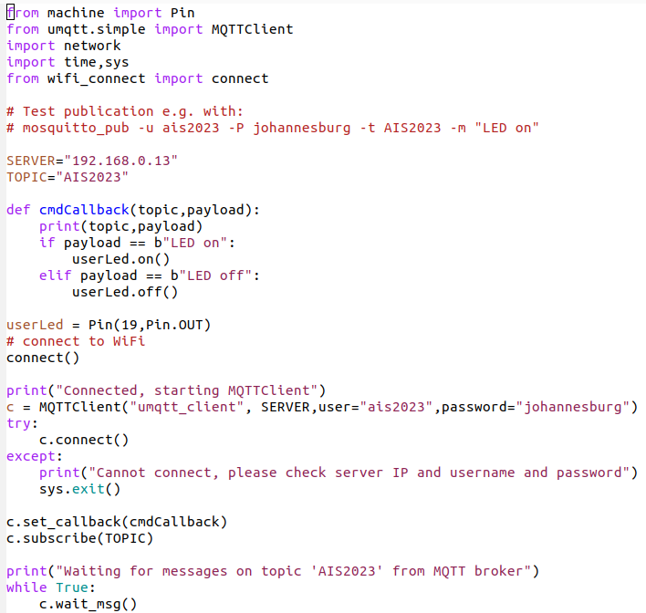
Subscribing client on the ESP32
d

Slide 24
ThingsBoard
Thingsboard is an OpenSource IoT platform
You can send and receive data from it through HTTP or MQTT
It provides the MQTT broker
You can set up a dash board with user interface elements its provides and connect these to your sensors and actuators
You can use a server in the cloud or install your own server on your local computer.

Slide 25
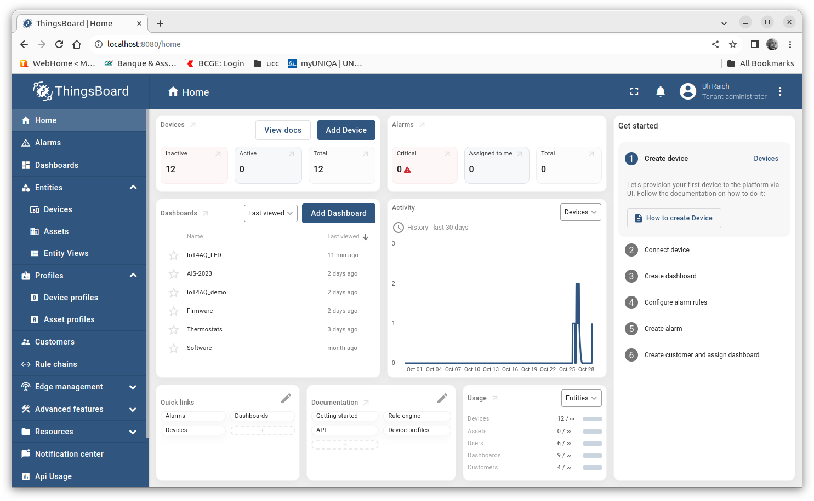
ThingsBoard home

Slide 26
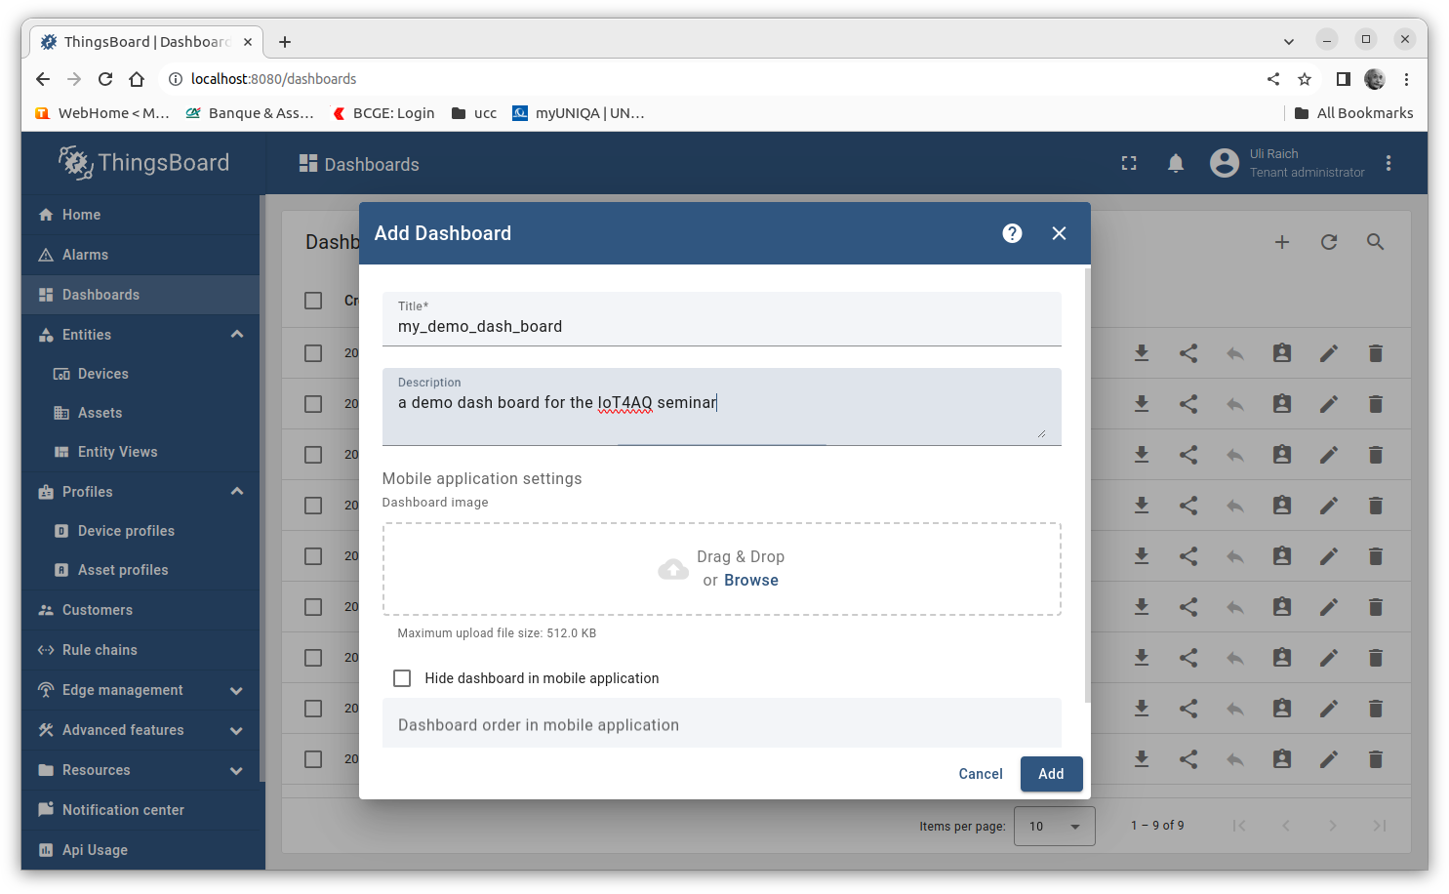
Setting up the dash board

Slide 27
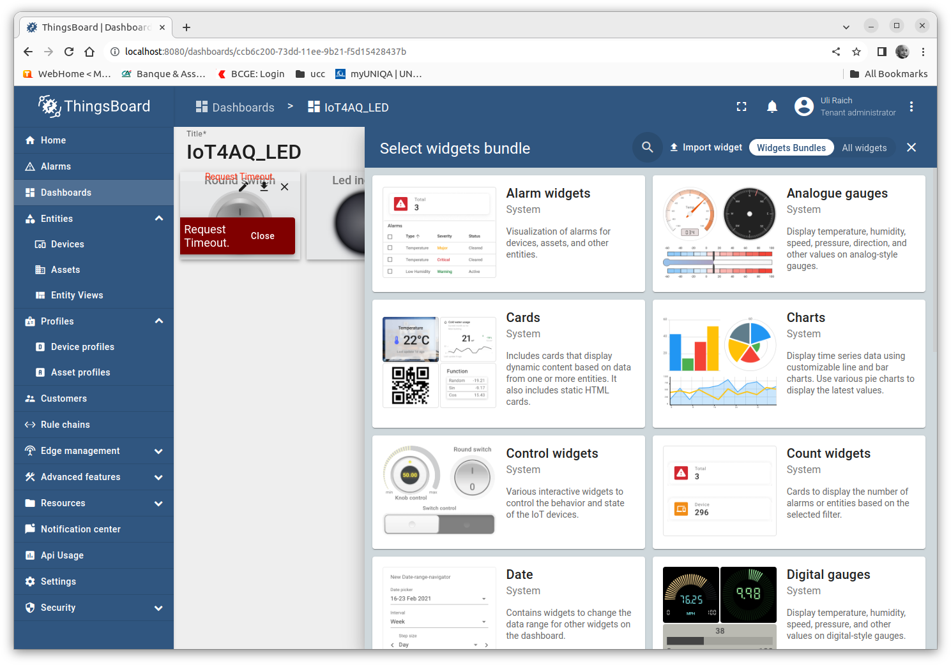
Widgets

Slide 28
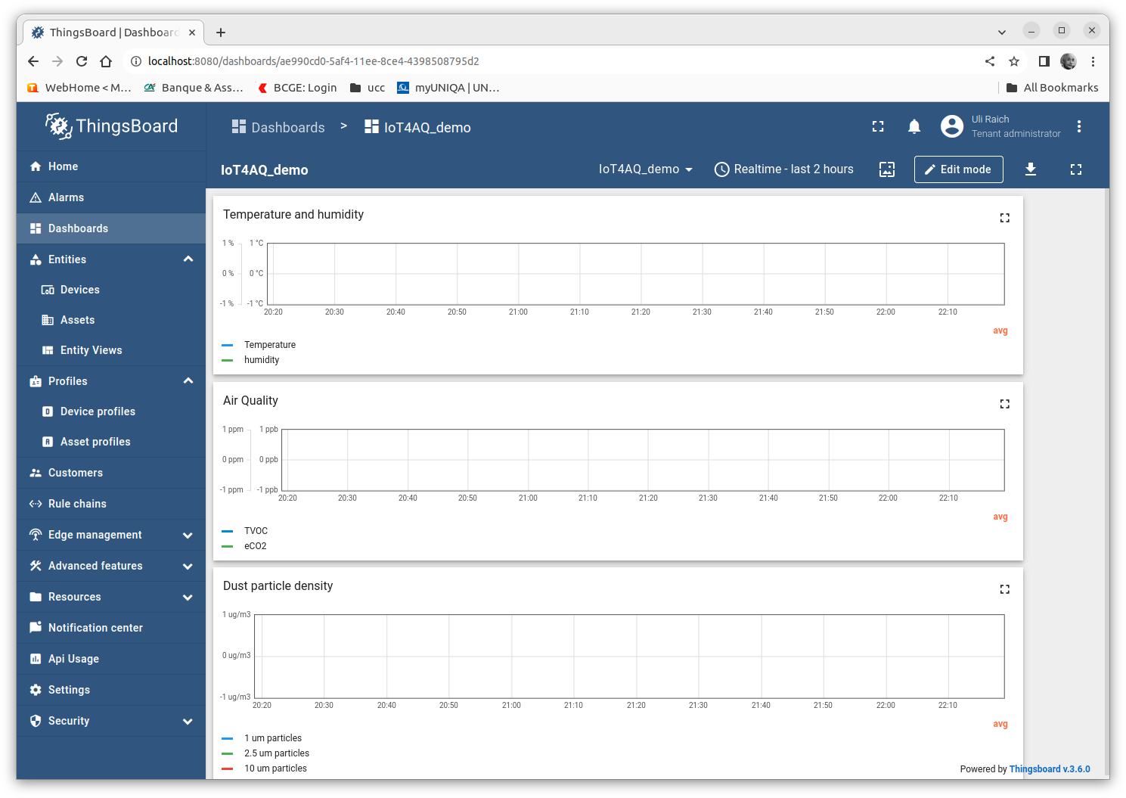
IoT4AQ dashboard
The demo dashboard for the
Seminar contains only
timeline graphs
Temperature and humidity
eCO2 and TVOC
Dust concentration
All of the devices are
acquisition only

Slide 29
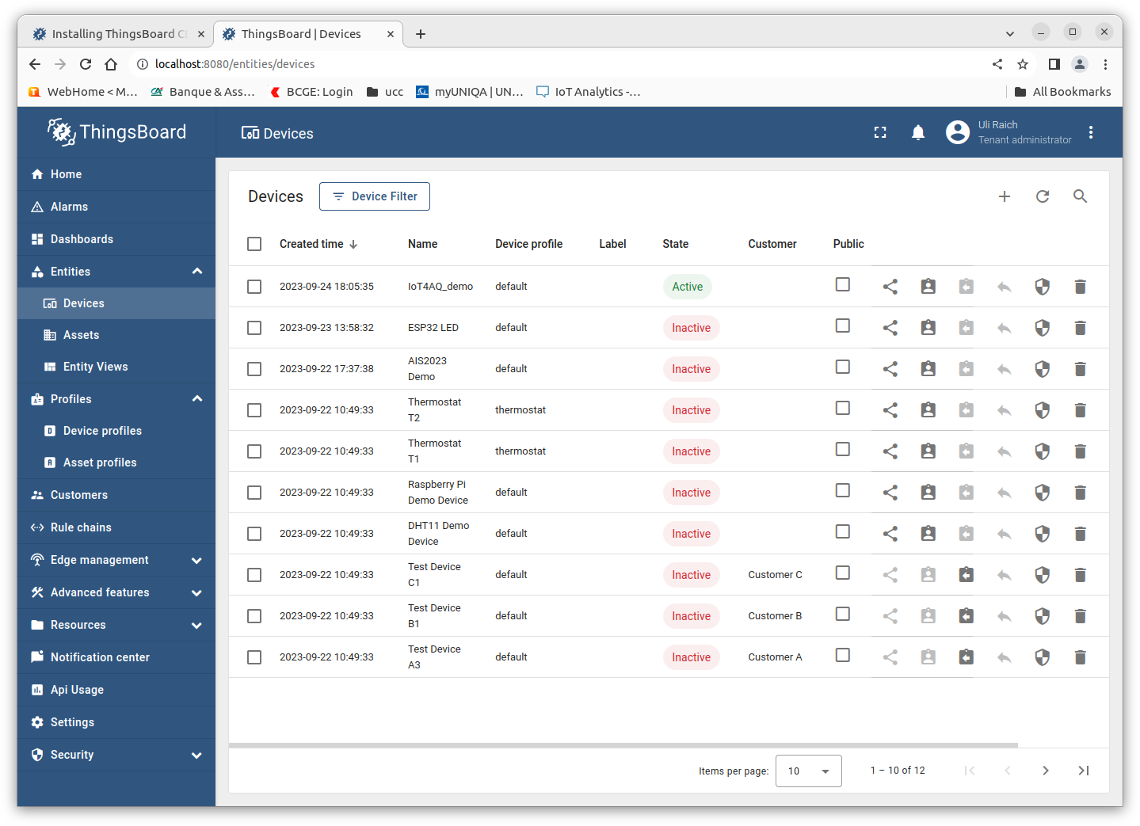
Creating a new device

Slide 30
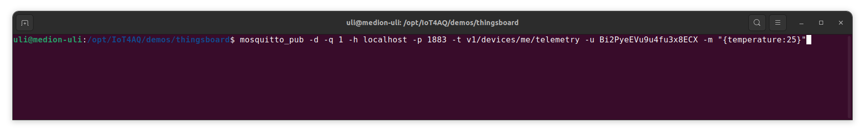
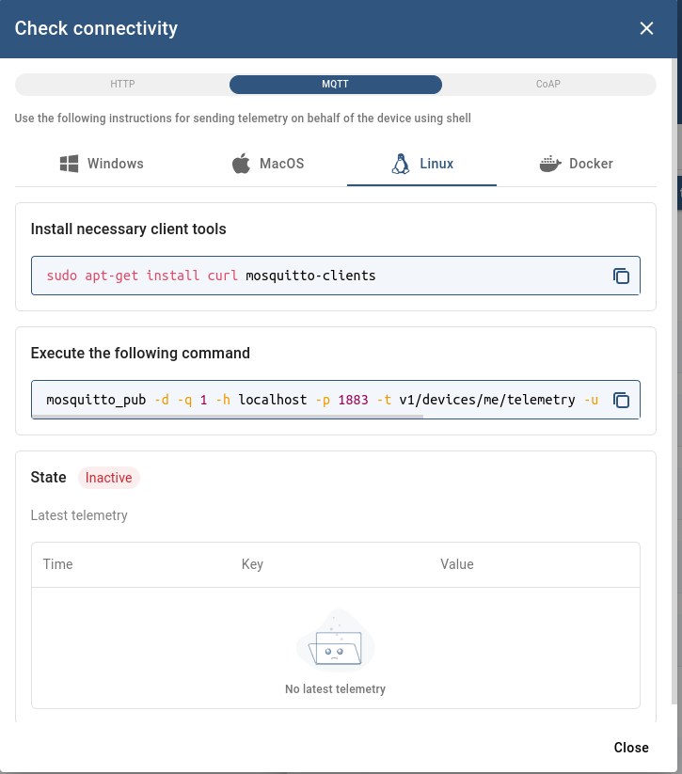
Accessing the device
Now we know how to update widgets
on the dashboard.
Since we already know how to create
MQTT messages on the ESP32
we can also send measurement data
to the dashboard

Slide 31
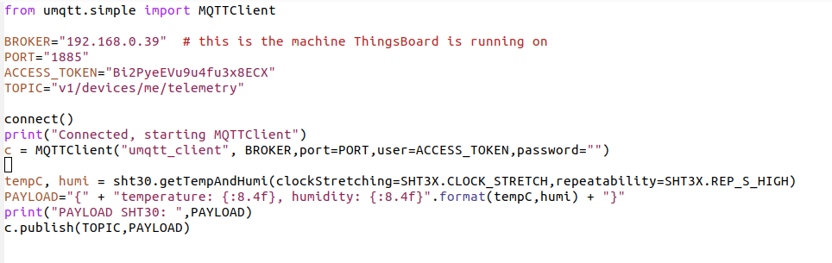
Code snippets
Code snippets from the ESP32 program sending data to the dashboard

Slide 32
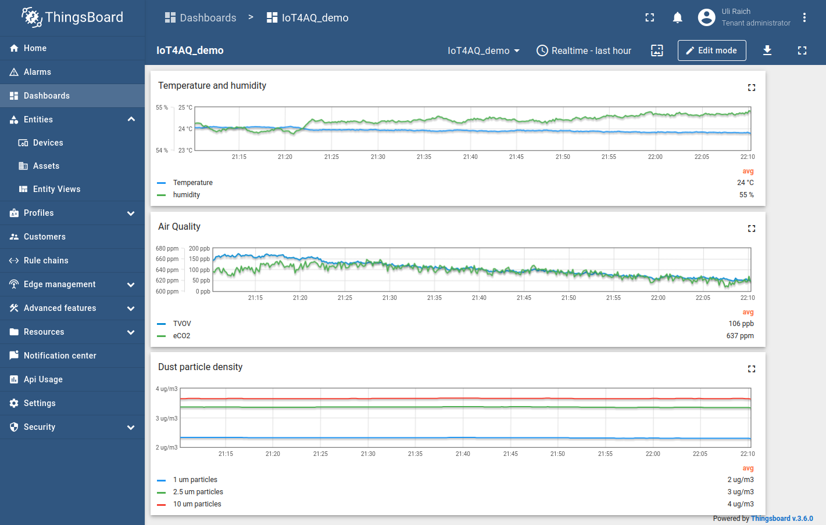
The IoT4AQ dashboard

Slide 33
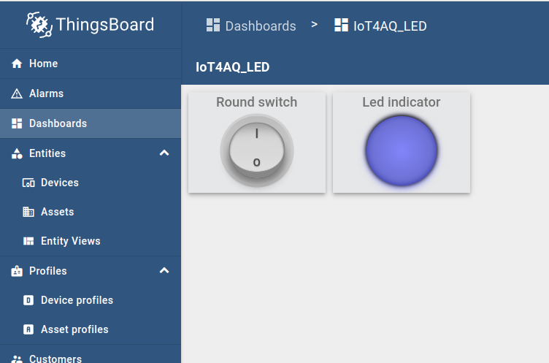
Controlling a device
The switch controls the
user led on the ESP32 CPU board
The LED indicator shows the
current state.

Slide 34
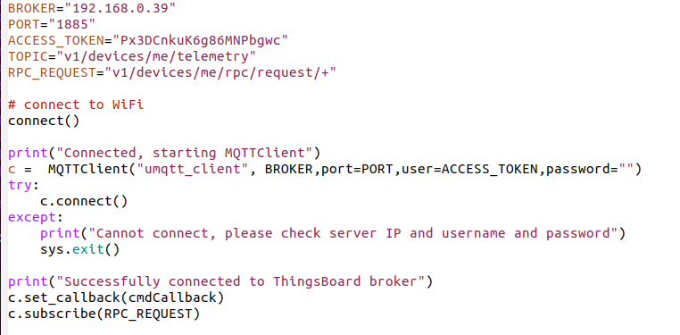
Create a MQTT subscriber

Slide 35
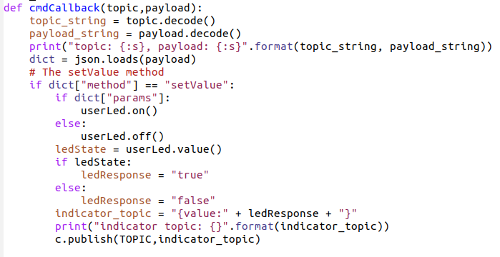
The subscriber callback

Slide 36
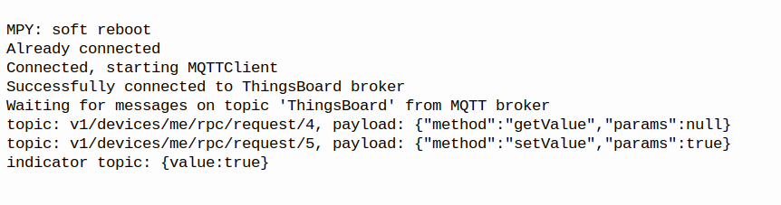
Log from ESP32 MQTT subscriber

Slide 37


