Slide 1




Air pollution, science, health impacts and challenges
Prof. Suzanne Paulson
Department of Atmospheric and Oceanic Sciences, UCLA
Notes:
Add Jiaqi’s undergrad

Slide 2
Outline
Air pollution history & Sources
Who is impacted by air pollution and where
What are the pollutants and which do we regulate
Measuring pollutants
Particulate matter: the largest killer
Trends of major pollutants over time

Slide 3
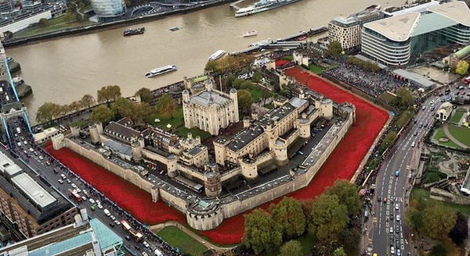
Air Pollution has a Long (and Terrible) History
Earliest written records of air pollution begin in at least 65 BC.
Mention of air pollution increased steadily as society developed.
The first air pollution regulation may have been the one issued in 1273, when King Edward I forbid coal burning near the White Castle in London.
But humans have been breathing smoke since we started cooking on fires.
Notes:
There are writings throughout history recognizing the effects of air pollution in the inhabitants of cities. Records begin in at least 65 BC, and increased in intensity throughout the middle ages as cities grow and particularly as coal in introduced.
The first air pollution regulation was probably issued in ~1300, when King Edward I forbid coal burning near the palace.

Slide 4
Sources of Pollution
Source | Pollutant(s)
Dust | larger particles
Plants | Volatile organic compounds (VOCs)
Volcanoes | Sulfur, particles
Ocean | Larger particles. mostly
Wetlands | Ammonia, sulfur compounds
Combustion of all kinds | Particulate Matter, VOCs, carbon monoxide, oxides of nitrogen (NO_{x})
Wildfires, cooking with solid fuels | Particles, especially black carbon, organic carbon metals, more toxic VOCs
Diesel and petrol engines | CO, NO_{x}, particles, volatile organic compounds
Fuel evaporation | Gasoline
Paint, consumer products | volatile organic compounds

Slide 5
Outline
Air pollution history & Sources
Who is impacted by air pollution and where
What are the pollutants and which do we regulate
Particulate matter: the largest killer
Measuring pollutants & trends
A few thoughts on regulations and policy
My research

Slide 6
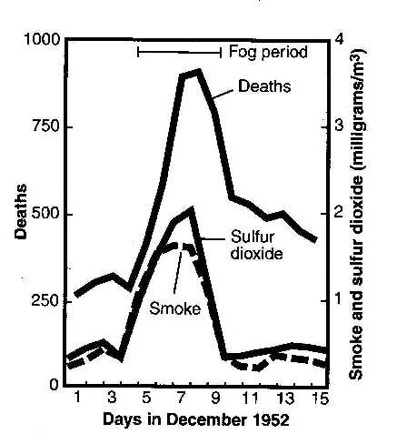
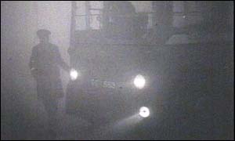
“Excess Deaths”, Who Dies and Why
1952 London: While London was already polluted, a weather system arrived that trapped the air and made the pollution much worse.
A lot of people died (4000 immediately and another 8000 in the next few months).
Who died?
  Children
  Elderly
  Those with pre-existing respiratory conditions (like the flu, asthma, COPD) or cardiovascular issues like high blood pressure
We now know that poor birth outcomes are also a major impact of air pollution.
Photo from around noon.
Notes:
By the mid-1900’s air pollution was making itself impossible to ignore.
1943 First recognized episodes of smog occur in LA. Visibility is only three blocks, people suffer from smarting eyes, respiratory discomfort, nausea, and vomiting. The phenomenon is termed a "gas attack" and blamed on a nearby butadiene plant, but the situation does not improve when the plant is shut down.
In 1948, Donora, PA - four-day air pollution episode resulted in 20 deaths, 6000 people ill
1952 London, weeklong episode resulted in at least 4000 excess deaths. A re-analysis of the data indicate the deaths were more like 12,000, and extended over several months.
What is an excess death?
“The fog was thicker on that Friday morning than many people could ever remember. Through the day it steadily grew even thicker and people were already experiencing discomfort, and noticing the choking smell in the air…On (Saturday and) Sunday the fog continued and so did the deaths. The emergency services were no longer able to respond in any effective way. It is doubtful that many people perceived the nature of the calamity that had befallen them.”
- —Peter Brimblecombe, The Big Smoke

Slide 7
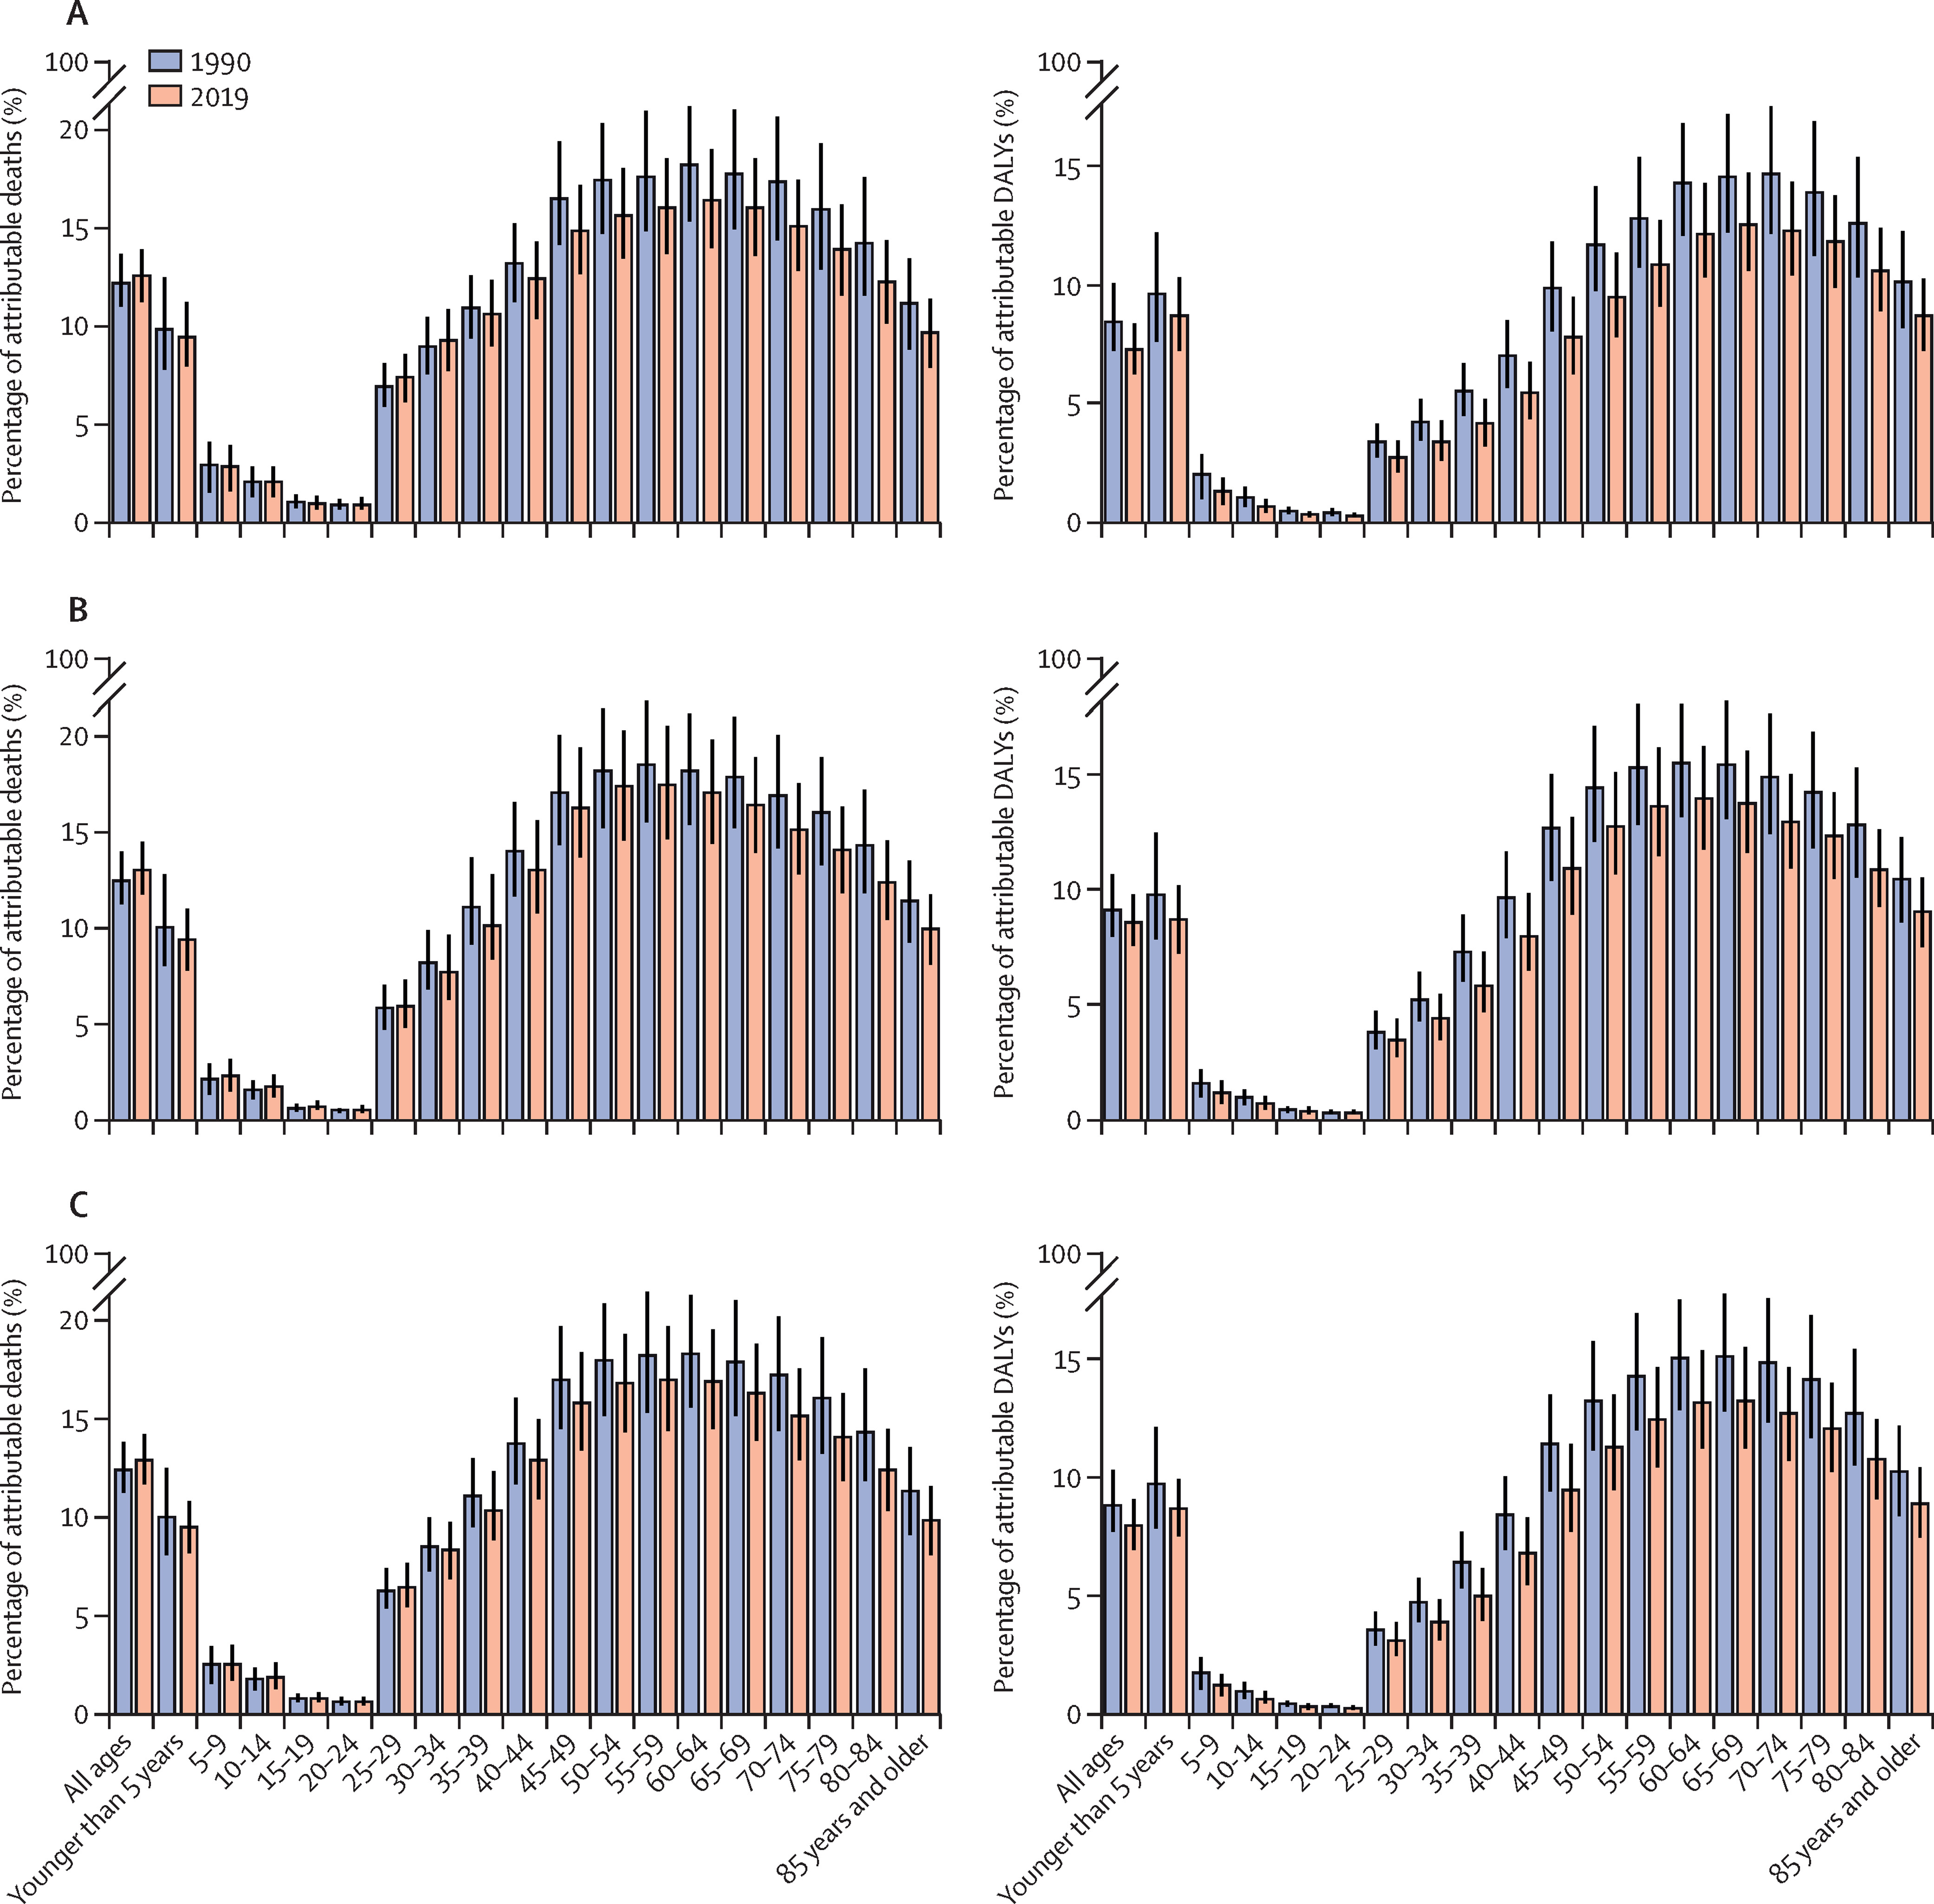
Percentage of Deaths Attributable to Air Pollution by Age
Percentage of deaths and DALYs attributable to air pollution by age groups among women (A), men (B), and both sexes (C) in North Africa and the Middle East, 1990 and 2019
Mohsen Abbasi-Kangevari, MDThe Lancet Planetary Health 3032
Notes:
By the mid-1900’s air pollution was making itself impossible to ignore.
1943 First recognized episodes of smog occur in LA. Visibility is only three blocks, people suffer from smarting eyes, respiratory discomfort, nausea, and vomiting. The phenomenon is termed a "gas attack" and blamed on a nearby butadiene plant, but the situation does not improve when the plant is shut down.
In 1948, Donora, PA - four-day air pollution episode resulted in 20 deaths, 6000 people ill
1952 London, weeklong episode resulted in at least 4000 excess deaths. A re-analysis of the data indicate the deaths were more like 12,000, and extended over several months.
What is an excess death?
“The fog was thicker on that Friday morning than many people could ever remember. Through the day it steadily grew even thicker and people were already experiencing discomfort, and noticing the choking smell in the air…On (Saturday and) Sunday the fog continued and so did the deaths. The emergency services were no longer able to respond in any effective way. It is doubtful that many people perceived the nature of the calamity that had befallen them.”
- —Peter Brimblecombe, The Big Smoke

Slide 8
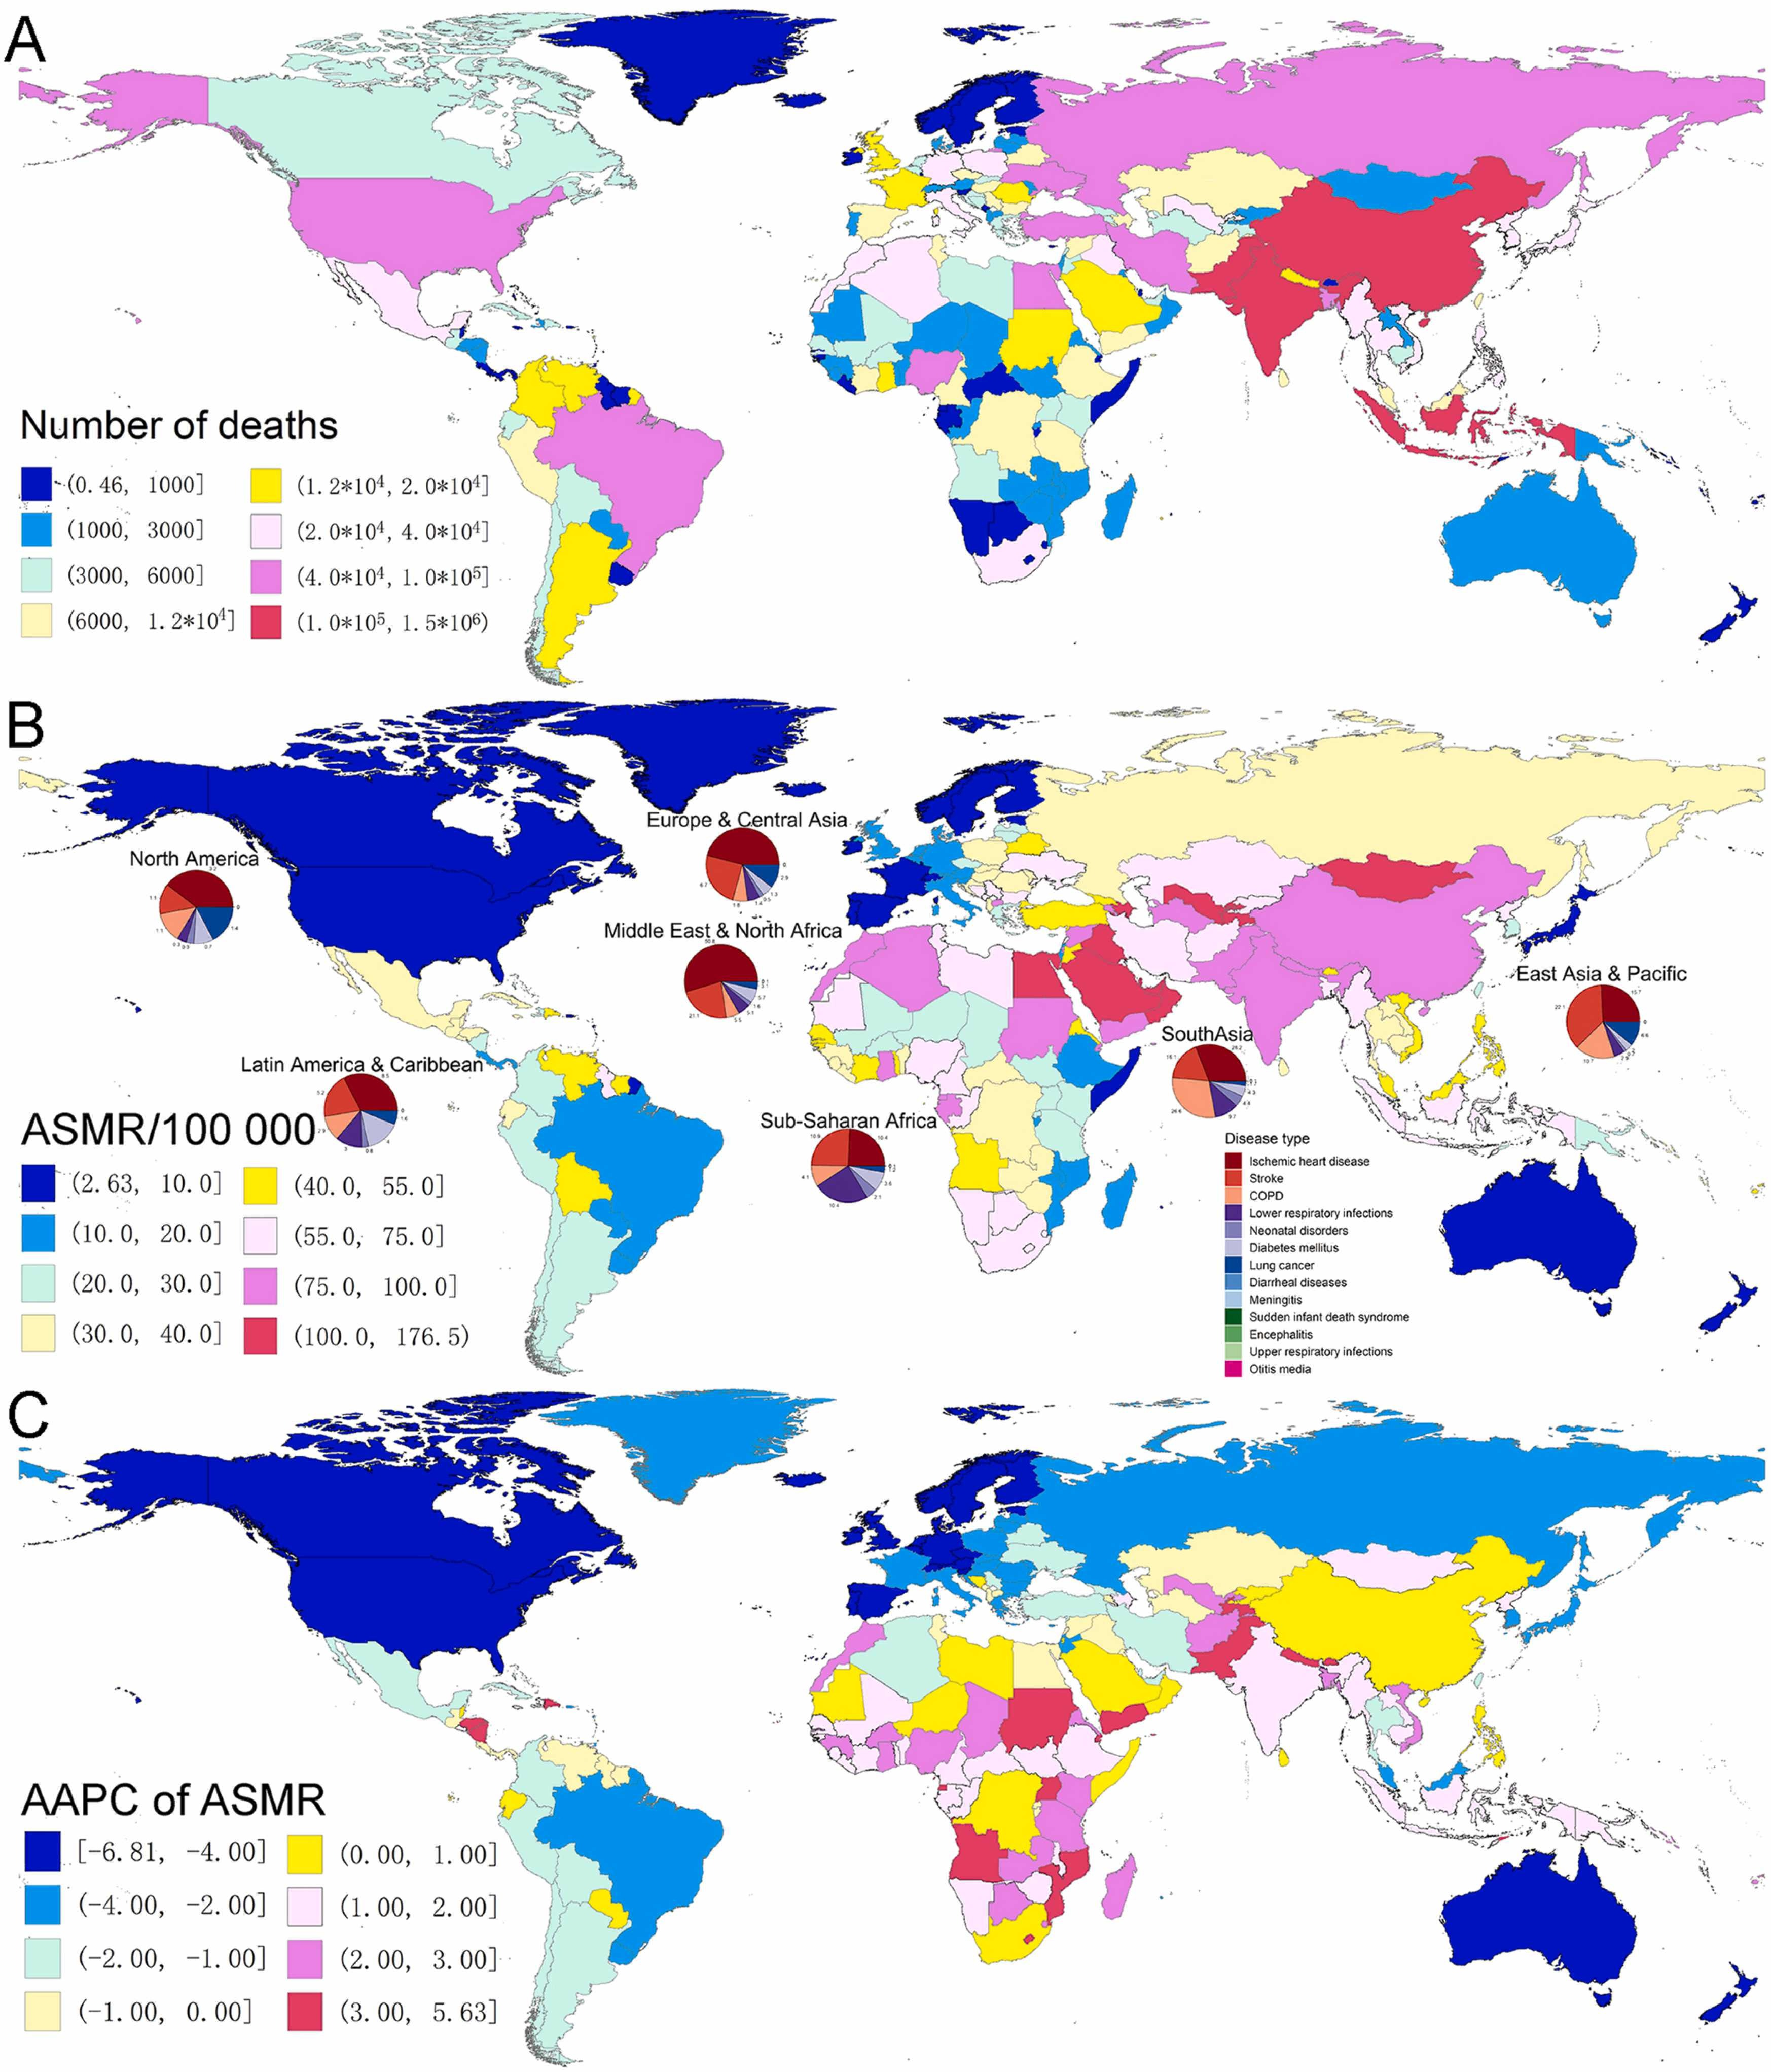
Air Pollution Impacts on Loss of Life and Health: Current Estimates are about 1.1 Million Africans/year
Sang et al Ecotoxicology & Environ. Safety 2022 ASMR is age adjusted years of life lost due to mortality or major disability
Notes:
By the mid-1900’s air pollution was making itself impossible to ignore.
1943 First recognized episodes of smog occur in LA. Visibility is only three blocks, people suffer from smarting eyes, respiratory discomfort, nausea, and vomiting. The phenomenon is termed a "gas attack" and blamed on a nearby butadiene plant, but the situation does not improve when the plant is shut down.
In 1948, Donora, PA - four-day air pollution episode resulted in 20 deaths, 6000 people ill
1952 London, weeklong episode resulted in at least 4000 excess deaths. A re-analysis of the data indicate the deaths were more like 12,000, and extended over several months.
What is an excess death?
“The fog was thicker on that Friday morning than many people could ever remember. Through the day it steadily grew even thicker and people were already experiencing discomfort, and noticing the choking smell in the air…On (Saturday and) Sunday the fog continued and so did the deaths. The emergency services were no longer able to respond in any effective way. It is doubtful that many people perceived the nature of the calamity that had befallen them.”
- —Peter Brimblecombe, The Big Smoke

Slide 9
Annual Percent Change in the Loss of Life & Health from Air Pollution 1990 – 2019
Notes:
By the mid-1900’s air pollution was making itself impossible to ignore.
1943 First recognized episodes of smog occur in LA. Visibility is only three blocks, people suffer from smarting eyes, respiratory discomfort, nausea, and vomiting. The phenomenon is termed a "gas attack" and blamed on a nearby butadiene plant, but the situation does not improve when the plant is shut down.
In 1948, Donora, PA - four-day air pollution episode resulted in 20 deaths, 6000 people ill
1952 London, weeklong episode resulted in at least 4000 excess deaths. A re-analysis of the data indicate the deaths were more like 12,000, and extended over several months.
What is an excess death?
“The fog was thicker on that Friday morning than many people could ever remember. Through the day it steadily grew even thicker and people were already experiencing discomfort, and noticing the choking smell in the air…On (Saturday and) Sunday the fog continued and so did the deaths. The emergency services were no longer able to respond in any effective way. It is doubtful that many people perceived the nature of the calamity that had befallen them.”
- —Peter Brimblecombe, The Big Smoke

Slide 10
Concerns about Current Estimates of Health Impacts for Africa
Extremely sparse ground measurements; satellites can underestimate concentrations
Almost all health impact estimates come from the developed world, which have different genetic susceptibilities, nutritional profiles, and healthcare access from Africans.
Ill health generally makes people more susceptible to air pollution, but Africans face different health challenges, including higher prevalence and different infectious diseases.
The chemical composition of the particles in Africa are different (and differ from place to place)
Spatial distributions of pollution are different. For example, roadway pollution is much higher in many African cities, potentially making PM2.5 less predictive of health outcomes.

Slide 11
Outline
Air pollution history & Sources
Who is impacted by air pollution and where
What are the pollutants, and which do we regulate
Particulate matter: the largest killer
Measuring pollutants & trends
A few thoughts on regulations and policy
My research

Slide 12
Air Pollution Regulation
It is impractical to regulate more than a few of the thousands of different pollutants. But a small number of pollutants can be used as ‘sentinel’ species for different types of pollution.
If levels of these pollutants are successfully reduced, related pollutants will also drop.
Also: Choose species that are individually toxic, and present at high concentrations

Slide 13
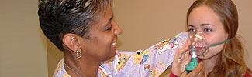
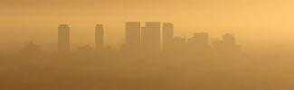




Most Commonly Measured/Regulated Pollutants
Ground-Level Ozone
Particulate Matter
Carbon Monoxide
Lead
Sulfur Dioxide
Nitrogen Dioxide
https://www.epa.gov/criteria-air-pollutants

Slide 14
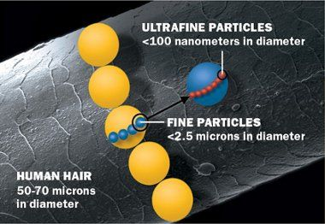
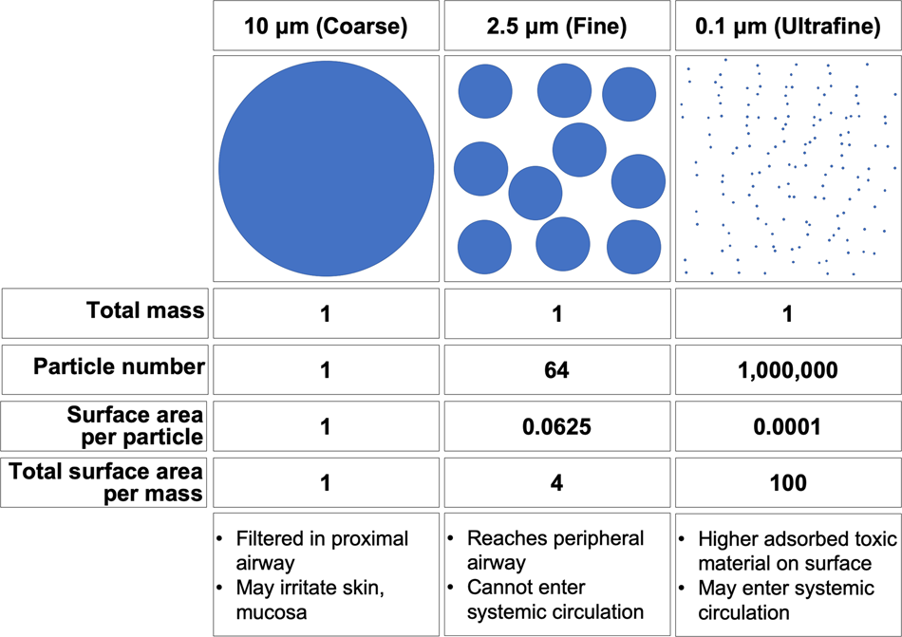
Particle Size Matters
“Coarse” Particles (PM10)
Kwon et al Experimental and Molecular Medicine 2020

Slide 15
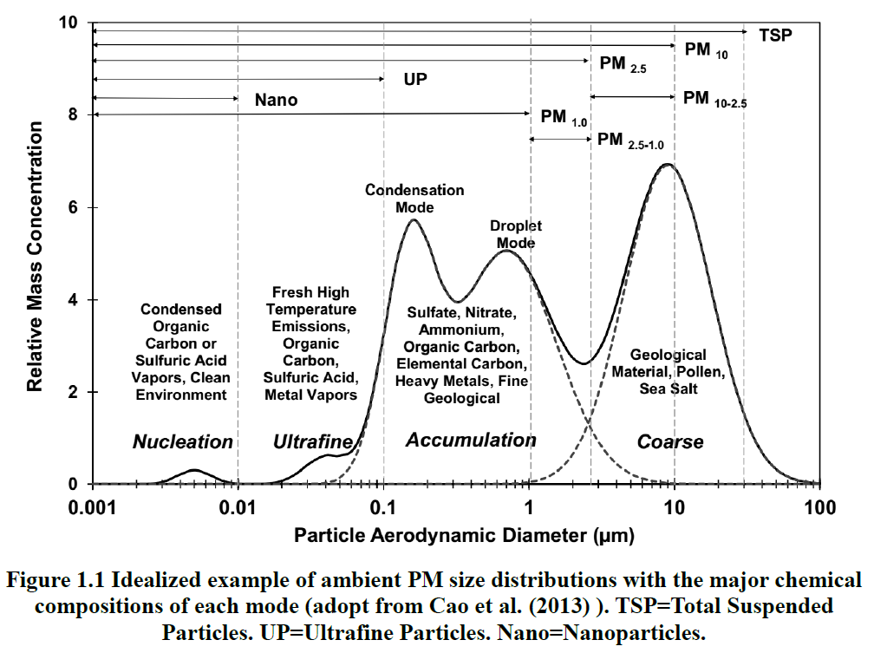
Ultrafine (PM0.1),
Fine (PM2.5) and Coarse Particles (PM10, includes PM2.5)

Slide 16
Outline
Air pollution history & Sources
Who is impacted by air pollution and where
What are the pollutants and which do we regulate
Particulate matter: the largest killer
Measuring pollutants & trends
A few thoughts on regulations and policy
My research

Slide 17
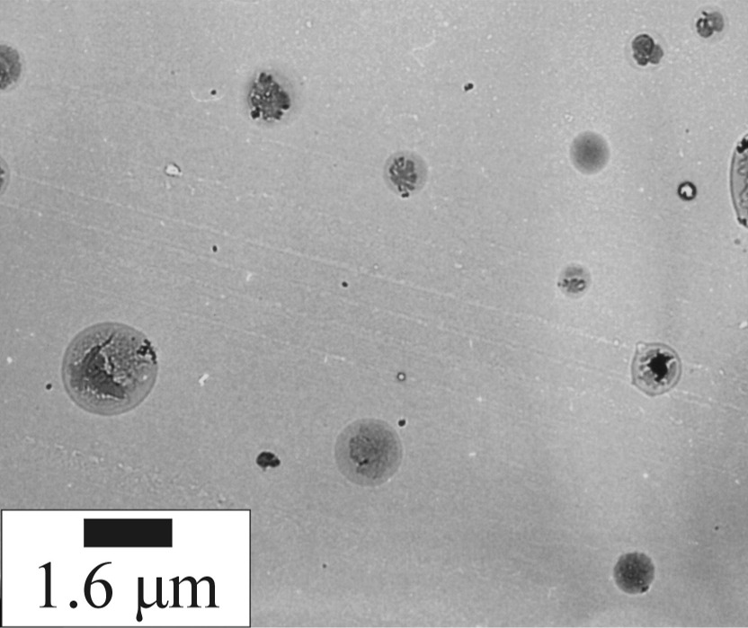
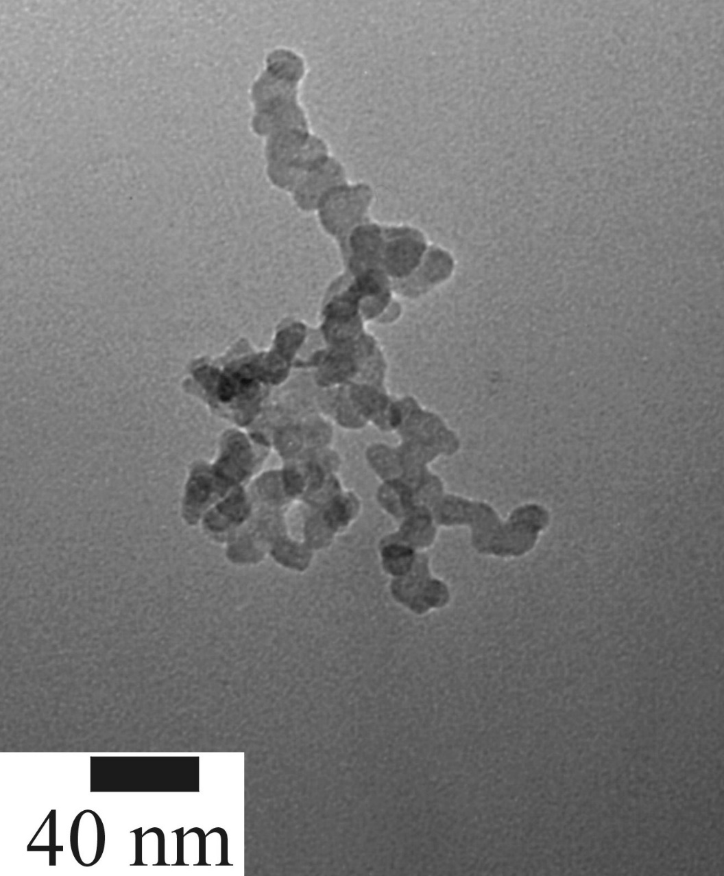
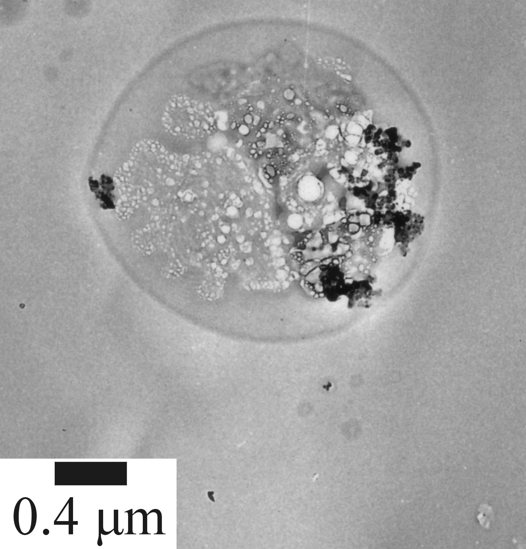
Particulate Matter is Complex
Numbers range from 10³ (10⁴+ in Thies) to 10⁷ cm⁻³ in urban areas
PM2.5 Particles collected at UCLA
Diesel Exhaust
Liquid Droplet
PM2.5 particle
Diesel Particle Close-up
Soot Agglomerate

Slide 18
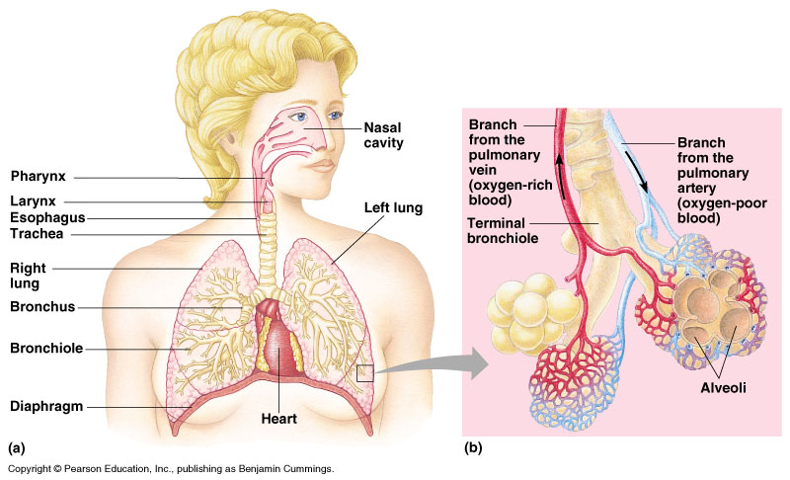
Where Particles Deposit Depends on Their Size
Movememt of ultrafine particles along sensory neurons → (neurodegeneration)
Coarse Particles, > 2.5 microns
Deposit in upper airways, where they are removed by cilia but likely exacerbate Asthma
Transfer of ultrafines to circulatory system
0.1 micron < Fine particles < 2.5 microns
Penetrate into Alveoli. Body cannot remove them.

Slide 19
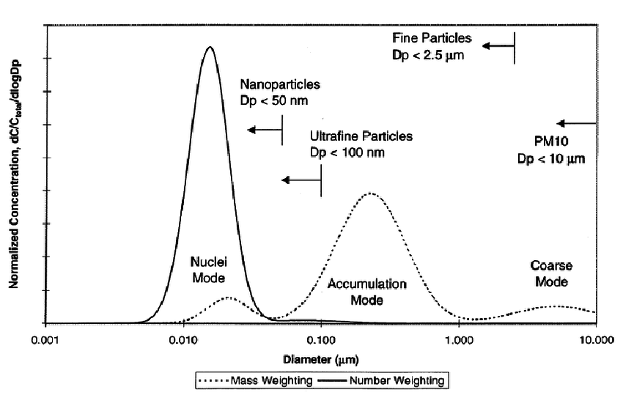
There is Growing Concern about Ultrafine Particles, which Dominate the Numbers but Contribute little to Mass
0.1 0.3
2.5 µM
Ultrafine
Coarse
Fine
Lower limit for optical scattering measurements

Slide 20
Outline
Air pollution history & Sources
Who is impacted by air pollution and where
What are the pollutants and which do we regulate
Particulate matter: the largest killer
Measuring pollutants & trends
A few thoughts on regulations and policy
My research

Slide 21
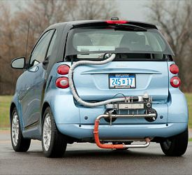
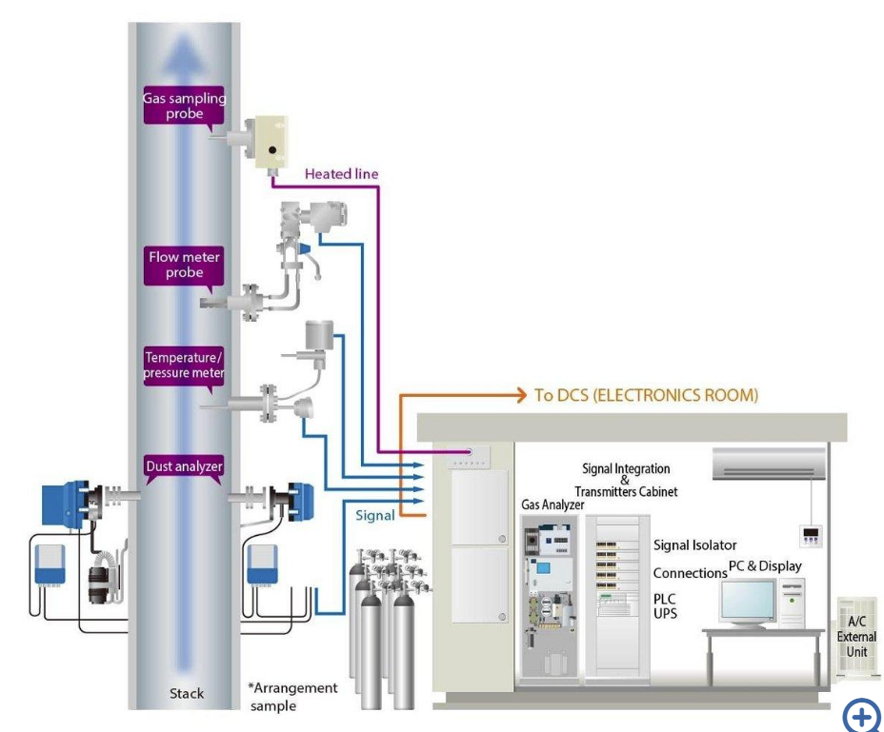
Emissions Measurement
  Monitoring particulate and gaseous emissions from a specific source
Image Source

Slide 22
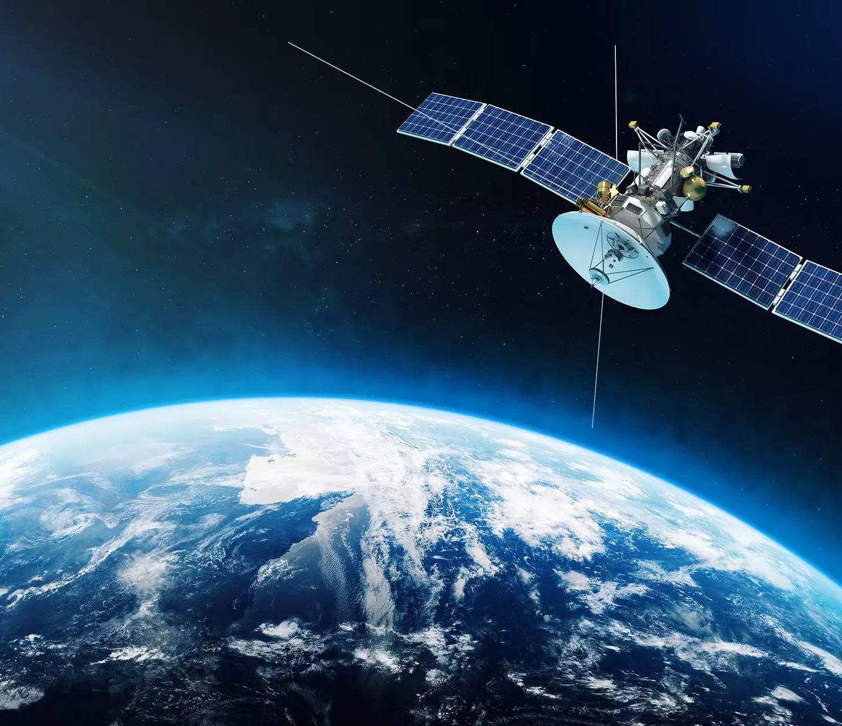
Satellites
Can have either broad spatial coverage or good temporal coverage.
Look through entire atmosphere. Can only derive surface concentrations using a large model; the measurements are good but not great. Ground measurements make them better.
Average concentrations for relatively large areas.
Measure a limited set of parameters, choices of what to measure where and when set by global north.
Data usually free

Slide 23
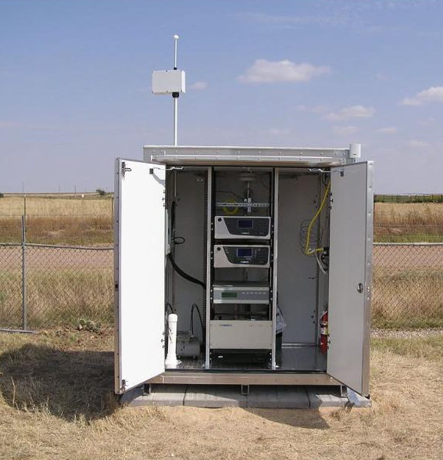
Reference Monitoring
Reference Grade Instruments
  Instruments have undergone extensive testing for reliability. Generally only available to measure regulated pollutants.
    While they are well established, they are not always perfect.
    More than $10,000/6,000,000 FCFA

Slide 24
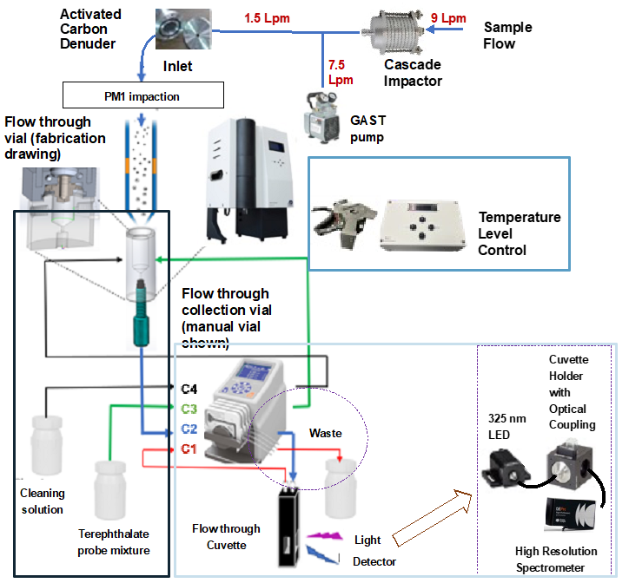
Research Instruments
Huge variety. Many are commercially available, some are laboratory built.
Made in small quantities, they tend to be very expensive, for what they are.
More than $ 20,000 – ~300,000 /
12,000,000 – 180,000,000 FCFA

Slide 25
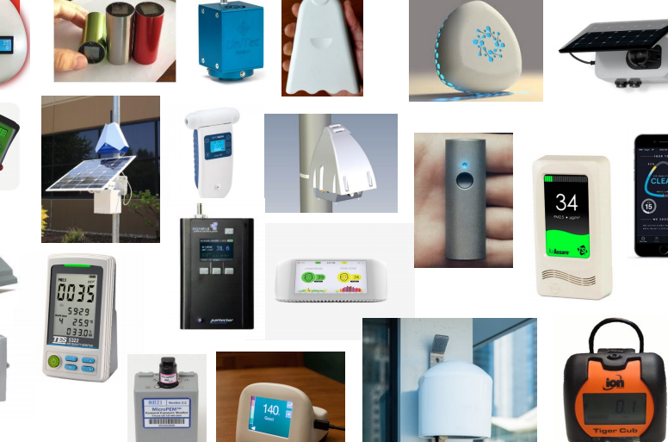
Low-Cost Sensors
A wonderful new development for air quality, low-cost sensors are starting to revolutionize access to air pollution data, for countries, for individuals, for researchers.
$50 – 1200 USD
30,000 – 720,000 FCFA

Slide 26
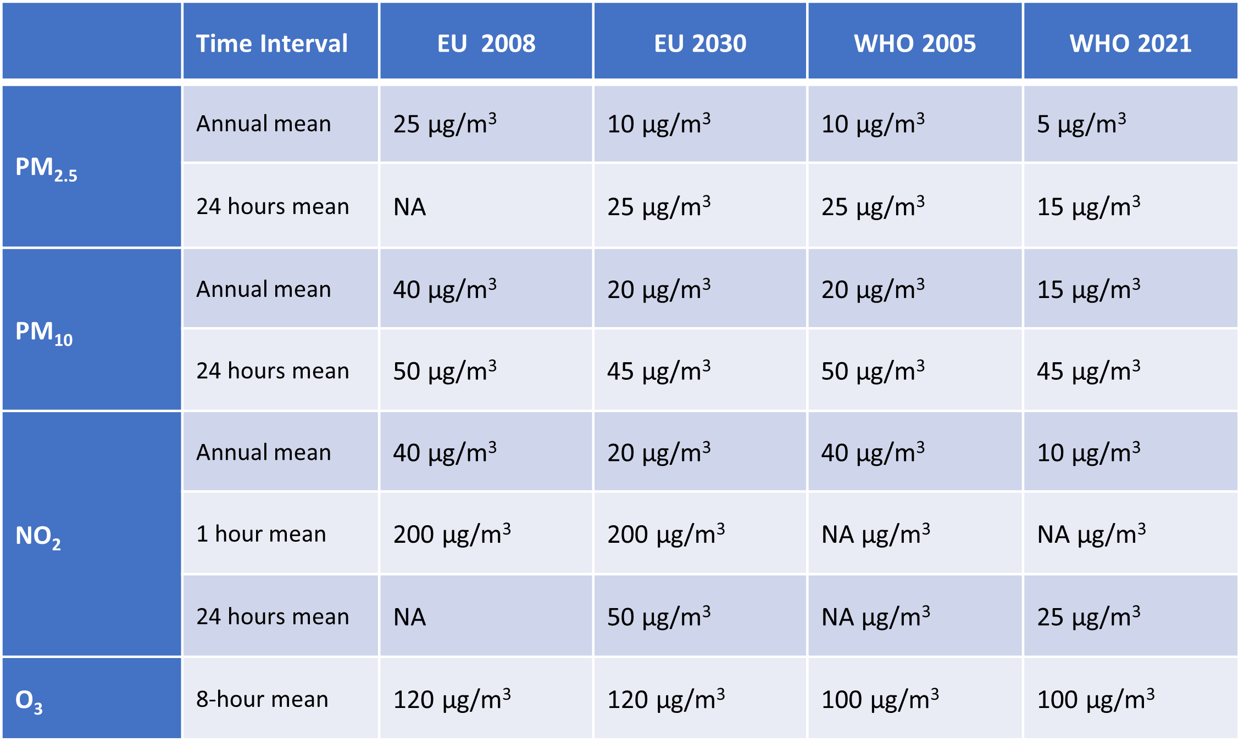
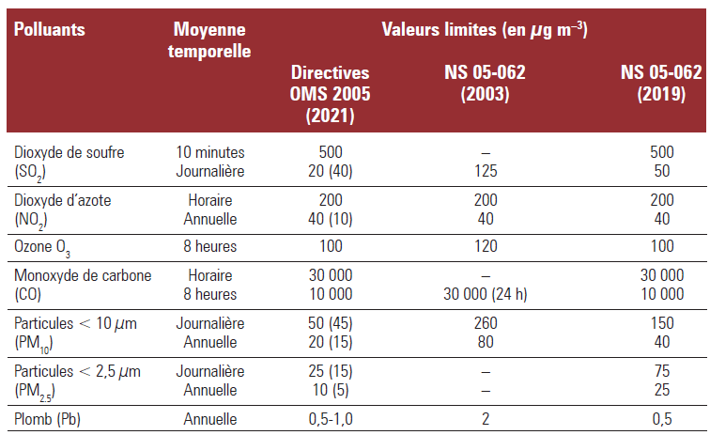
AQI and threshold limits
Air quality threshold limits from the European commission and the WHO
Air quality threshold limits from the WHO and Senegal

Slide 27
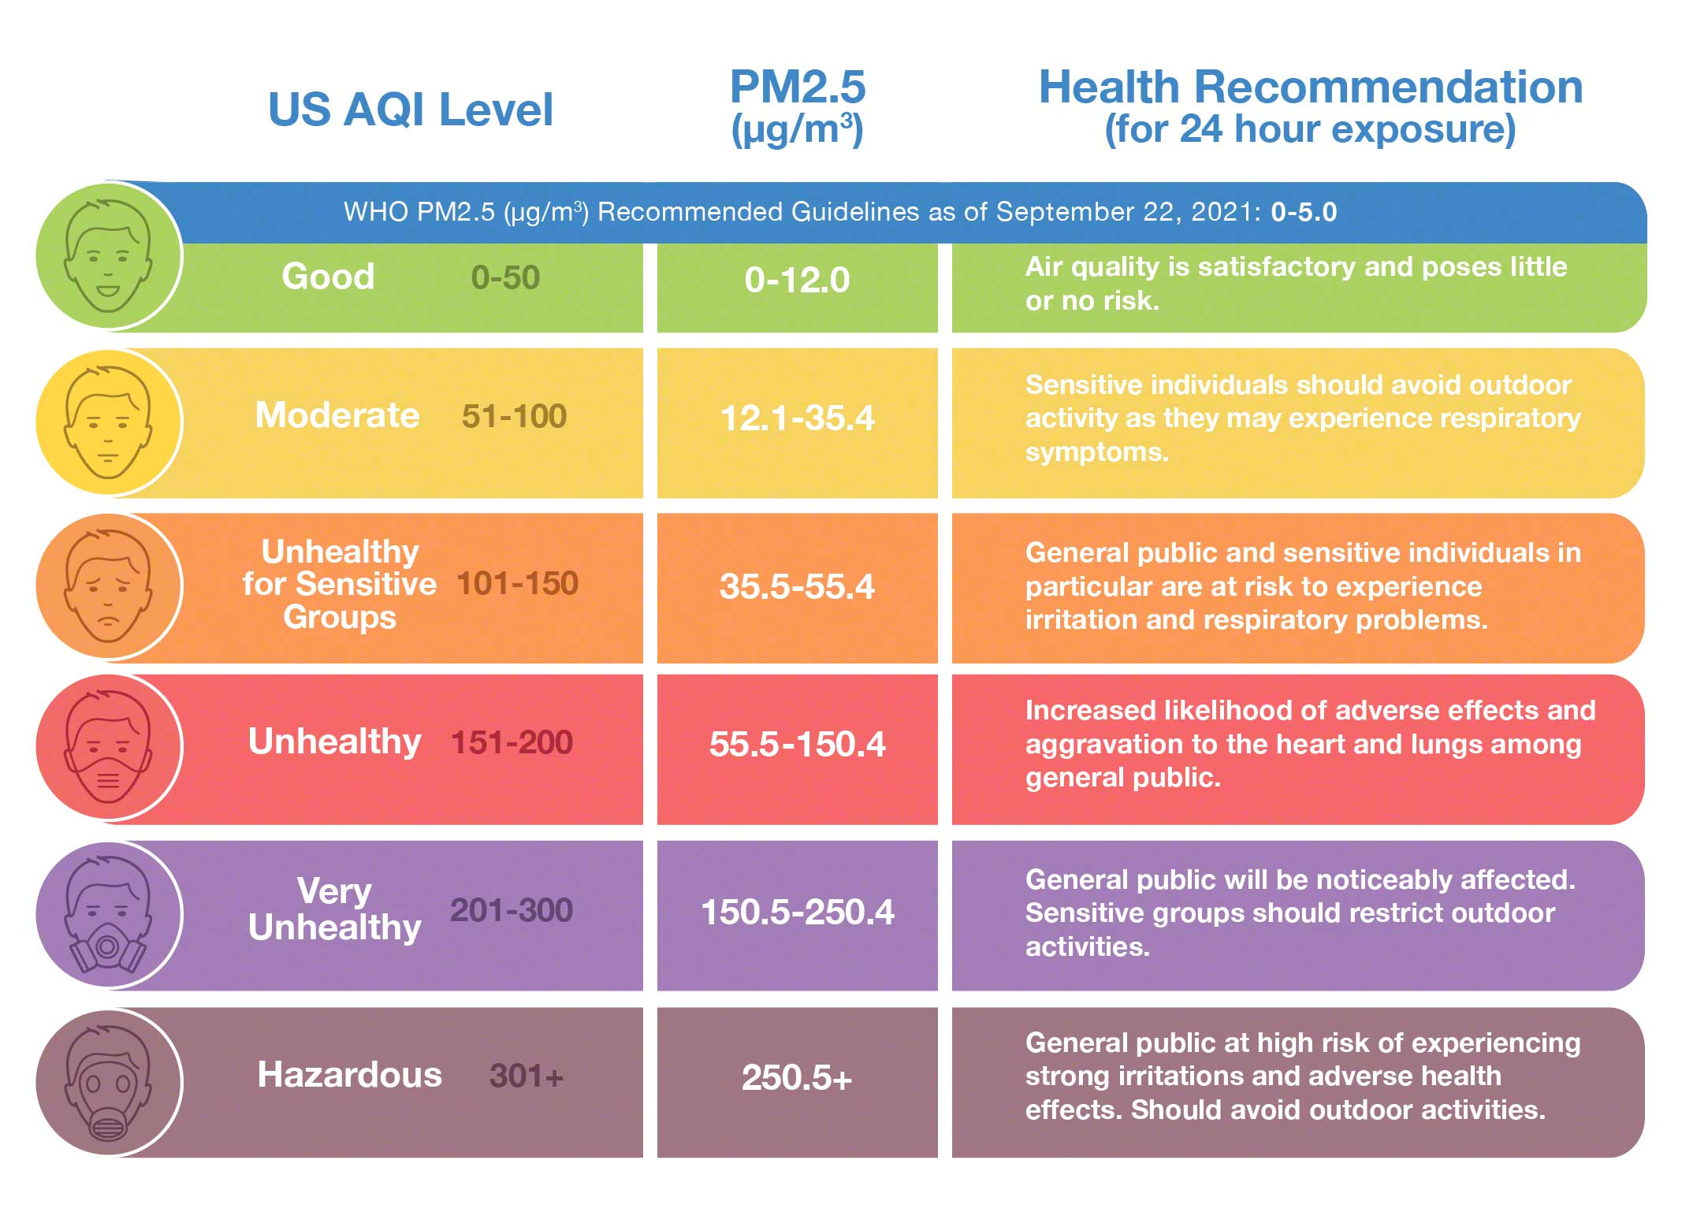
Color Scale Interpretation/Based on US AQI

Slide 28
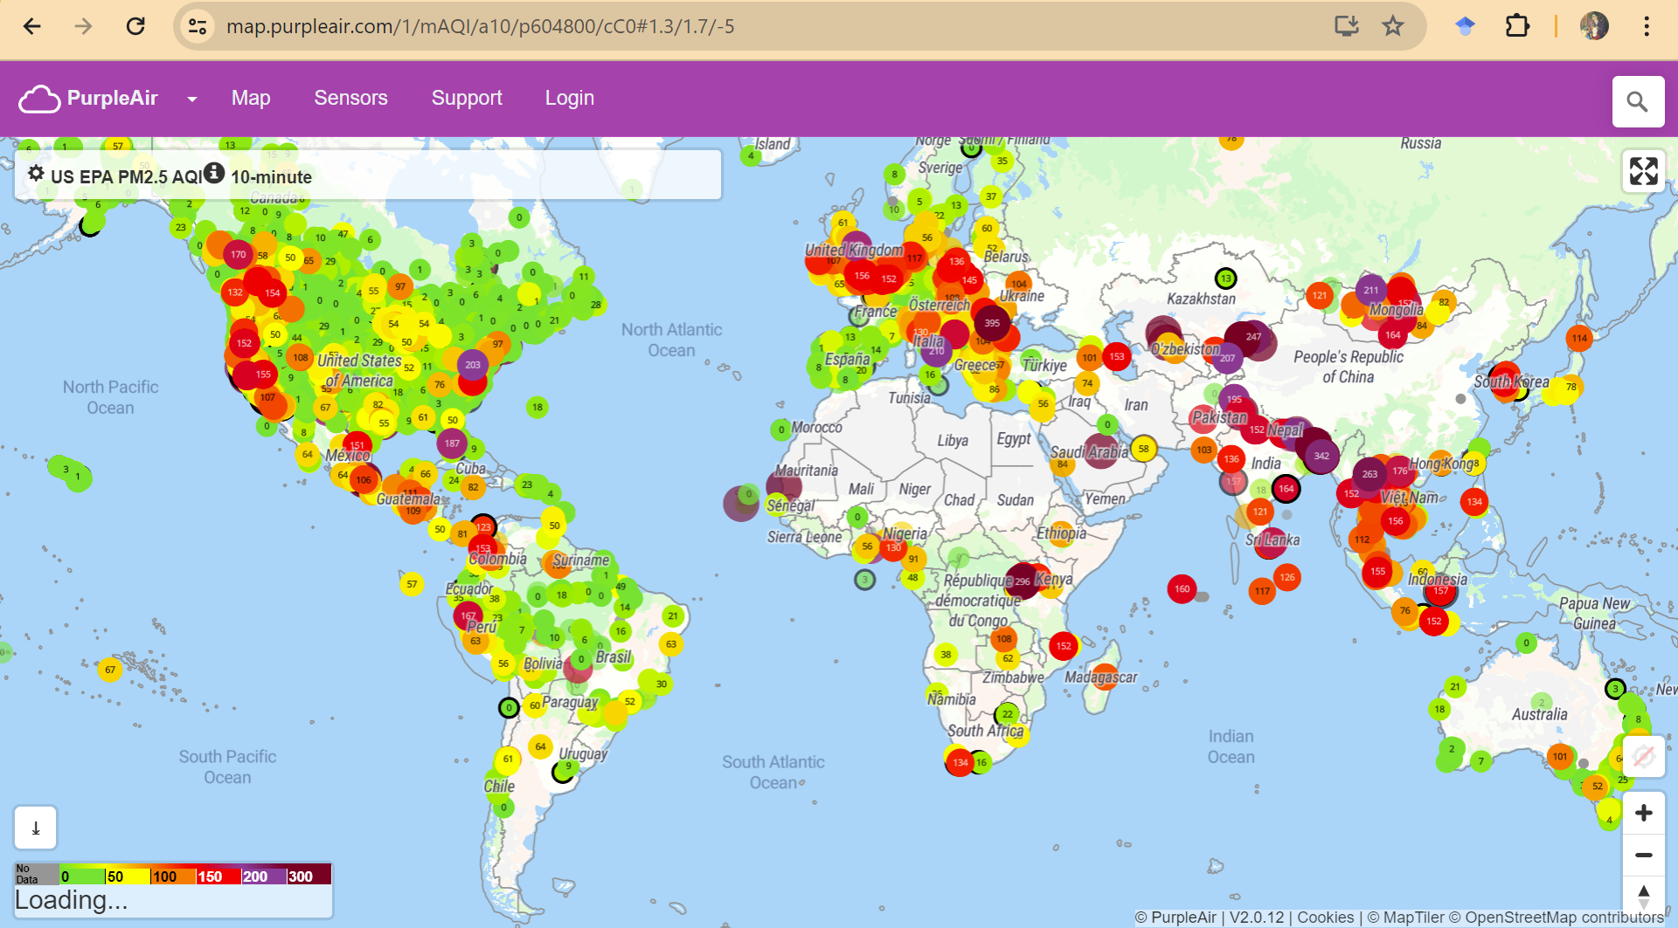
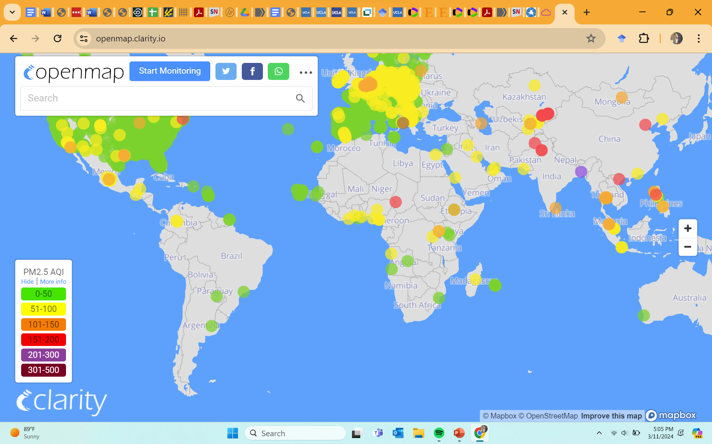
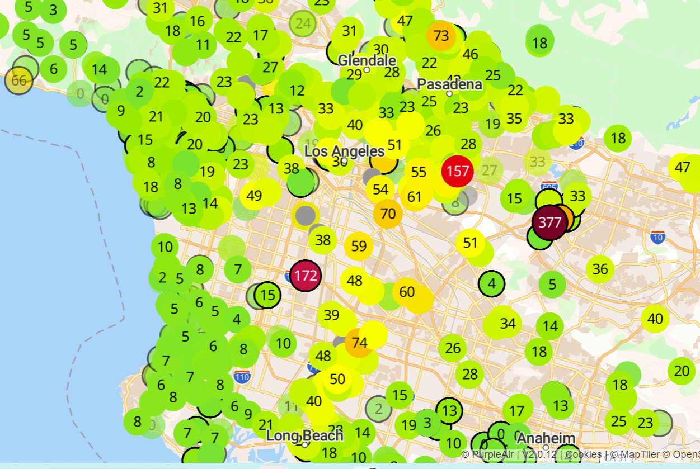
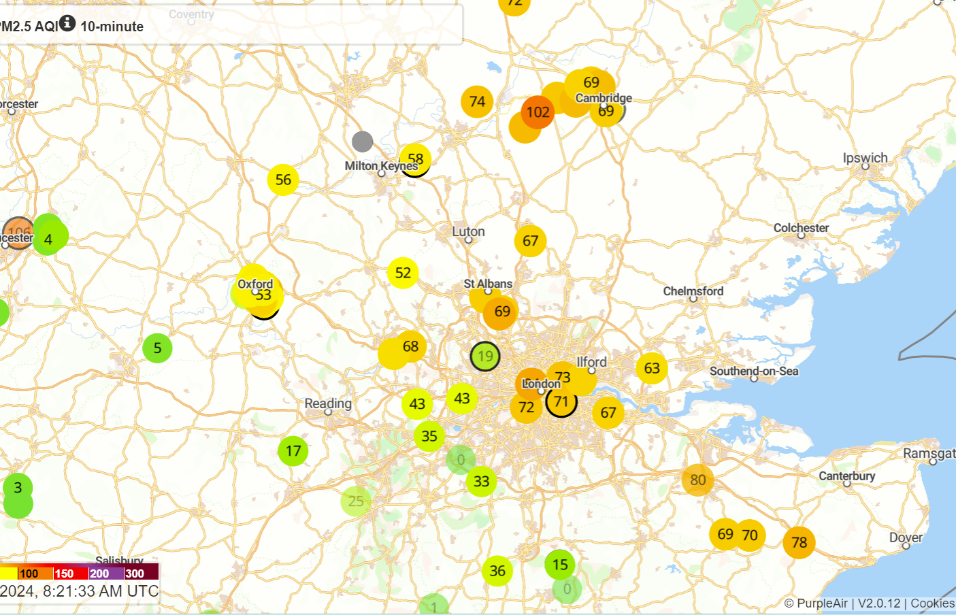
Real Time PM2.5 Maps

Slide 29
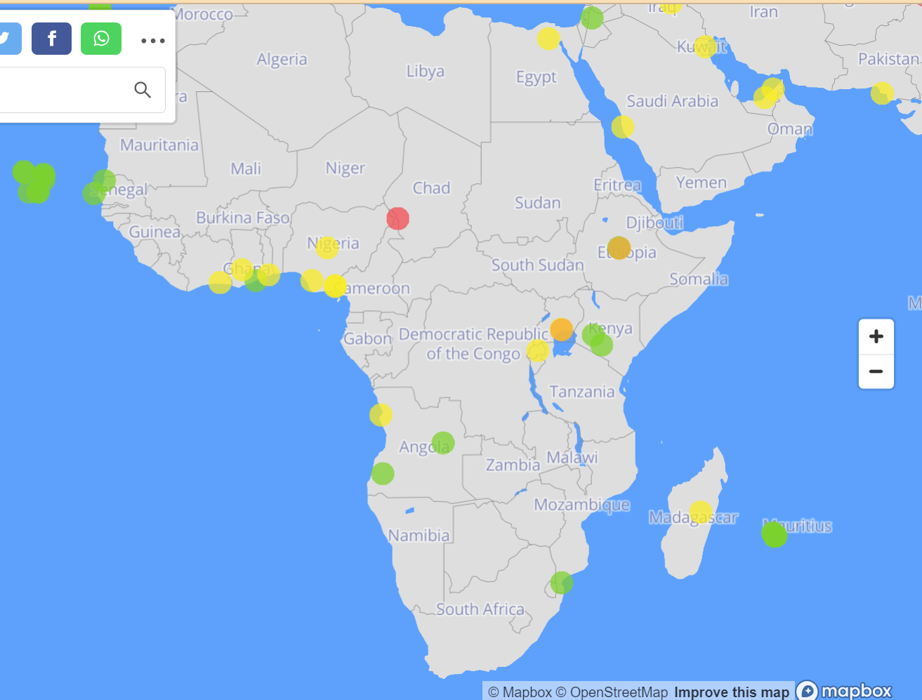
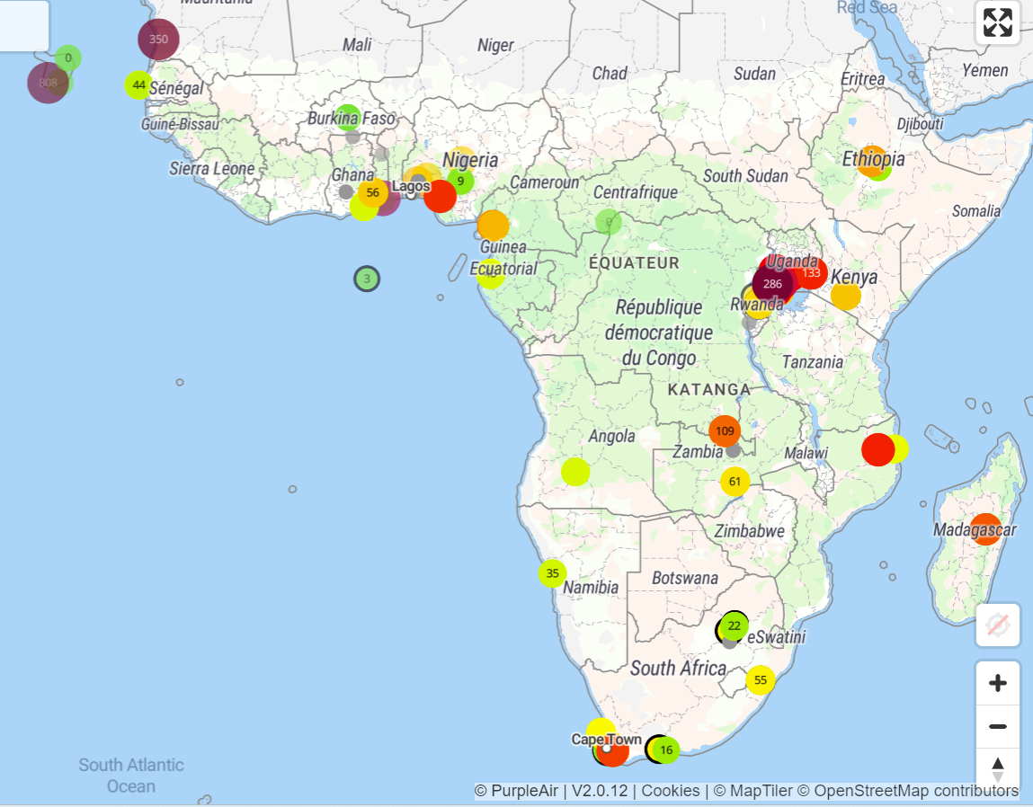
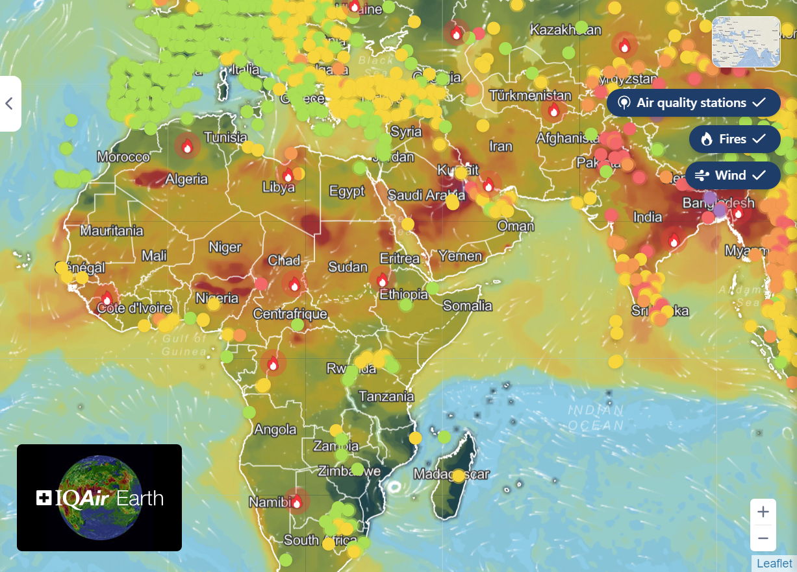
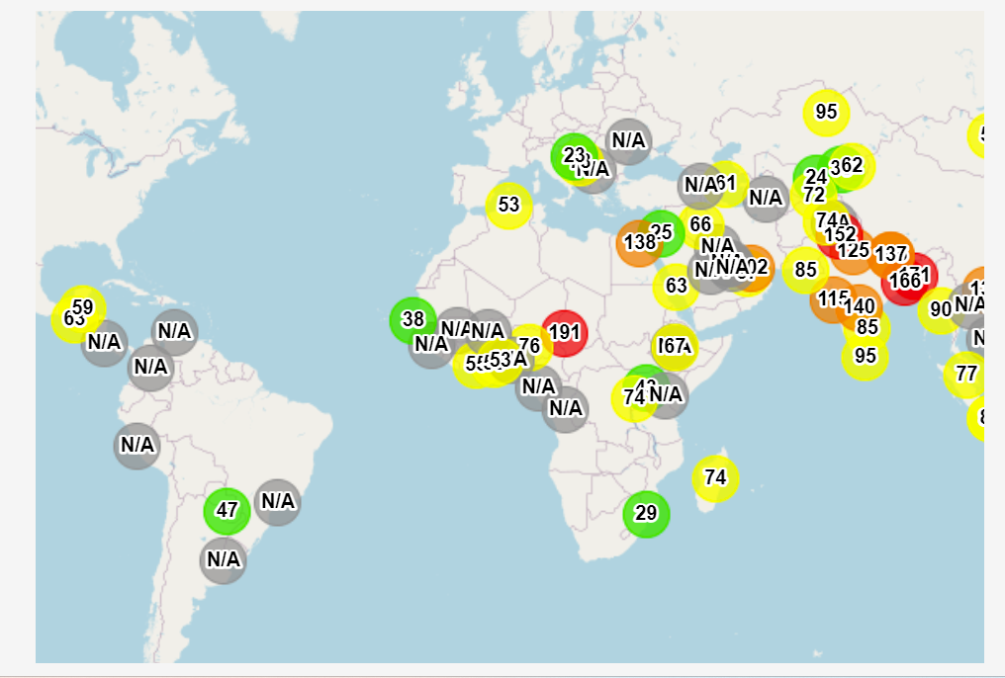
Sensors are sparse in Africa

Slide 30
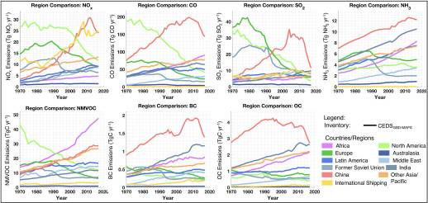
Emissions have been Rising in Africa

Slide 31
Outline
Air pollution history & Sources
Who is impacted by air pollution and where
What are the pollutants and which do we regulate
Particulate matter: the largest killer
Measuring pollutants & trends
A few thoughts on regulations and policy
My research

Slide 32
Bedrocks of Effective Air Pollution Regulation
Effective regulation stands needs two types of information
1. Measurements of Air Quality.
Target areas most impacted, monitor progress and impacts of regulation.
2. A Reasonable Quantitative Understanding of Sources.
The sources might seem obvious, but assumptions about the sources have led to many failed regulations.

Slide 33
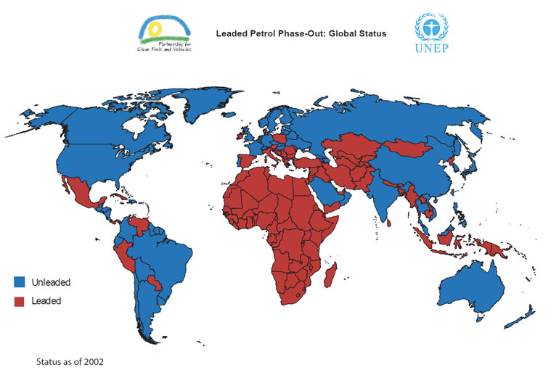
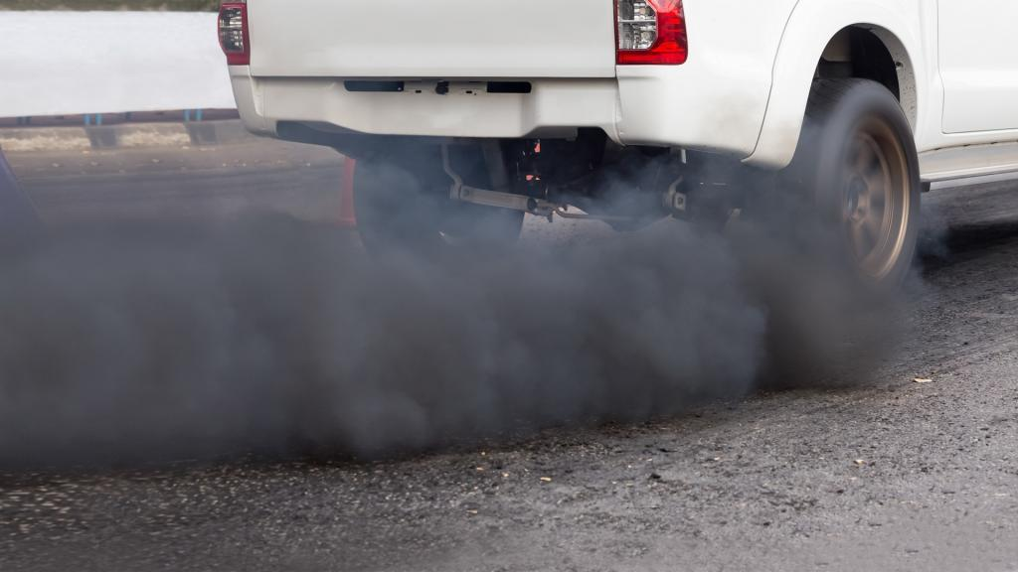
Removing Lead from Fuel is a Major Win for Air Quality and for Humanity
Lead exposure in childhood:
  Lowers intelligence
  Increases incidence of mental health problems and violent and antisocial behaviors.
Causes Early Death
  More than 1 million lives are saved each year.

Slide 34
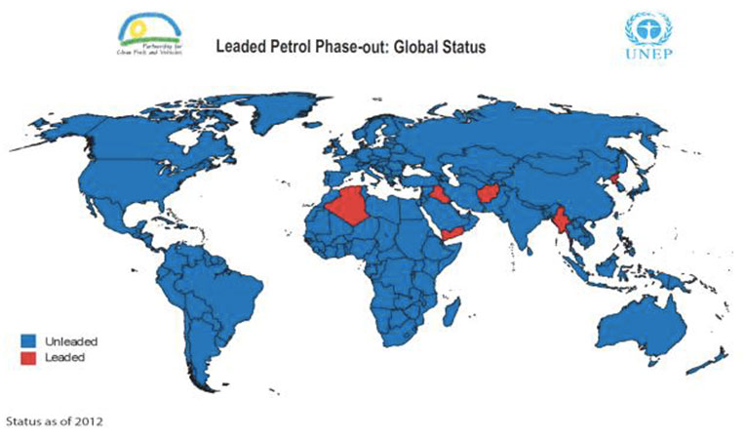
Removing Lead from Fuel is a Major Win for Air Quality and for Humanity
Lead exposure in childhood:
  Lowers intelligence
  Increases incidence of mental health problems and violent and antisocial behaviors.
Causes Early Death
  More than 1 million lives are saved each year.

Slide 35
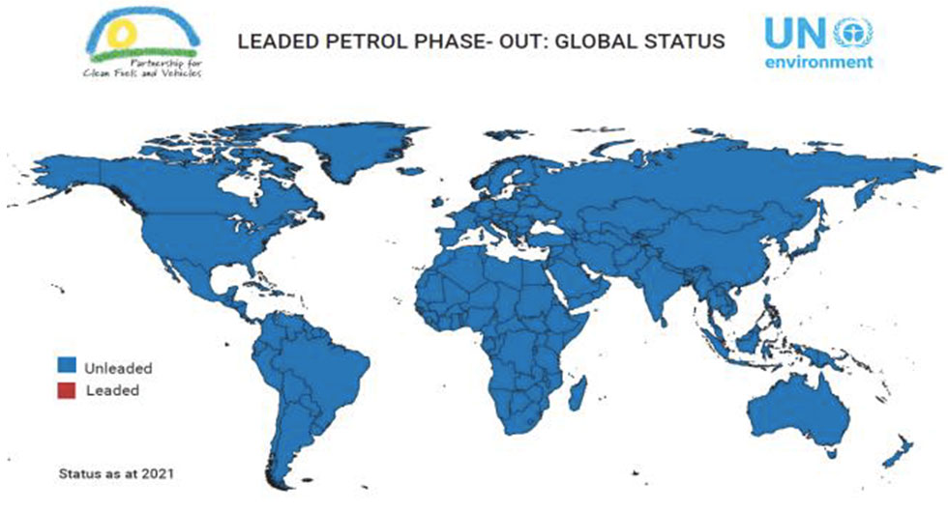
Removing Lead from Fuel is a Major Win for Air Quality and for Humanity
Lead exposure in childhood:
  Lowers intelligence
  Increases incidence of mental health problems and violent and antisocial behaviors.
Causes Early Death
  More than 1 million lives are saved each year.

Slide 36
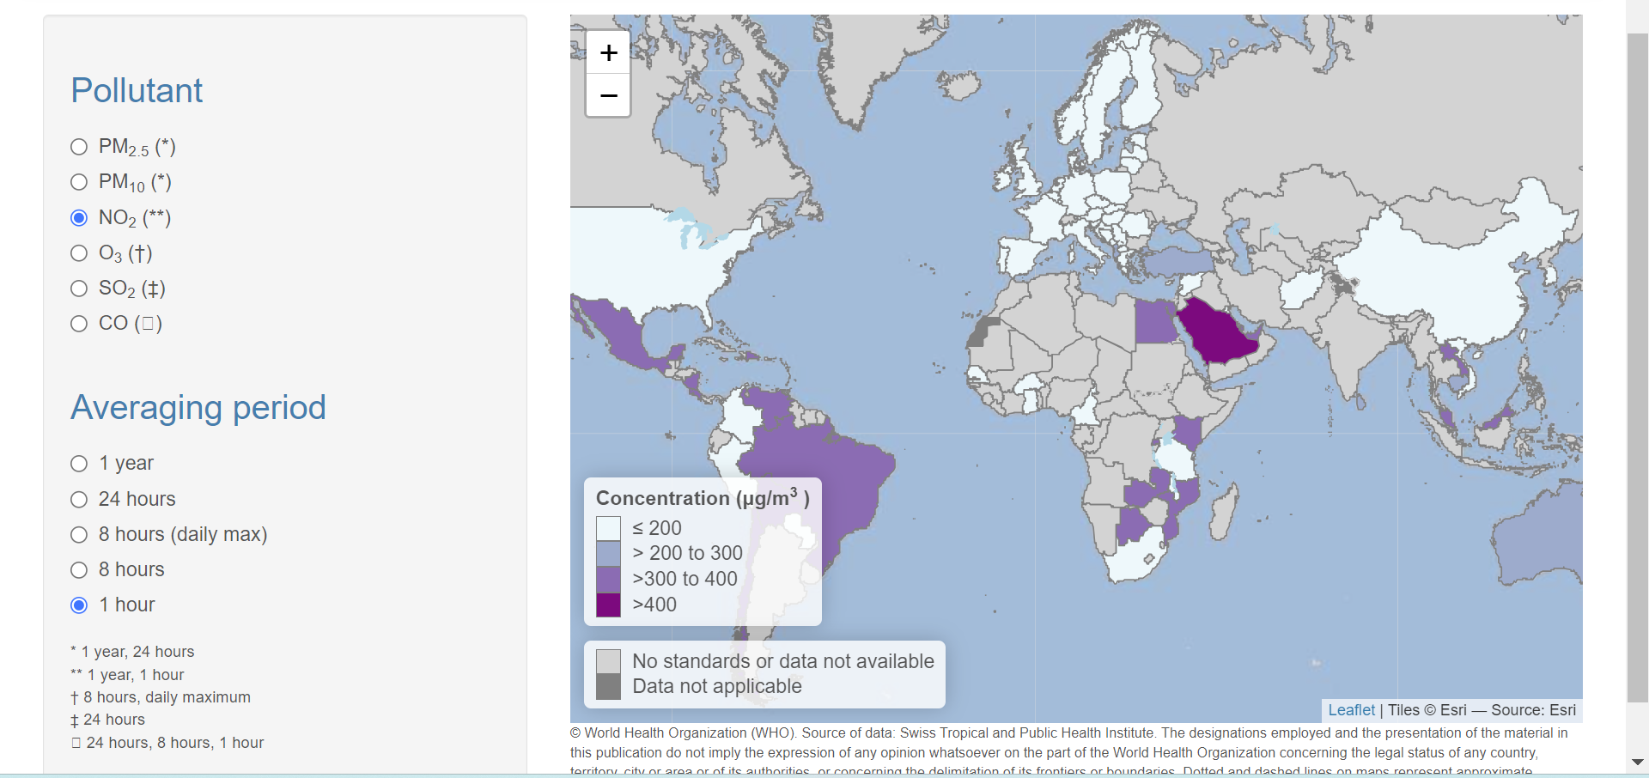
NO₂ Regulations (summarized by WHO)

Slide 37
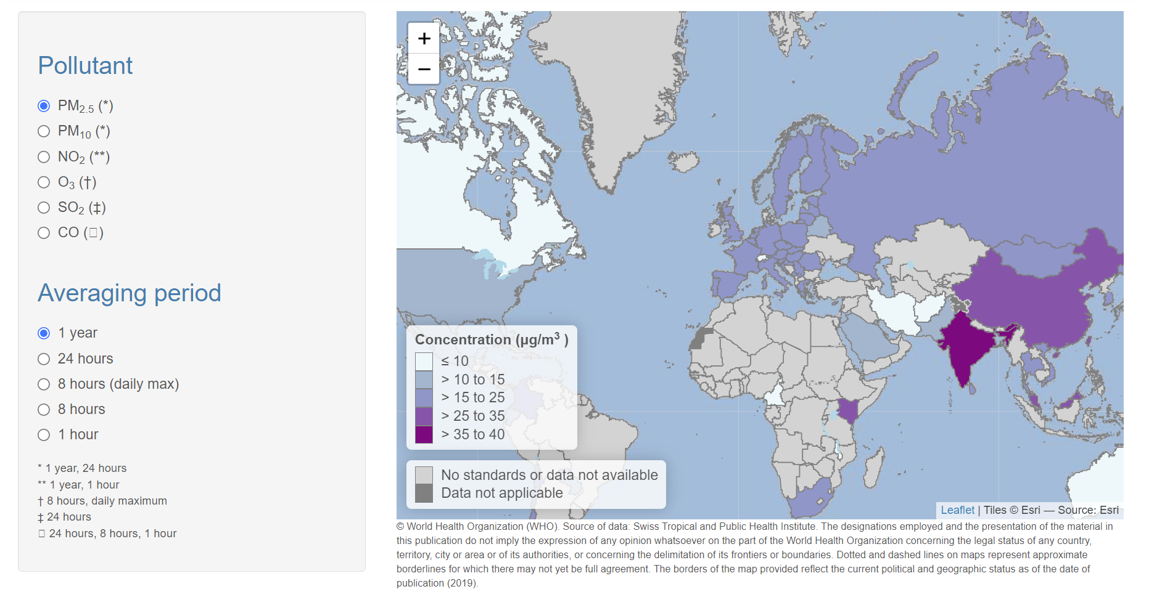
https://whoairquality.shinyapps.io/AirQualityStandards/

Slide 38
Air Pollution Mitigation Options
Source Control
Cleaner stoves, cleaner cooking fuels, electrification
Emissions controls on imported vehicles
Cleaner Fuels, cleaner industrial processes
Exposure Reduction
Behavioral
Separate pollution sources from sensitive populations
Educate about the hazards of burning waste
Keep kids inside on highly polluted days so they breathe less
Mechanical/Built Environment
Keep the windows closed when practical
Filtration

Slide 39
Improving Health Outcomes from Air Pollution Exposure
Many other interventions can reduce susceptibility to air pollution health effects, including improvements to healthcare, nutrition, and reduction of communicable diseases

Slide 40
Outline
Air pollution history & Sources
Who is impacted by air pollution and where
What are the pollutants and which do we regulate
Particulate matter: the largest killer
Measuring pollutants & trends
A few thoughts on regulations and policy
My research

Slide 41

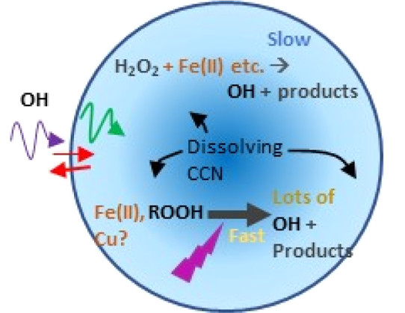
Burst of OH Formation
°
°
°
°
°
°
°
°
°
OH-driven chemistry
°
°
°
Cloud water chemistry
°
°
°
°
°
°
°
°
°
°
°
°
°
°
°
°
°
°
Particles are larger and chemically changed after cloud processing.

Slide 42
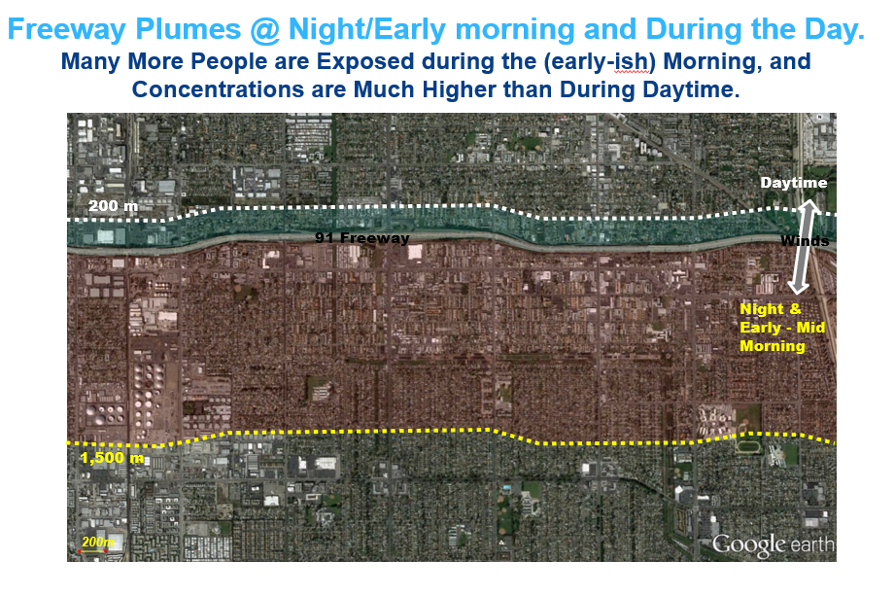
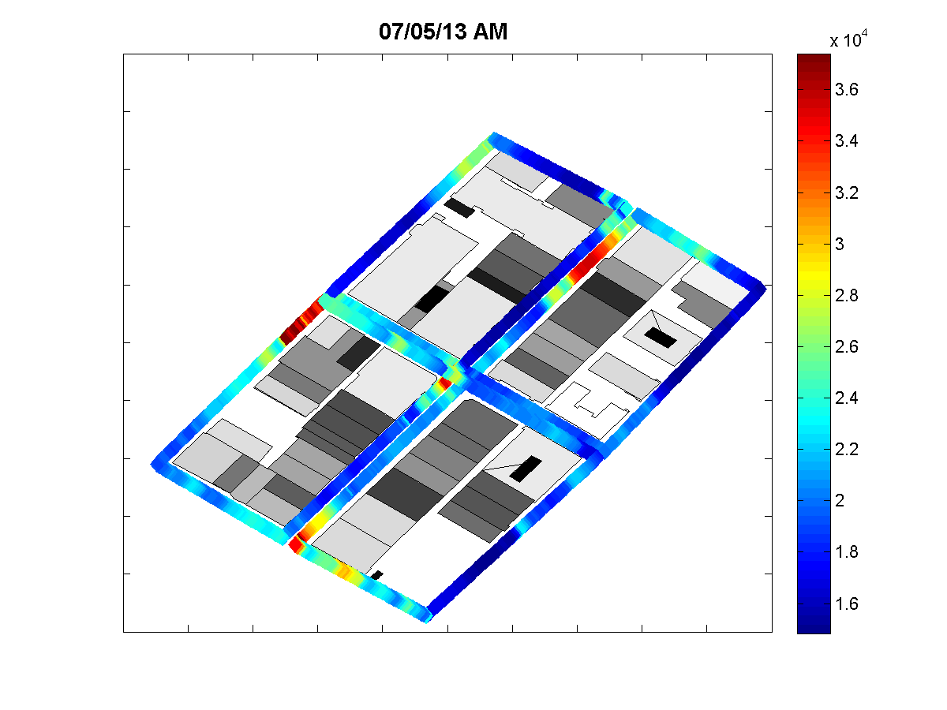
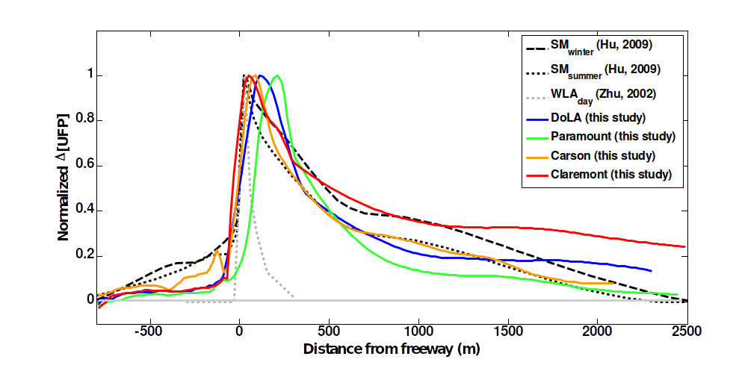
Spatial Variation of Pollution in Urban Areas/Exposure studies
Downwind
Upwind

Slide 43
What is it about particles that makes people sick, and Environmental Justice

Slide 44
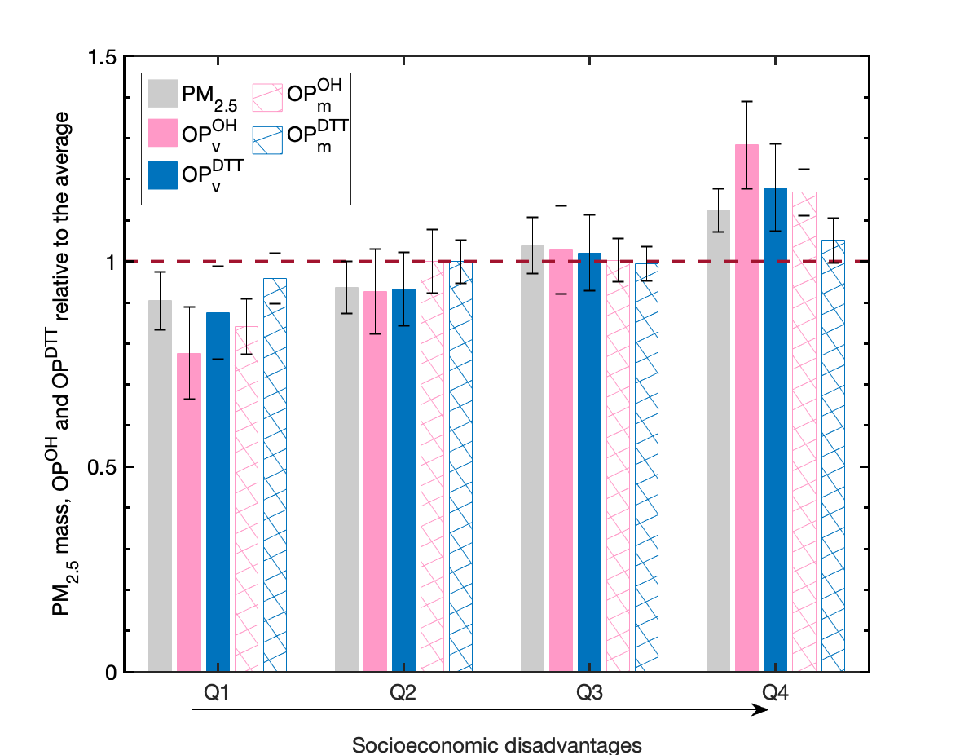
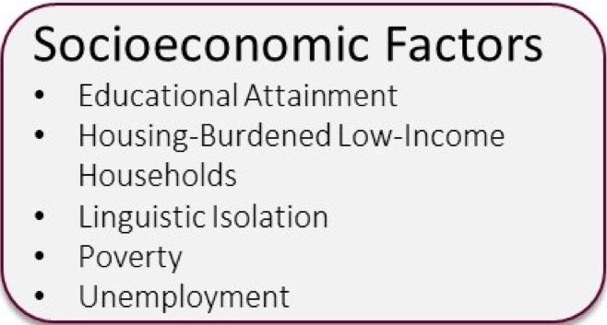
In Los Angeles, California, USA, People in the quartile with the most socioeconomic disadvantages were exposed to 24%, 65%, 35% higher levels of PM2.5 mass, OP^{OH}, OP^{DTT}
Oxidative potential is a measure of the ability of particle to induce oxidative stress, which causes many diseases.
The large variation of OP^{OH} (pink) across different SES groups is an outcome of both higher particle mass concentrations and larger intrinsic toxicity at more socioeconomic disadvantaged areas
The variation of OP^{DTT} is mainly a signal of particle mass

Slide 45
Instrument Development: Online reactive oxygen species measurements

Slide 46
Also:
Collaborations with Prof. Bertrand Tchanche Fankam
Projects developing new sensors based on new capabilities from quantum science/quantum entanglement.
More soon!

Slide 47
Thank you!

