Slide 1
What I did:
Binding energies were summed up for the CaMKII and STG condensates.
A binding of molecules decreases overall energy. This decrease was set to be positive.
Panels from left to right show :
1: Target condensate regions.
2-5: Distribution of each constituent molecule.
6: Top: Concentrations in the condensates. Bottom: Radial distribution profile.
7: Top: Total binding energy of the condensates. Bottom: Condensate volumes.
The total binding energy of a condensate critically depended on the condensate volume.
Thus, I got:
8: Binding energy per volume.
Images are stored in \\172.26.45.85\samba\pandey\analyses_pips\imgs\binding_energy\profiles
Programs are stored in \\172.26.45.85\samba\pandey\analyses_pips\main_binding_energy_XXX.py
Edited data are stored in \\172.26.45.85\samba\pandey\analyses_pips\data\binding_energy
Lammpstrj files are stored in \\172.26.45.85\samba\pandey\lammpstrj\binding_energy

Slide 2
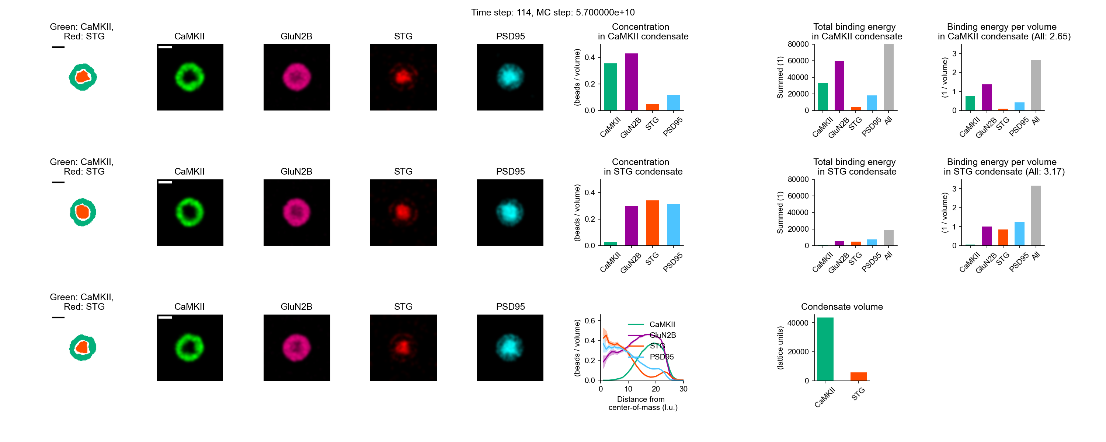
PIPS
Sorry, but the binding energy was
summed up for those two condensates.
Energy in CaMKII condensate (2.65, shell) < Binding energy in STG condensate (3.17, core)

Slide 3
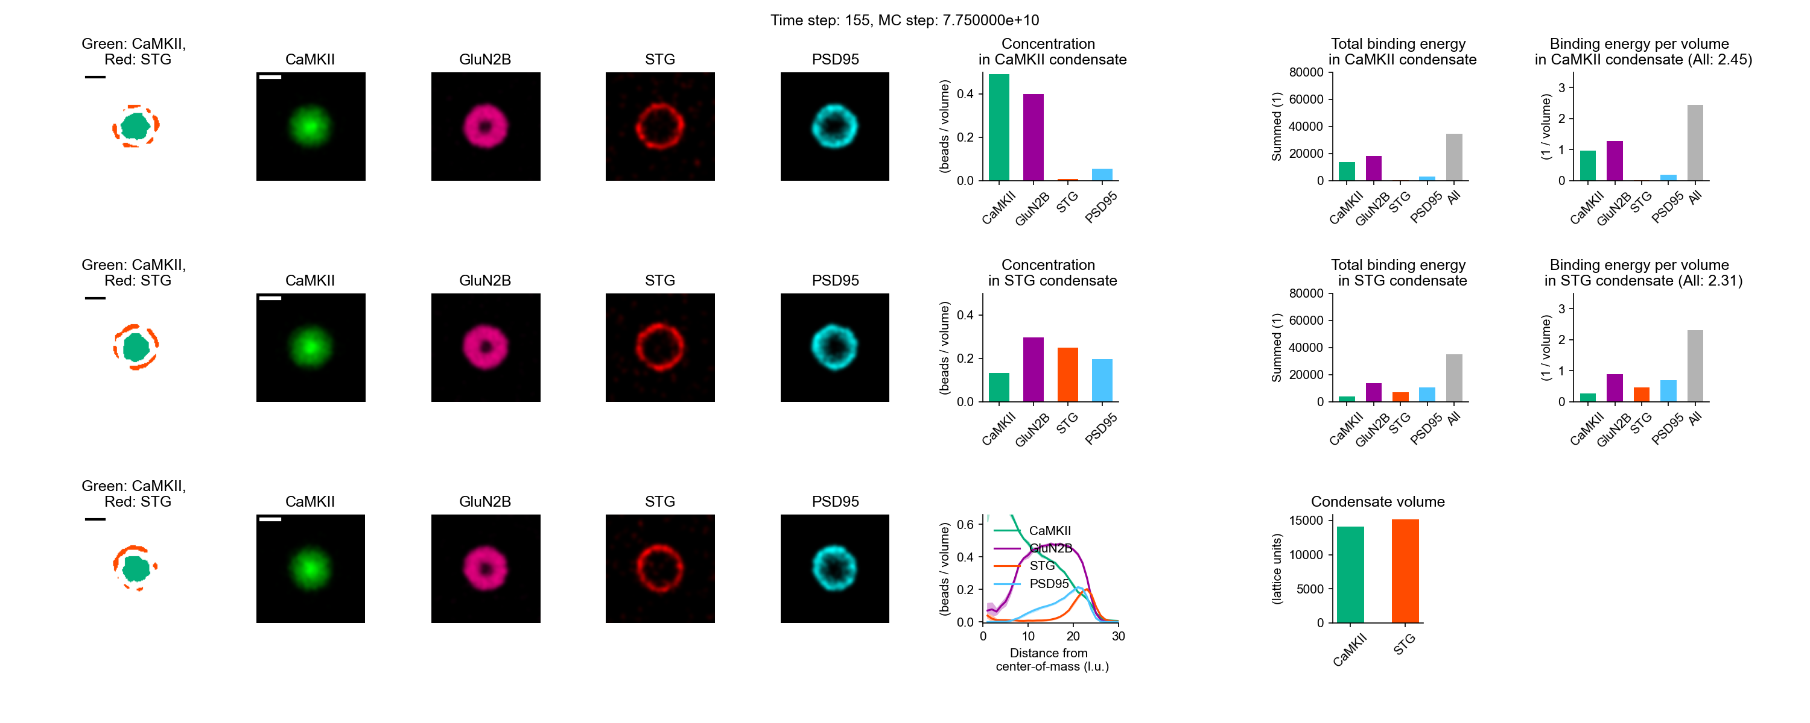
iPIPS
Energy in CaMKII condensate (2.45, core) > Binding energy in STG condensate (2.31, shell)

Slide 4
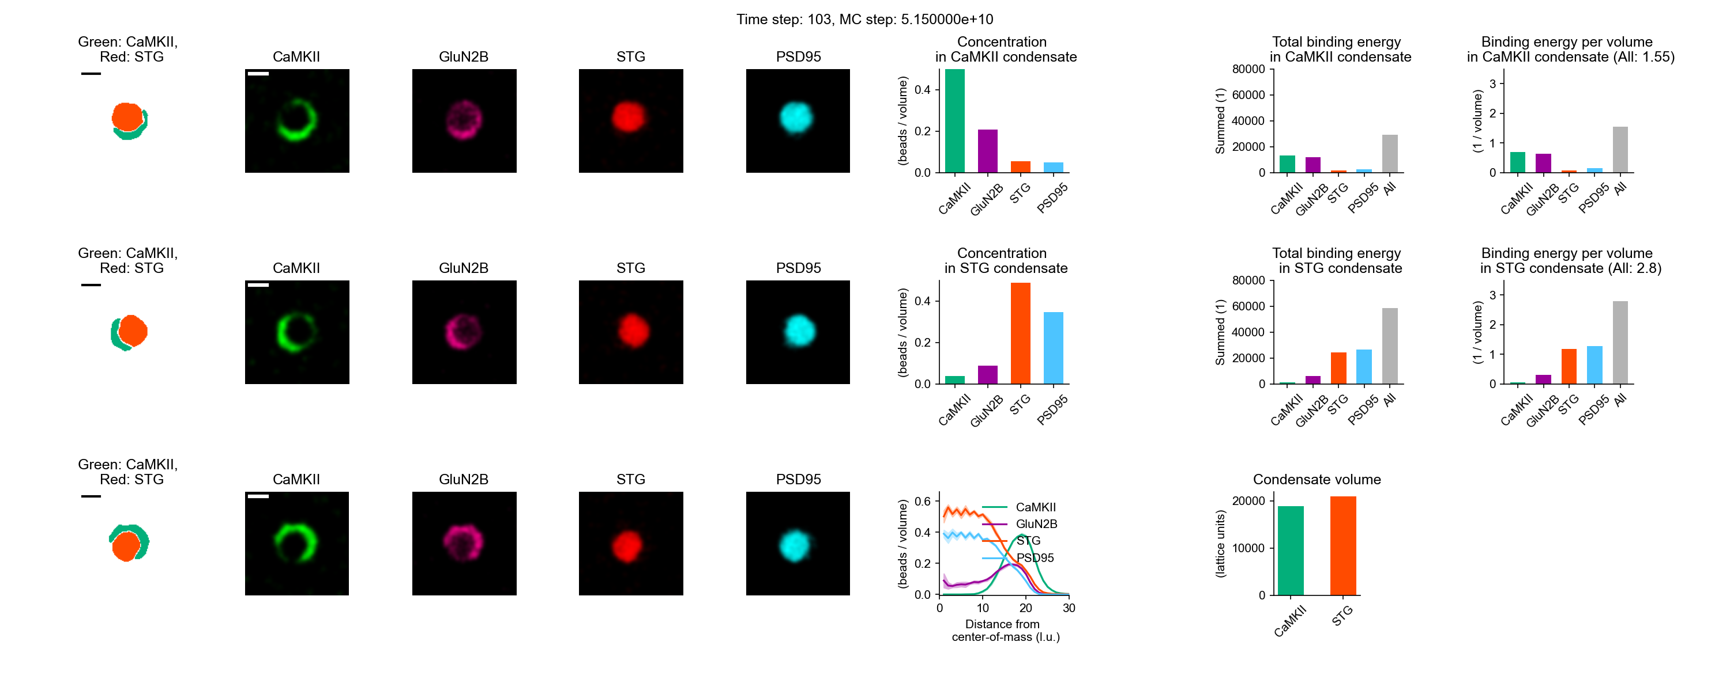
Partial engulfment
Energy in CaMKII condensate (1.55, shell) < Binding energy in STG condensate (2.8, core)

Slide 5
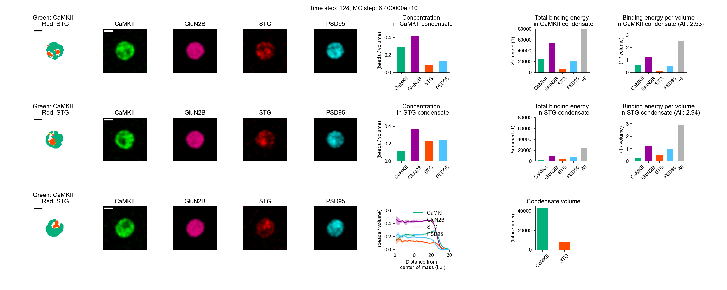
Homogenous LLPS (CaMKII valence: 4)
Energy in CaMKII condensate (2.53, shell) < Binding energy in STG condensate (2.9, core)

Slide 6
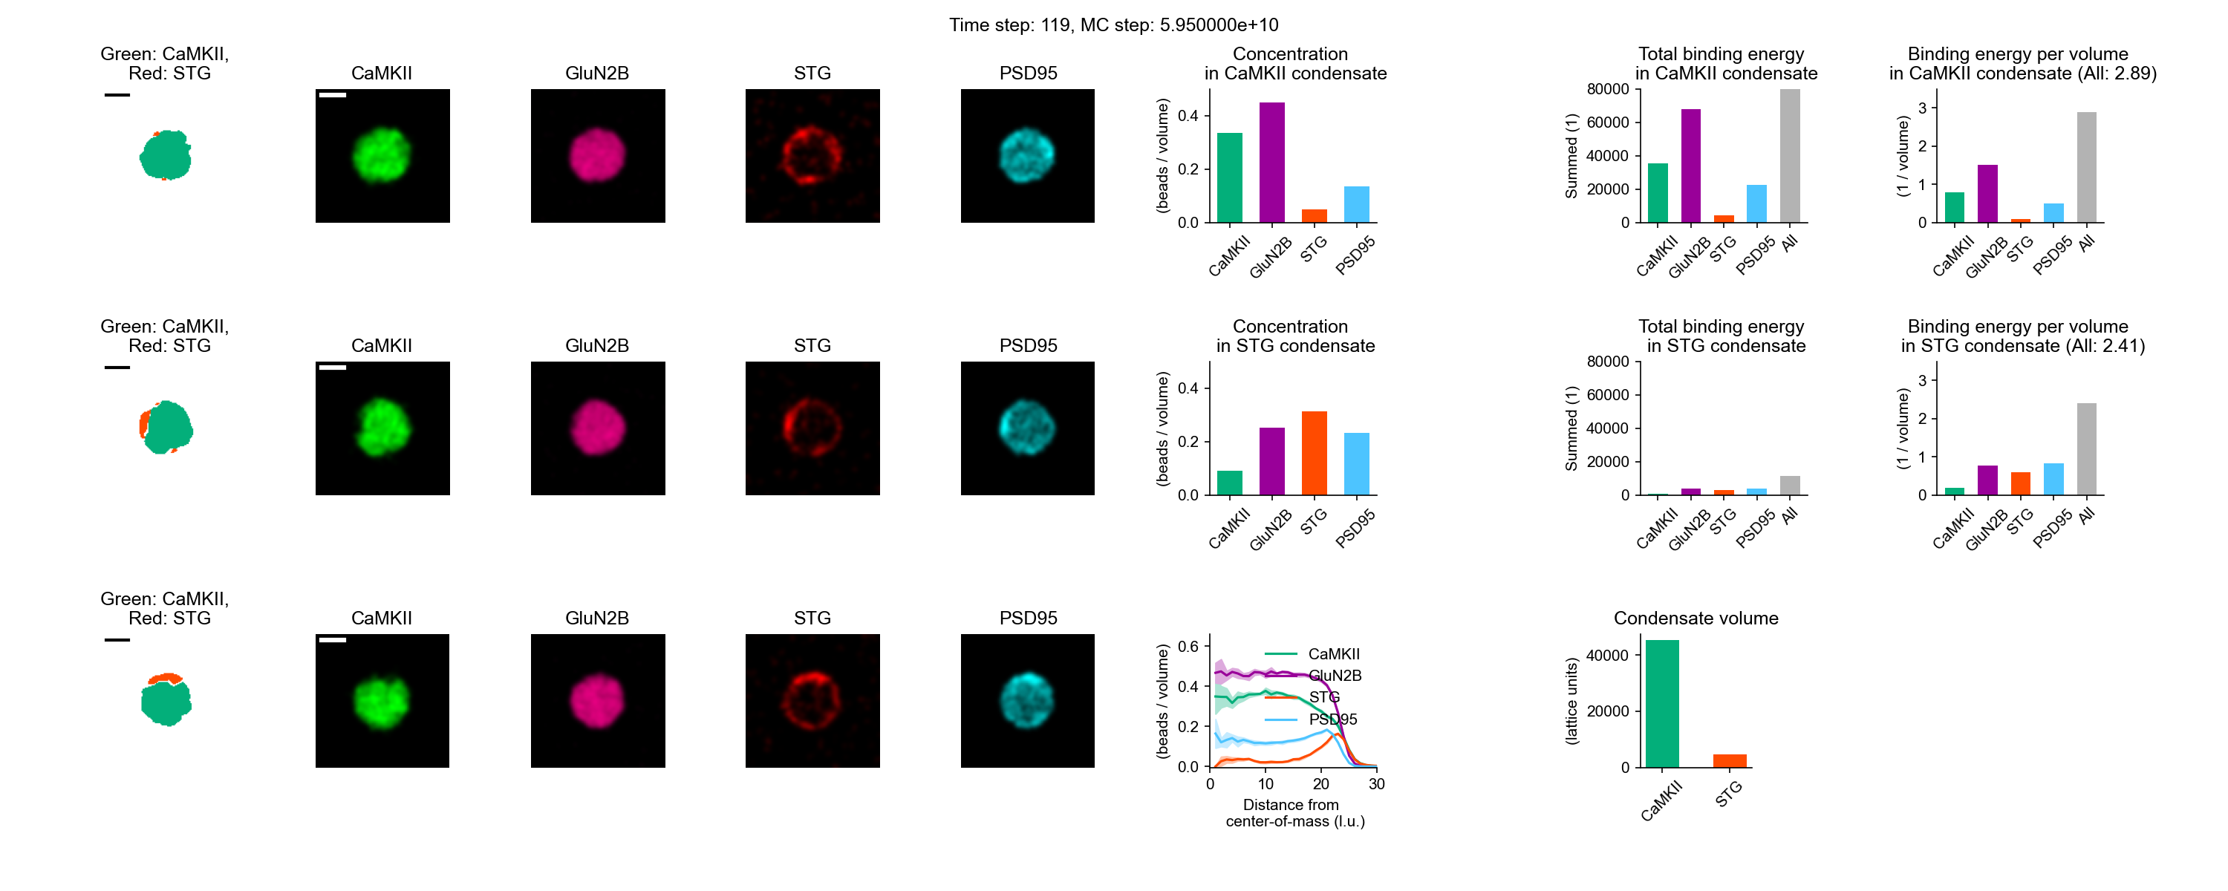
Homogenous LLPS (linear CaMKII)
Energy in CaMKII condensate (2.89, core) > Binding energy in STG condensate (2.41, shell)

