Slide 1
A GPS-only diagnostic agent
for open-pit haulage
BN pilot — building it, stress-testing it, and correcting the headline
From truck GPS alone: find the bottleneck for a load zone and say which lever helps — honestly.
GPS only
4 layers
+62% → +54%
no payload, fuel, dispatch or shovel data
perception → attribution → decision → LLM brief
headline corrected this week
Baruun Naran circuit, South Gobi · November 2025 data

Slide 2
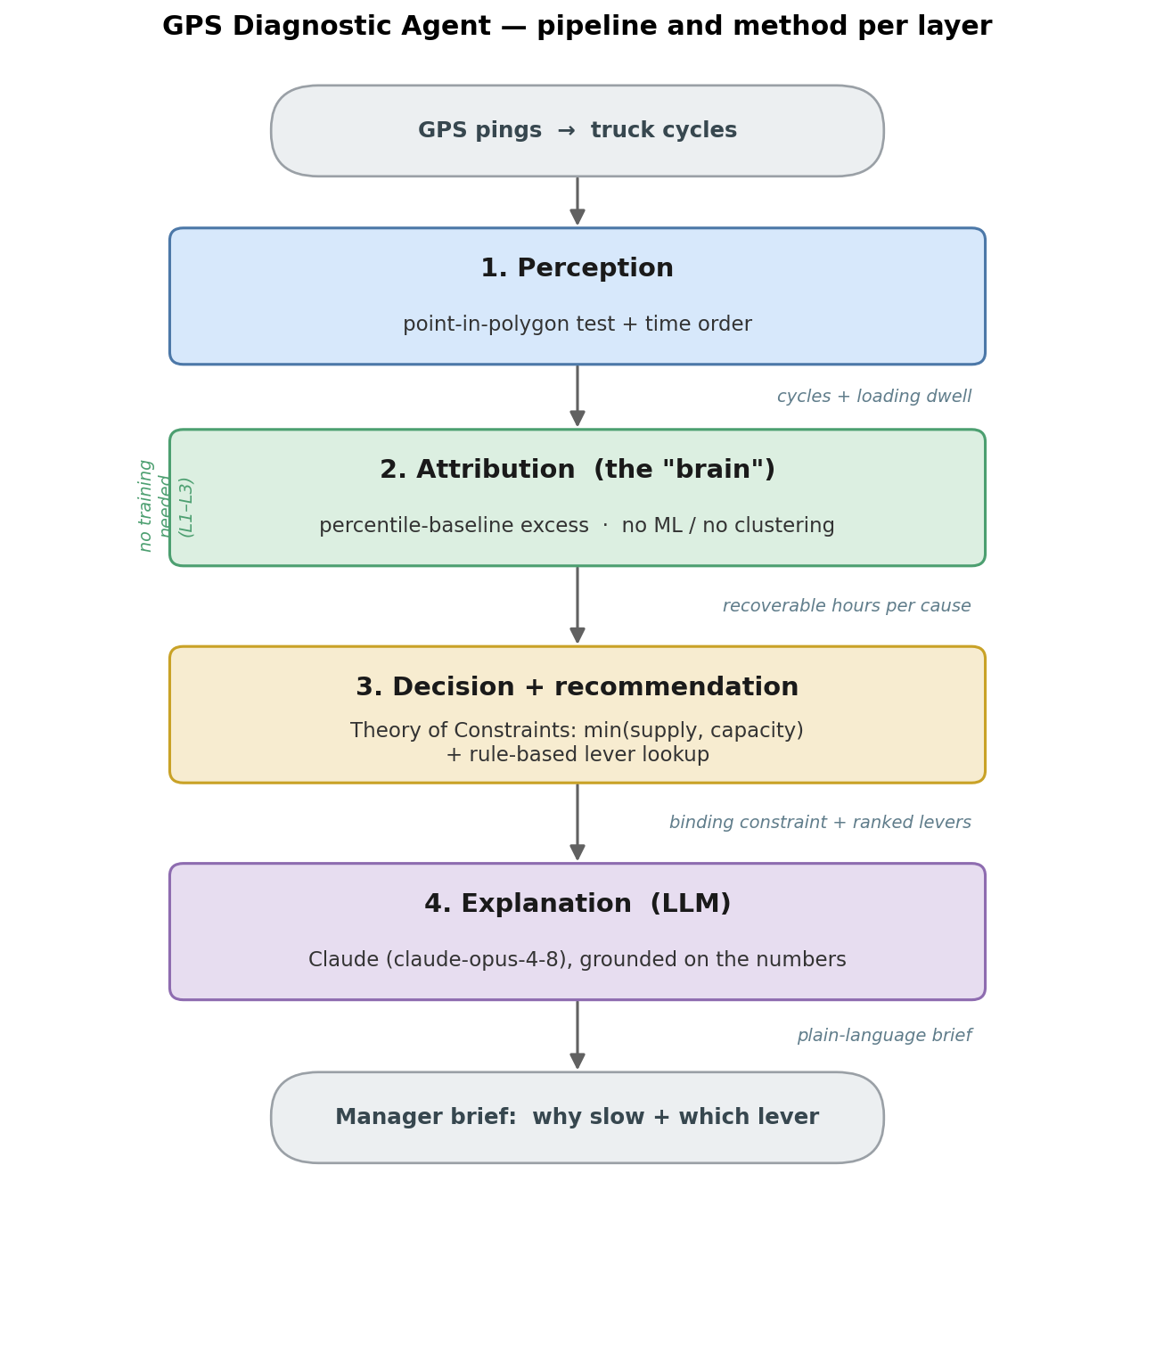
LAST WEEK
What we built: a 4-layer diagnostic pipeline
Input: GPS-derived truck cycles (load → haul → dump → return). No payload / fuel / dispatch / shovel data — by design.
1 · Perception — point-in-polygon + timing → cycles & loading dwell
2 · Attribution — percentile-baseline excess (no ML) → recoverable hours per cause
3 · Decision — Theory of Constraints, min(supply, shovel) → binding constraint + levers
4 · Explanation — LLM (Claude) → plain-language manager brief
Layers 1–3 need no training — interpretable and reproducible.

Slide 3
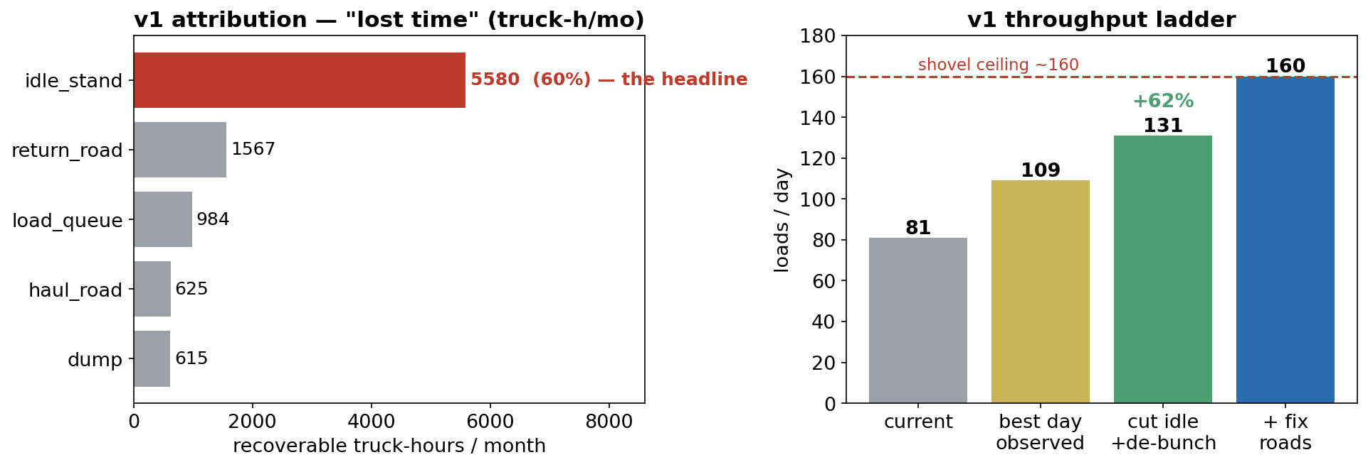
LAST WEEK
How the key numbers are computed — and the v1 result
Free-flow baseline
p15 of haul / return time — a fast, clean trip
Loading service
p20 of dwell; queue vs idle cut at 120 min
Shovel rate
busy inter-departure → 7.3/h; ceiling 160/day
Decision
Theory of Constraints: min(supply, shovel)
v1 headline: idle = 60% of lost time → “cut idle, +62%”

Slide 4
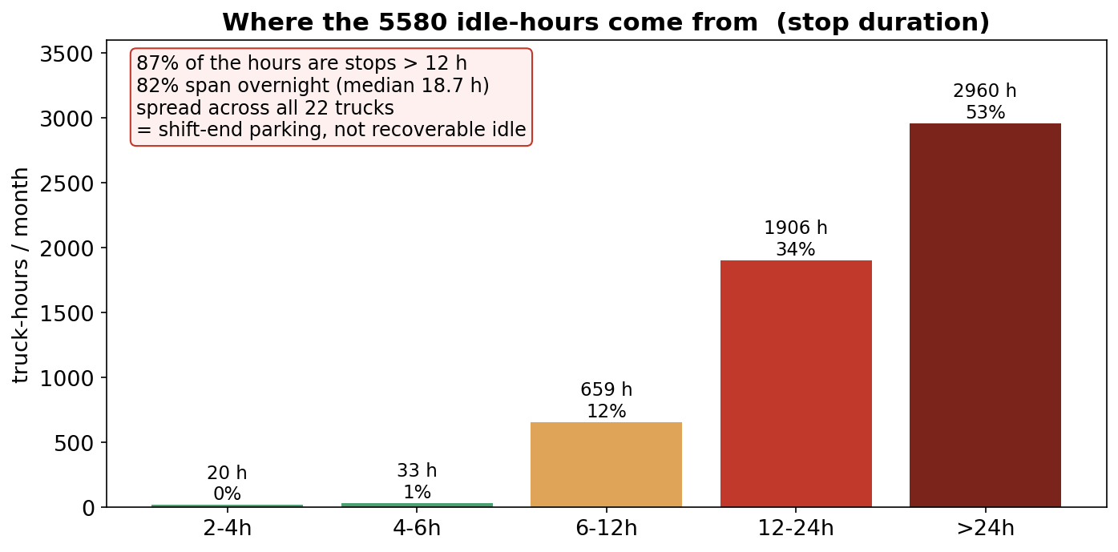
THIS WEEK
We stress-tested the headline — and it was soft
The +62% rests almost entirely on idle_stand (5,580 h = 60% of lost time).
We decomposed the 316 long stops:
• 87% of the hours are stops longer than 12 h
• 82% span overnight (median 18.7 h)
• spread across all 22 trucks — shift-end parking
→ So most “idle” is not recoverable
The fleet simply is not running 24/7. That is a staffing / scheduling question, not a dispatch waste.

Slide 5
THIS WEEK
The fix: two changes
1 · Split the idle
Add a second cut line at 6 h:
• 2 h – 6 h → on-shift idle (recoverable-ish)
• > 6 h / overnight → downtime
(off-shift; a staffing lever, not dispatch)
2 · Realistic ceiling
Keep the actual fleet availability; credit only faster active cycling (remove queue + road):
loads_new = loads × (old cycle ÷ new cycle)
Not “22 trucks running 24/7”.
The loading dwell, split at two lines:
16 min
120 min
6 h
load
(base)
load_queue
idle_onshift
downtime (staffing)
dwell →
Both changes are general; the 6 h line is a provisional, BN-tuned threshold → make cycle-relative when generalising.

Slide 6
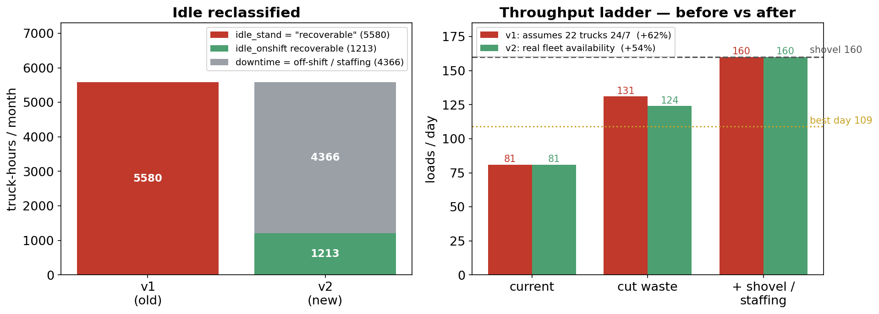
THIS WEEK
Before vs after — a more honest diagnosis
• idle 5,580 h → 1,213 recoverable + 4,366 downtime (staffing)
• headline +62% (assumes 24/7) → +54% to 124/day — near the best observed day (109), so credible
• shovel ceiling 160/day unchanged

Slide 7
Takeaways · limits · next steps
What holds up
• Same code, different diagnosis: BN is road-bound, Middling is queue-bound — a real diagnostic, not a hard-coded answer.
• We found and corrected our own inflated headline — intellectual honesty built in.
Honest limits
• Recoverable numbers = upper bounds; November data only.
• The 6 h idle threshold is provisional (BN-tuned).
• No payload → loads & truck-hours, not tonnes.
• A diagnostic, not proof — a real gain needs a before/after pilot.
Next
• Make the thresholds cycle-relative.
• Handle multi-destination flows.
• Generalise to the other region (Reject, Middling).
• Run a small before/after pilot.

