Slide 1
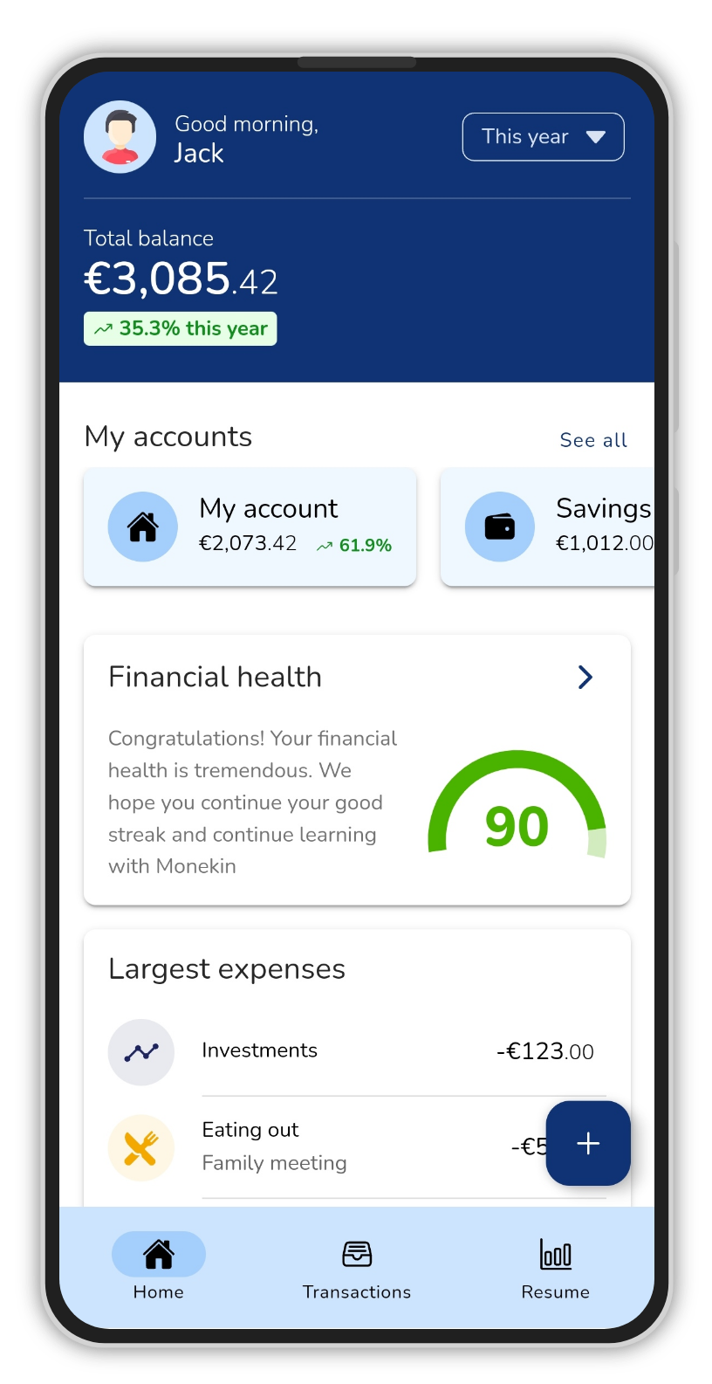
Manage your finances
Analyze where your money is going and learn how to manage it

Slide 2
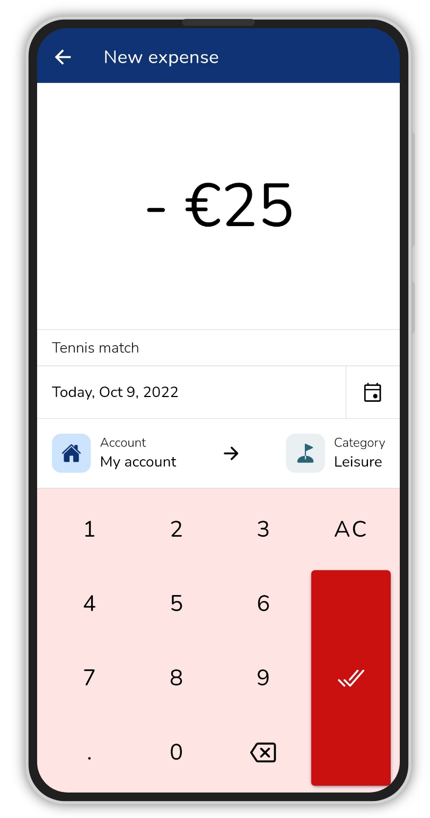
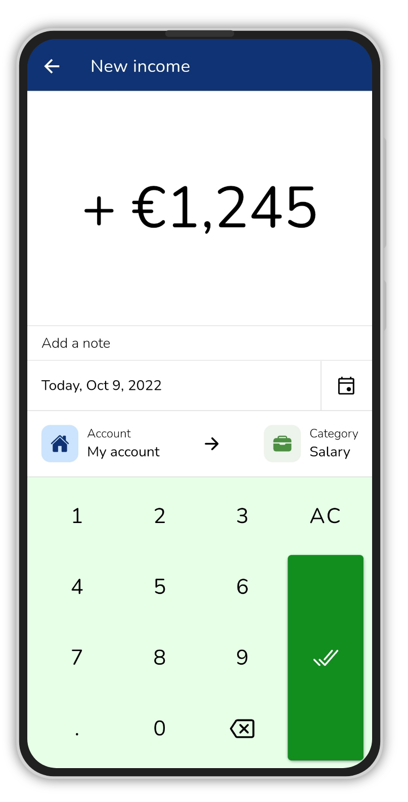
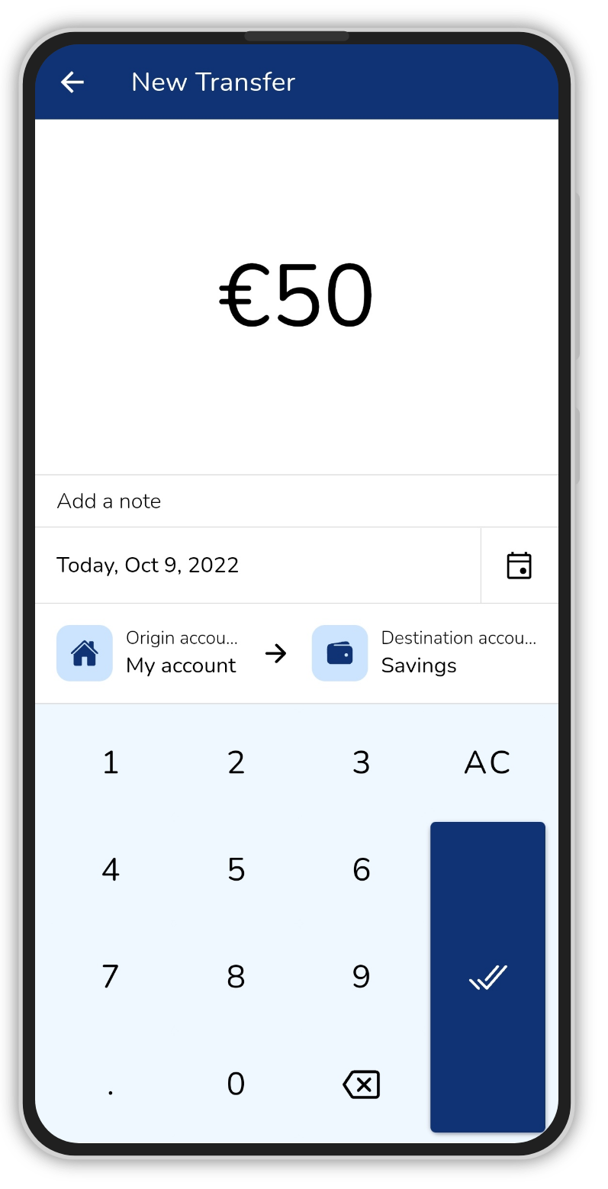
Add transactions
Create unlimited expenses, revenues, and transfers quickly

Slide 3
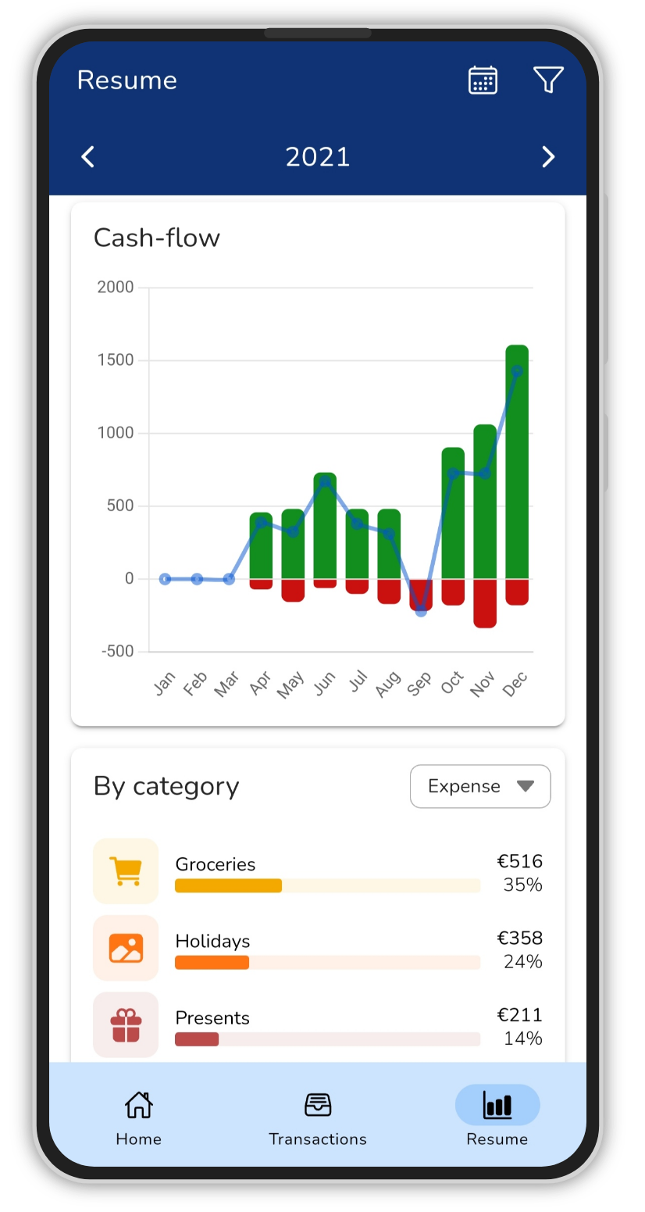
See statistics
A multitude of graphs and filters so you can better analyze your finances

Slide 4
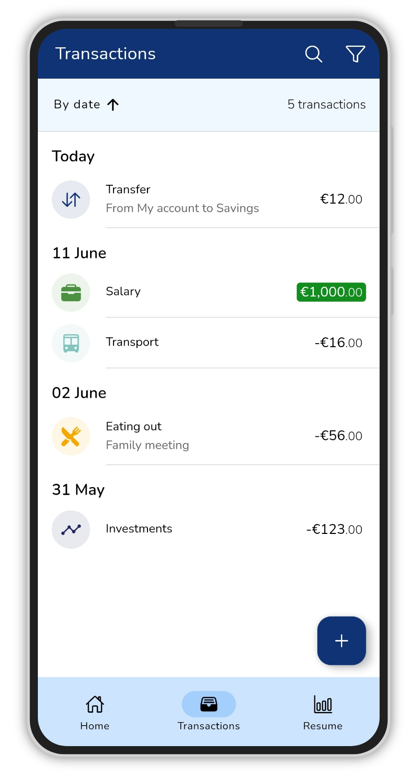
Safe and fast
Only you know your data, the app can work without connecting to the network

Slide 5
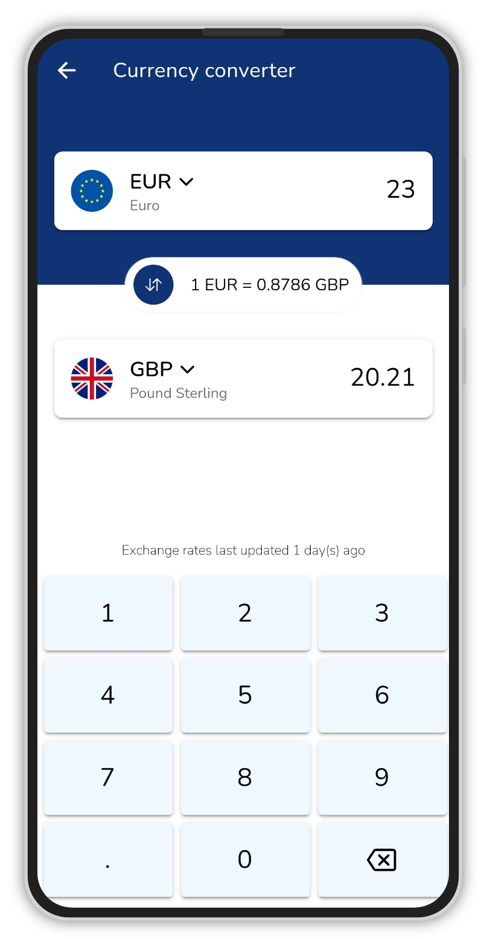
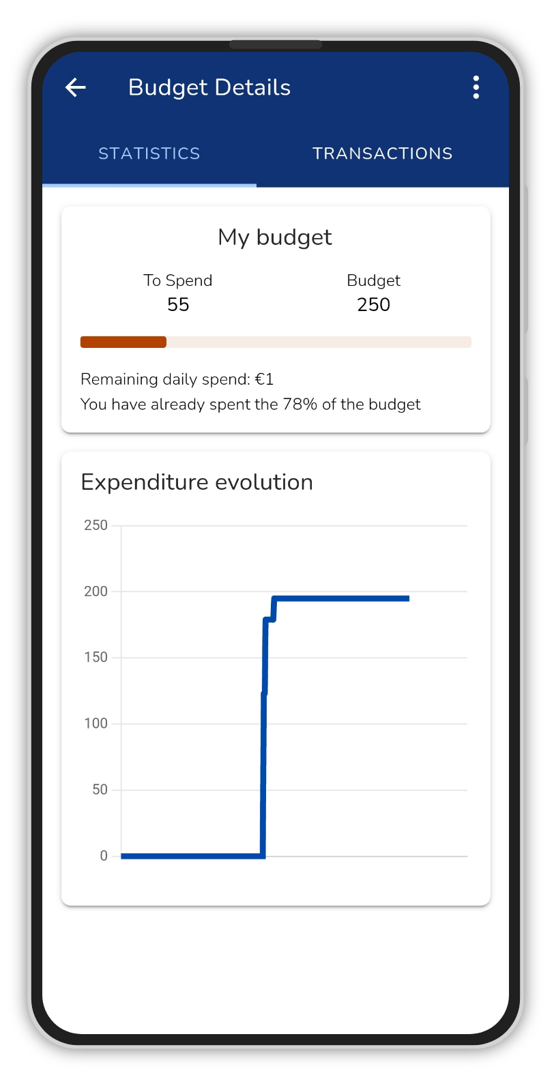
Multitude of functions

Slide 6
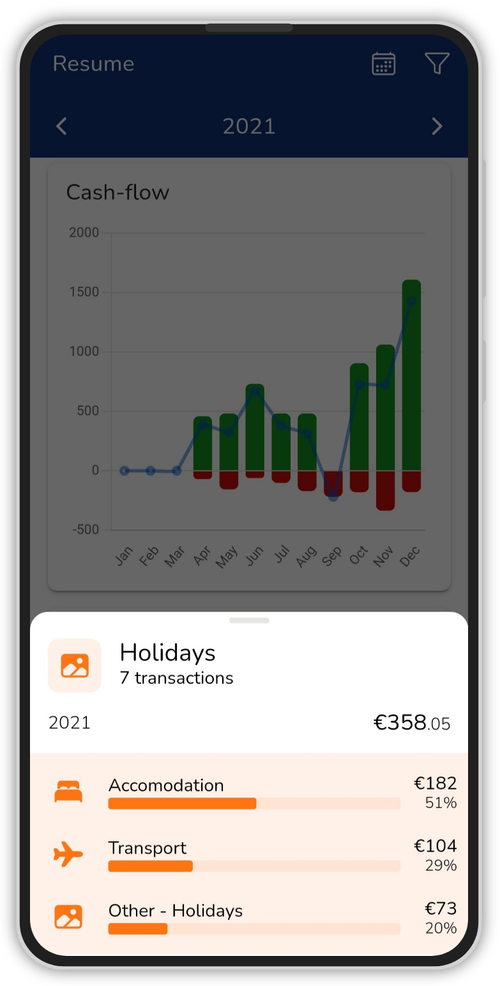
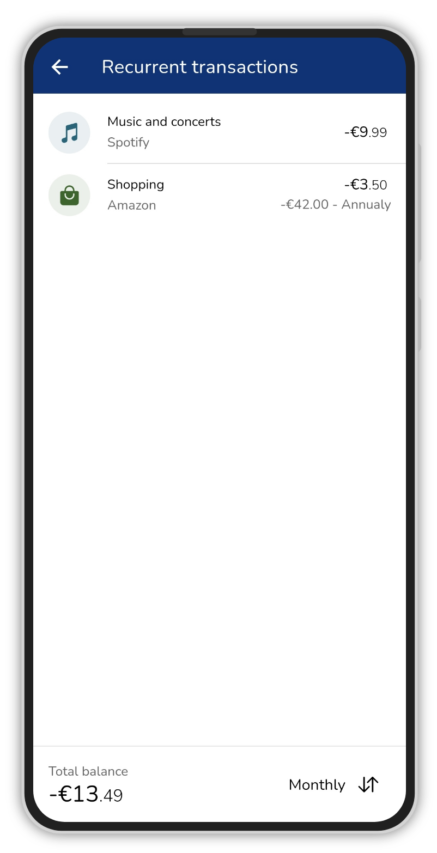
Supports subcategories and recurring transactions

