Slide 1

















Report system concept
Corporate
data center
AWS Cloud
EC2 instance contents
1
3
前処理コード
S-test
MES data
Database
(Auto) Data uploader
VPN connection
Amazon RDS
Amazon Glue
S test
・2PC ・1PC
MES
・着工履歴 ・ILT, PQC
4
レポート処理コード
Dataset
学習済みモデル
2
Amazon S3
Image data
Amazon Batch
Amazon S3
Database
(Manual)
Data uploader
VPN connection
Amazon S3
5
製品の設定
・スペック ・カテゴリ設定 ・品質基準表 ・BIN色
Setting data
Amazon SageMaker
Setting file
Amazon S3
6
Report file
Amazon
WorkSpaces Family
Amazon S3
Engineer
Authenticated user
Engineers
社内基盤データから、データ前処理(マスキング)を加えたデータ(オブジェクト?ファイル?)をAWSのRDSへ送る。
要した際に、スペック情報やBIN等のカテゴリ情報、工程作業フローの情報を設定ファイルとしてAWS S3へ送る。
定期的にRDSデータを参照し、レポート用データセットの作成と前処理を実行する。また別インスタンスでウェーハマップ画像作成を実行し、AWS S3へ保存する。
定期的にS3内のデータを参照し、学習済みモデルを用いた画像分類や、統計解析と機械学習を実行し、レポートファイル作成を実行する。
要した際に、モデルの再学習を行い学習済みモデルを更新する。
レポートの確認や、レポートされた詳細のデータを確認する。

Slide 2
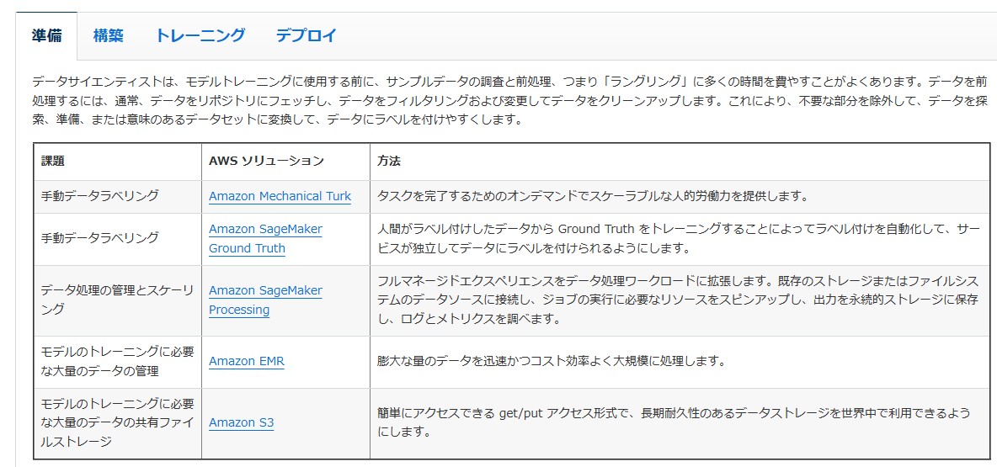


機械学習系
準備

Slide 3
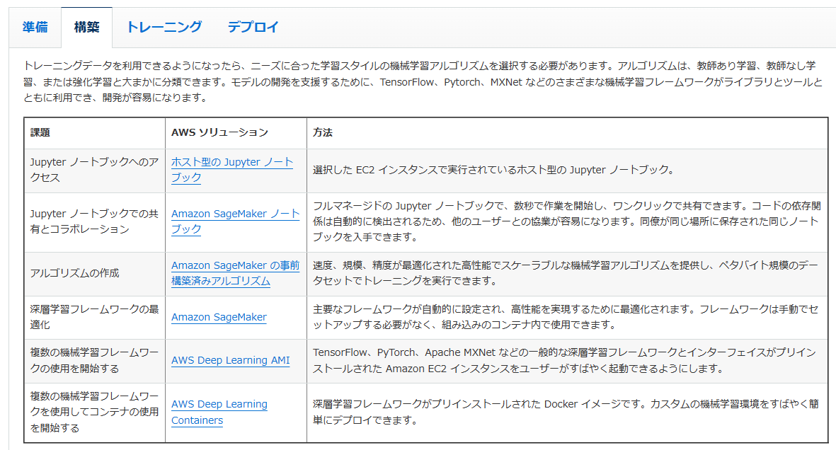


機械学習系
構築

Slide 4
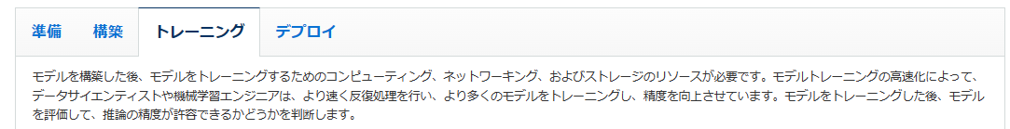
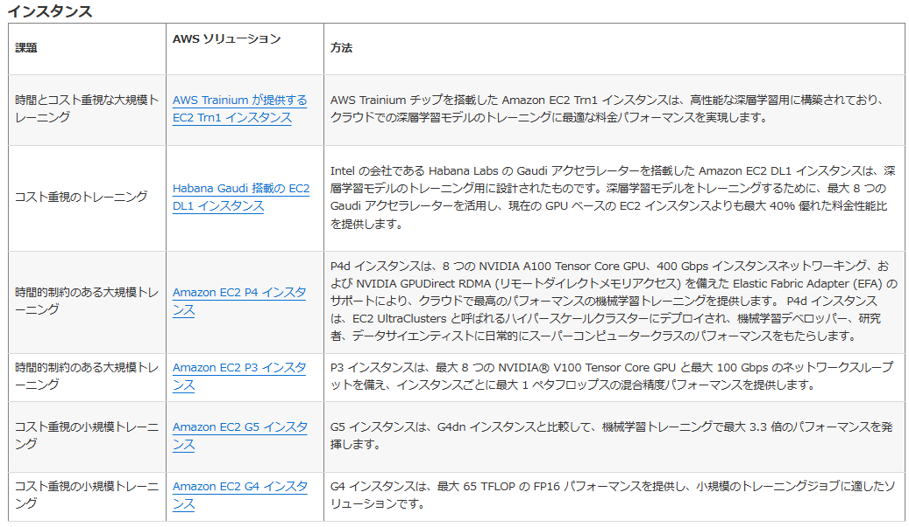
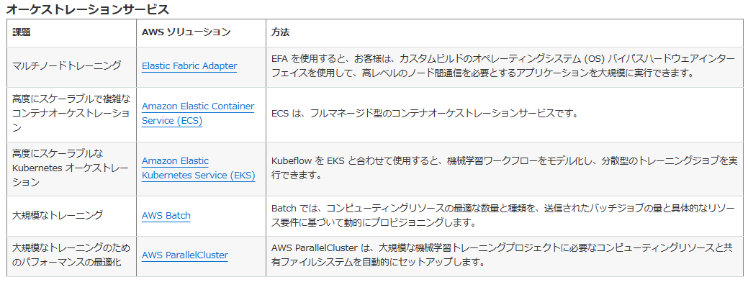




機械学習系
トレーニング

Slide 5
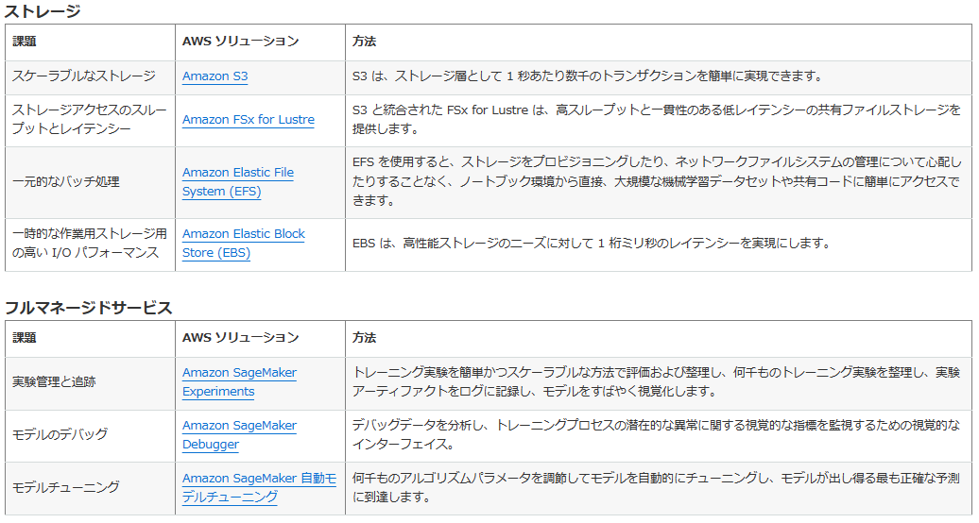



機械学習系
トレーニング

Slide 6
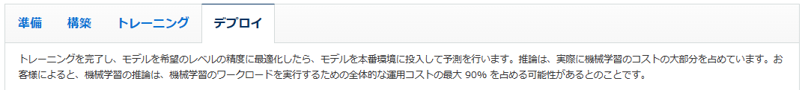
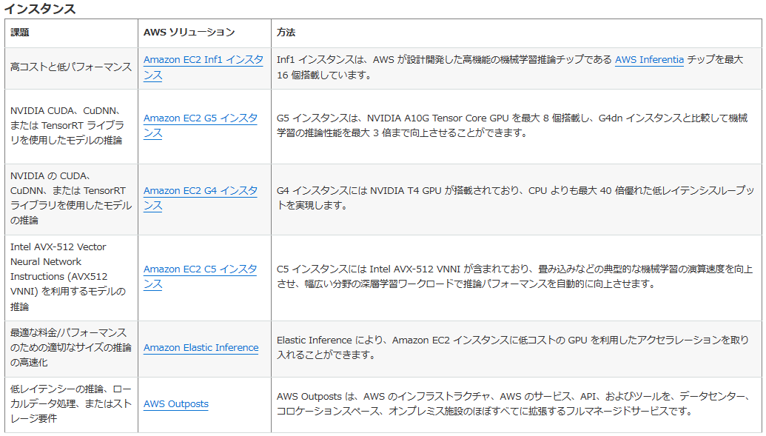
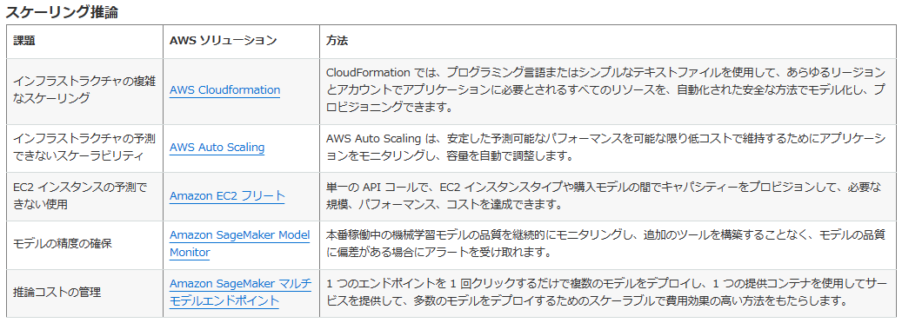





機械学習系
デプロイ

Slide 7
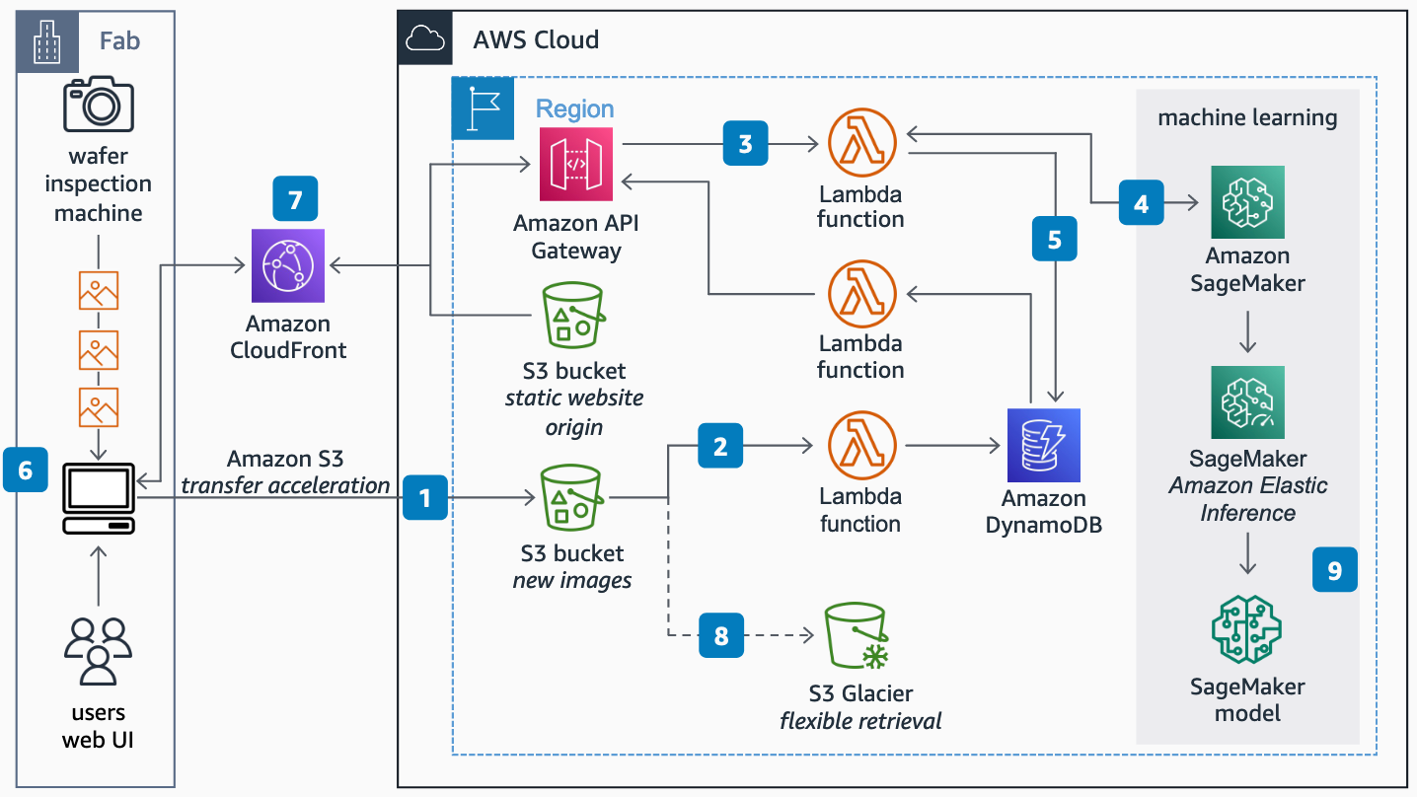
ウェーハの外観検査
Users upload images from wafer inspection to an Amazon Simple Storage Service (Amazon S3) bucket through a web user interface (UI) using transfer acceleration.
Amazon S3 calls an AWS Lambda function, logging the new image location in an DynamoDB table.
The web interface calls an Amazon API Gateway instance with the images metadata, which is stored in Amazon DynamoDB by a second Lambda function.
The Lambda function calls Amazon SageMaker for inference. Amazon Elastic Inference lowers the cost of inference by only attaching a graphics processing unit (GPU) when data needs to be processed.
The Lambda function adds the Inference results to the Amazon DynamoDB table.
Users are notified in the UI of detected defects. The UI fetches the image and metadata of the defected wafer from Amazon API Gateway. Wafers without defects move faster to the next step.
To accelerate user access to the image and inference results Amazon CloudFront caches both static content and API calls.
Amazon S3 lifecycle policies move older images to cold storage for cost optimization.
Images analyzed by engineers are added to the next model-training datasets to improve inference accuracy.

Slide 8
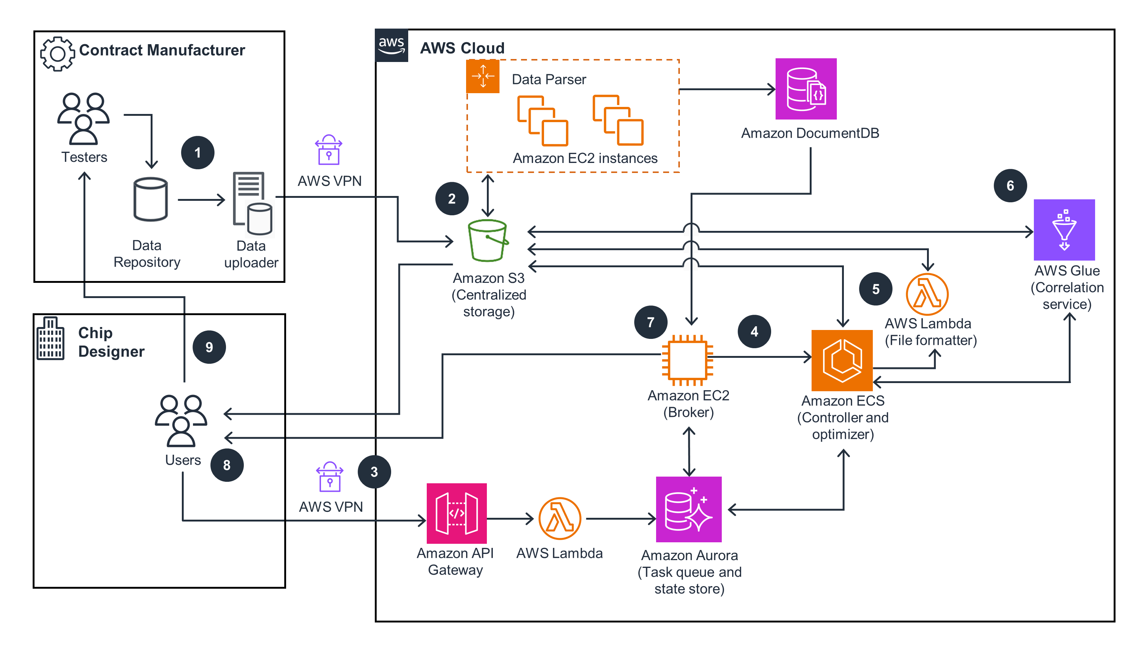
A tester stages data on the data repository and uses the data uploader to upload data to an Amazon Simple Storage Service (Amazon S3) bucket for centralized storage.
Amazon Elastic Compute Cloud (Amazon EC2) instances along with Amazon EC2 Auto Scaling parse data into test files. Data is stored in the S3 bucket and a database in Amazon DocumentDB.
A user submits a Dynamic Parameter Reduction (DPR) request through Amazon API Gateway. An AWS Lambda function stores the request in the task queue and state store in an Amazon Aurora database.
The broker (EC2 instance) pulls the DPR request from the task queue, queries data from Amazon DocumentDB, updates the requested input state store, and invokes the controller.
The controller, running on Amazon Elastic Container Service (Amazon ECS), initiates Lambda, which is running the file formatter, to prepare data in the S3 bucket. The file formatter updates the status in the Aurora state store.
The controller also initiates the correlation service running on AWS Glue, and the results are sent to the Optimizer (Amazon ECS). The S3 bucket stores optimized results.
The broker is notified that the DPR job completed from state store, and the user receives a notification email.
User(s) collect results from the S3 bucket.
After the results are reviewed, the user adjusts parameters and provides these new parameters to testers to drive future testing.

