Slide 1



Urba Ali Awan
Week 3
Student of CIT

Slide 2
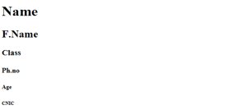
Heading
<h1>----</h1>
Why we use h1 tag in html?
The <h1> to <h6> tags are used to define HTML headings.
The H1 is an HTML tag that indicates a heading on a website.
Example:

Slide 3
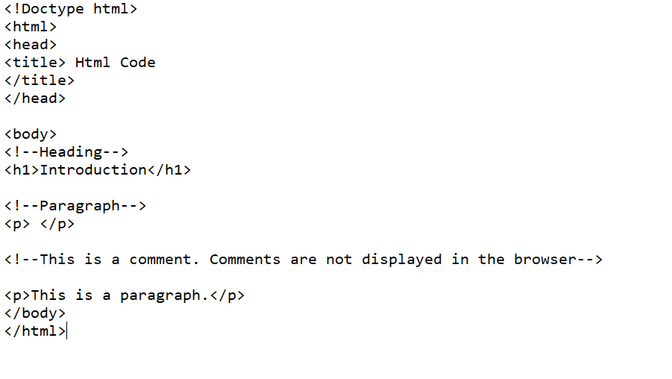
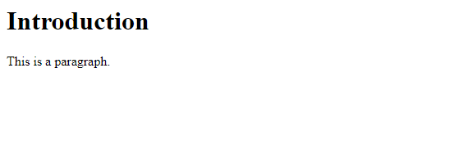
Comment
Example:
<!--Comment-->
Why we used comment tag in html?
You can use comments to explain your code. Comments are not displayed in the browsers.
Output :

Slide 4
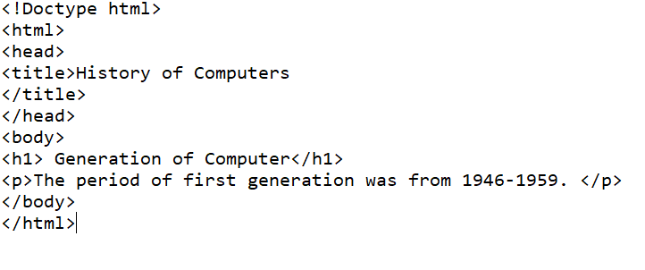
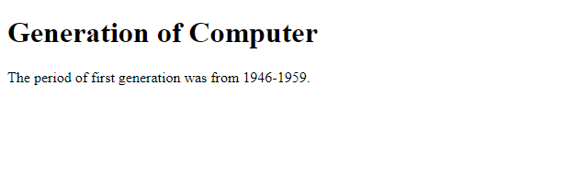
Paragraph
Example:
<p>-----</p>
Why we used paragraph tag in html?
When writing in html, the <p> tag is a block element used to designate a paragraph.
Output

Slide 5
Doctype html
<!Doctype html>
Why we used doctype html tag in html?
Doctype tag is used to inform the browser about the version of html used in the document.

Slide 6

Title
<title>----</title>
Why we used title tag in html?
HTML title tag is used to name a document.
Example: Output

Slide 7
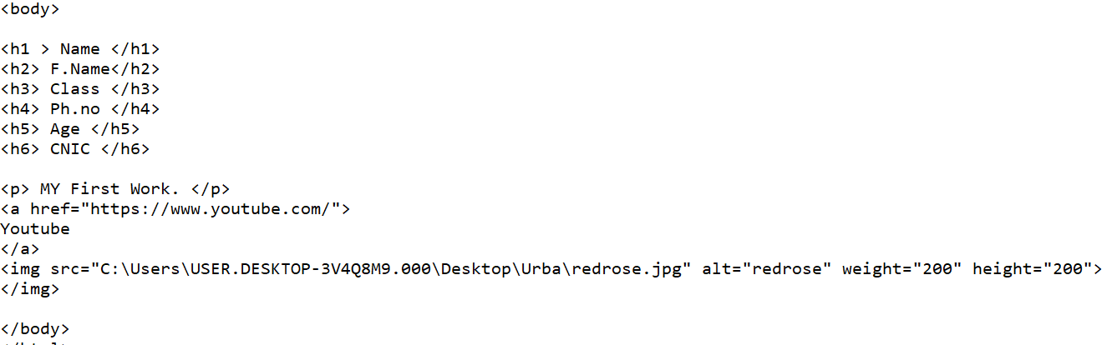
Body
Example:
<body>-----</body>
Why we use body tag in html?
The<body> element contains all the contents of an HTML document, such as headings, paragraphs, images, hyperlinks, tables, lists, etc.

Slide 8

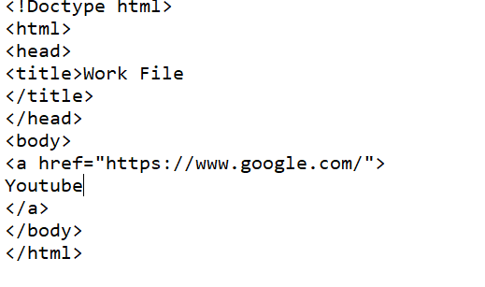

A
<a href>-----</a>
Why we use a tag in html?
You can use the <a> tag to link text or images.
Example: Output

Slide 9
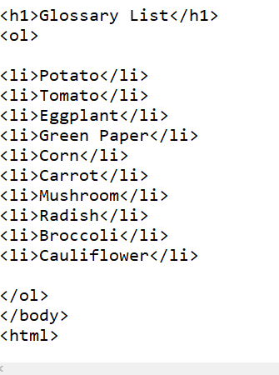
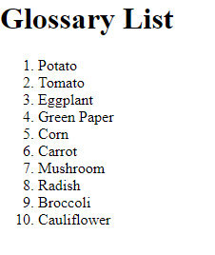
Order List
Example:
<ol>----<li>---</li></ol>
Why we use ol tag in html?
The ol tag defines an ordered list.
Li is used to include items in a list.
Output

Slide 10

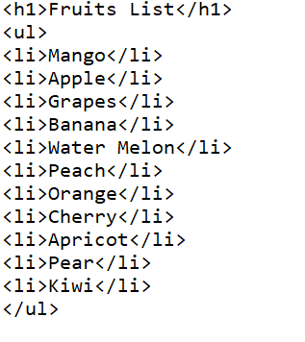
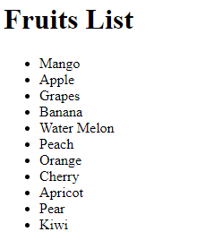
Unordered List
<ul>----<li>---</li></ul>
Why we use ul tag in html?
the ul element is used to define an unordered list of items it is useful for creating bulleted list.
Example: Output

Slide 11
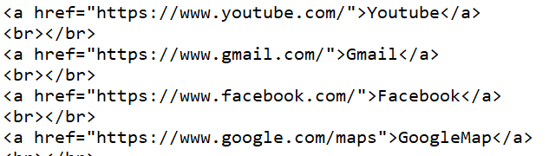
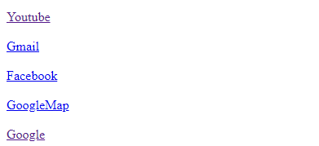
br
<br>---</br>
Why we use br tag in html?
It is use to break the line.
Example: Output

Slide 12
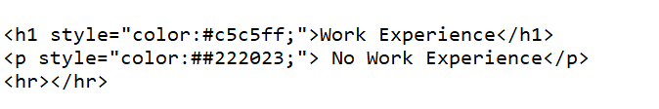
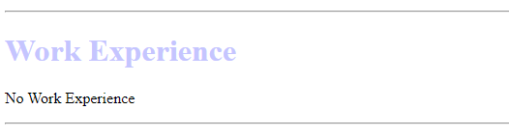
hr
Example:
<hr>---</hr>
Why we use hr tag in html?
It is use to a horizontal line.
Output

Slide 13

Sup
<sup>---</sup>
Why we use sup tag in html?
Superscript text can be used for mathematics.
Example: Output

Slide 14


sub
<sub>---</sub>
Why we use sub tag in html?
Subscript text can be used for chemical formulas, like H2O.
Example: Output

Slide 15
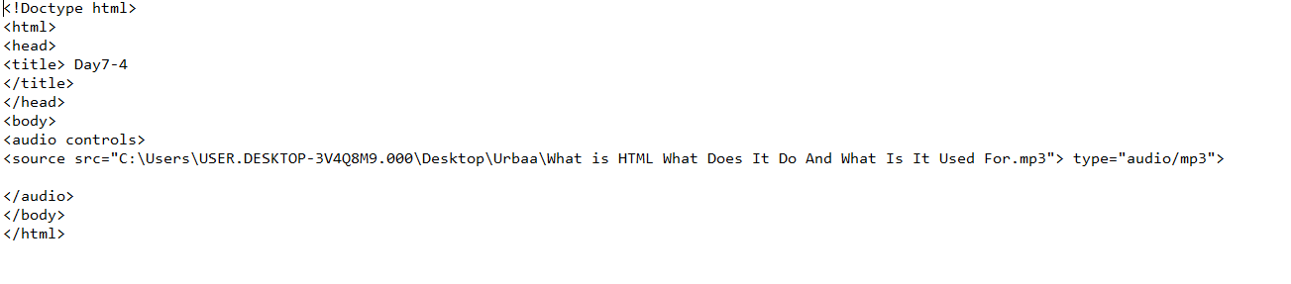
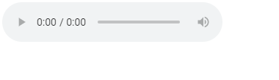
Audio
Example:
<audio>---</audio>
Why we use audio tag in html?
The <audio> tag is used to embed sound content in a document, such as music or other audio streams.
Output

Slide 16


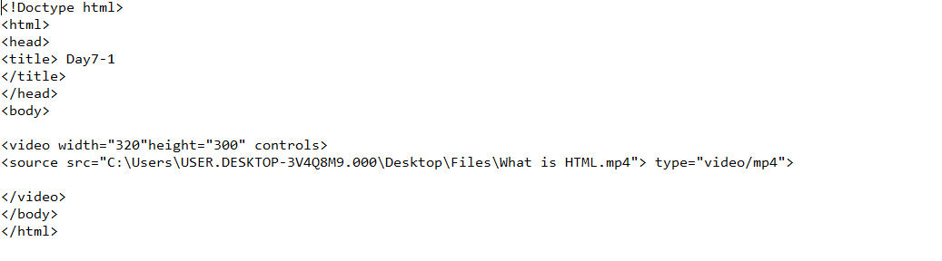
video
<video>----</video>
Why we use video tag in html?
The <video> tag is used to embed video content in a document, such as a movie clip or other video streams.
Example: Output

Slide 17
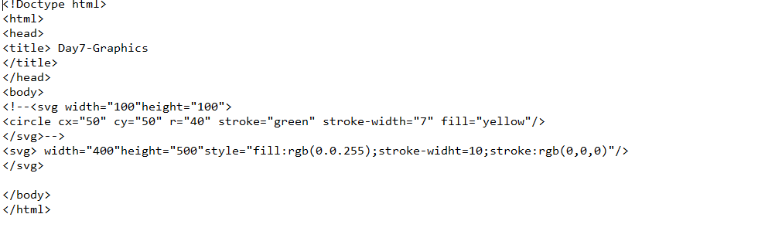
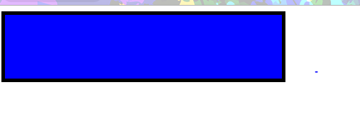
Svg
Example:
<svg>---</svg>
Why we use svg tag in html?
SVG stand Scalble Vector Graphics.
SVG has several methods for drawing paths, boxes, circles, text, and graphic images.
Output

Slide 18
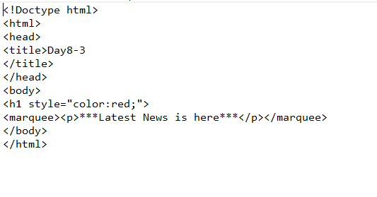
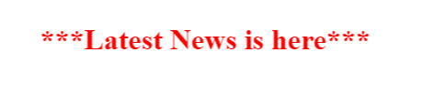
Marquee
Example:
<marquee>------</marquee>
The marquee tag is a non-standard HTML element which causes text to scroll up, down, left or right automatically.
Click to add OOutput

Slide 19
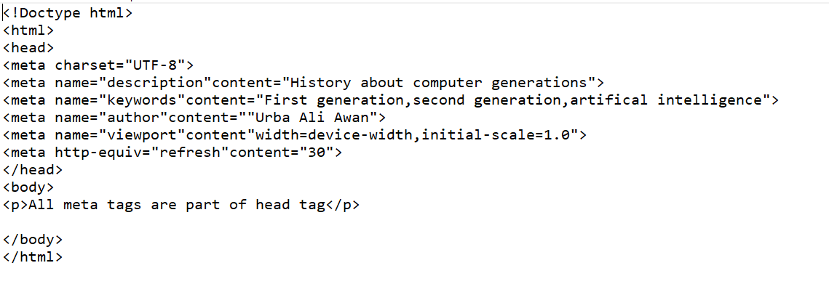

Meta
Why we use meta tag in html?
Metadata is data (information) about data.
The <meta> tag provides metadata about the HTML document. Metadata will not be displayed on the page
Example: Output

Slide 20

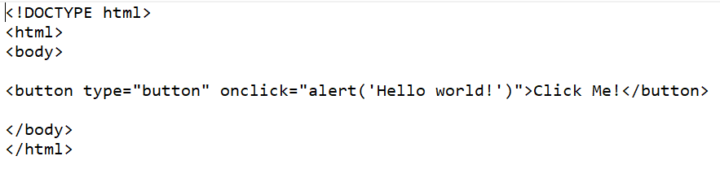
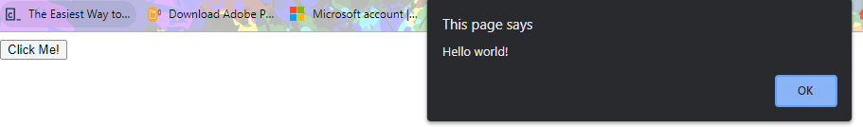
button
Why we use button tag in html?
<button> tag is used to submit the content.
Example: Output

Slide 21
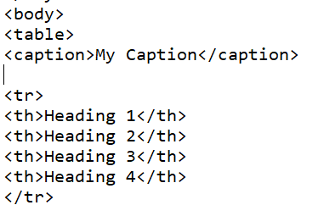

caption
<caption------</caption>
Why we use caption tag in html?
The <caption> tag defines a table caption.
Example: Output

Slide 22
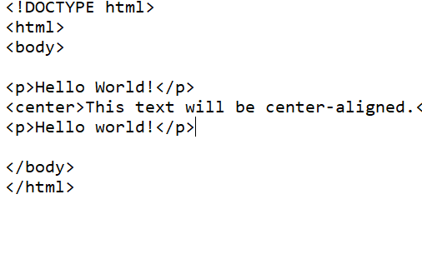
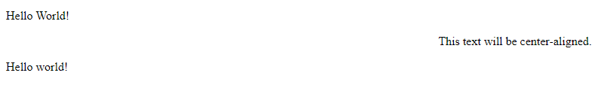
Center
<center>------</center>
Why we use center tag in html?
The <center> tag is used to center-align text.
Example: Output

Slide 23
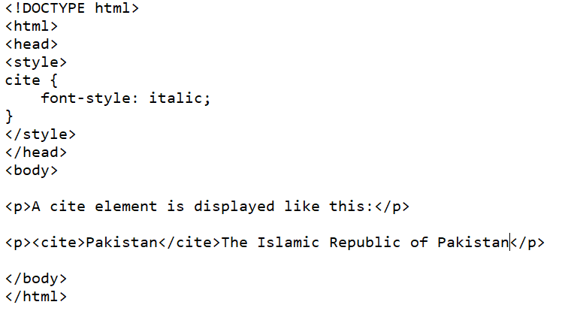
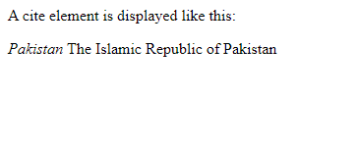
cite
Example:
<cite>-----</cite>
Why we use cite tag in html?
The <cite> tag defines the title of a work (e.g. a book, a song, a movie, a TV show, a painting, a sculpture, etc.)
Output

Slide 24
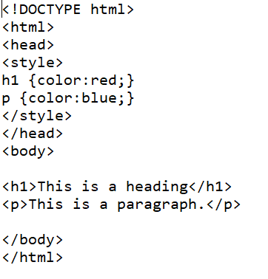
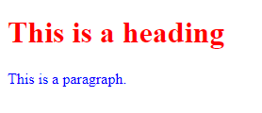
Style
Example:
<style>------</style>
Why we use style tag in html?
The <style> tag is used to define style information for an HTML document.
Output

Slide 25
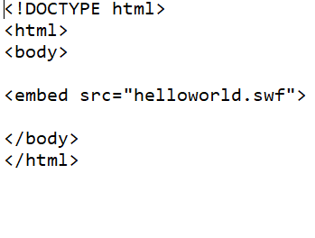

Embed
<embed>-----< /embed>
Why we use embed tag in html?
The <embed> tag defines a container for an external application or interactive content (a plug-in).
Example: Output

Slide 26
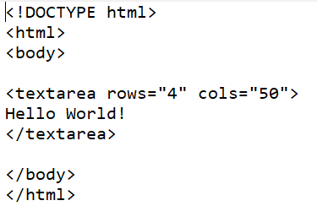

textarea
<textarea>-----</textarea>
Why we use textarea tag in html?
The <textarea> tag defines a multi-line text input control.
Example: Output

Slide 27
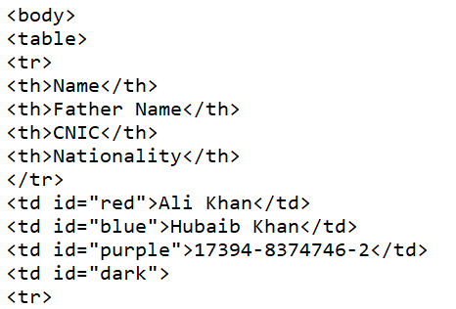
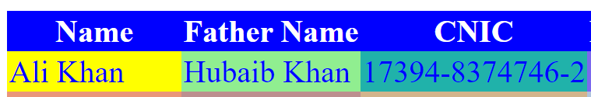
Table
Example:
<table>-----</table>
Why we use table tag in html?
The <table> tag defines an HTML table.
An HTML table consists of the <table> element and one or more <tr>, <th>, and <td> elements.
The <tr> element defines a table row, the <th> element defines a table header, and the <td> element defines a table cell.
Output

Slide 28
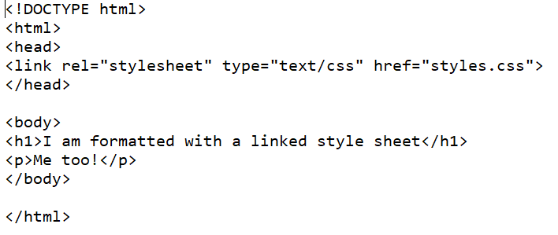
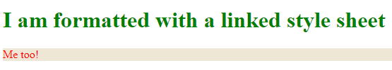
link
<link>-----</link>
Why we use link tag in html?
The <link> tag defines a link between a document and an external resource.
The <link> tag is used to link to external style sheets.
Example: Output

Slide 29
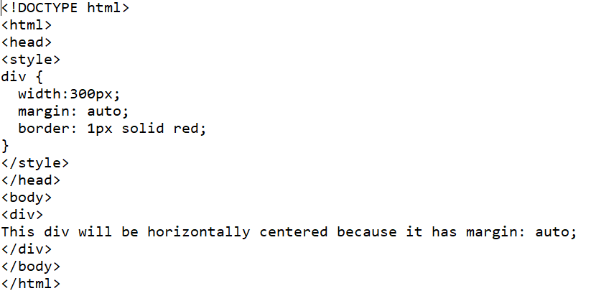
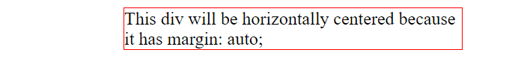
div
Example:
<div>------</div>
Why we use div tag in html?
The div tag is used in HTML to make divisions of content in the web page like (text, images, header, footer, navigation bar, etc).
Output

Slide 30
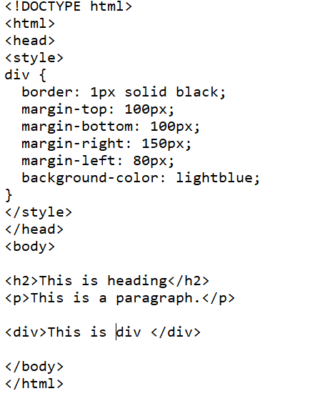
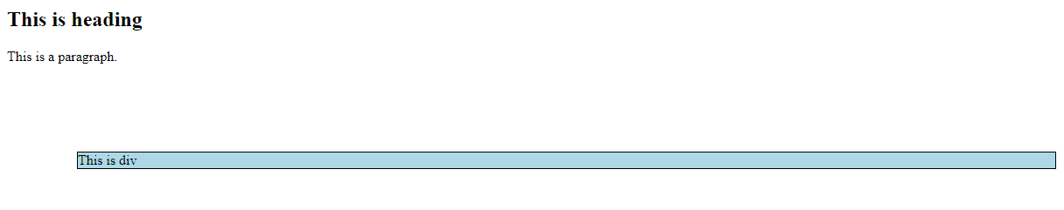
Margin
Example:
<margin>----</margin>
Why we use margin tag in html?
HTML margin-left sets the margin area on the left side of an element.
CSS has properties for specifying the margin for each side of an element:
margin-top:
margin-bottom:
margin-right:
margin-left:
Output:

Slide 31

Thank You!

