Slide 1



Urba Ali Awan
Week 3
Student of CIT

Slide 2
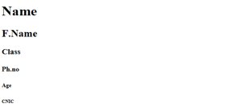
Heading
<h1>----</h1>
Why we use h1 tag in html?
The <h1> to <h6> tags are used to define HTML headings.
The H1 is an HTML tag that indicates a heading on a website.
Example:

Slide 3
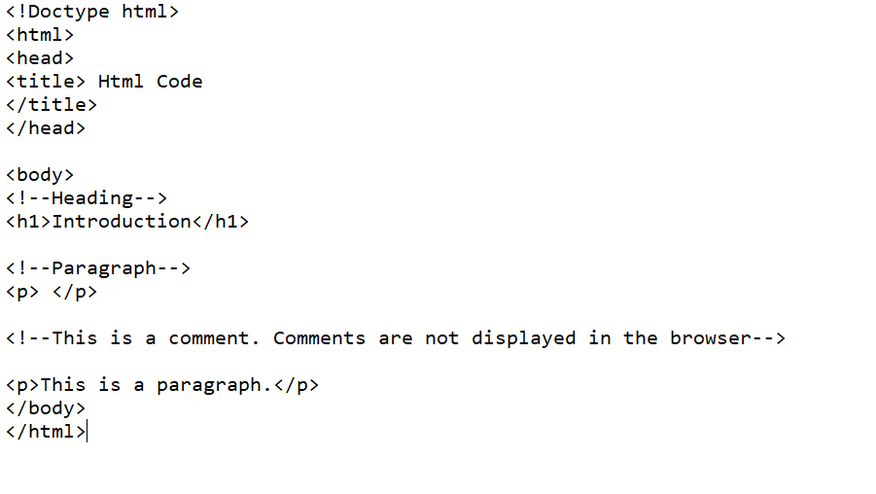
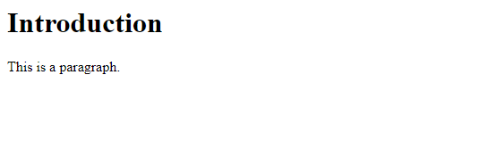
Comment
Example:
<!--Comment-->
Why we used comment tag in html?
You can use comments to explain your code. Comments are not displayed in the browsers.
Output :

Slide 4
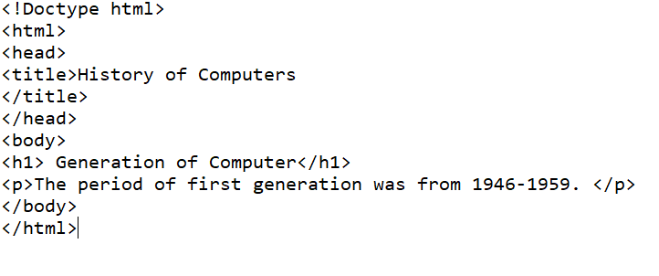
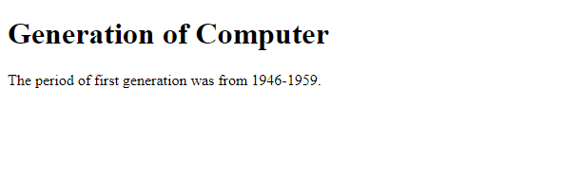
Paragraph
Example:
<p>-----</p>
Why we used paragraph tag in html?
When writing in html, the <p> tag is a block element used to designate a paragraph.
Output

Slide 5
Doctype html
<!Doctype html>
Why we used doctype html tag in html?
Doctype tag is used to inform the browser about the version of html used in the document.

Slide 6

Title
<title>----</title>
Why we used title tag in html?
HTML title tag is used to name a document.
Example: Output

Slide 7
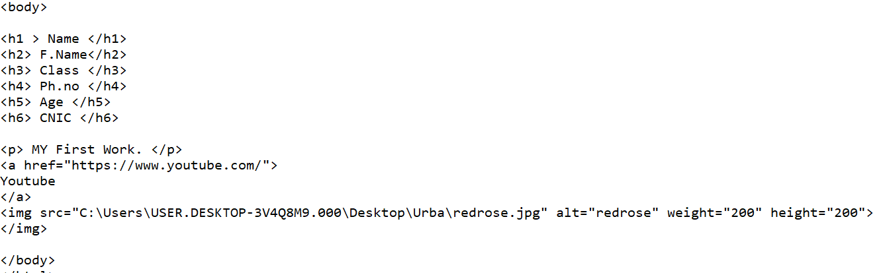
Body
Example:
<body>-----</body>
Why we use body tag in html?
The<body> element contains all the contents of an HTML document, such as headings, paragraphs, images, hyperlinks, tables, lists, etc.

Slide 8

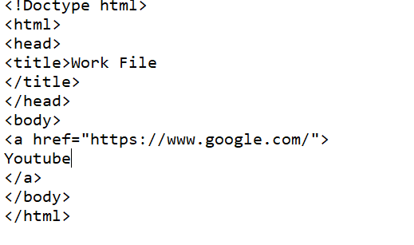

A
<a href>-----</a>
Why we use a tag in html?
You can use the <a> tag to link text or images.
Example: Output

Slide 9
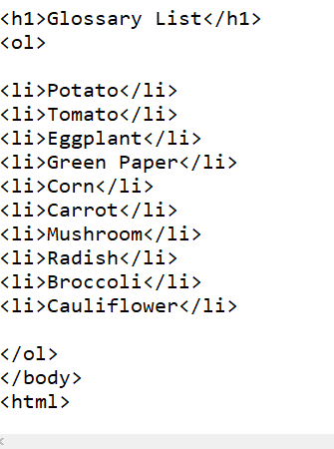
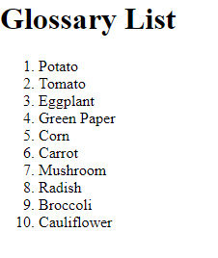
Order List
Example:
<ol>----<li>---</li></ol>
Why we use ol tag in html?
The ol tag defines an ordered list.
Li is used to include items in a list.
Output

Slide 10

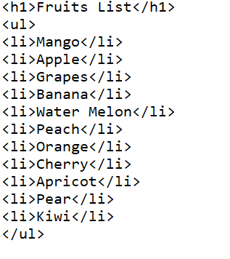
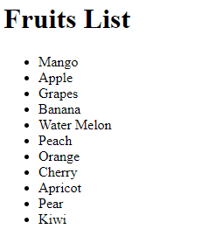
Unordered List
<ul>----<li>---</li></ul>
Why we use ul tag in html?
the ul element is used to define an unordered list of items it is useful for creating bulleted list.
Example: Output

Slide 11
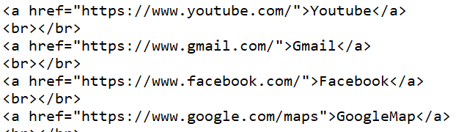
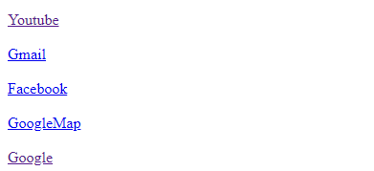
br
<br>---</br>
Why we use br tag in html?
It is use to break the line.
Example: Output

Slide 12
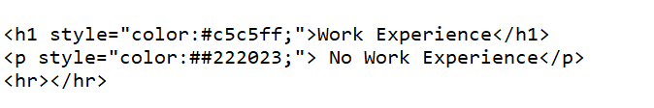
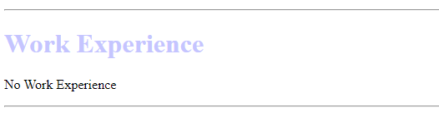
hr
Example:
<hr>---</hr>
Why we use hr tag in html?
It is use to a horizontal line.
Output

Slide 13

Sup
<sup>---</sup>
Why we use sup tag in html?
Superscript text can be used for mathematics.
Example: Output

Slide 14


sub
<sub>---</sub>
Why we use sub tag in html?
Subscript text can be used for chemical formulas, like H2O.
Example: Output

Slide 15
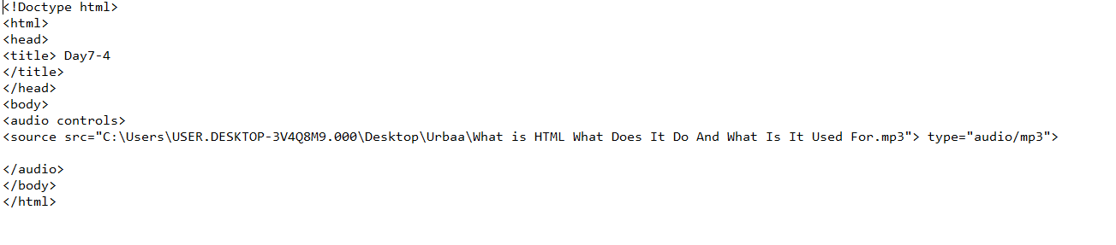
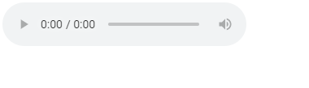
Audio
Example:
<audio>---</audio>
Why we use audio tag in html?
The <audio> tag is used to embed sound content in a document, such as music or other audio streams.
Output

Slide 16

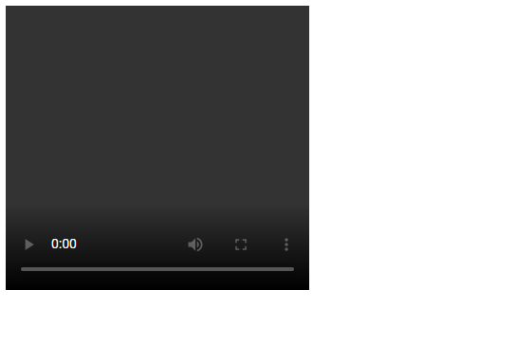
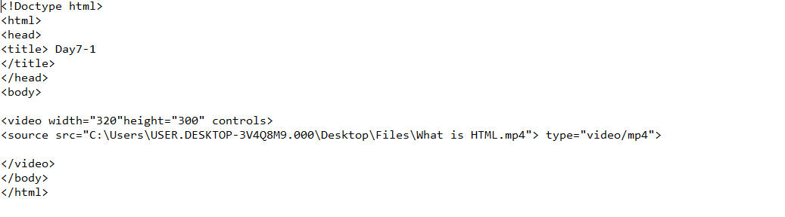
video
<video>----</video>
Why we use video tag in html?
The <video> tag is used to embed video content in a document, such as a movie clip or other video streams.
Example: Output

Slide 17
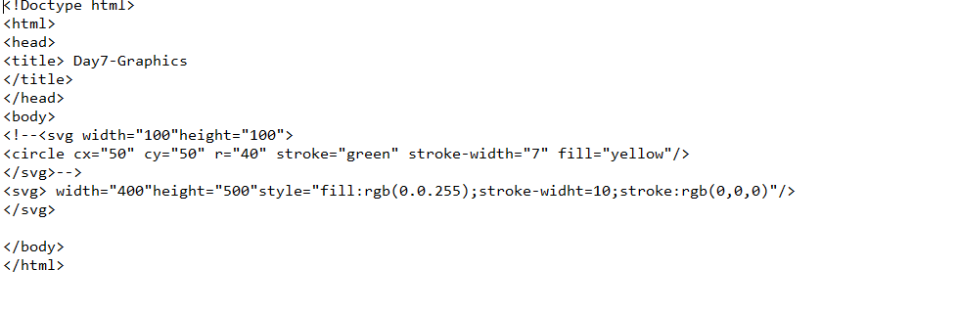
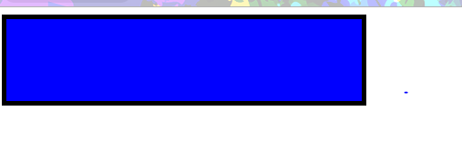
Svg
Example:
<svg>---</svg>
Why we use svg tag in html?
SVG stand Scalble Vector Graphics.
SVG has several methods for drawing paths, boxes, circles, text, and graphic images.
Output

Slide 18
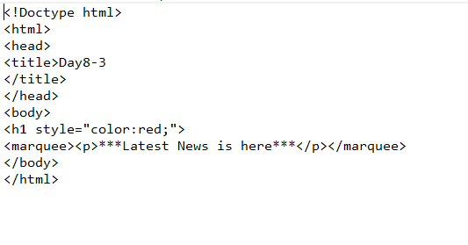
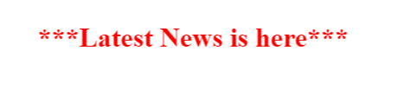
Marquee
Example:
<marquee>------</marquee>
The marquee tag is a non-standard HTML element which causes text to scroll up, down, left or right automatically.
Click to add OOutput

Slide 19
Thank You!

