Slide 1
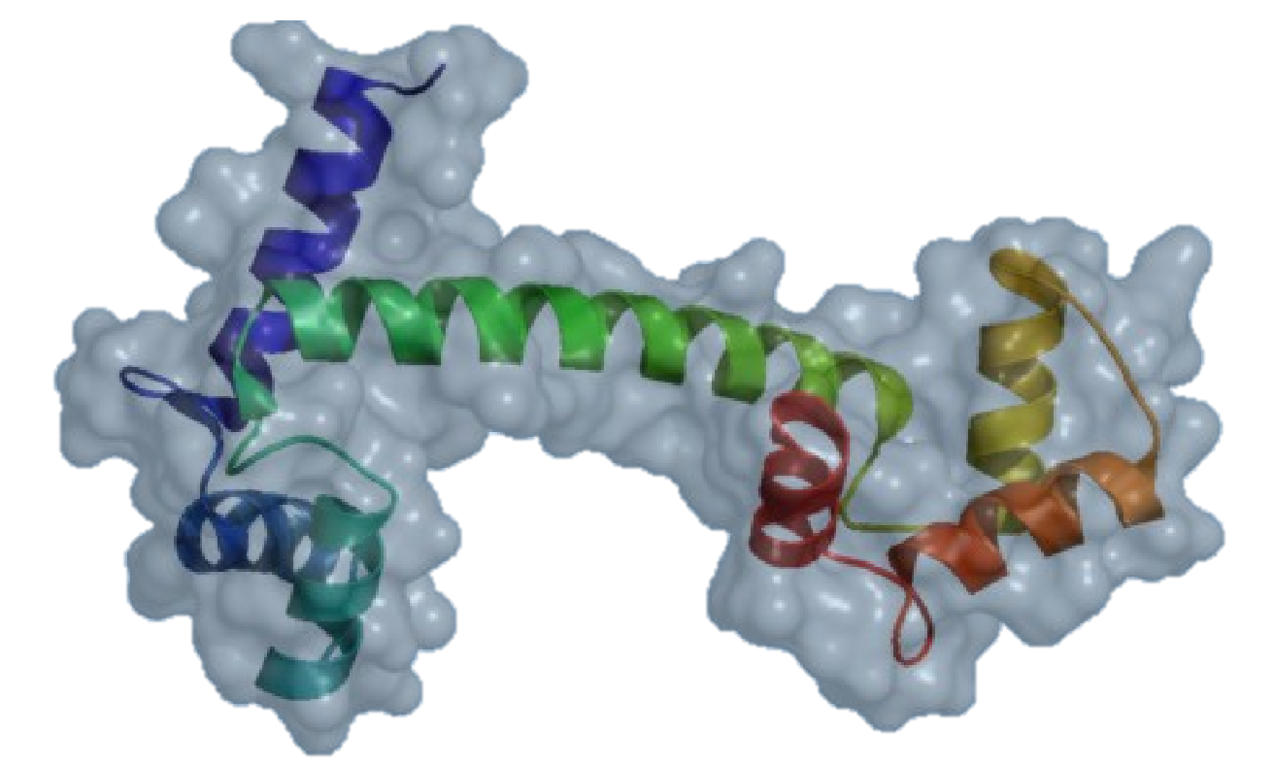
Open-Source PyMOL™
Initially developed by DeLano Scientific and now maintained by Schrödinger.
Unofficial PyMOL™ Executable – Copyright Schrödinger, LLC
To obtain the official incentive PyMOL executables with maintenance and support, visit https://www.pymol.org/

