Slide 1
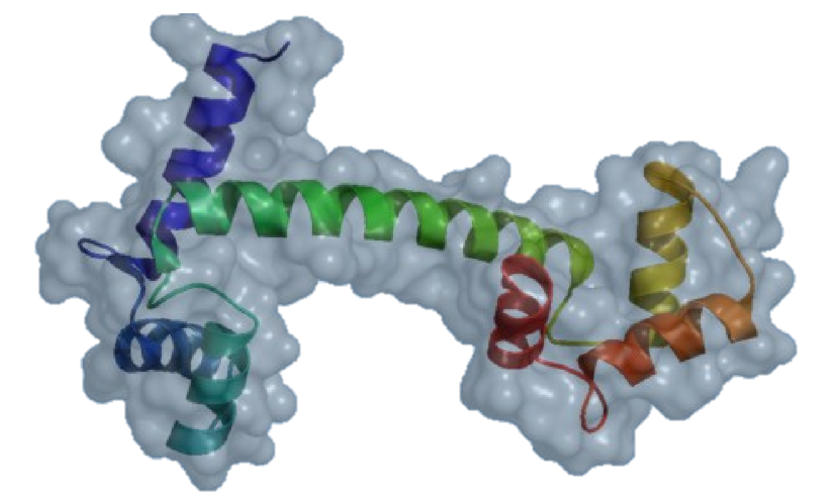
Open-Source PyMOL™
Initially developed by DeLano Scientific and now maintained by Schrödinger.
Unofficial PyMOL™ Executable – Copyright Schrödinger, LLC
To obtain the official incentive PyMOL executables with maintenance and support, visit https://www.pymol.org/

Slide 2
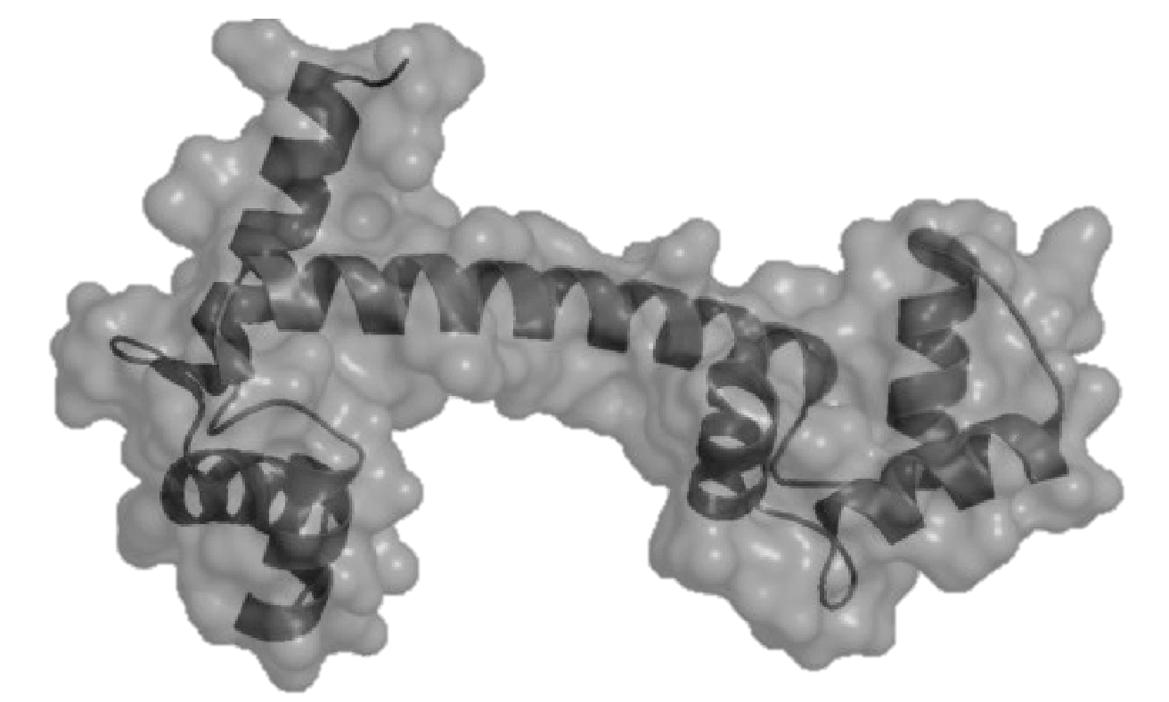
Open-Source PyMOL™
Unofficial Windows PyMOL™ Executable – Copyright © Schrödinger, LLC
Initially developed by Warren L. DeLano and now maintained by Schrödinger LLC.
This is a custom PyMOL Executable Build for the Windows operating system.
PyMOL was initially a project by Warren L. DeLano and mainly developed by DeLano Scientific LLC and is now maintained by Schrödinger LLC.
Many thanks to all the developers and especially to Warren for giving the world a free and open-source software to visualize the molecular world.
NOTICE: To obtain the official incentive PyMOL executables with maintenance and support, visit https://www.pymol.org/

Slide 3

Open-Source PyMOL™

