Slide 1





Number of Variables
One
More than one
Type of
Variables
Type of
Variables
Numeric &
Categorical
Numeric
Categorical
Numeric
Categorical
Histogram
Bar Plot
Scatter Plot
2-way Table
Box Plot
Designed by Andy Hong (andyhong.org)

Slide 2


Slide 3
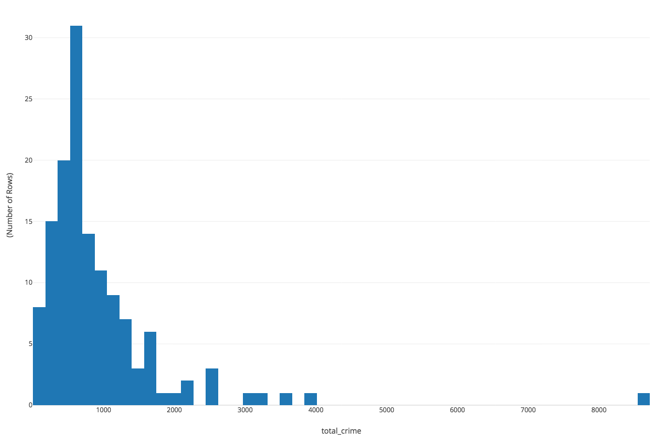
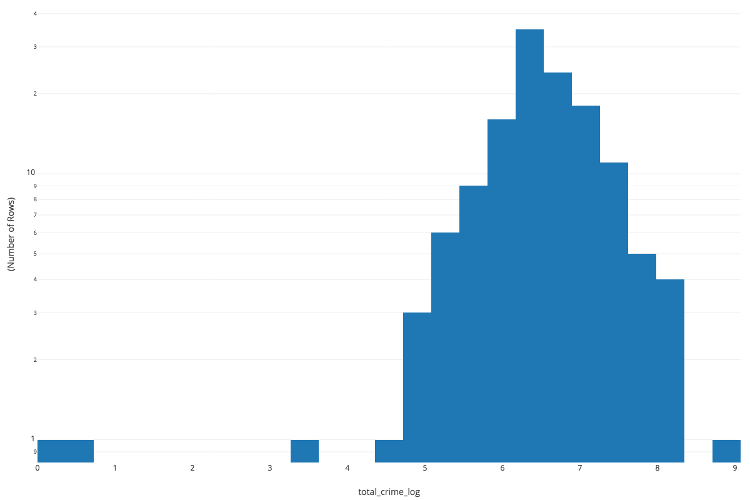
Total Crime
Log of Total Crime

Slide 4
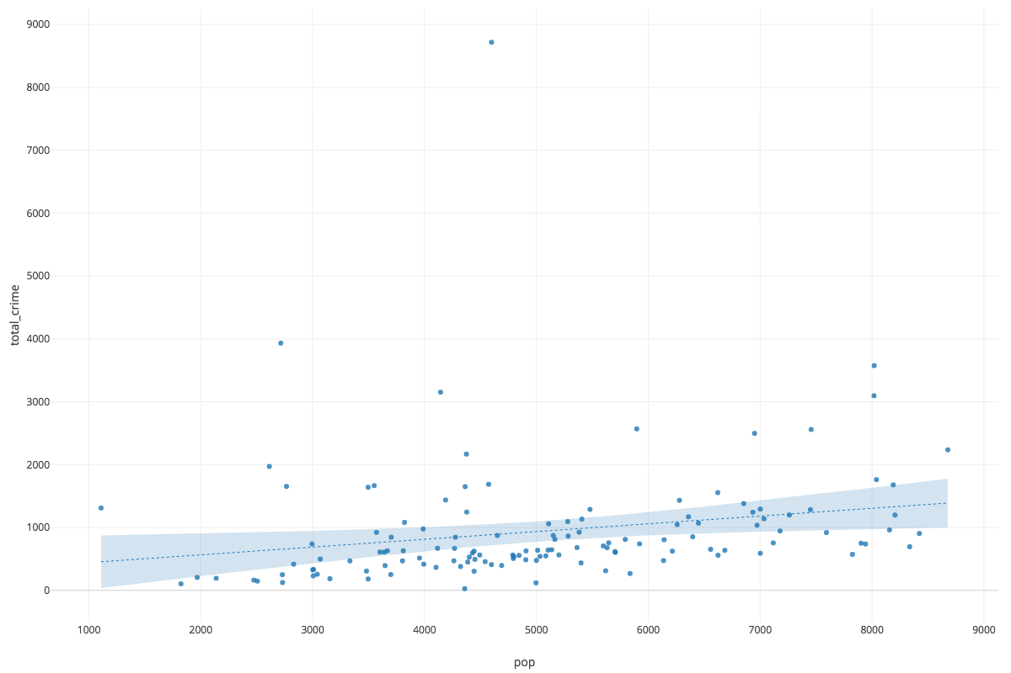
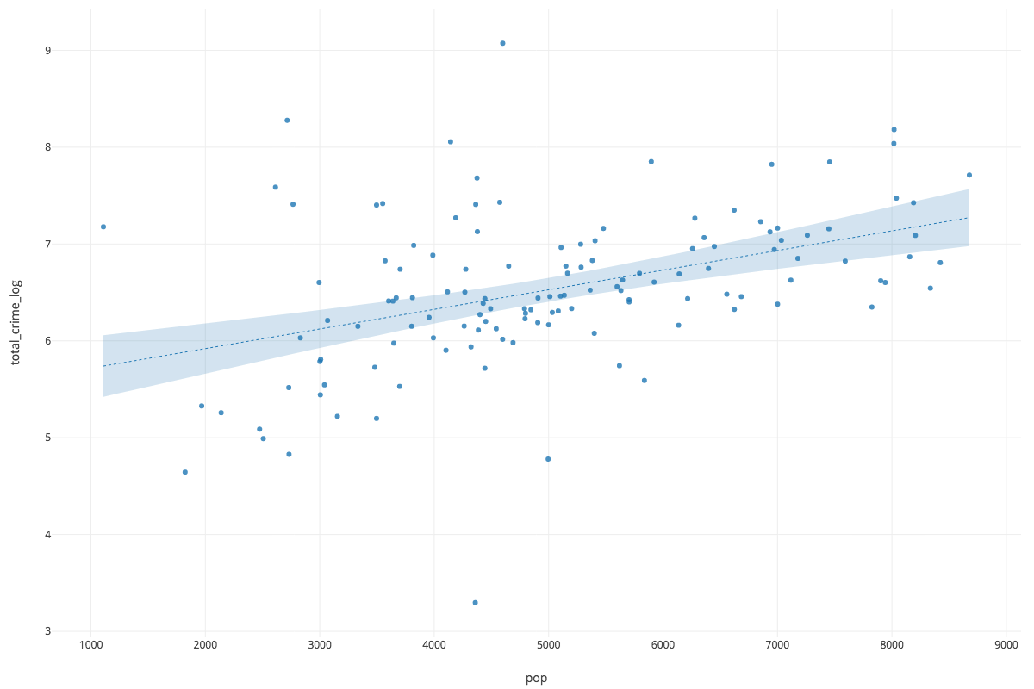
Total Crime
Log of Total Crime

Slide 5


Slide 6
Covariance

