Slide 1
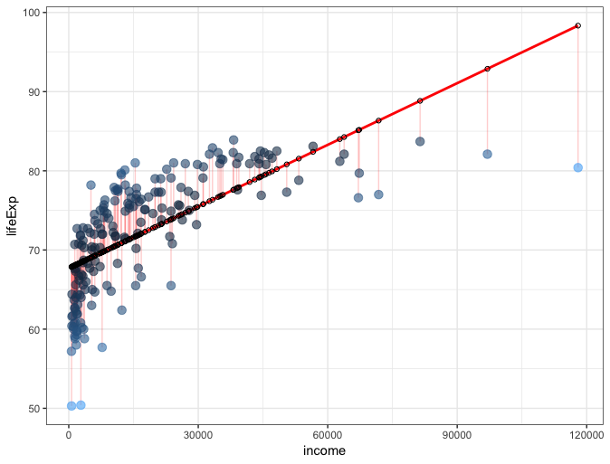

Slide 2
Regression Line

Slide 3
Regression Line
Observed y

Slide 4
Regression Line
ŷ predicted from x
Observed y

Slide 5
Regression Line
ŷ predicted from x
Residual (y – ŷ)
Observed y

