Slide 1

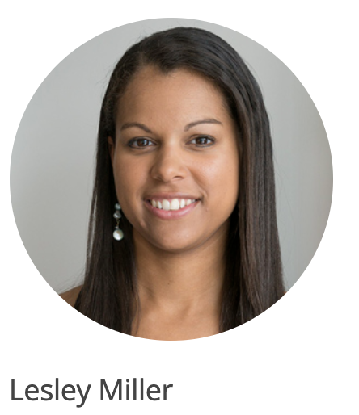



Slide 2
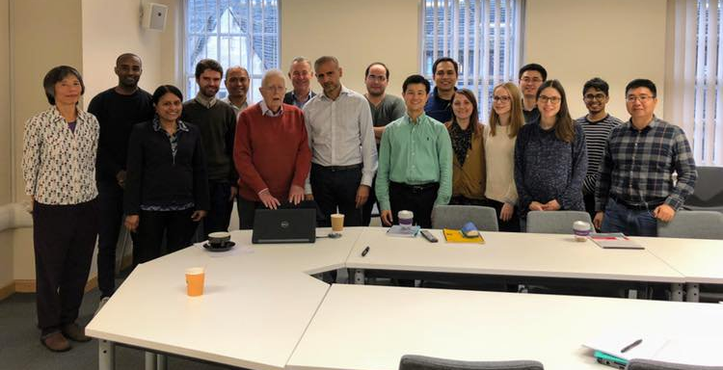
Sir David Cox’s Special Lecture
Nov 7, 2018 @ The George Institute for Global Health, UK

Slide 3
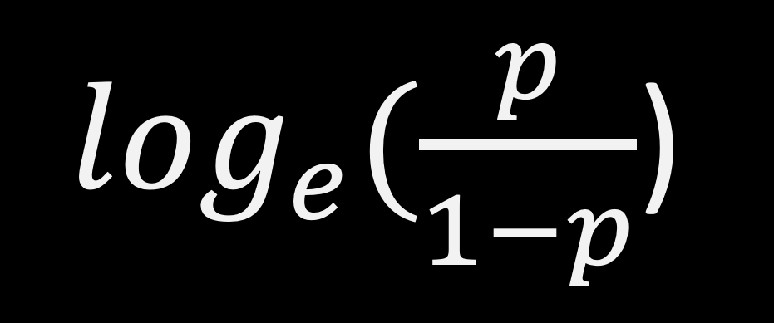
$\log_{e}(\frac{p}{1−p}$)

Slide 4
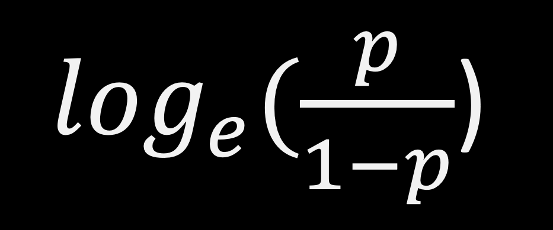
$\log_{e}(\frac{p}{1−p}$)
Odds

Slide 5

Probability of event
(e.g. probability of winning)
$$Odds =\frac{p}{1−p}$$
Probability of non-event
(e.g. probability of losing)
Odds Ratio is the relative chance of an event happening under two different conditions. It is the odds that the outcome will occur in one condition, compared to the odds in the absence of that condition.

Slide 6
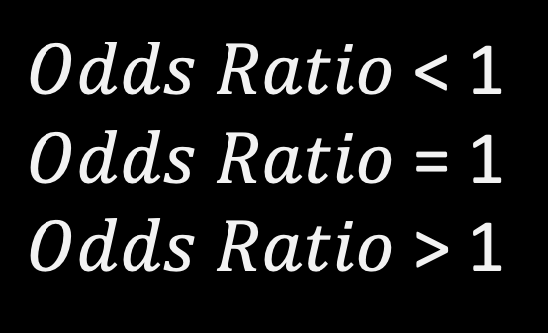
$Odds Ratio$ < 1
$Odds Ratio$ = 1
$Odds Ratio$ > 1
Decreased occurrence of event
No association
Increased occurrence of event
Ex) Odds of having a cancer for Smoker vs Non-smoker
50% less odds for smoker to have a cancer
OR = 0.5
OR = 2
twice more odds for smoker to have a cancer

