Slide 1

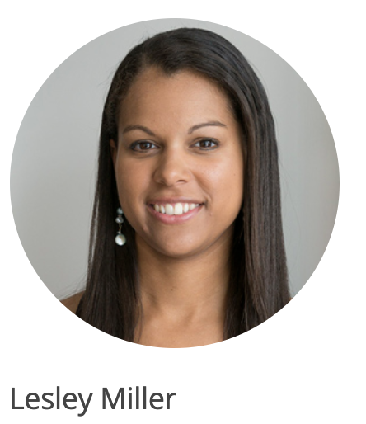



Slide 2
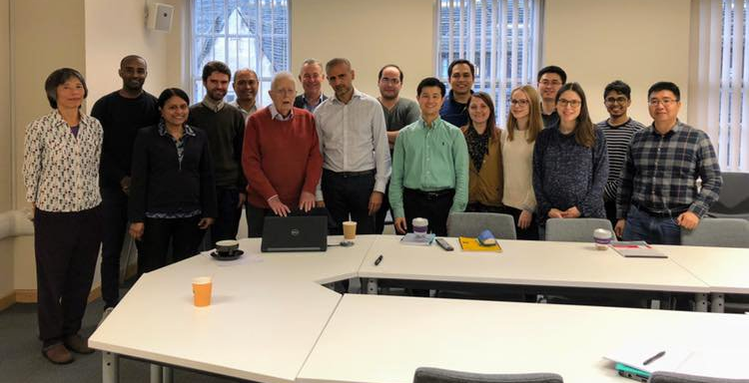
Sir David Cox’s Special Lecture
Nov 7, 2018 @ The George Institute for Global Health, UK

Slide 3
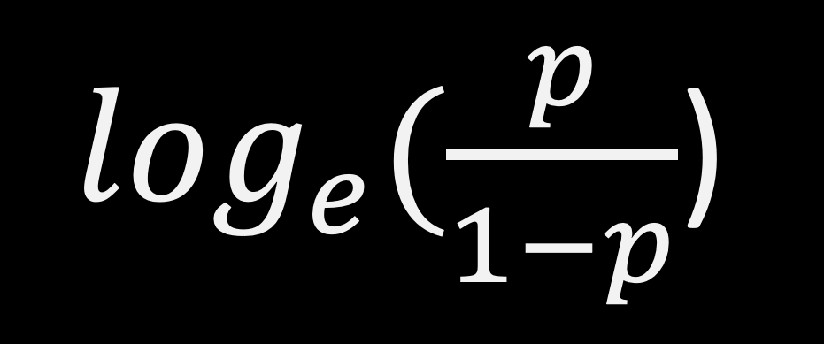
$\log_{e}(\frac{p}{1−p}$)

Slide 4
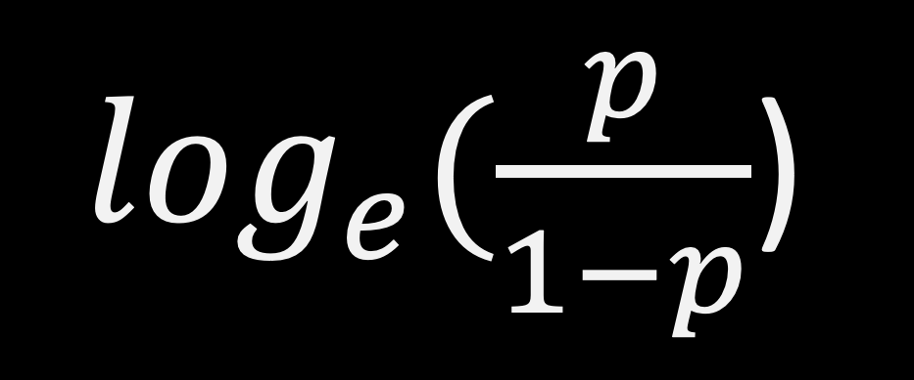
$\log_{e}(\frac{p}{1−p}$)
Odds

Slide 5

Probability of event
(e.g. probability of winning)
$$Odds =\frac{p}{1−p}$$
Probability of non-event
(e.g. probability of losing)
Odds Ratio is a measure of association between exposure and an outcome. Odds that the outcome will occur given a particular exposure, compared to the odds in the absence of that exposure

Slide 6
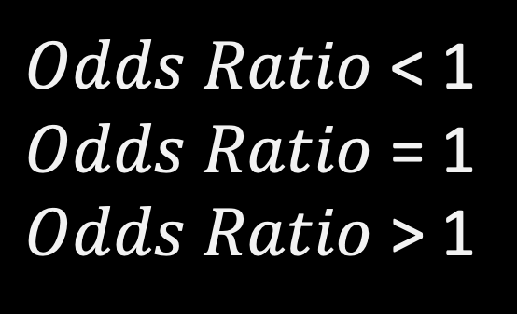
$Odds Ratio$ < 1
$Odds Ratio$ = 1
$Odds Ratio$ > 1
Decreased occurrence of event
No association
Increased occurrence of event
Ex) Odds of having a cancer for Smoker vs Non-smoker
50% less odds for smoker to have a cancer
OR = 0.5
OR = 2
twice more odds for smoker to have a cancer

