Slide 1

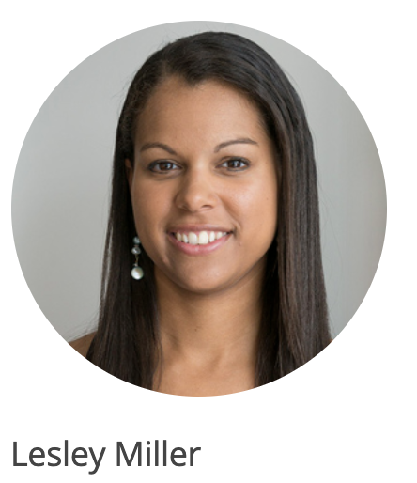



Slide 2
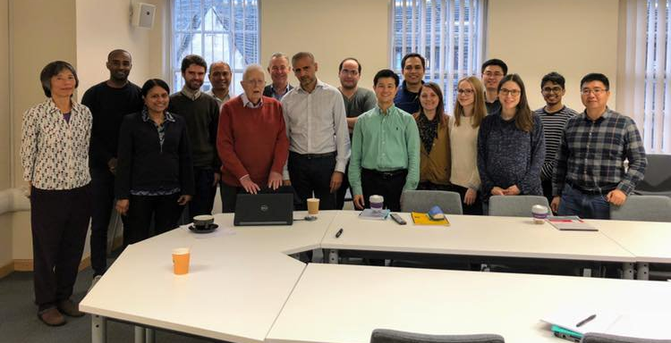
Sir David Cox’s Special Lecture
Nov 7, 2018 @ The George Institute for Global Health, UK

Slide 3

$\log_{e}(\frac{p}{1−p}$)

Slide 4

$\log_{e}(\frac{p}{1−p}$)
Odds Ratio

Slide 5

Odds of some event
(e.g. odds of winning)
$$Odds Ratio=\frac{p}{1−p}$$
Odds of the other event
(e.g. odds of losing)

Slide 6
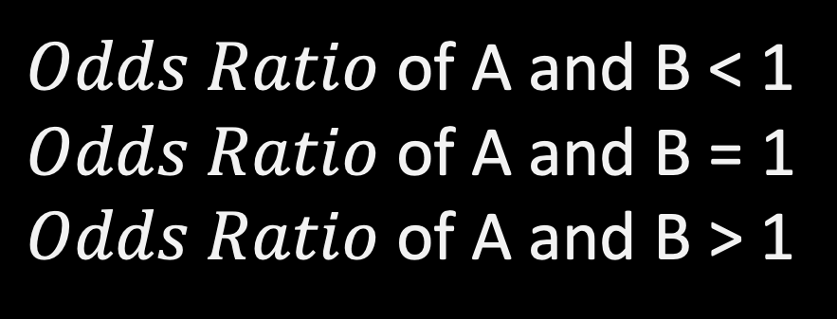
$Odds Ratio$ of A and B < 1
$Odds Ratio$ of A and B = 1
$Odds Ratio$ of A and B > 1
Negative association
No association
Positive association
Ex) Odds of having a cancer for Smoker vs Non-smoker
50% less odds for smoker to have a cancer
OR = 0.5
OR = 2
twice more odds for smoker to have a cancer

