Slide 1
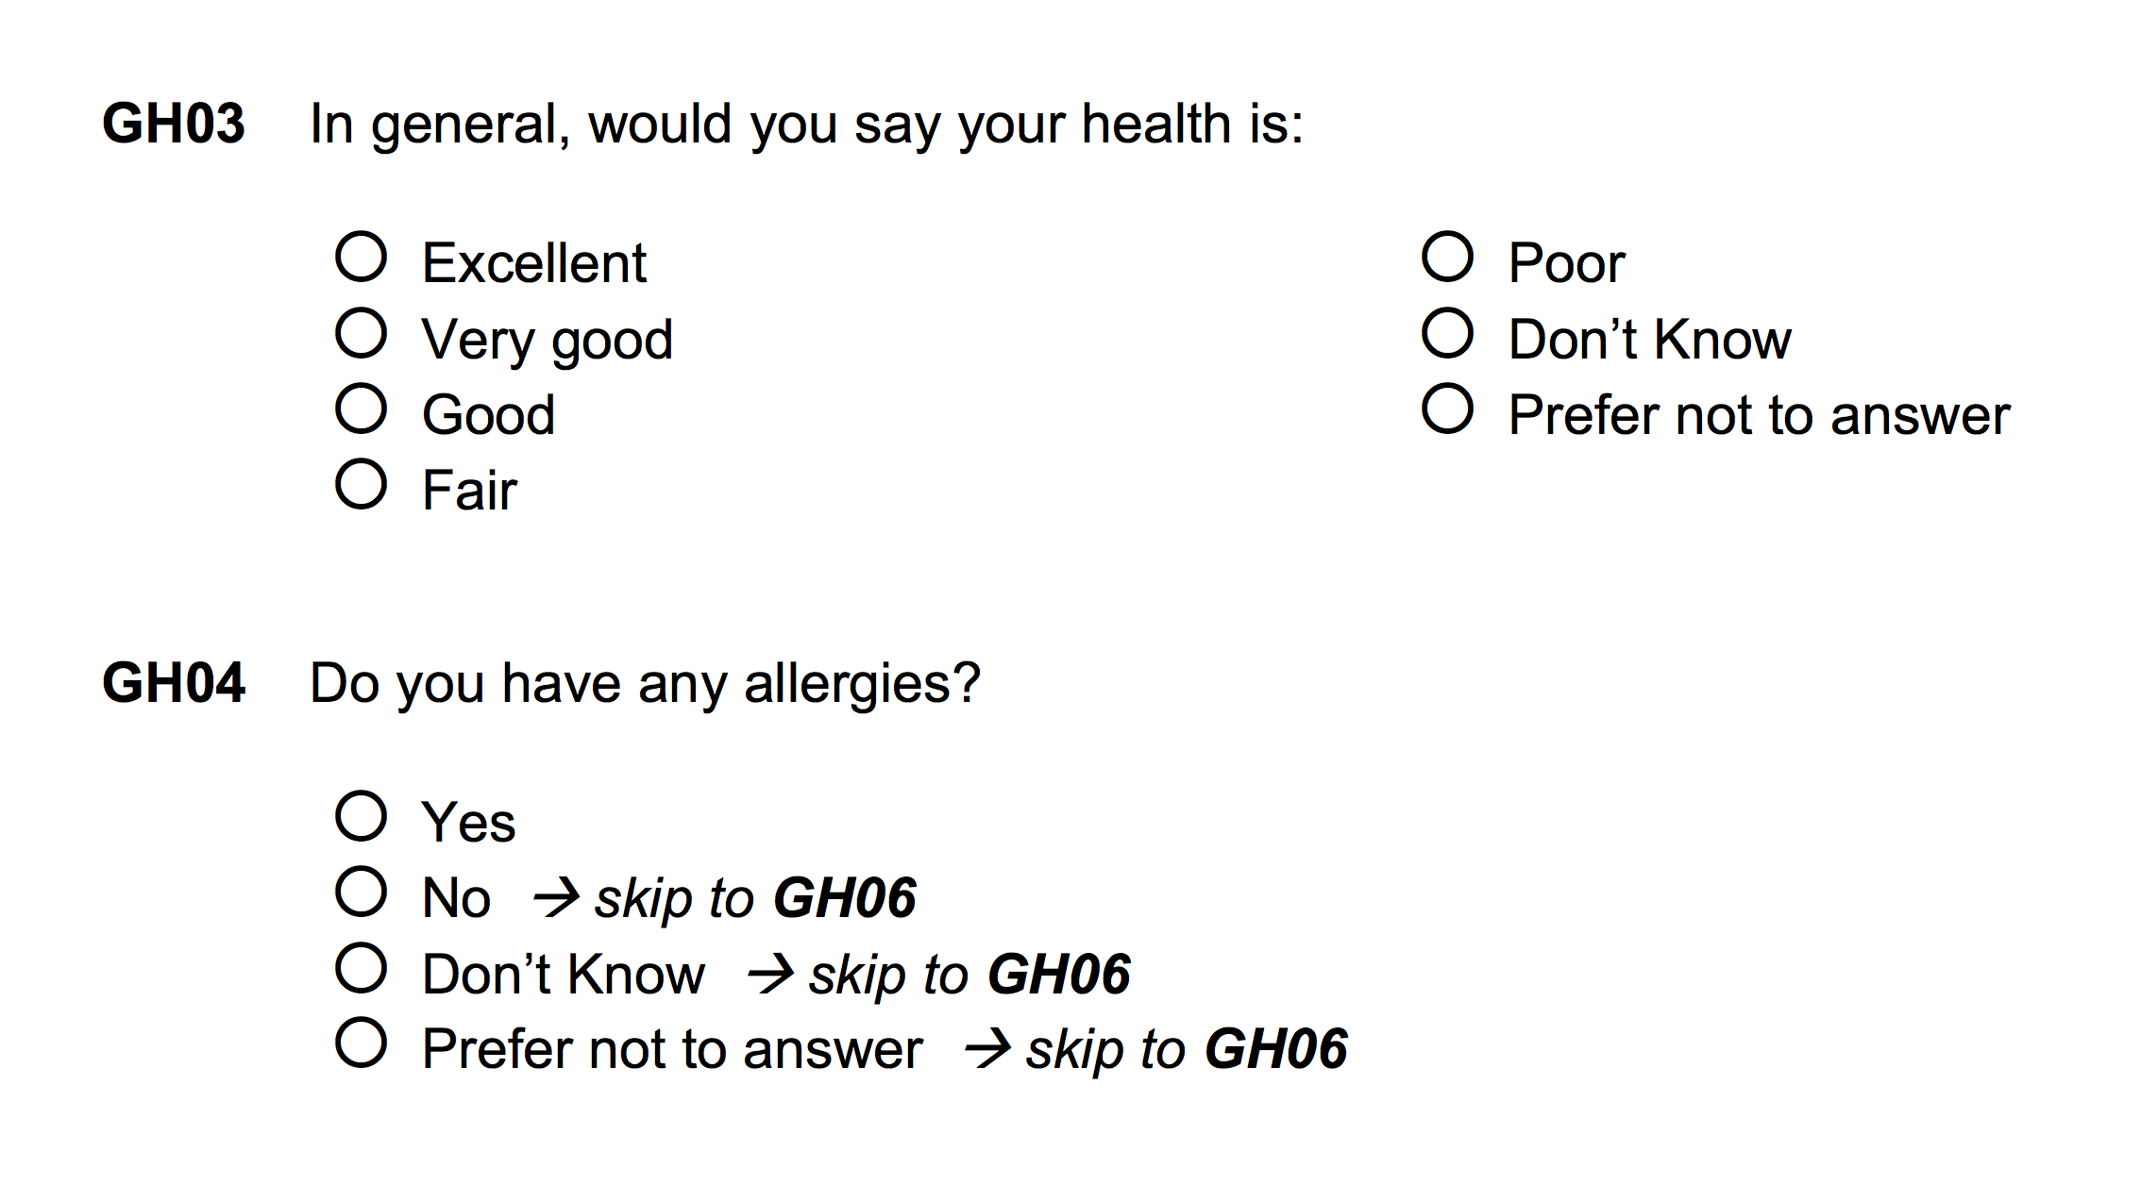
Ordered categorical variable

Slide 2
Yes/no binary variable

Slide 3
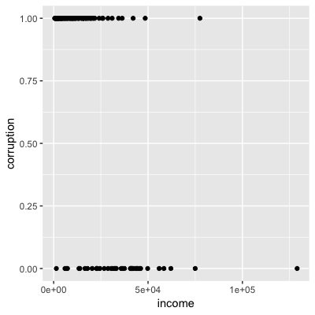
Corruption(0, 1) ≈ f(income)

Slide 4
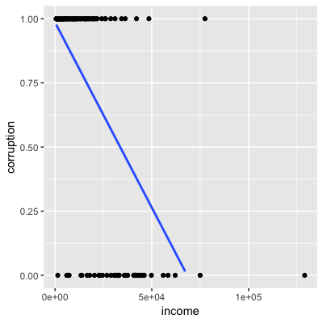
f = Linear function

Slide 5
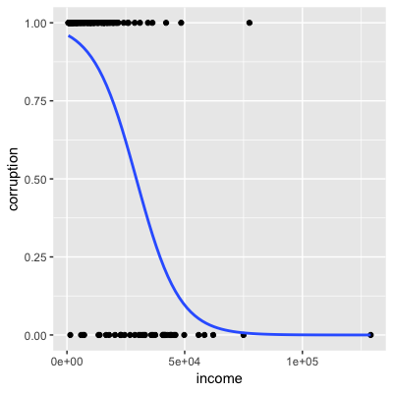
f = Logistic function

