Slide 1
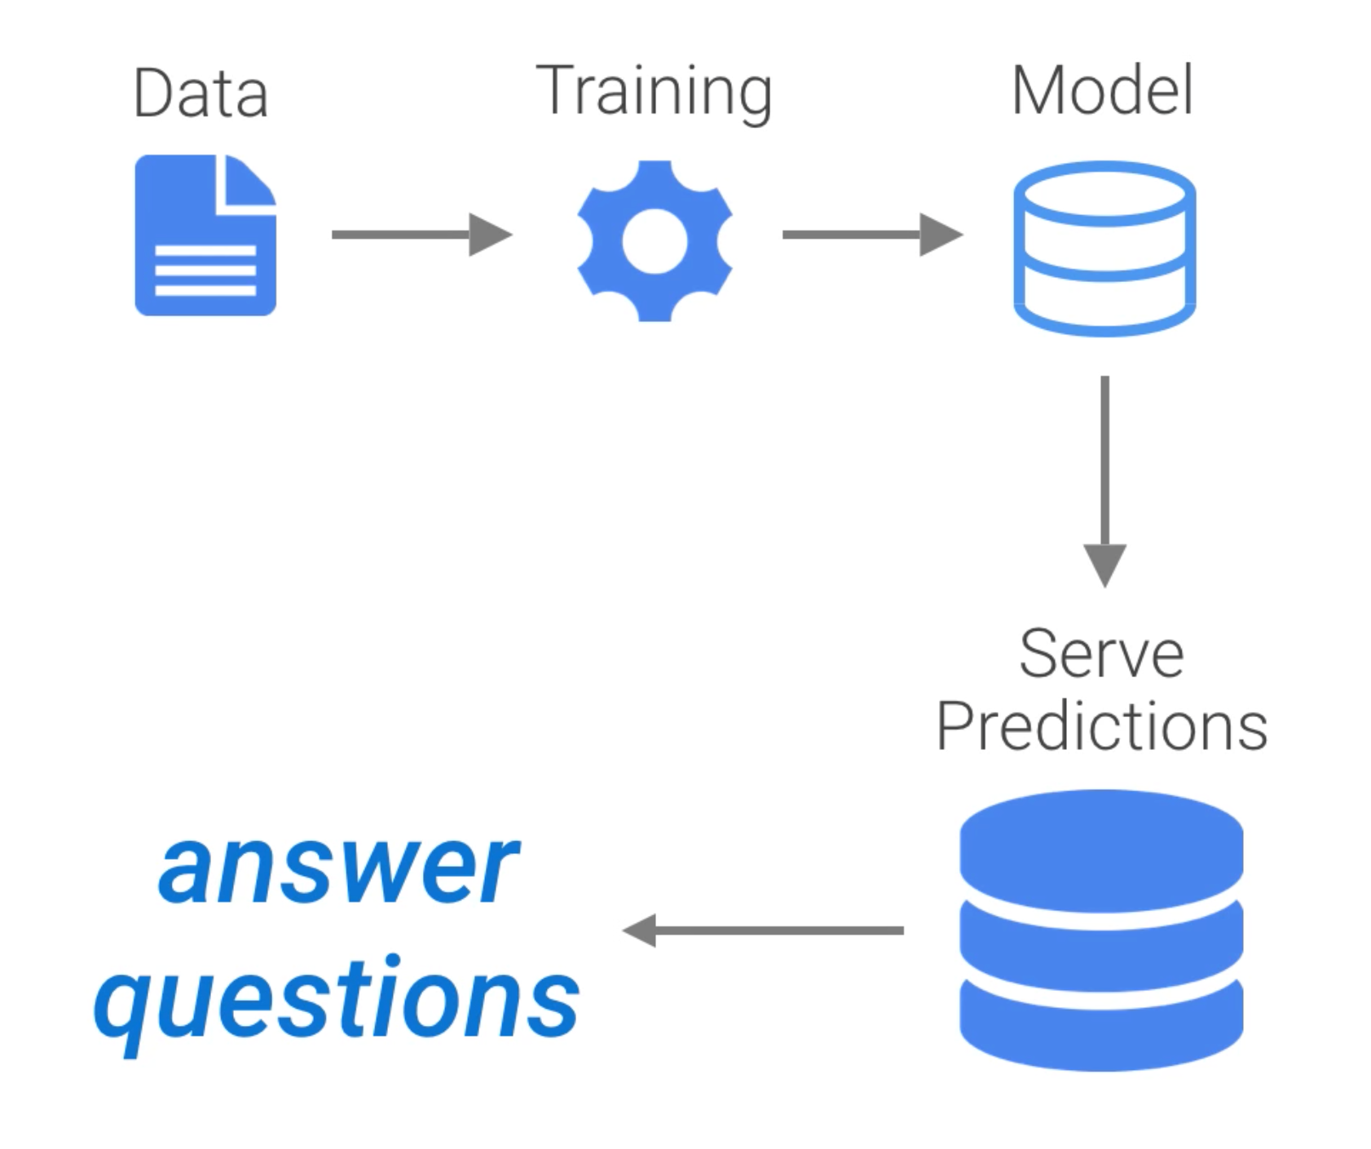

Slide 5
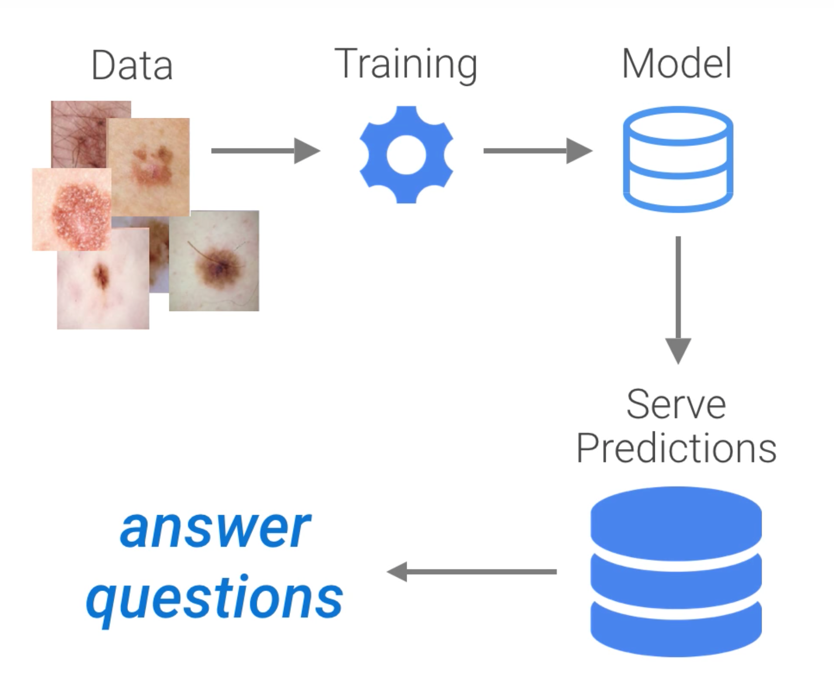

Slide 6
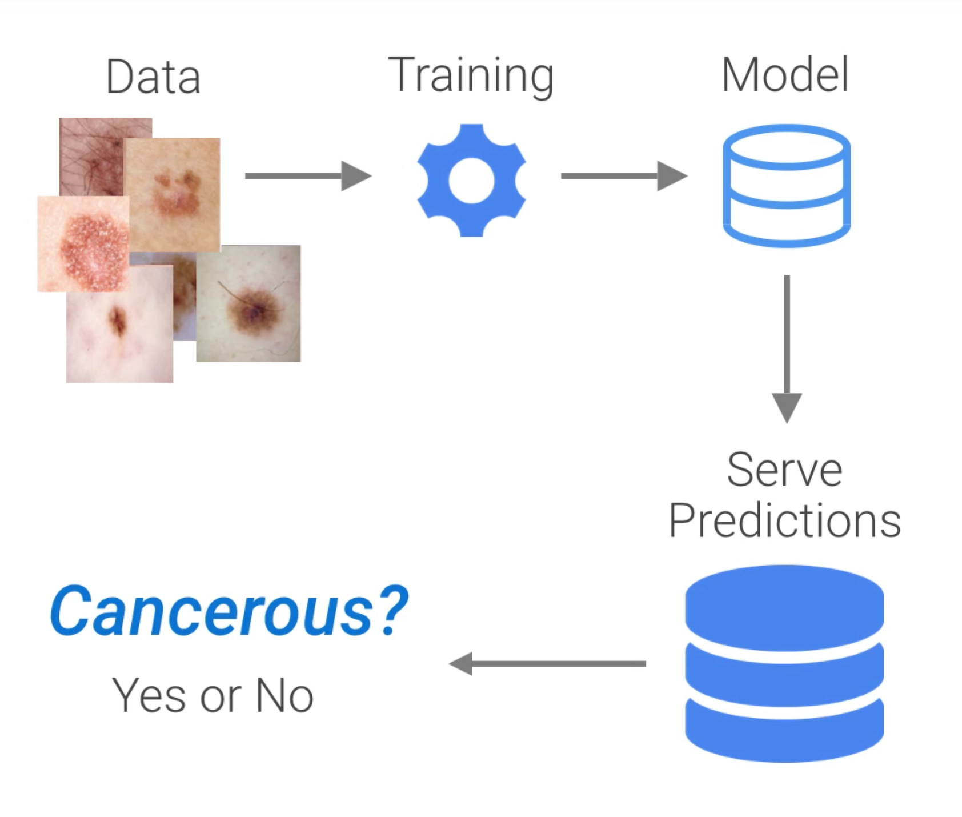

Slide 7
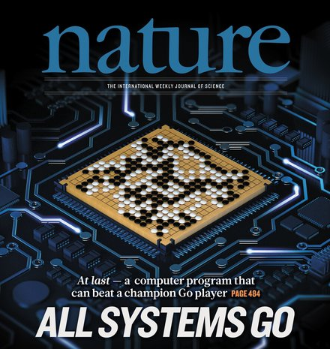

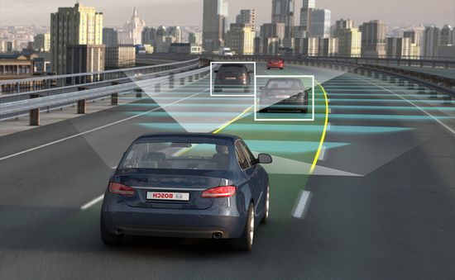
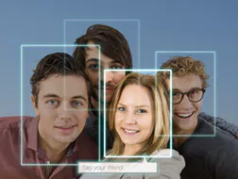
Movie Recommendation
AlphaGo
Face Recognition
Autonomous Vehicles

Slide 8
Using data

Slide 9
to answer questions

Slide 10
Training

Slide 11
Prediction

Slide 12
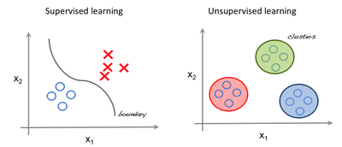
Supervised
Classification
Regression
Support Vector Machines
Linear Regression
Logistic Regression
Discriminant Analysis
Decision Trees
Naive Bayes
Neural Networks
Nearest Neighbor

Slide 13
Supervised
Unsupervised
Classification
Regression
Clustering
Support Vector Machines
Linear Regression
K-Means
Logistic Regression
Hierarchical
Discriminant Analysis
Decision Trees
Gaussian Mixture
Naive Bayes
Neural Networks
Hidden Markov
Nearest Neighbor

Slide 14
Supervised
Unsupervised
Classification
Regression
Clustering
Support Vector Machines
Linear Regression
K-Means
Logistic Regression
Hierarchical
Discriminant Analysis
Decision Trees
Gaussian Mixture
Naive Bayes
Neural Networks
Hidden Markov
Nearest Neighbor

Slide 15
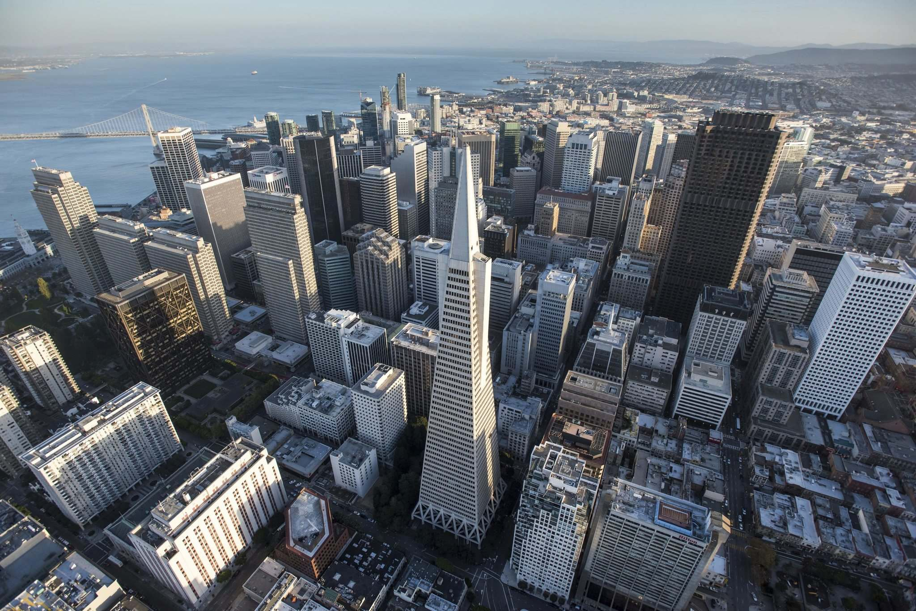
Urban Population

Slide 16
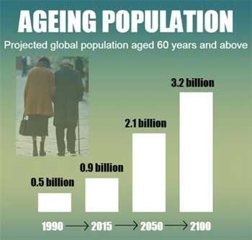
Urban Population
Aging Population

Slide 17

Urban Population
Aging Population
Climate Change

