Slide 1


Slide 2
What is a CSA?
CSA, or Community Supported Agriculture is a program that supports local farmers and producers while allowing the community premium access to fresh, local foods through the purchase of a seasonal membership including:
Fruits and Vegetables
Meat (Beef, chicken, pork)
Eggs
Cheese
Grains
Canned Goods (jams, jellies, salsa, pickles)

Slide 3
Member Benefits
Receive produce that was picked the very same day ensuring the utmost quality, freshness, nutrition and taste!
On Average, most fruits and vegetables in grocery stores travel 1300 miles before appearing on shelves.
Know exactly where your food is coming from.
Ask questions!
Try new things!
Skip the grocery store—just pick up a fresh bag every week.

Slide 4
Question: “Is local more nutritious”
Top 7 Factors that effect nutrient levels in fresh produce
Variety
Production Method
Ripeness
Post Harvest Handling
Processing and Packaging
Storage
Transportation

Slide 5
Answer:
Relying on local sources for your produce needs has some distinct advantages
1.) Even when the highest post-harvest handling standards are met, foods grown far away spend significant time on the road, and therefore have more time to lose nutrients before reaching the marketplace.
2.) Farmers growing for a local (and especially a direct) market favor taste, nutrition and diversity over ship- ability when choosing varieties. Greater crop diversity from the farmer means greater nutritional diversity for the eater.
3.) In direct and local marketing strategies, produce is sold within 24 hours after harvest, at its peak freshness and ripeness, making consuming them a more attractive prospect.
4.) During this short time and distance, produce is likely handled by fewer people, decreasing potential for damage, and typically not harvested with industrial machinery. Minimizing transportation and processing can ensure maximum freshness and flavor, and nutrient retention.

Slide 6
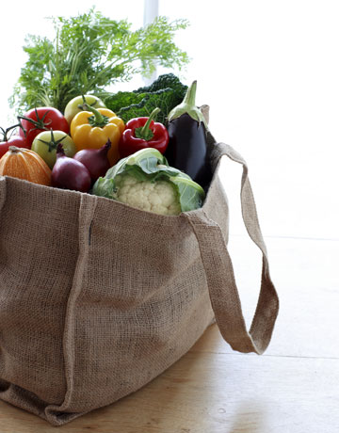
How it works
1.)Members join the CSA by pre-paying all or a portion of their membership plan.
2.)Customize your plan by choosing what type of bag you would like each week, and number of participation weeks.
3.) Pick up your bag each week and enjoy!

Slide 7
Bag Options– Customize your plan
Bag | Price per week | Description
Veggie: Full Share | $12 | fruits and vegetables as they come into season
Veggie: Half Share | $6 | fruits and vegetables as they come into season
Meat: | $12 | Local grain fed beef, farm raised whole chickens, and various pork cuts
Grain | $10 | Homemade pastas, baked goods, and breads
Canned Goods | $7 | Salsa, jams, jelly, pickles, honey
Eggs | $3.50 | Free range eggs
Dairy | $7 | Various cheeses
Combo | $7 | Alternating between Grains, Canned good, Eggs, and Dairy (Note: Meat and Vegetables not included)

Slide 8
Bag Options– Choose your Timeframe
Bag | Price per week | 1 session (9 weeks) | 2 sessions (18 weeks) | 3 sessions (27 weeks)
Veggie: Full | $12 | $108 | $216 | $324
Veggie: Half | $6 | $54 | $108 | $162
Meat: | $12 | $108 | $216 | $324
Grain | $10 | $90 | $180 | $270
Canned Goods | $7 | $63 | $126 | $189
Eggs | $3.50 | $31.50 | $63 | $94.5
Dairy | $7 | $63 | $126 | $189
Combo | $7 | $63 | $126 | $189
The CSA program will run from May 1st through November 5th for a total of 27 weeks. Members may choose to participate for the all three seasons (9 weeks each) or individual seasons. Different vegetables will be featured as they come into season.

Slide 9
What is the difference between each season?
Season | Available Vegetables
Spring May 1 –June 30 | Leafy greens, red lettuce, green lettuce, kale, spinach, swiss chard, kohlrabi, radishes, asparagus, cilantro, strawberries, cauliflower broccoli, beets,
Summer July 3—September 1 | Sweet Corn, Bell peppers, tomatoes, cherry tomatoes, cucumbers, jalapenos, watermelon, cantaloupe, onions, peaches, Cabbage broccoli, cauliflower, zucchini, yellow squash, carrots
Fall September 4—November 5 | Cabbage, Broccoli, cauliflower, Bell peppers, jalapenos, Butternut Squash, Acorn Squash, Spaghetti Squash, Buttercup Squash, Pie pumpkins, apples

Slide 10
Fruit and Vegetable Chart for 2016 CSA
Produce | Spring |  | Summer |  | Fall
 | May | June | July | Aug | Sept | Oct | Nov
Acorn squash |  |  |  |  | x | x | x
Apples |  |  |  |  | x | x | x
Asparagus | x | x
Beets | x | x | x | x | x | x | x
Potatoes |  |  |  | x | x | x | x
Broccoli | x | x | x | x | x | x | x
Butternut squash |  |  |  |  | x | x | x
Cabbage | x | x | x | x | x | x | x
Carrots |  | x | x |  |  | x | x
Cauliflower | x | x | x | x | x | x | x
Cucumbers |  | x | x | x | x
Eggplant |  | x | x | x | x | x | x
Green beans |  |  | x | x | x
Herbs | x | x | x | x | x | x | x
Kale | x | x | x | x | x | x | x
Kohlrabi | x | x | x | x | x | x | x
Fruit and Vegetable Chart for 2016 CSA
Produce | Spring |  | Summer |  | Fall
 | May | June | July | Aug | Sept | Oct | Nov
Lettuce | x | x | x | x | x | x | x
Cantaloupe |  |  |  | x | x | x
Okra |  |  |  | x | x | x
Peaches |  |  | x | x
Peppers | x | x | x | x | x | x | x
Pie Pumpkins |  |  |  |  | x | x | x
Radish | x | x | x | x | x | x | x
Red Romas |  |  | x | x | x
Salad Tomatoes |  |  | x | x | x | x
Spaghetti squash |  |  |  |  | x | x | x
Spinach | x | x | x | x | x | x | x
Strawberries |  | X
Summer squash |  |  | x | x | x
Sweet Corn |  |  | x | x | x
Tomatoes |  | x | x | x | x | x
Watermelon |  |  |  | x | x | x
Zucchini |  | x | x | x | x

Slide 11


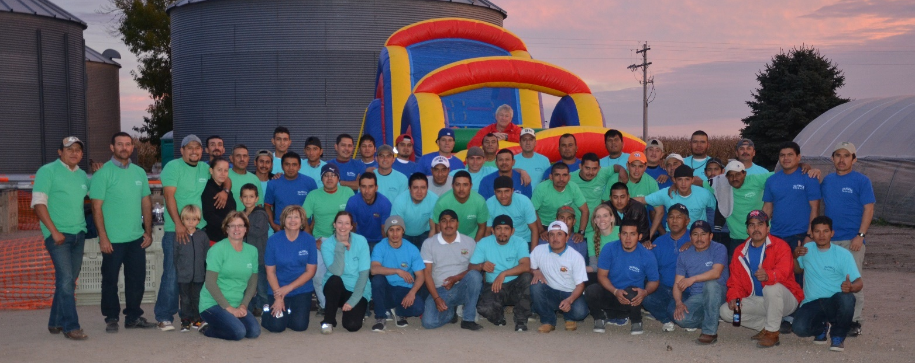
Who are the Providers?
Columbus, NE

Slide 12


Who are the Providers?
Columbus, NE

Slide 13
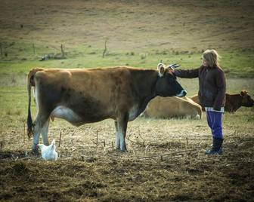
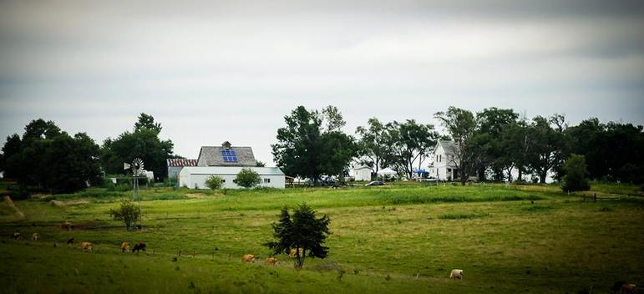
Who are the Providers?
Orchard Hill Creamery
Unadilla, NE

Slide 14
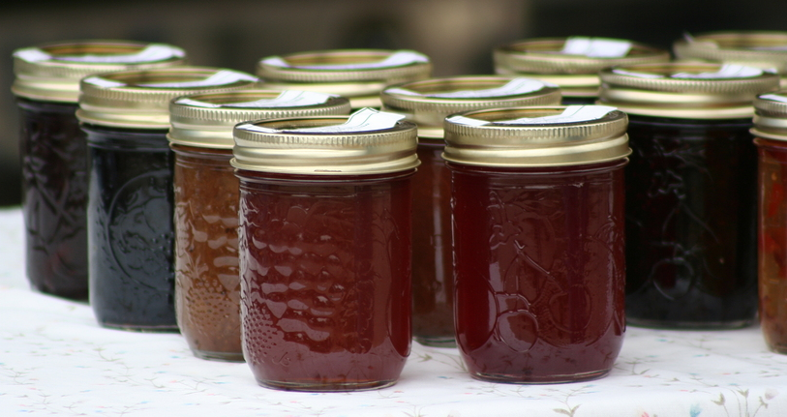
Who are the Providers?
Ma’s Bakery: Verdegre NE

Slide 15

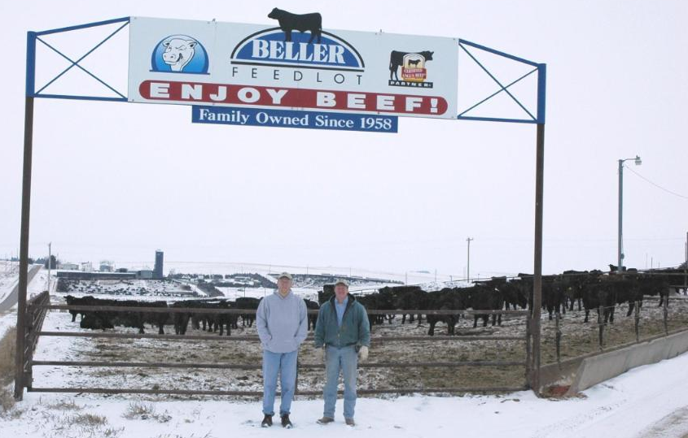
Who are the Providers?
Beller Beef: Columbus, Nebraska

Slide 16
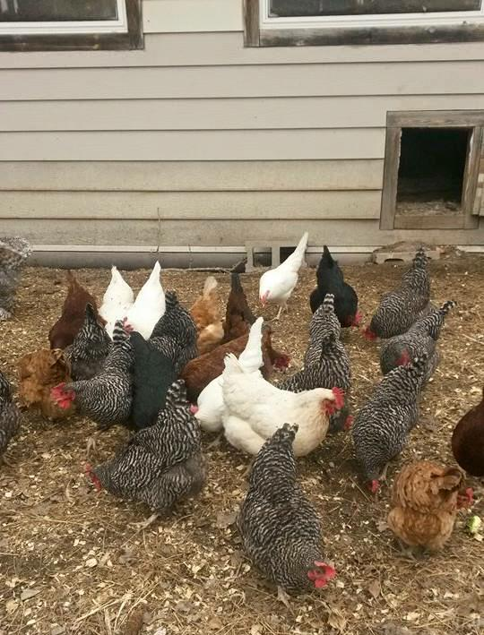
Who are the Providers?
Krings free range Eggs
Lindsay, NE
Wegner Family Farms Chickens
Platte Center, NE

Slide 17
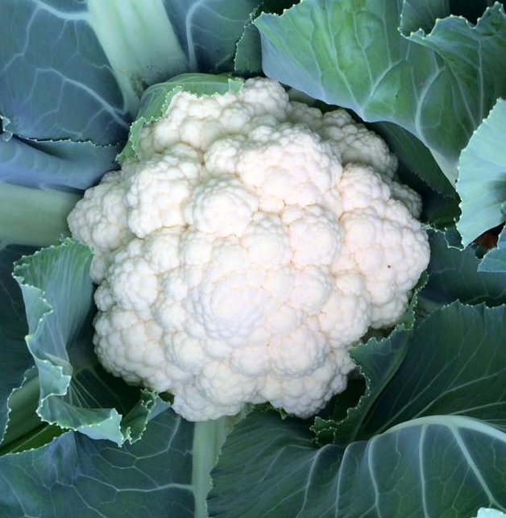
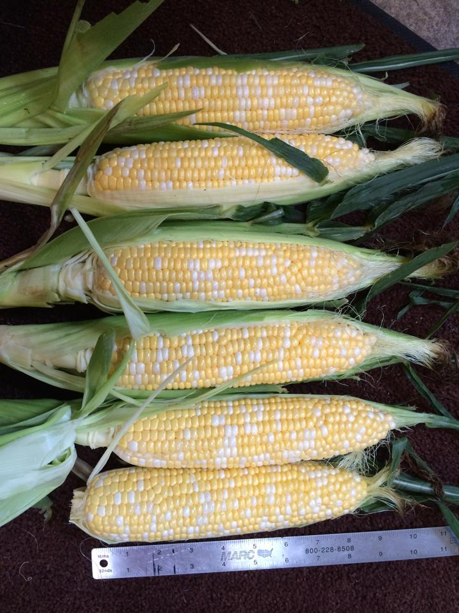

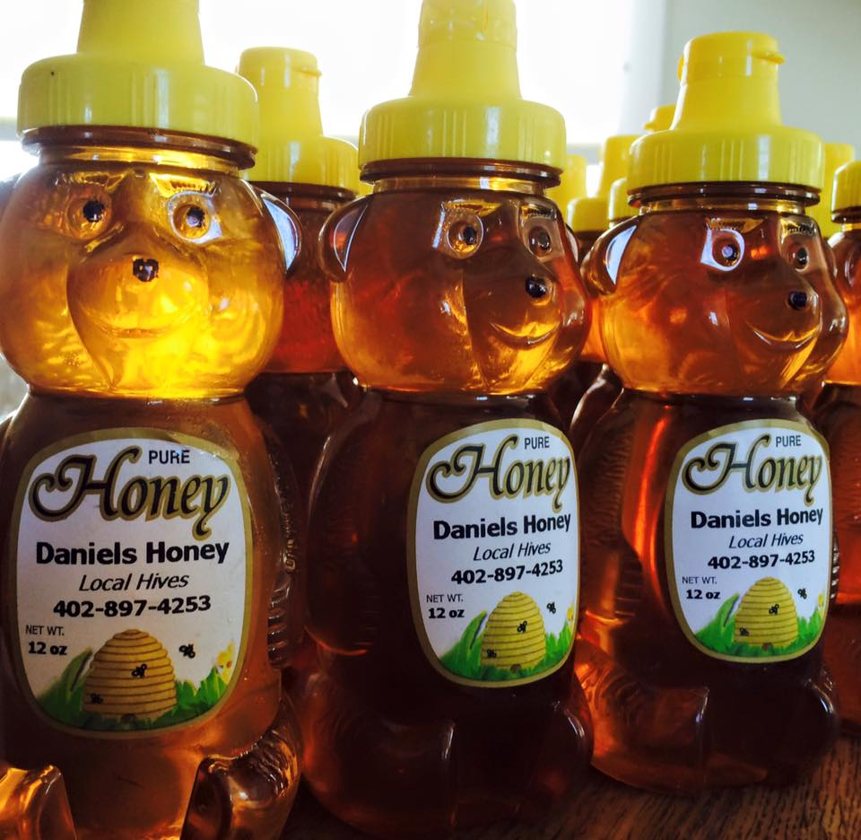
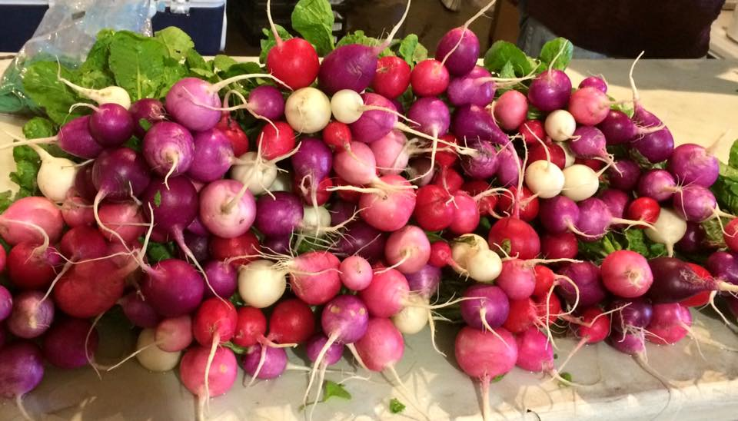
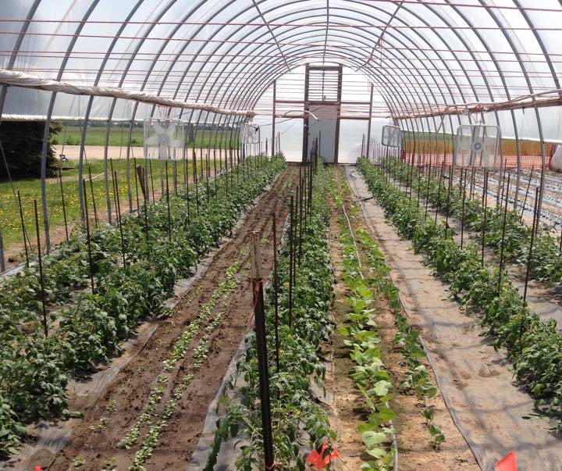
Questions?

