Slide 1




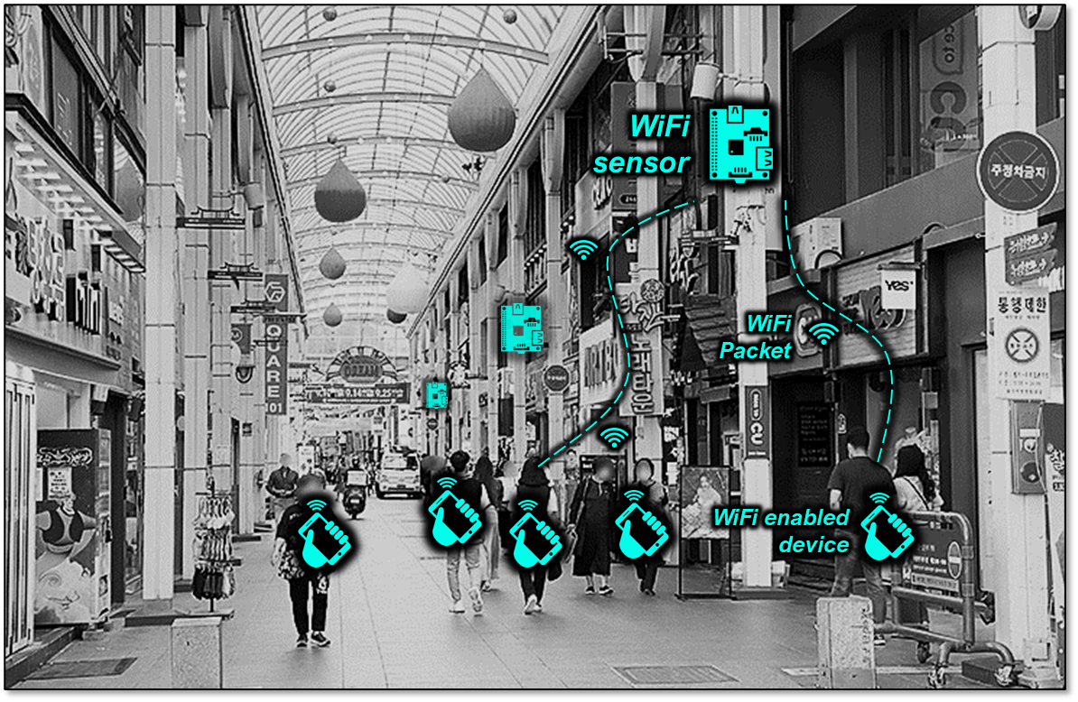
WiFi sensor
WiFi
Packet
WiFi enabled
device

Slide 2
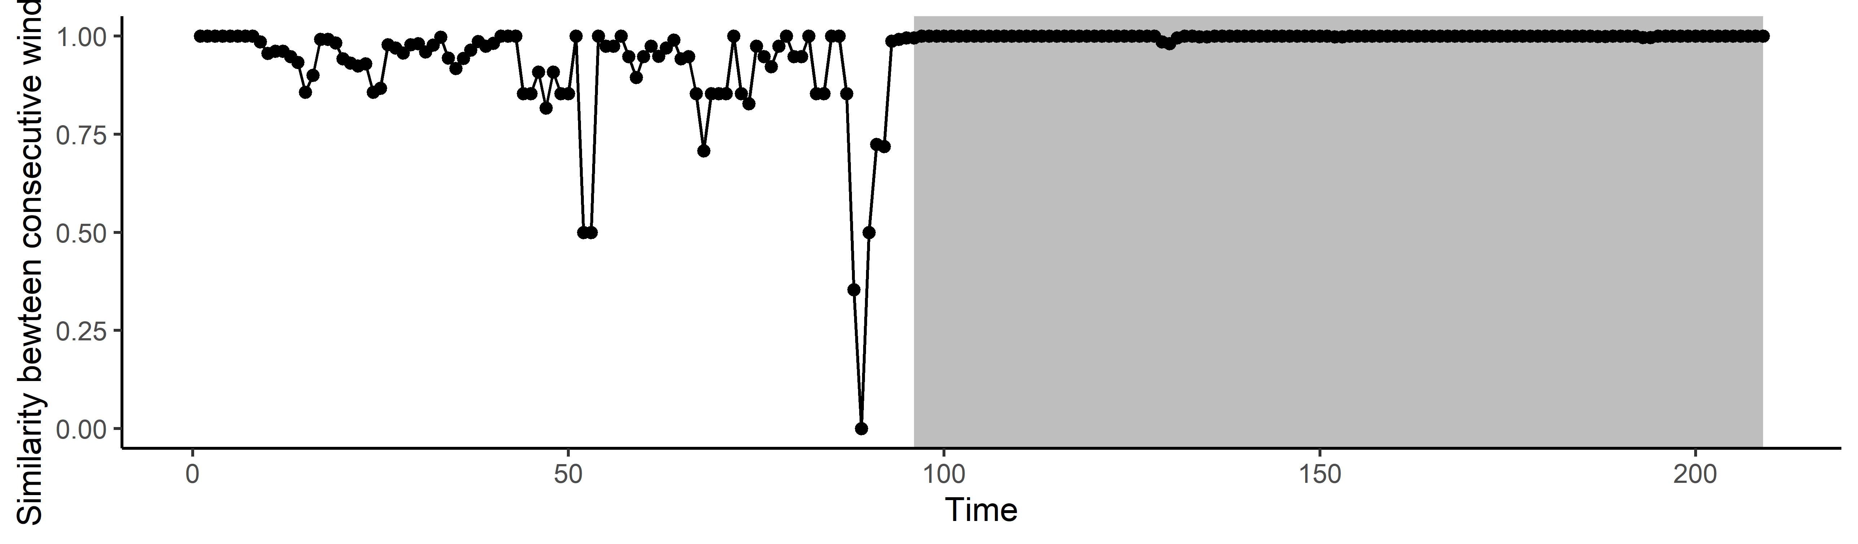
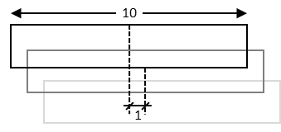
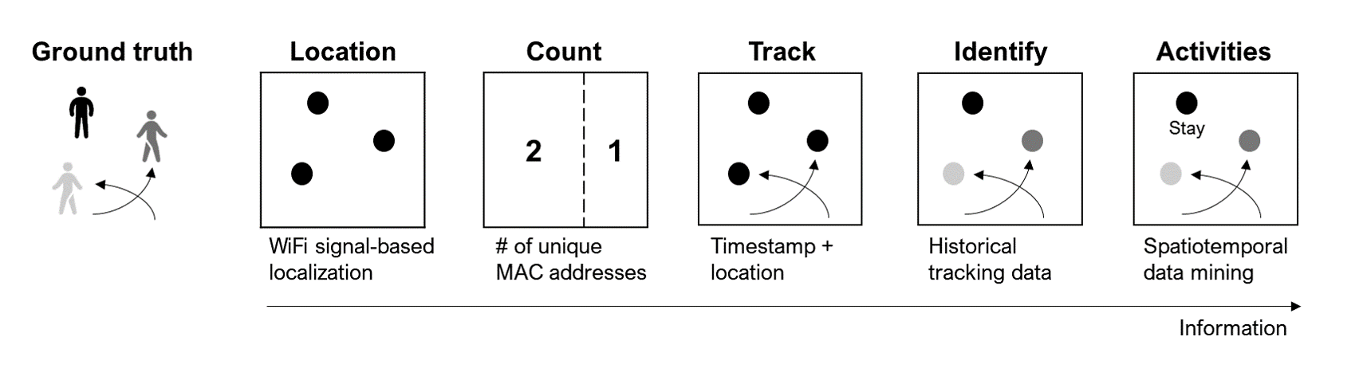
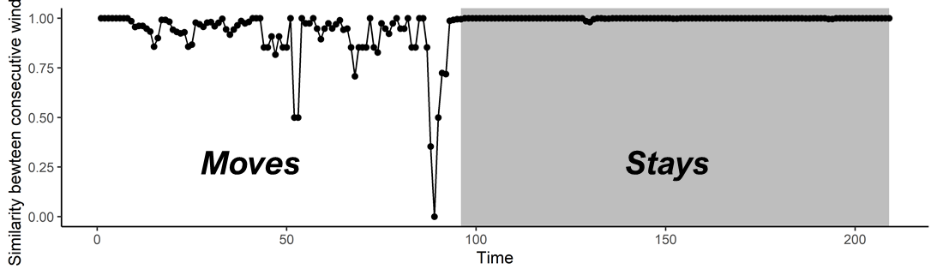
10
1
Moves
Stays

Slide 3






Ground truth
WiFi Sensing
WiFi-enabled devices
WiFi sensor
Access point
(e.g., Public WiFi)
Extract Metrics
Location
Count
Track
Identify
Activities
2 | 1
Stay
WiFi signal-based localization
# of unique MAC addresses
Timestamp + location
Historical tracking data
Spatiotemporal data mining
Information

Slide 4
Ground truth
WiFi Sensing
Observed by
WiFi-enabled devices
WiFi sensor
Access point
(e.g., Public WiFi)
Extracted Metrics
Location
Count
Track
Identify
Activities
2 | 1
Stay
WiFi signal-based localization
# of unique MAC addresses
Timestamp + location
Historical tracking data
Spatiotemporal data mining
Information

Slide 5
Ground truth
WiFi Sensing
WiFi-enabled Devices
WiFi sensor
Location
Count
Track
Identify
Activities
2 | 1
Stay
WiFi signal-based localization
# of unique MAC addresses
Timestamp + location
Historical tracking data
Spatiotemporal data mining
Information

Slide 6
Extracting Metrics

