Slide 1


SICARAY Sicamobi
™
Alunos:
Anderson Urbano
Gustavo Pimentel
Leticia Lapenda

Slide 2
Summary
Introduction
Analysing the problem
Architecture
Generic technique
Types of techniques
Fingerprinting
Architecture
Choosing grid points
Pathloss prediction
Location prediction
References

Slide 3
Introduction
The task consist of locating users in the city based on RSS measurements to 6 different ERBs.
There are 2556 total measurements in the database with respective geographic coordinates.
New test set will have 200 measurements similar to the ones in the training database.

Slide 4
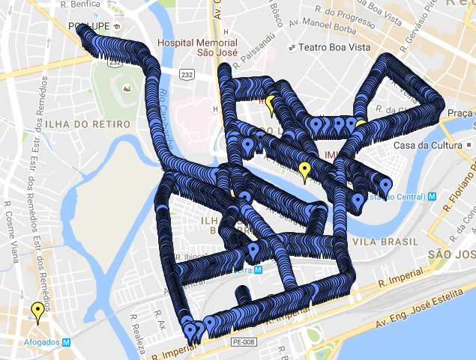
Analysing the problem

Slide 5
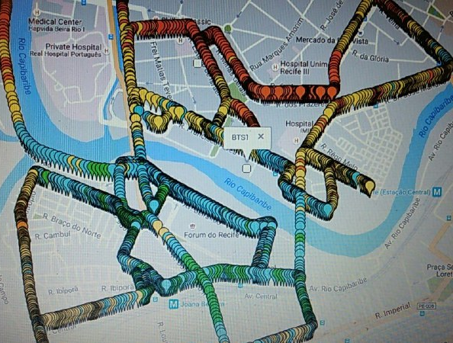
Analysing the problem

Slide 6
Architecture: Generic Technique
Offline training
Online testing
Measurement Database
Technique Model
Technique Model
Geographic Coordinates
ERB Database
Test Samples

Slide 7
Architecture: Types of Techniques
Technique
Fingerprinting Techniques
Regression Techniques
Instance Based Techniques
Trilateration Techniques
...
KNN Parthloss Predictor
Math Model Parthloss Predictor
SVM Regressor
Random Forest Regressor
WKNN Tester
KNN with Trend
MLP Regressor
...
...
...

Slide 8
Case Study
Fingerprinting Technique

Slide 9
Fingerprinting: Architecture
Measurement Database
Offline training
Online testing
ERB Pathloss Map
Location
Predictor
ERB Database
Coordinates
Pre-defined
Grid Points
Pathloss
Predictor
Test Samples

Slide 10

Fingerprinting: Choosing Grid Points
Problem: There are many ways to choose points to compose the grid. Which would be best?
Plausible Assumption: In an urban environment users are most likely to be located on or near streets.
Proposed Solution: Use Google Maps API to get points on the streets of the desired region in a certain resolution. This strategy
also drastically reduces the number
of cells in the grid

Slide 11
Fingerprinting: Pathloss Prediction
MODEL / ERB | ERB 1 | ERB 2 | ERB 3 | ERB 4 | ERB 5 | ERB 6
Free Space | 30.979 | 32.137 | 29.073 | 28.284 | 33.493 | 37.329
Okumura Hata | 10.893 | 10.380 | 5.837 | 9.408 | 9.654 | 12.849
COST-231 Hata | 17.071 | 15.619 | 22.871 | 19.509 | 15.353 | 11.427
COST-231 W. | 62.662 | 63.302 | 72.961 | 67.141 | 62.519 | 58.395
ECC-33 | 17.029 | 15.328 | 21.025 | 19.059 | 14.821 | 11.152
Ericsson 9999 | 17.867 | 17.988 | 32.360 | 21.582 | 18.281 | 12.841
SUI | 12.523 | 10.576 | 15.754 | 13.349 | 9.781 | 8.264
Lee | 18.144 | 17.512 | 6.224 | 13.957 | 16.672 | 20.543
Flat Earth | 49.242 | 48.453 | 38.060 | 44.613 | 49.169 | 53.325
Average error of pathloss for each mathematical model in the measurement database (in dB)

Slide 12
Fingerprinting: Location Prediction
With the pathloss map we can estimate new test sample geographic coordinates as the coordinates of the most similar grid cell in terms of pathloss.
The similarity can be measured in many ways. We did it by using squared euclidian distance. The most similar cell is the one with the smallest distance.
square_dist = (cell.pathloss1-m.pathloss1)² + (cell.pathloss2-m.pathloss2)² + ...

Slide 13
References
[1] Seyed A. Zekavat, Michael Buehrer, “Handbook of position location - Theory, Practice and Advances”

