Slide 1

GitHub and Data Reproducibility
Mason Fidino

Slide 2

How do researchers typically store files?
paper_draft.docx
paper_draft2.docx
paper_draft2_MF.docx
paper_final.docx
paper_final2.docx
paper_final_revision.docx

Slide 3
Why is this a problem?
How do you keep track of edits?
How do we handle “accidents”?
fundamentally, an issue with data reproducibility.

Slide 4
Why worry about data reproducibility?
We are currently experiencing a crisis of reproducibility in science!
In response to this, code review is now a required component of peer review for many journals.
Better, more reproducible code also makes it easier to standardize methodology.

Slide 5

Git and GitHub

Slide 6
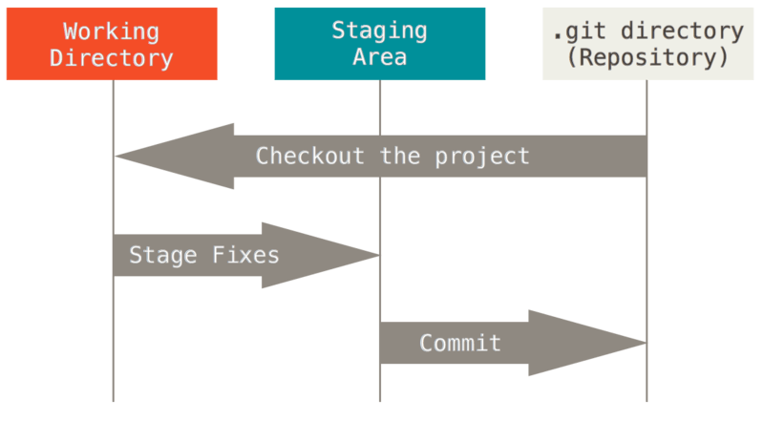
What is Git?
Started in 2005 - version control system for Linux developers
Now, one of the most commonly used distributed version control systems

Slide 7
What is GitHub?
GitHub is an easier, user-friendly way to use Git online
integrates with a number of other software platforms - including Rstudio
Only requires a GitHub account to use, and the free accounts will cover 99.9% of ecological data analysis work

Slide 8
GitHub is easier than Git, but that does not mean GitHub is easy to learn
1. Abstract Git concepts & terms
- commit, push, pull, merge, branch, etc.
2. Unclear workflow
- When do you use the above concepts? How often?
- What is the difference between local and remote repositories?
3. File management
- Why aren’t all my files up on GitHub?
- How do I keep a file off GitHub?

Slide 9
GitHub terms

Slide 10



What is a Repository (repo)?
Definition: a project folder that GitHub is tracking (i.e., where you have your code and data for a project). These can be local and remote.
data
data
code
code
plots
plots
Local repo on your computer
A remote repo is a version of your local repo stored on a GitHub server

Slide 11
How you sync information between your local and remote repo is related to most of the other GitHub terms
data
data
code
code
plots
plots
local
remote

Slide 12
Git Commit: what is it?
A snapshot of your project at a point in time
It saves changes to your local repo, not your remote repo
Example: Mason writes some code and creates a figure for a paper. GitHub has not yet tracked this change. To do so Mason needs to make a commit action.

Slide 13
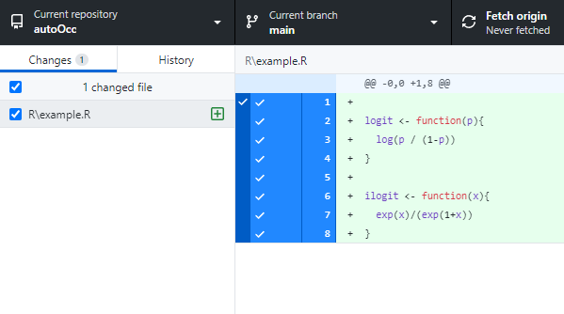
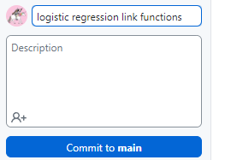
How to do commits with GitHub Desktop
Make changes – Edit your files in a project in Rstudio
Open GitHub Desktop (if you have not done it yet)
Review changes (you can click on files to see how they were changed)
Write a commit message that is short and clear (e.g., fixed typo in README.md)
Click button on bottom left to do your commit.

Slide 14
Commit best practices
Commit small, logical changes (not everything at once)
Use descriptive, BUT SHORT, messages. There is a description box as well to contain longer info if needed.
Commit early and often

Slide 15
Commits do not move changes to your remote repo. They are in a staging area waiting to be pushed.
Push actions send your committed changes from your local repo to your remote repo
Thus, push actions are the way you update the remote repo so collaborators can see your work
Can be one, or often, multiple commits.

Slide 16
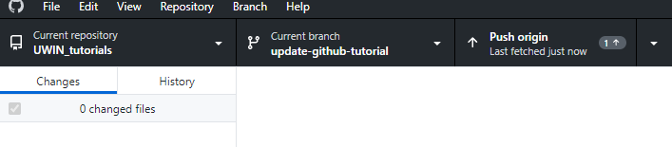
How to push on GitHub desktop
Make and commit your changes
Check status bar on top, if you see ‘Push origin’ you have commits to upload
Click ‘Push origin’ to send those changes to the remote repo

Slide 17
We talked about going from the local repo to the remote. How do you go from the remote repo to a local repo?
data
data
code
code
plots
plots
local
remote

Slide 18
You make a local repo with either a clone or fork action
Is the remote repository yours?
yes
no
Clone the remote repo to make a local repo
Have you been set up as a collaborator on the remote repo?
yes

Slide 19
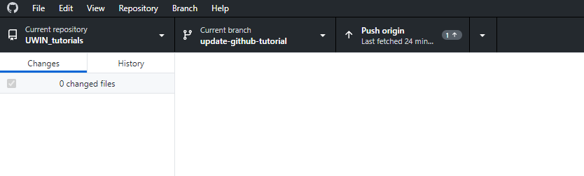
How to clone in GitHub desktop

Slide 20
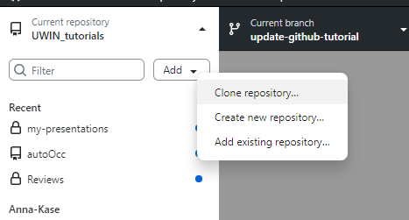
How to clone in GitHub desktop
Click ‘Add’
Click ‘Clone repository’

Slide 21
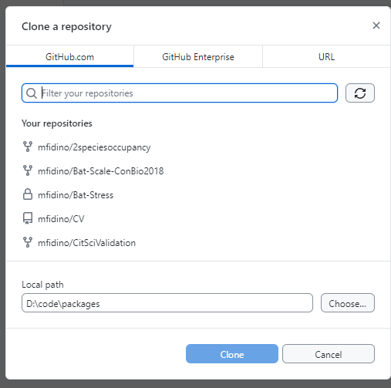
Type the repo name to filter down
Click on the repo you want to clone
Choose where the local repo should be located

Slide 22
You make a local copy with either a clone or fork action
Is the remote repository yours?
yes
no
Clone the remote repo to make a local repo
Have you been set up as a collaborator on the remote repo?
yes
no
Fork the remote repo to make a local repo

Slide 23
When to fork?
You don’t have write access to a repo (i.e., you don’t own the repo and are not a collaborator)
Contributing to open-source projects
Can be done to experiment without affecting the original repo

Slide 24
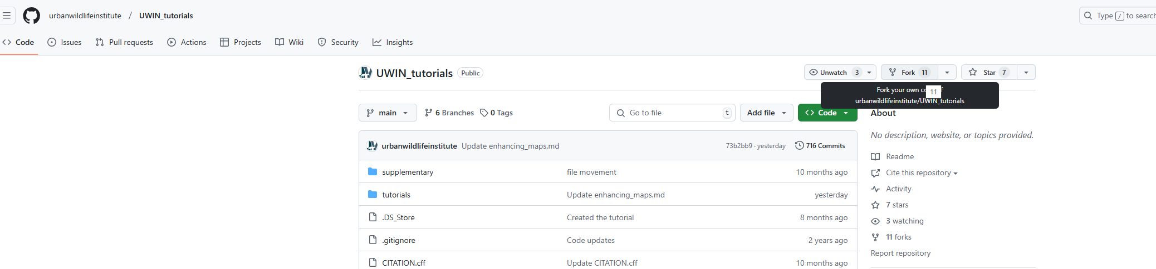
How to fork?
Find the repo on www.github.com
Click the ‘fork’ button
This will create a copy on your GitHub account. You can then clone that copy the same as before.

Slide 25
We can create local repositories now, but how do we make sure there are not changes on the remote repo that should come to the local repo?
data
data
code
code
plots
plots
local
remote

Slide 26
Fetch and pull
What is fetch?
Checks for updates in the remote repository without applying them.
Lets you see if there are new commits before bringing them to your local repo.
Helps keep your local repository in sync with the latest work from others.
What is pull?
Checks for updates in the remote repository AND applies them.
Lets you see if there are new commits before bringing them to your local repo.
Helps keep your local repository in sync with the latest work from others.

Slide 27
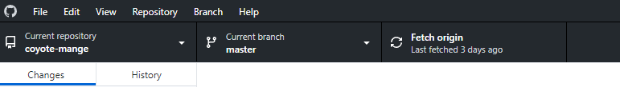
Click here to fetch. If there are changes on the remote repo to bring to your local, then this button will say pull.

Slide 28
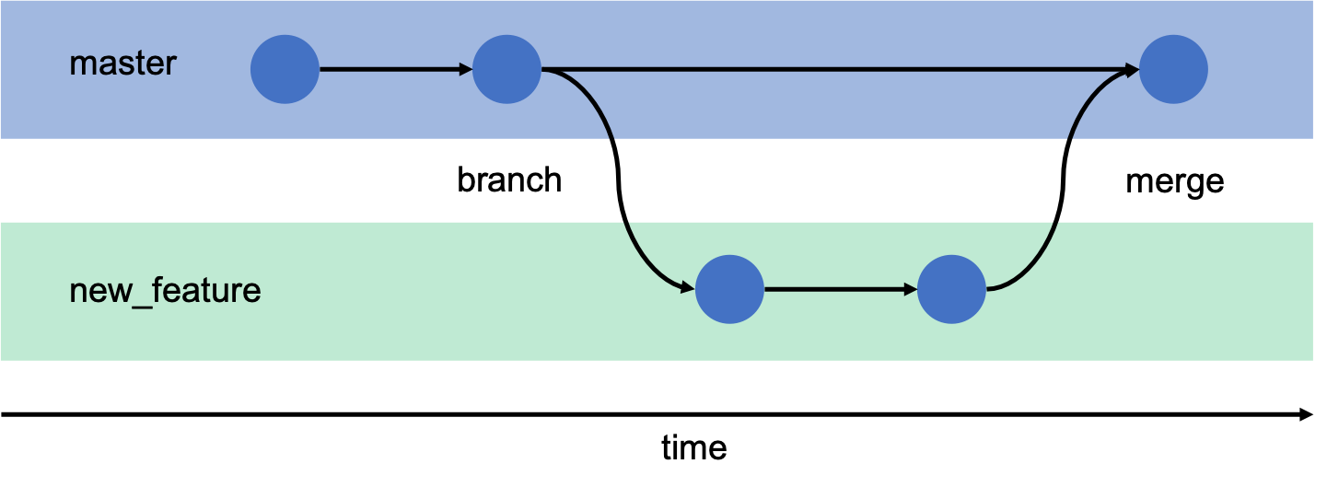
Branches: How to safely experiment, fix bugs, and develop new features.
A branch is a separate version of your project to work on changes without affecting the main code base (i.e., the main branch).
Can be merged back into the main branch when it is ready.
main

Slide 29
Branch (example)
Mason has some code for a project that works, but he wants to improve the code to make it run faster. To do so Mason creates a branch titled performance-tests off of the main branch so he can try out different ways to improve the speed of his code without affecting the code in the main branch.

Slide 30
When to use branches?
When first using GitHub, I never used branches. That has changed because they are quite useful. But treat this as a more ‘advanced’ option after you get used to commits, pushing, pulling, etc.
Great for new features (e.g., functions), bug fixes, etc.
Almost mandatory when working on a team to avoid conflicts with other developers.

Slide 31
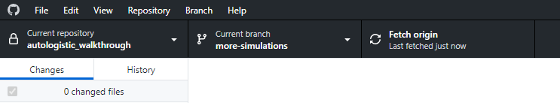
Creating a branch or switching between branches with GitHub Desktop is very easy

Slide 32
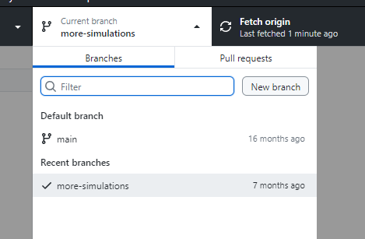
Creating a branch or switching between branches with GitHub Desktop is very easy

Slide 33
Creating a branch or switching between branches with GitHub Desktop is very easy

Slide 34
You move code from your new branch back to the main branch with a pull request and a merge action.
Definition: A pull request (PR) is a way to tell collaborators (or yourself) that the changes you pushed to a branch are ready for review. Think of a pull request as a staging area that you use before you merge one branch back into another.
  To set up a pull request, you have to select the branch with the code you changed and the branch you want to merge those changes into.
  When working collaboratively, someone else reviews the pull request, discussion happens, and based on that some followup commits may be needed.
  Once approved, you can merge the feature branch into the other branch you selected.

Slide 35
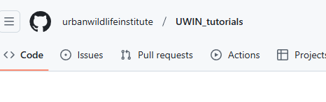
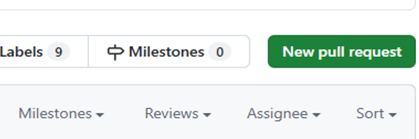


Pull requests are easier to do on www.github.com
Push your changes to your branch
Go the the URL for you remote repo on github.com
Click on pull requests tab
Click ‘New Pull request’ and select the branch you want to merge into main
Click ‘create pull request’

Slide 36
Most ecologists will not likely worry about reviewing pull requests
If working by yourself, click the ‘merge’ action and you are done. You can delete that old branch as well (usually a good idea to keep the repo clean).
If working with others, they may want to review your PR and suggest changes before a merge occurs.

Slide 37
I think pull requests are easier to do on www.github.com
Choose the branch you want to merge as well as the branch you want to merge into.
Click on pull requests at the top, and click ‘new pull request’

Slide 38
Pull Request (example)
Example: Mason want’s to make a new function for his autoOcc R package. To do so, Mason created a new branch, pushed commits to that branch, and when the function was ready made a pull request to merge the feature branch into the main branch.

Slide 39
Other things to know about GitHub

Slide 40
Privacy settings
Repositories can be public or private!
  Public repositories are viewable by everyone
  Private repositories are only viewable by yourself and collaborators you add to the repository
  For most research projects, start your repository as private. You can change them to public when you submit the paper for publication.

Slide 41
MERGE CONFLICTS!!!
The most annoying part of version control.
Happens when you try to merge branches and they have conflicting commits.
  Example: Kim and Mason are working on a project with GitHub. Kim does the right thing and creates a new branch to modify a data analysis script. Mason makes some changes to that same script and pushes them to the main branch. When Kim makes a pull request to merge branches, Git will need your help to decide which changes to incorporate into a final merge.

Slide 42
Don’t store everything on GitHub
Can’t store files > 100 Mb on GitHub (so if you have big datasets you may need a workaround).
Don’t store files on the cloud that already live there (e.g., large spatial data files), but provide documentation on how to find those files!
Don’t store sensitive information in public repositories (e.g., API keys, passwords, etc.). GitHub has a way to use those safely.

Slide 43
It is really easy and free to archive your code and create a DOI
GitHub interfaces with Zenodo, which is an open repository operated by CERN.
After connecting the two, you can archive and generate a DOI for a given repository in minutes.
Archiving code and data is becoming increasingly common when papers get published, so you may as well start getting familiar with this process.

Slide 44
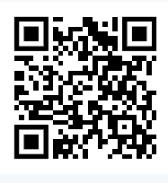
Tutorial for linking zenodo to GitHub
https://zenodo.org/records/20428659
QR code to tutorial on how to link zenodo and GitHub

