Slide 1

Autologistic occupancy models
Mason Fidino

Slide 2
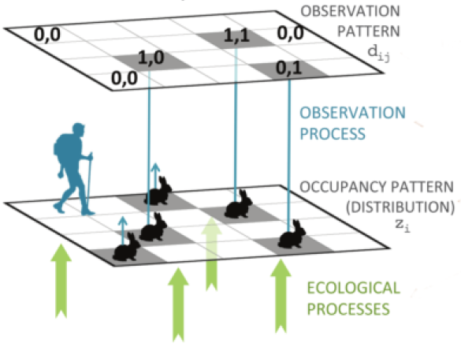
Camera traps and occupancy models work together…
Non-invasive sampling of many species at once
Collects data so that you can account for imperfect detection (i.e., detection probability)
Enables extensive, long-term monitoring across habitats

Slide 3
But if you collect a lot of data through time, what occupancy models can you use?

Slide 4
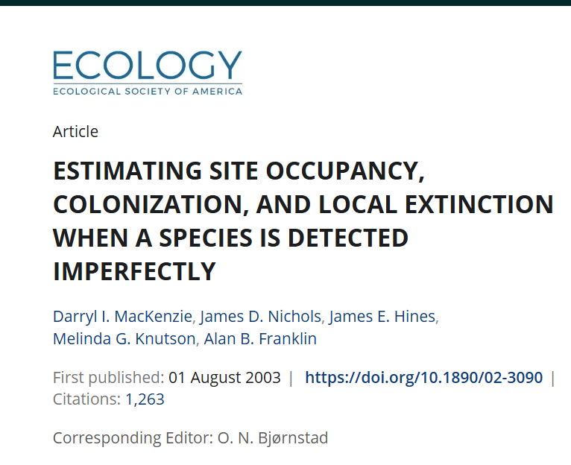

Slide 5
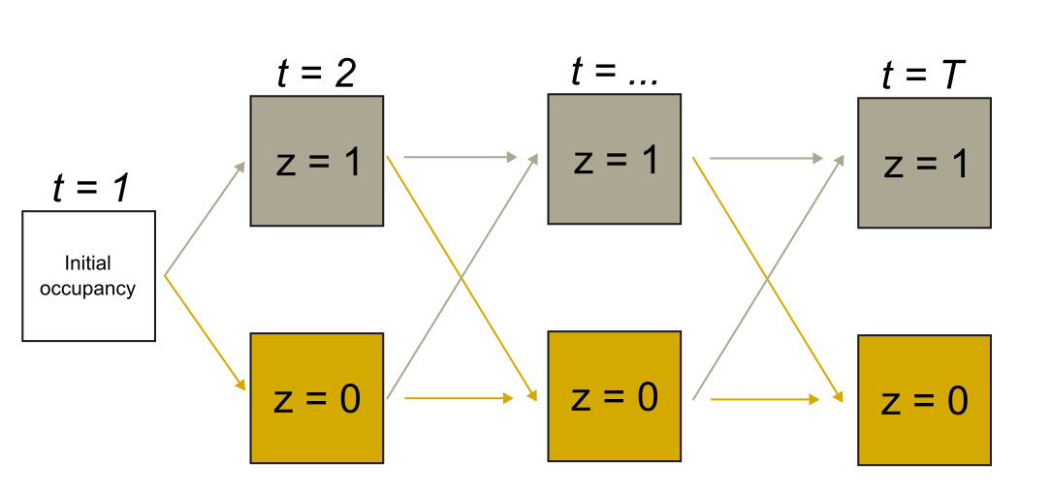

Slide 6
Pr(initial occupancy) = ψ

Slide 7
Pr(Colonization) = λ

Slide 8
Pr(extinction) = ε

Slide 9
Pr(persistence) = ϕ = (1 – ε) = 1 – Pr(extinction)

Slide 10
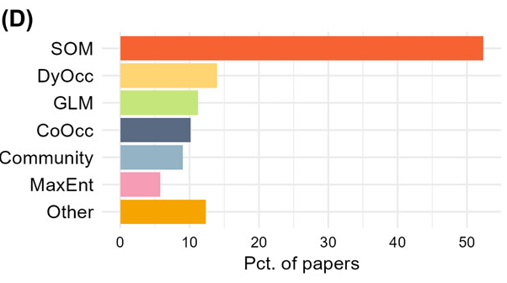
Yet, most occupancy modeling papers still use the traditional site occupancy model (SOM). Only about 14% use a dynamic model (DyOcc).
Goldstein et al. (2024)

Slide 11


Slide 12
Simulations show that dynamic occupancy models have substantial bias when either the number of sites or sampling seasons are low.

Slide 13
Autologistic occupancy models
The most simple version of a dynamic occupancy model
Estimates occupancy each time step
No separate linear predictors for local colonization and extinction (i.e., the data hungry parts of standard dynamic occupancy models)
Well suited when you are interested in patterns of species occupancy (you most often are)
Works far better than standard dynamic occupancy models when you have a smaller sample size (you most often do)

Slide 16
Pr(occupancy) = Ψ
Ψ
Ψ
Ψ

Slide 17
Pr(occupancy) = Ψ
Ψ
Ψ
Ψ
1-Ψ
1-Ψ

Slide 18
Pr(occupancy| z_{t-1}=1) = Ψ^{θ}
Ψ^{θ}
Ψ^{θ}

Slide 19
Pr(occupancy| z_{t-1}=1) = Ψ^{θ}
Ψ^{θ}
Ψ^{θ}
1-Ψ^{θ}
1-Ψ^{θ}

Slide 20
Pr(occupancy| z_{t-1}=1) = Ψ^{θ}
Ψ^{θ}
Ψ^{θ}
Ψ
Ψ
1-Ψ^{θ}
1-Ψ^{θ}
1-Ψ
1-Ψ

Slide 21

The first sampling period is identical to a standard occupancy model
For $i$ in $1,…,I$ sites
For $t$ in $1,…,T$ sampling periods (e.g., UWIN sampling season)
Let $z_{i,t}$ be the occupancy state of your species

Slide 22
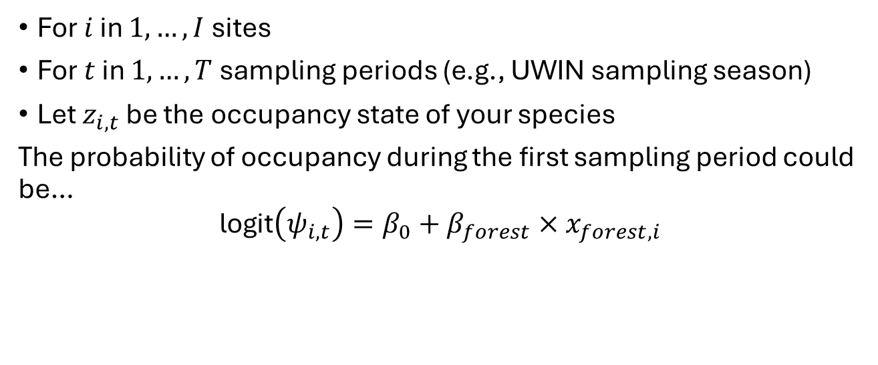
The first sampling period is identical to a standard occupancy model
For $i$ in $1,…,I$ sites
For $t$ in $1,…,T$ sampling periods (e.g., UWIN sampling season)
Let $z_{i,t}$ be the occupancy state of your species
The probability of occupancy during the first sampling period could be…
$$\text{logit}\left(ψ_{i,t}\right)=β_{0}+β_{forest}×x_{forest,i}$$

Slide 23
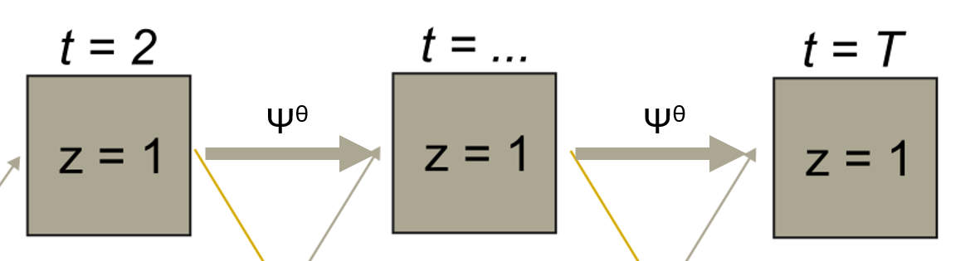

After the first sampling period, autologistic models add a new parameter to the occupancy linear predictor
The autologistic term, $θ$, helps control for temporal correlation in occupancy at a site between seasons. Therefore, the occupancy at a site in time $t$ depends on the occupancy state in the previous timestep ($t−1$)!
$$\text{logit}\left(ψ_{i,t}\right)=β_{0}+β_{forest}×x_{forest,i}+θ×z_{i,t−1}$$

Slide 24

A little bit of algebra
If this is our linear predictor…
$$\text{logit}\left(ψ_{i,t}\right)=β_{0}+β_{forest}×x_{forest,i}+θ×z_{i,t−1}$$

Slide 25
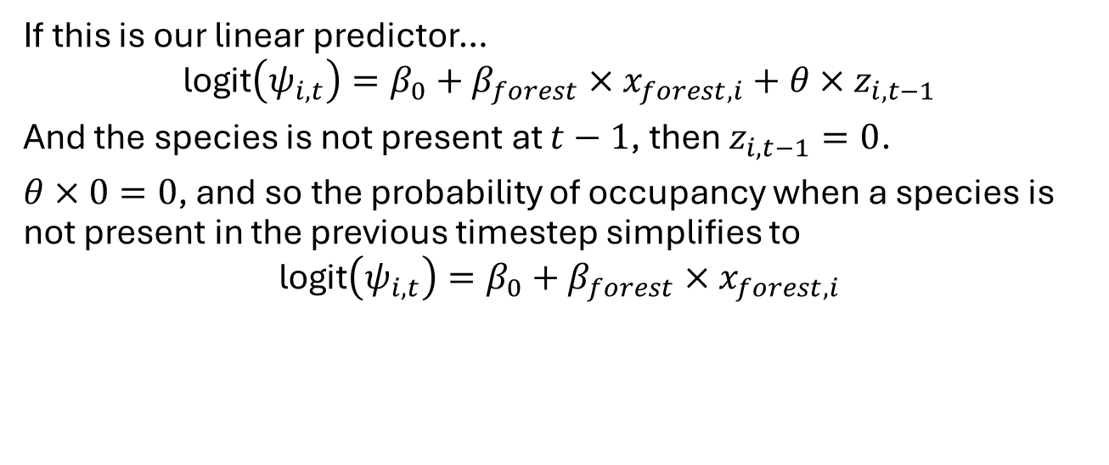
A little bit of algebra
If this is our linear predictor…
$$\text{logit}\left(ψ_{i,t}\right)=β_{0}+β_{forest}×x_{forest,i}+θ×z_{i,t−1}$$
And the species is not present at $t−1$, then $z_{i,t−1}=0$.
$θ×0=0$, and so the probability of occupancy when a species is not present in the previous timestep simplifies to
$$\text{logit}\left(ψ_{i,t}\right)=β_{0}+β_{forest}×x_{forest,i}$$

Slide 26
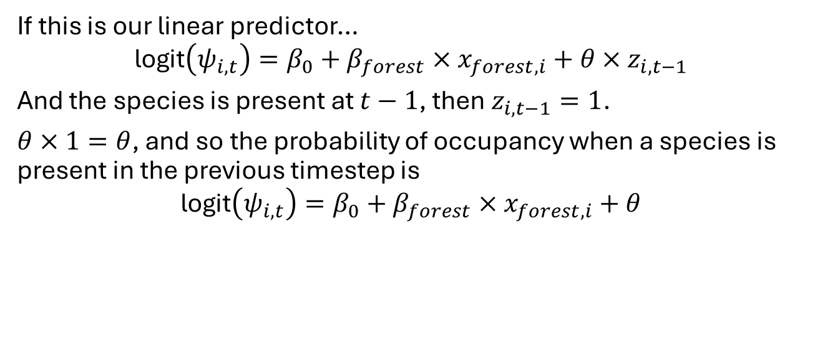
A little bit of algebra (continued)
If this is our linear predictor…
$$\text{logit}\left(ψ_{i,t}\right)=β_{0}+β_{forest}×x_{forest,i}+θ×z_{i,t−1}$$
And the species is present at $t−1$, then $z_{i,t−1}=1$.
$θ×1=θ$, and so the probability of occupancy when a species is present in the previous timestep is
$$\text{logit}\left(ψ_{i,t}\right)=β_{0}+β_{forest}×x_{forest,i}+θ$$

Slide 27
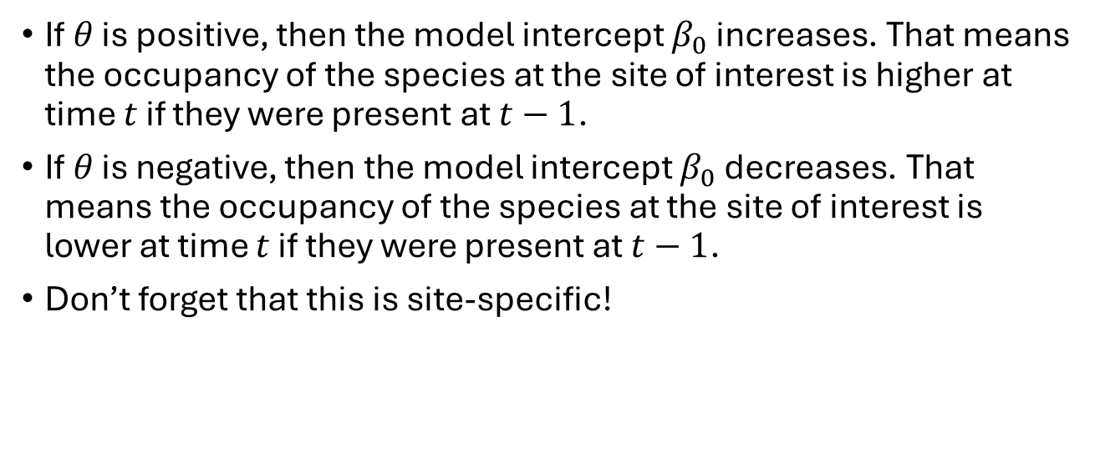
How do you interpret the autologistic term?
If $θ$ is positive, then the model intercept $β_{0}$ increases. That means the occupancy of the species at the site of interest is higher at time $t$ if they were present at $t−1$.
If $θ$ is negative, then the model intercept $β_{0}$ decreases. That means the occupancy of the species at the site of interest is lower at time $t$ if they were present at $t−1$.
Don’t forget that this is site-specific!

Slide 28
And what about the detection model?
The detection model is identical to the detection model in a dynamic occupancy model.
Can include covariates that are spatial, temporal, and/or spatiotemporal covariates.
Temporal or spatiotemporal covariates can vary among primary sampling periods (e.g., average temperature over a whole sampling period).
In the detection model, temporal or spatiotemporal covariates can vary among primary sampling periods or secondary sampling periods within a primary sampling period (e.g., daily average rainfall).

Slide 29
How do you fit autologistic occupancy models?
Code it up in your Bayesian software package of choice.
Use autoOcc, an R package Mason developed to fit autologistic models, compare their fit via AIC, and make model predictions.

Slide 30
Steps for your standard analysis in autoOcc
Read in and format your detection data.
Read in, scale, and format your covariates.
Fit models.
Compare and view models.
Plot out relationships.

Slide 31
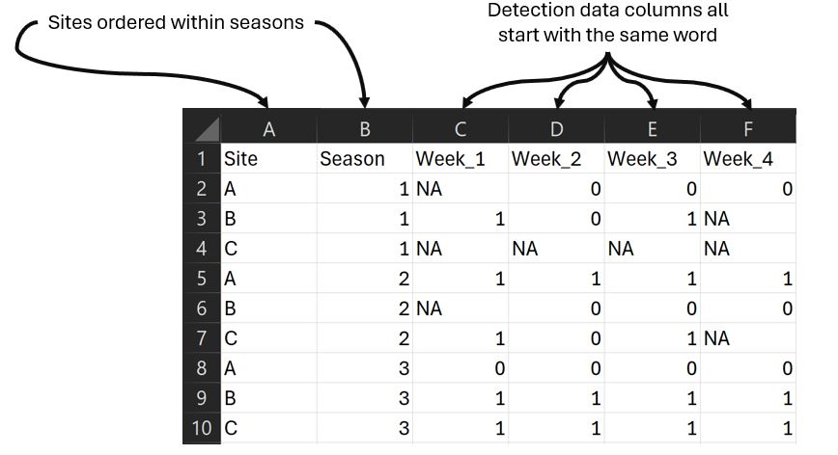
Format your detection data with format_y()

Slide 32
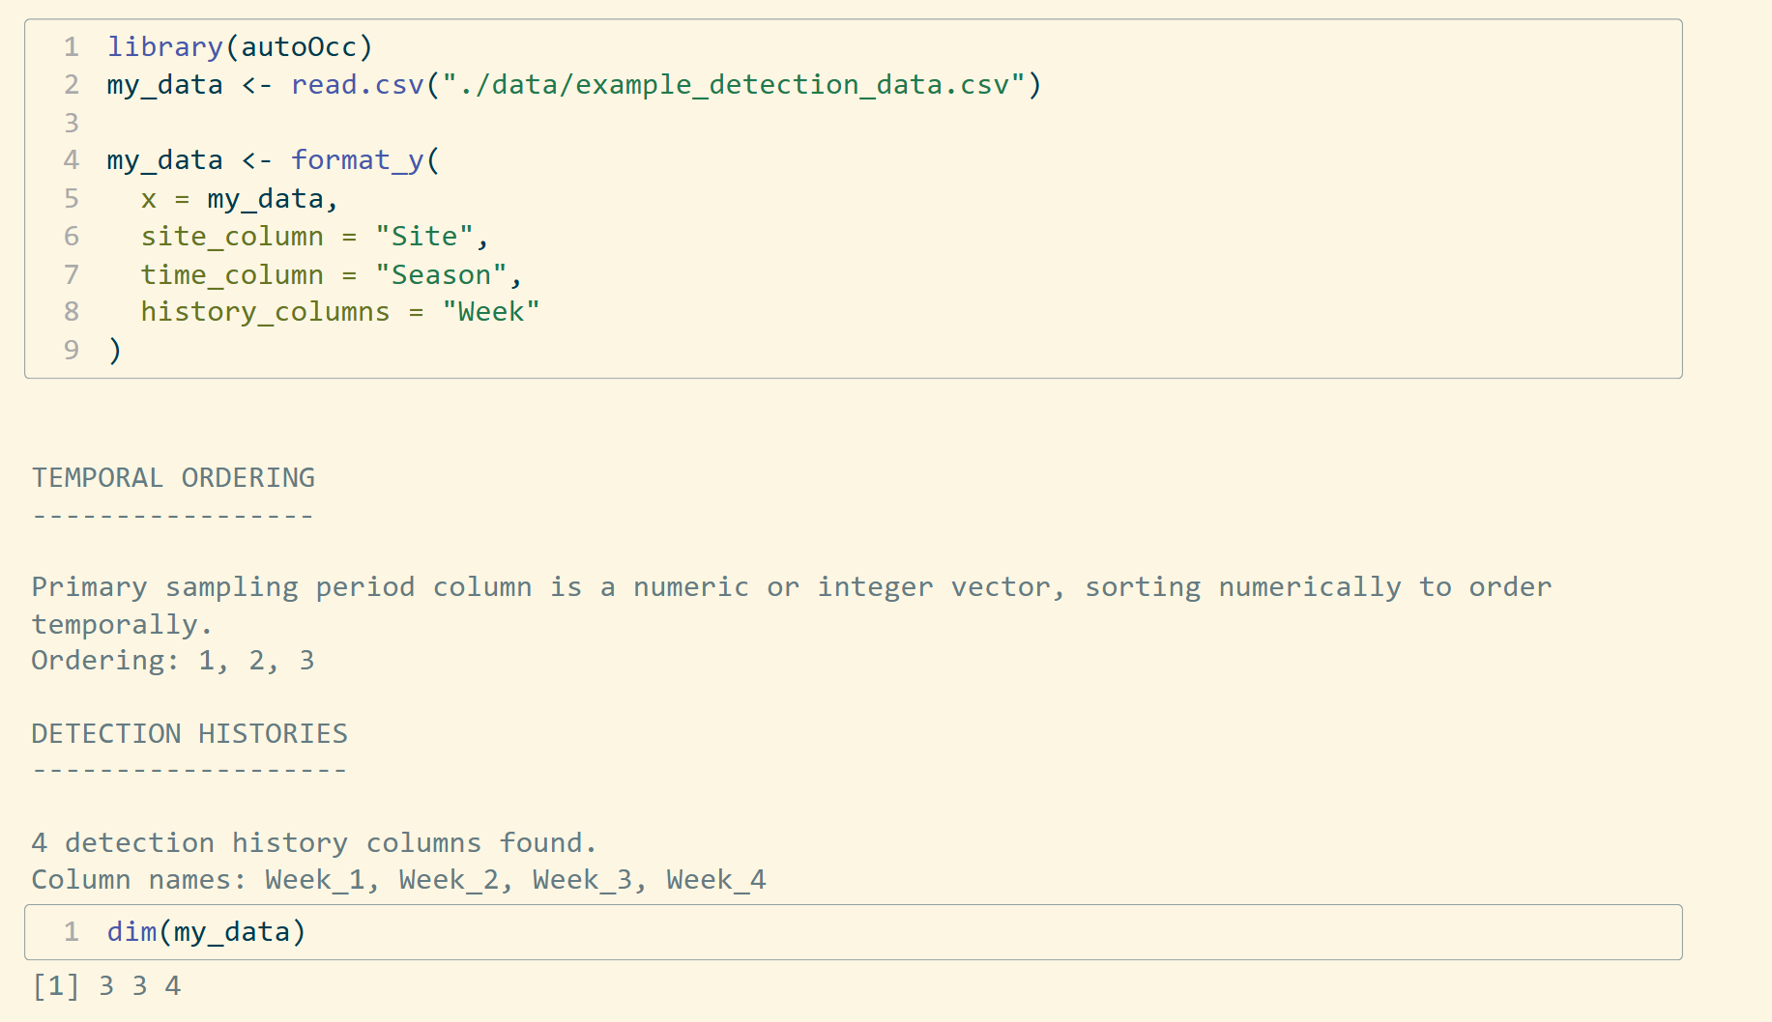
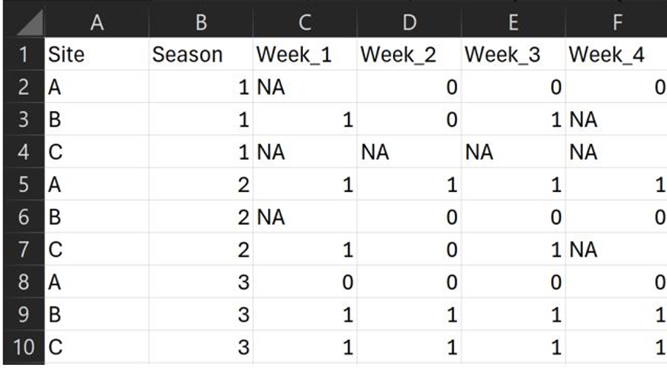
Format your detection data with format_y()

Slide 33
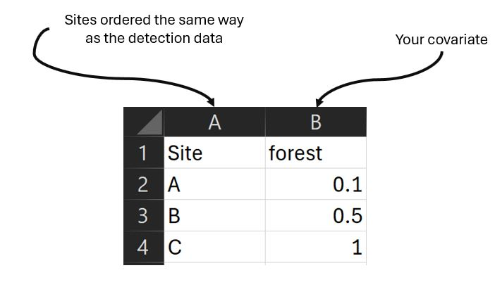
Format your covariates with dplyr

Slide 34
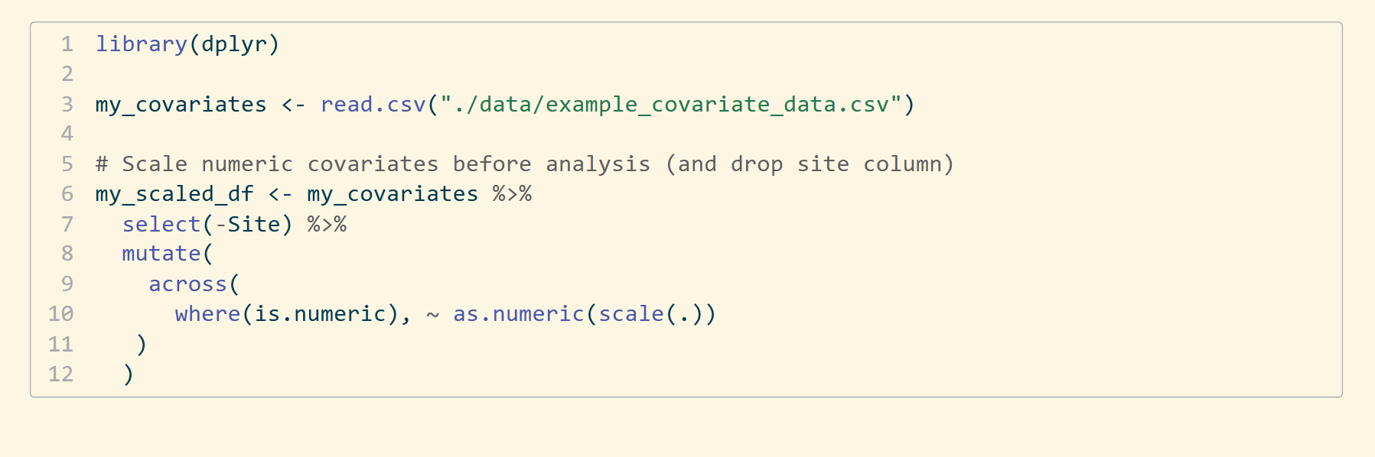
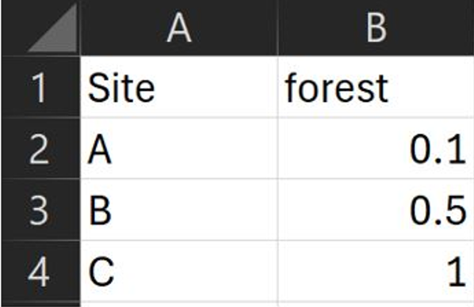
Format your covariates with dplyr

Slide 35
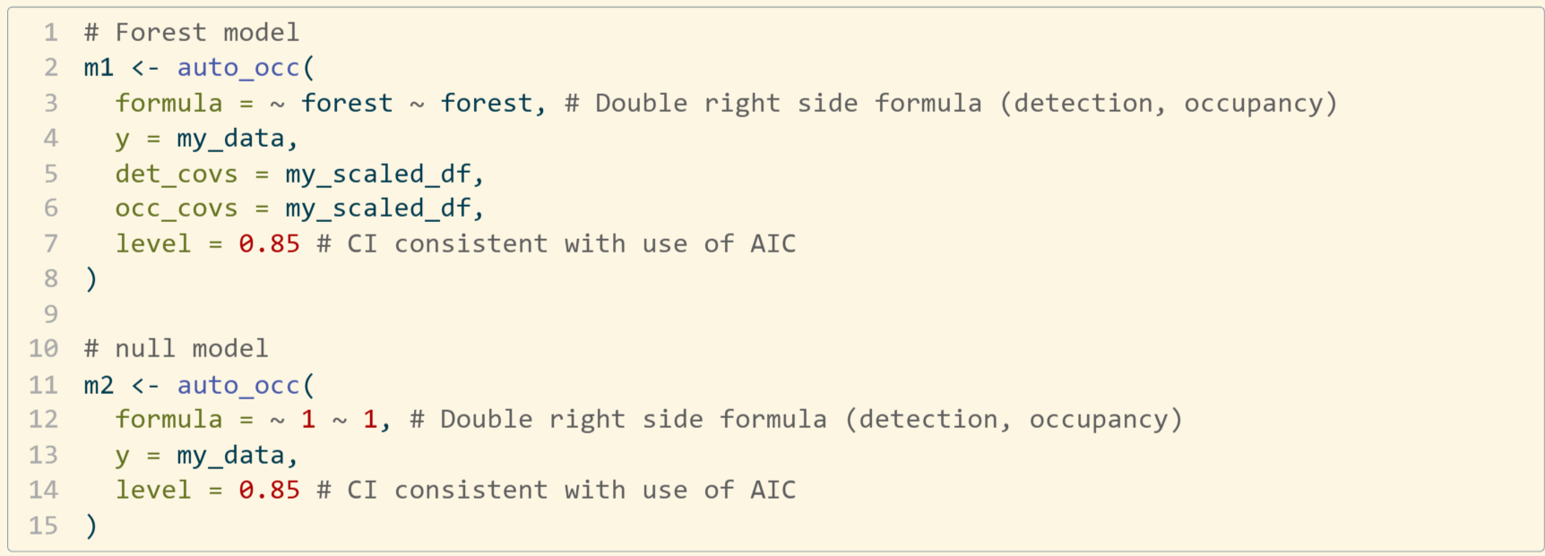
Fit models with auto_occ()

Slide 36
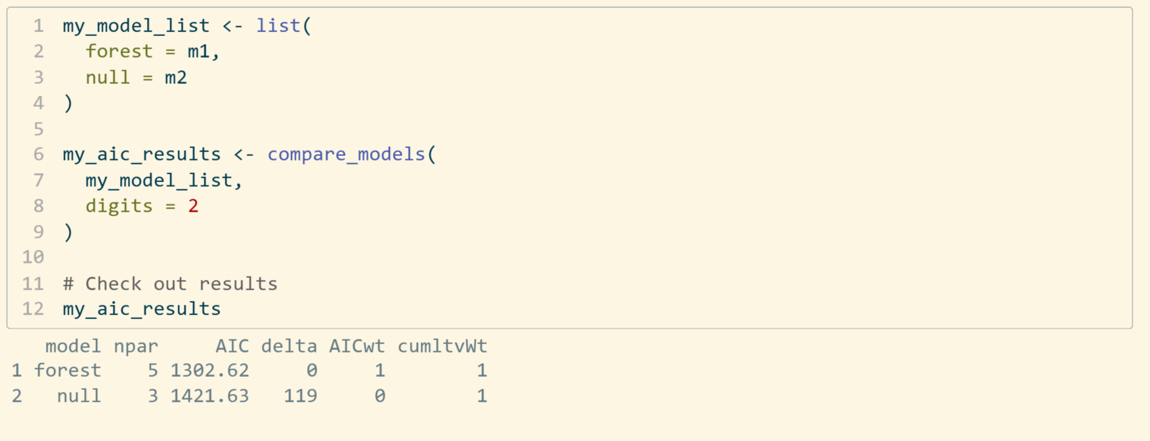
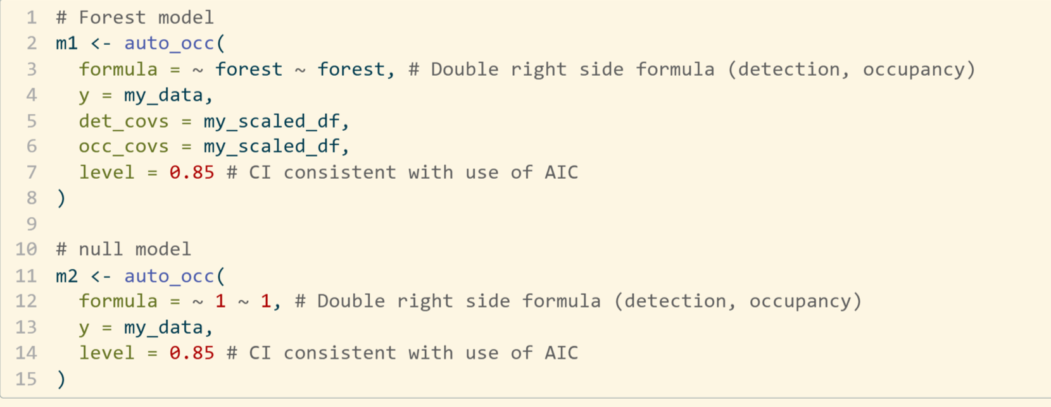
Compare models with compare_models()

Slide 37
View model results with summary()
summary(m1)
Call:
auto_occ(formula = ~forest ~ forest, y = my_data, det_covs = my_scaled_df,
occ_covs = my_scaled_df, level = 0.85)
optim convergence code: 0
optim iterations: 32
Occupancy estimates:
parameter Est SE lower upper p
1 psi - (Intercept) -0.533 0.156 -0.758 -0.308 6.39e-04
2 psi - forest 1.167 0.153 0.947 1.387 2.39e-14
3 psi - theta 1.006 0.274 0.611 1.401 2.45e-04
Note: psi - theta is the autologistic term
Detection estimates:
parameter Est SE lower upper p
4 rho - (Intercept) 0.335 0.107 0.180 0.489 1.82e-03
5 rho - forest 0.642 0.113 0.479 0.805 1.47e-08
AIC: 1302.625

Slide 38
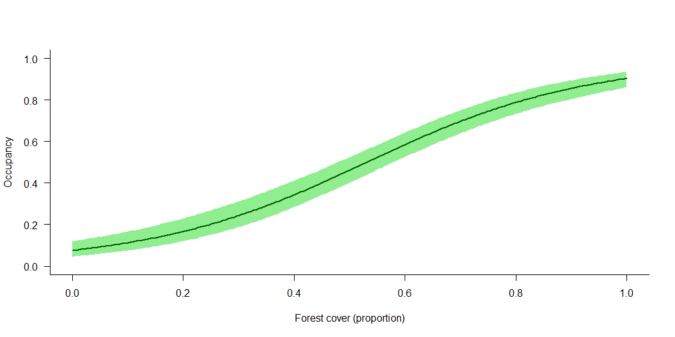
Make model predictions with predict()

