Slide 1

UWIN workshop: GitHub and Data Reproducibility
Nathan Byer and Mason Fidino

Slide 2

Who we are
Nathan Byer
Research & Database Manager at Cleveland Metroparks (CMP)
Research committee member with UWIN; manages CMP wildlife and ecological data
contact: nwb@clevelandmetroparks.com

Slide 3

Who we are
Mason Fidino
Senior Quantitative Ecologist at the Urban Wildlife Institute, Lincoln Park Zoo
Analytics advisor for UWIN, helps steer database management and development
contact: mfidino@lpzoo.org

Slide 4
How do researchers typically store files?
paper_draft.docx
paper_draft2.docx
paper_draft2_MF.docx
paper_final.docx
paper_final2.docx
paper_final_revision.docx

Slide 5
Why is this a problem?
How do you keep track of edits?
How do we handle “accidents”?
fundamentally, an issue with data reproducibility.

Slide 6
Why worry about data reproducibility?
We are currently experiencing a crisis of reproducibility in science!
In response to this, code review is now a required component of peer review for many journals.
Better, more reproducible code also makes it easier to standardize methodology.

Slide 7

Git and GitHub

Slide 9
What is Git?

Slide 10
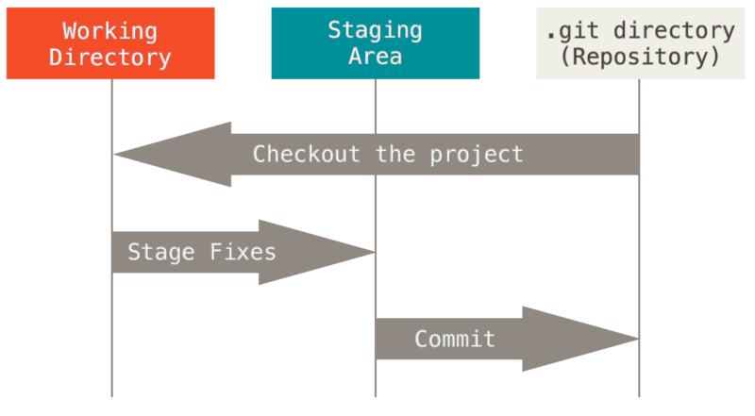
Started in 2005 - version control system for Linux developers
Now, one of the most commonly used distributed version control systems
https://git-scm.com/book/en/v2/images/areas.png

Slide 11
What is GitHub?

Slide 12
GitHub is an easier, user-friendly way to use Git online
integrates with a number of other software platforms - including RStudio

Slide 13
A brief overview of GitHub terminology

Slide 14
Repository
Definition: essentially, a project directory - where code, documents, and everything associated with a project will live.
By default, typically contains a README.md file that describes the repository.

Slide 15
Clone
Definition: the creation of a local copy of a remote repository.
In other words, you are copying the remote repository stored in the cloud on GitHub to a folder of your choice on your computer (i.e., creating a local copy).

Slide 16
Branch
Definition: Branches are used to isolate the development of code without affecting other parts of the code base.
When you create a repository you have one branch
New branches are created off an existing branch.
Branches are used to develop features, fix bugs, or safely experiment with new ideas in a contained part of a repository.

Slide 17
Branch (example)
Nathan has some code for a project that works, but he wants to improve the code to make it run faster. To do so Nathan creates a branch titled performance-tests off of the main branch so he can try out different ways to improve the speed of his code without affecting the code in the main branch.

Slide 18
Commit
Definition: a summary of changes made to files within a repository on a given branch.
typically capture the following:
a commit log, explaining the commit and its contributor(s)
a unique hash ID (GitHub handles this for you).
the parent commit - basically, where your commit came from!
a summary of files that have changed
In essence, a commit is the changes you made to your local copy of a repository, which you want to save and eventually send up to the remote repository.
commit early, commit often!

Slide 19
Push
Definition: when local commits are pushed to a branch on a remote repository.
What do we mean by this?
you will likely be creating a commit on a local machine.
after you create that commit, it will not be reflected in the remote repository until those changes are pushed.
Commits records changes to the local repository.
Pushes update the remote repository with commits you’ve made.

Slide 20
Pull
Definition: when remote changes on a branch are applied to your local, cloned repository.
What do we mean by this?
if you are working on a repository collaboratively, others may make edits that are not initially reflected in your local repository.
when you pull from the remote repository, these remote changes are synced with your local directory.
Not to be confused with pull requests, which are a different thing!

Slide 21
Pull Request
Definition: A pull request (PR) is a way to tell collaborators (or yourself) that the changes you pushed to a branch are ready for review. Think of a pull request as a staging area that you use before you merge one branch back into another.
To set up a pull request, you have to select the branch with the code you changed and the branch you want to merge those changes into.
When working collaboratively, someone else reviews the pull request, discussion happens, and based on that some followup commits may be needed.
Once approved, you can merge the feature branch into the other branch you selected.

Slide 22
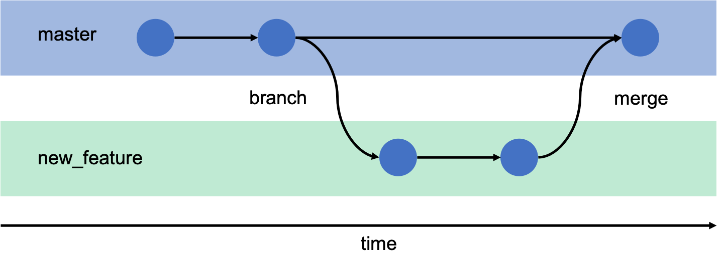
Pull Request (example)
Example: Mason want’s to make a new function for his autoOcc R package. To do so, Mason created a new branch, pushed commits to that branch, and when the function was ready made a pull request to merge the feature branch into the main branch.

Slide 23
fork
Definition: A fork is a way to create a new repository based on a different repository you are (most often) not the owner of.
You can think of forks it as a branch off a repository you do not own. You can make changes to your forked repository and then submit a pull request to the original project owner.
As such, forks are used a lot when working on open source projects.
Creating a fork is the easiest way to copy everything in someone else’s repository.
However, if you are working on a research project with a few trusted people it is often easier to set them up as collaborators instead of having them fork your repository, make a PR of changes, etc.

Slide 24
How to use GitHub in your projects (from most to least user friendly)

Slide 25
Use GitHub Desktop!
Found at https://desktop.github.com.
Provides a graphical user interface (GUI) to do pretty much everything you would need to do.
Can’t handle complex Git commands, but 99.9% of researchers will not need them anyways.
There are a few other things that are a bit easier to do from your internet browser instead of the desktop GUI.
Pull requests (i.e., merging branches)
Changing settings
Inviting collaborators to a repository

Slide 26
Link Rstudio with GitHub
Rstudio does provide a way to use GitHub within it’s interactive developer environment (IDE)
Can be a little finicky
Not as general as GitHub desktop, so we suggest the GitHub Desktop GUI instead.

Slide 27
Git from the command line (GitHub CLI)
Bringing this up for completeness
Used to be the primary way you could use Git via GitHub
Do not suggest doing this when learning.
Sometimes needs to be used to resolve certain issues, but those are quite rare (and the GitHub Desktop GUI provides you with the command line code to run if needed).

Slide 28
Other things to know about GitHub

Slide 29
Privacy settings
Repositories can be public or private!
Public repositories are viewable by everyone
Private repositories are only viewable by yourself and collaborators you add to the repository
For most research projects, start your repository as private. You can change them to public when you submit the paper for publication.

Slide 30
MERGE CONFLICTS!!!
The most annoying part of version control.
Happens when you try to merge branches and they have conflicting commits.
Example: Nathan and Mason are working on a project with GitHub. Nathan does the right thing and creates a new branch to modify a data analysis script. Mason makes some changes to that same script and pushes them to the main branch. When Nathan makes a pull request to merge branches, Git will need your help to decide which changes to incorporate into a final merge.

Slide 31
Don’t store everything on GitHub
Can’t store files > 100 Mb on GitHub (so if you have big datasets you may need a workaround).
Don’t store files on the cloud that already live there (e.g., large spatial data files), but provide documentation on how to find those files!
Don’t store sensitive information in public repositories (e.g., API keys, passwords, etc.). GitHub has a way to use those safely.

Slide 32
It is really easy and free to archive your code and create a DOI
GitHub interfaces with Zenodo, which is an open repository operated by CERN.
After connecting the two, you can archive and generate a DOI for a given repository in minutes.
Archiving code and data is becoming increasingly common when papers get published, so you may as well start getting familiar with this process.

