Slide 1
Museum guide: genre recognition on WikiArt
• 5 genres x 300 paintings, 128 x 128 px (cityscape, landscape, portrait, religious painting, still life)
• Split by artist: 1 000 train / 250 validation / 250 test, no artist in two sets
• Question of the director: is a neural network worth it on modest kiosk CPUs?
Notes:
30 s. Present the data and the question. Stress the split by artist: otherwise the network recognises the painter.

Slide 2
1. Dense network from scratch (m1)
• 49 152 - 128 sigmoid - 5: 6.3 million weights for 1 000 images
• Test accuracy 0.380 (chance 0.20)
• Landscape / cityscape mixed up (21 times); religious paintings recognised 4 times out of 50
• Flattening throws away which pixels are neighbours
Notes:
1 min. Test set measured once. Confusion matrix in notebook 01.

Slide 3
2. Monitoring and failure diagnosis (m2)
• Train accuracy 0.93 vs validation 0.43 after 30 epochs: gap 0.50 = overfitting
• Validation loss best at epoch 4 (1.413), 1.731 at epoch 30
• Early stopping (patience 5): gap 0.20, but validation accuracy unchanged (0.420 vs 0.432)
• Noisy training loss: learning rate 0.2 too large (not fixed)
• Ruled out: nan, flat loss at ln 5 = 1.61
Notes:
2 min. Diagnosis table of Session 6: symptom, evidence, cause, action. Early stopping avoids memorising but does not teach the genres: the limit is the model.

Slide 4
3. Pretrained ResNet-18 (m3)
• New head (512 x 5) trained alone, then layer4 fine-tuned with lr 1e-4
• Test accuracy 0.772 in m3 (0.796 in the m4 rerun) vs 0.380 for the dense network
• Religious paintings: 31/50 instead of 4/50
• After fine-tuning: train accuracy 0.998, validation loss goes up: a few epochs are enough
Notes:
1.5 min. Batch norm kept in eval mode. ImageNet normalisation. The two runs differ by about 6 images; we did not investigate why.

Slide 5
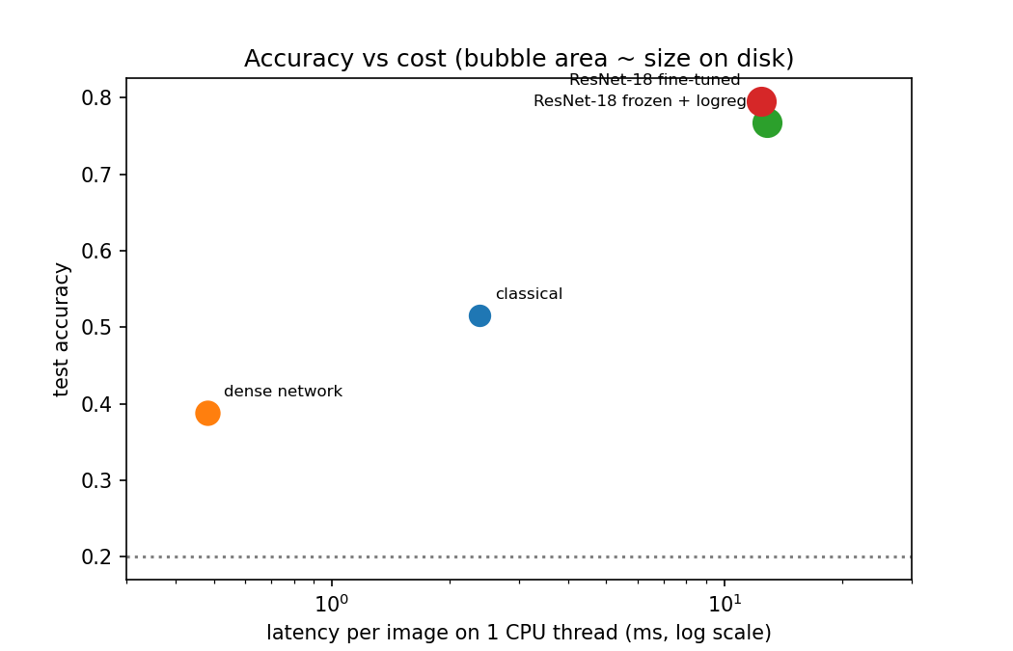
4. Classical model vs neural networks (m4)
• Classical: colour histograms + HOG + RBF-SVM, chosen on validation
• Same split, same 250 test images, 1 CPU thread, HOG included in the latency
• Margin of an accuracy on 250 images: about +/- 0.05
Notes:
2 min. The dense network is worse than the classical model. The pretrained ResNet is 25 points above it.

Slide 6
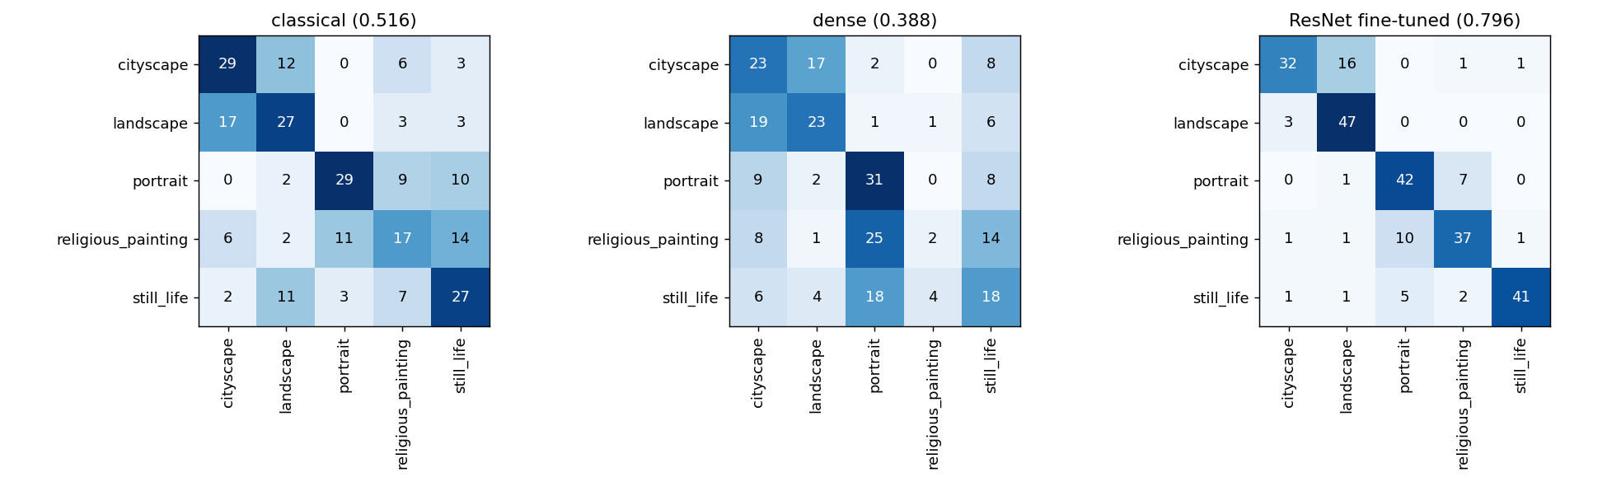
Results
• Classical (HOG + SVM): 0.516 | 14.5 MB | 2.4 ms
• Dense network: 0.388 | 25.2 MB | 0.5 ms
• ResNet-18 frozen + logreg: 0.768 | 44.8 MB | 12.9 ms
• ResNet-18 fine-tuned: 0.796 | 44.8 MB | 12.4 ms
• Frozen vs fine-tuned: 7 images out of 250, inside the margin
Notes:
1 min. Numbers come from results_m4.csv.

Slide 7
Recommendation to the director
• Yes, a neural network is worth it, but a pretrained one, not one trained from scratch
• Start with frozen ResNet-18 + logistic regression: no fine-tuning to maintain, accuracy within the margin of the fine-tuned model
• 12 ms and 45 MB per photo on one CPU thread: acceptable for a kiosk
• Limits: latency measured on a laptop, not on the kiosk; only 5 genres; natural-language search not covered
Notes:
1.5 min. Re-measure latency on the target hardware before committing.

