Slide 1
Business-Level Strategy: Creating and Sustaining Competitive Advantages - 1
Strategic Management Part 2 - Strategic Formulation
BUS 4750
Instructor: Dr. Xiaodan “Abby” Wang
Western Michigan University

Slide 2

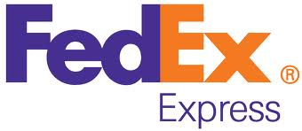


Generic Strategies
Source of Competitive Advantage
Uniqueness
Cost
Differentiation
Commitment to very speedy delivery .
Cost
Leadership
Attract a large customer base and keep prices low by buying massive quantities of goods from suppliers.
Broad/Industrial wide
Strategic Target / Scope of Operations
“ When it absolutely, positively has to be there overnight.”
Focused
Differentiation
Focus on selling natural and organic product. Has a nick name of “whole paycheck” due to high price.
Narrow/Particular segment
Focused Cost Leadership
Target young women with inexpensive jewelry, accessories, and ear piercings.
Notes:
The process of defining a business
What are the customer needs
Who are the major customer groups we intend to serve
How are we going to accomplish our goal.
Distinctive confidence

Slide 3
Generic Strategies
Overall cost leadership
Low-cost-position relative to a firm’s peers
Manage relationships throughout the entire value chain
Differentiation
Create products and/or services that are unique and valued
Non-price attributes for which customers will pay a premium
Focus strategy
Narrow product lines, buyer segments, or targeted geographic markets
Attain advantages either through differentiation or cost leadership
Notes:
Cost leadership
Wal-mart
McDonalds
Differentiation
Victoria Secret
Apple
Focus
Rolex
Lamborghini

Slide 4
Overall Cost Leadership
Reduce costs to below those of all competitors.
Sources of cost advantages
Size differences and economies of scale (but exceeding the optimal volume of production will cause diseconomies of scale)
Experience differences and learning curve economies
Differential access to productive inputs
Efficient internal operations (structure, technology, etc.)
Policy choices

Slide 5
Overall Cost Leadership
Requires a tight set of interrelated tactics
Aggressive construction of efficient-scale facilities
Vigorous pursuit of cost reductions from experience
Tight cost and overhead control
Avoidance of marginal customer accounts
Cost minimization in all activities in the firm’s value chain, such as R&D, service, sales force, and advertising

Slide 6
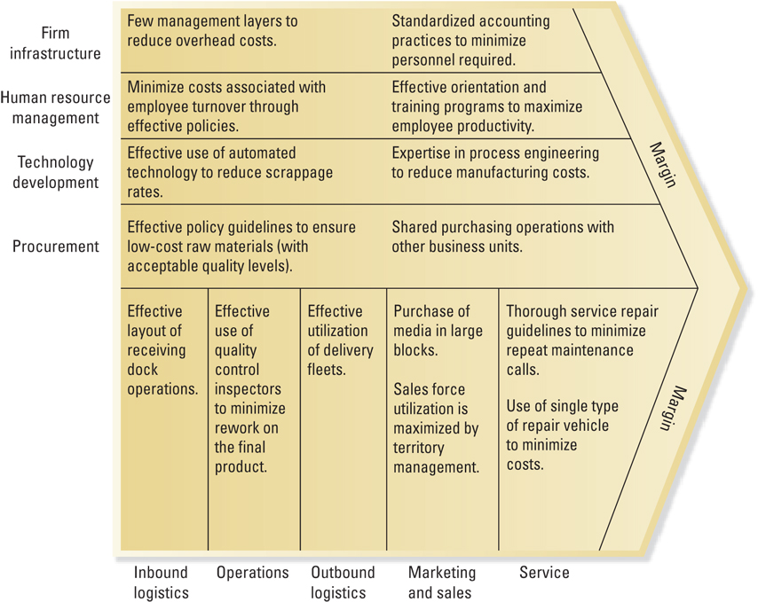
Value-Chain Activities: Overall Cost Leadership

Slide 7
Overall Cost Leadership
Firms pursuing cost leadership strategies usually emphasize two product attributes in their advertisements: reliability and price.
A firm following an overall cost leadership position
Must attain parity on the basis of differentation relative to competitors
Parity on the basis of differentiation
Permits a cost leader to translate cost advantages directly into higher profits than competitors
Allows firm to earn above-average profits

Slide 8
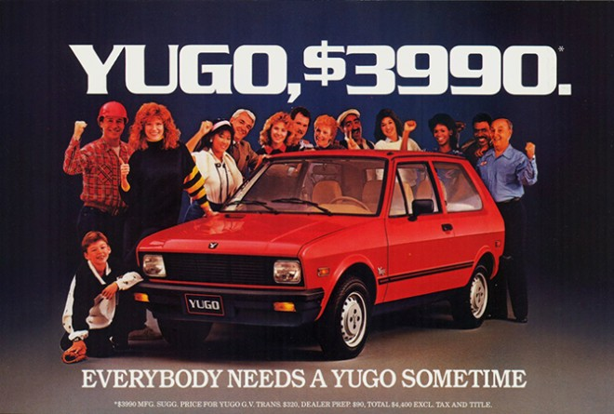

Yugo
Amazingly low price
Amazingly bad quality
A failure to attain parity on the basis of differentiation.
No matter how good the price, the most cost-sensitive consumer won’t buy a bad product.
Notes:
In 1980s

Slide 9

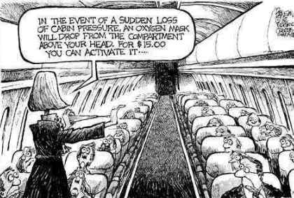


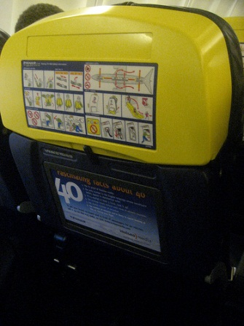
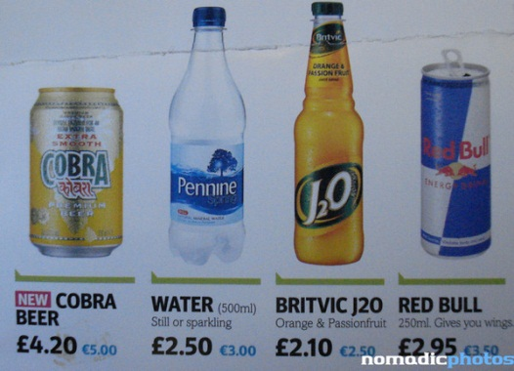
Ryanair – A Successful Example
“Wal-Mart with wings”

Slide 10
Internet-Enabled Low Cost Leader Strategies
Online bidding and order processing are eliminating the need for sales calls and are minimizing sales force expenses.
Online purchase orders are making many transactions paperless, thus reducing the costs of procurement and paper.

Slide 11
Overall Cost Leadership: Improving Competitive Position vs. the Five Forces
An overall low-cost position
Protects a firm against rivalry from competitors
Protects a firm against powerful buyers
Provides more flexibility to cope with demands from powerful suppliers for input cost increases
Provides substantial entry barriers from economies of scale and cost advantages
Puts the firm in a favorable position with respect to substitute products

Slide 12
Pitfalls of Overall Cost Leadership Strategies
Too much focus on one or a few value-chain activities
All rivals share a common input or raw material
The strategy is imitated too easily
A lack of parity on differentiation
Erosion of cost advantages when the pricing information available to customers increases

Slide 13
Differentiation
Increase the perceived value/uniqueness of the firm’s products or services.
Bases of differentiation (differentiation can take many forms)
1. The attributes of products/services
Product features
Product complexity
Timing of product introduction
Location

Slide 14

Differentiation
2. Relationships between the firm and its customers
Product customization
Consumer marketing
Product reputation
3. Linkages within or between firms
Linkages among functions within a firm
Linkages with other firms
Product mix
Distribution channels
Service and support

Slide 15
Differentiation
Firms achieve and sustain differentiation and above-average profits when price premiums excess extra costs of being unique (need reduce costs in all areas that do not affect differentiation – gain cost parity)
Firms may differentiate along several dimensions at once
Successful differentiation requires integration with all parts of a firm’s value chain
An important aspect of differentiation is speed or quick response

Slide 16
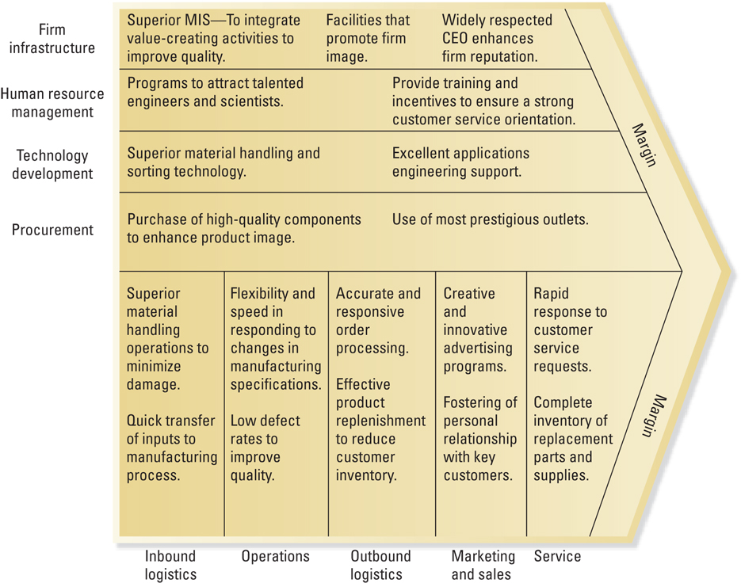
Value-Chain Activities: Differentiation

Slide 17
Internet-Enabled Differentiation Strategies
Internet-based knowledge management systems that link all parts of the organization are shortening response times and accelerating organization learning.
Quick online responses to service requests and rapid feedback to customer surveys and product promotions are enhancing marketing efforts.

Slide 18
Differentiation: Improving Competitive Position vs. the Five Forces
Differentiation
Provides protection against rivalry since brand loyalty lowers customer sensitivity to price and raises customer switching costs
Creates higher entry barriers due to customer loyalty
Provides higher margins that enable the firm to deal with supplier power
Reduces buyer power because buyers lack suitable alternative
Establishes customer loyalty and hence less threat from substitutes

Slide 19
Potential Pitfalls of Differentiation Strategies
Uniqueness that is not valuable
Too much differentiation
Too high a price premium
Differentiation that is easily imitated
Dilution of brand identification through product-line extensions
Perceptions of differentiation may vary between buyers and sellers

Slide 20

QUESTION
Convincing rivals not to enter a price war, protection from customer pressure to lower prices, and the ability to better withstand cost increases from suppliers characterize which type of competitive strategy? .
B. Differentiation
C. Focus
D. None of the above
A. Overall cost leadership
Notes:
20

Slide 21
QUESTION
A firm can achieve differentiation through all of the following means except
A. improving brand image.
B. providing better customer service.
D. adding additional product features.
C. offering lower prices to customers.
Notes:
21

Slide 22
Focus
Focus is based on the choice of a narrow competitive scope within an industry
Firm selects a segment or group of segments (niche) and tailors its strategy to serve them
Firm achieves competitive advantages by dedicating itself to these segments exclusively
Two variants
Cost focus – create a cost advantage in target market segment
Differentiation focus – differentiate in the target market segment

Slide 23
Internet-Enabled Focus Strategies
Permission marketing techniques are focusing sales efforts on specific customers who opt to receive advertising notices.
Niche portals that target specific groups are providing advertisers with access to viewers with specialized interests.

Slide 24
Focus: Improving Competitive Position vs. the Five Forces
Focus
Creates barriers of either cost leadership or differentiation, or both
Used to select niches that are least vulnerable to substitutes or where competitors are weakest

Slide 25
Pitfalls of Focus Strategies
Erosion of cost advantages within the narrow segment
Focused products and services still subject to competition from new entrants and from imitation
Focusers can become too focused to satisfy buyer needs

Slide 26
Competitive Advantage, Combination Strategies and Business Performance
Businesses combining multiple forms of competitive advantage outperform businesses that use only a single form.
Goal of combination strategy is to provide unique value in an efficient manner
Often called “best-cost strategy”
The lowest performers are those that do not identify with even a single type of advantage – “stuck in the middle”.

Slide 27
Combination Strategies: Integrating Overall Low Cost and Differentiation
Primary benefit of successful integration of low-cost and differentiation strategies is the difficulty for competitors to duplicate or imitate
Goal of combination strategy is to provide unique value in an efficient manner
Often called “best-cost strategy”

Slide 28
Three Combination Approaches
Automated and flexible manufacturing systems
Mass Customization – manufacture unique products in relatively small quantities at lower costs
Exploiting the profit pool concept for competitive advantage
Profit pool – the total profits in an industry at all points along the industry’s value chain
Coordinating the “extended” value chain by way of information technology
Link its own value chain with the value chains of customers and suppliers

Slide 29
Combination Strategies: Improving Competitive Position vs. the Five Forces
Firms that successfully integrate differentiation and cost strategies obtain advantages of competition from both approaches
High entry barriers
Bargaining power over suppliers
Reduces power of buyers (fewer competitors)
Value position reduces threat from substitute products
Reduces the possibility of head-to-head rivalry

Slide 30
Pitfalls of Combination Strategies
Firms that fail to attain both strategies may end up with neither and become “stuck in the middle”
Underestimating the challenges and expenses associated with coordinating value-creating activities in the extended value chain
Miscalculating sources of revenue and profit pools in the firm’s industry

