Slide 1
Strategic Control and Corporate Governance - 1
Strategic Management Part 3 - Strategic Implementation
BUS 4750
Instructor: Dr. Xiaodan “Abby” Wang
Western Michigan University

Slide 2
Strategic Control
Strategic control - the process of monitoring and correcting a firm’s strategy and performance.
Informational control – the ability to respond effectively to environment change.
whether or not the organization is “doing the right things”
Behavioral control – the appropriate balance and alignment among a firm’s culture, rewards, and boundaries
whether or not the organization is “doing things right” in the implementation of its strategy
Both types of control are necessary conditions for success

Slide 3
Informational Control
Deals with internal environment and external strategic context
Key question
“Do the organization’s goals and strategies still ‘fit’ within the context of the current strategic environment?”
Two key issues
Scan and monitor external environment (general and industry)
Continuously monitor the internal environment

Slide 4
Two Types of Control Systems
Traditional control system
Based largely on the feedback approach
Little or no action taken to revise strategies, goals and objectives until the end of the time period
Contemporary control system
Continually monitoring the environments (internal and external)
Identifying trends and events that signal the need to revise strategies, goals and objectives

Slide 5
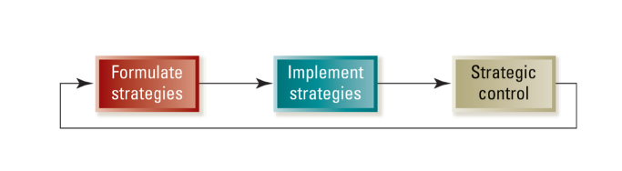
Traditional Approach to Strategic Control
Traditional approach is sequential
Strategies are formulated and top management sets goals
Strategies are implemented
Performance is compared to the desired standard and measured against the predetermined goal set

Slide 6
Traditional Approach to Strategic Control
Control is based on a feedback loop from performance measurement to strategy formulation
Typically involves lengthy time lags, often tied to the annual planning cycle
Little or no action is taken to revise strategies, goals and objectives until the end of the time period
This “single-loop” learning control system simply compares actual performance to a predetermined goal
Most appropriate when
Environment is stable and simple
Goals and objectives can be measured with certainty
Little need for performance

Slide 7
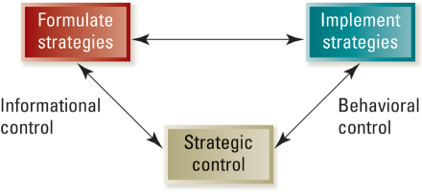
Contemporary Approach to Strategic Control
Relationships between strategy formulation, implementation and control are highly interactive
Includes both the informational and behavior components of strategic control

Slide 8
Benefits of Continuous Monitoring
Time lags are dramatically shortened
Changes in the competitive environment are detected earlier
The organization’s ability to respond with speed and flexibility is enhanced

Slide 9
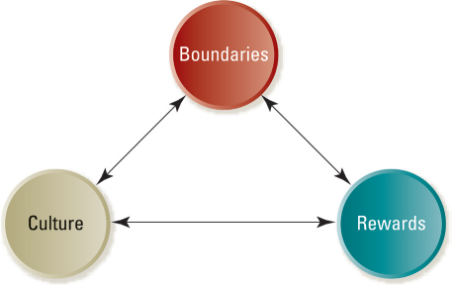
Behavioral Control
Behavioral control is focused on implementation - doing things right
Three key control “levers”

Slide 10
Approach Some Situational Factors
Rules: Written and explicit guidelines that provide external constraints on behavior.
Associated with standardized output
Tasks are generally repetitive and routine
Little need for innovation or creative activity
Culture: A system of unwritten rules that forms an internalized influence over behavior.
Often found in professional organizations
Associated with high autonomy
Norms are the basis for behavior
Rewards: The use of performance-based incentive systems to motivate.
Measurement of output and performance is rather straightforward
Most appropriate in organizations pursuing unrelated diversification strategies
Rewards may be used to reinforce other means of control

Slide 11
Building a Strong and Effective Culture
Organizational culture is a system of
Shared values (what is important)
Beliefs (how things work)
Organizational culture shapes a firm’s
People
Organizational structures
Control systems
Organizational culture produces
Behavioral norms (the way we do things around here)

Slide 12
The Role of Culture
Culture sets implicit boundaries (unwritten standards of acceptable behavior)
Dress
Ethical matters
The way an organization conducts its business
Culture encourages individual identification with the organization and its objectives
Culture acts as a means of reducing monitoring costs

Slide 13
Sustaining an Effective Culture
Effective culture must be
Cultivated
Encouraged
Fertilized
Maintaining an effective culture
Storytelling
Rallies or “pep talks” by top executives

Slide 14
Motivating with Rewards and Incentives
Rewards and incentive systems
Represent a powerful means of influencing an organization’s culture
Focus efforts on high-priority tasks
Motivate individual and collective task performance
Can be an effective motivator and control mechanism

Slide 15
Motivating with Rewards and Incentives – potential downside
Subcultures may arise in different business units with multiple reward systems
Shared values may emerge in subculture in opposition to patterns of the dominant culture
The multiple reward systems reinforce behavioral norms, attitudes, and belief systems in the subcultures of different business units
Reduce organizational cohesiveness
Impotent information may be hoarded rather than shared
Individuals begin working at cross-purpose
Lose sight of overall goals and objectives

Slide 16
Motivating with Rewards and Incentives
Effective reward and incentive programs share some common characteristics
Objectives are clear, well understood and broadly accepted
Rewards are clearly linked to performance and desired behaviors
Performance measures are clear and highly visible
Feedback is prompt, clear, and unambiguous
Compensation “system” is perceived as fair and equitable
Structure is flexible; it can adapt to changing circumstances

Slide 17
Setting Boundaries and Constraints
In the real world, a strong culture and effective rewards are not enough
Boundaries and constraints are needed to help ensure the achievement of overall organizational goals and objectives
Boundaries and constraints serve many useful purposes for organizations
Focusing efforts on strategic priorities
Providing short-term objectives and action plans
Improving operational efficiency and effectiveness
Minimizing improper and unethical conduct

