Slide 1
Analyzing the Internal Environment of the Firm - 2
Strategic Management Part 1 - Strategic Analysis
BUS 4750
Instructor: Dr. Xiaodan “Abby” Wang
Western Michigan University

Slide 2

Value-Chain Analysis
Value Chain
_______________________________________________
_______________________________________________
Value is the amount that buyers are willing to pay for what a firm provides them and is measured by total revenue.
As each activity on the value chain is done, the product/service becomes more valuable than it was at the previous step.
Notes:
2

Slide 3
The Value Chain (McKinsey)
Technology development
Product Design
Manufacturing
Marketing
Distribution
Service

Slide 4
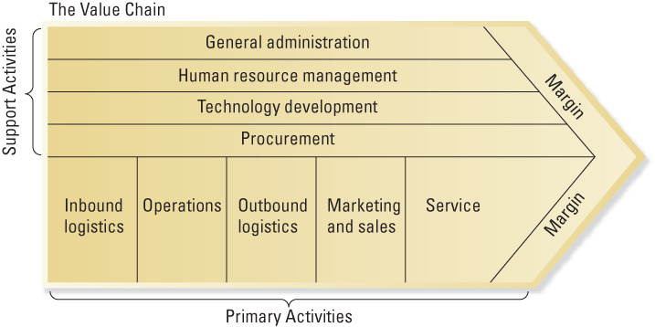
The Value Chain (Porter)

Slide 5
Value-Chain Analysis
Primary activities
contribute to the physical creation of the product or service, its sale and transfer to the buyer, and its service after the sale.
Support activities
activities of the value chain that either add value by themselves or add value through important relationships with both primary activities and other support activities

Slide 6

QUESTION
In assessing its primary activities, an airline would examine: A. Employee training programs C. Criteria for lease versus purchase decisions D. The effectiveness of its lobbying activities
B. Baggage handling

Slide 7
Primary Activity: Inbound Logistics
Associated with receiving, storing and distributing inputs to the product
Location of distribution facilities
Warehouse layout and designs
Notes:
7

Slide 8
Primary Activity: Operations
Associated with transforming inputs into the final product form
Efficient plant operations
Incorporation of appropriate process technology
Efficient plant layout and workflow design
Notes:
8

Slide 9

Primary Activity: Outbound Logistics
Associated with collecting, storing, and distributing the product or service to buyers
Effective shipping processes to provide quick delivery and minimize damages
Shipping of goods in large lot sizes to minimize transportation costs.
Notes:
9

Slide 10

Primary Activity: Marketing and Sales
Associated with purchases of products and services by end users and the inducements used to get them to make purchases
Innovative approaches to promotion and advertising
Proper identification of customer segments and needs
Notes:
10

Slide 11
Primary Activity: Service
Associated with providing service to enhance or maintain the value of the product
Quick response to customer needs and emergencies
Quality of service personnel and ongoing training
Notes:
11

Slide 12
Support Activity: Procurement
Function of purchasing inputs used in the firm’s value chain
Procurement of raw material inputs
Development of collaborative “win-win” relationships with suppliers
Analysis and selection of alternate sources of inputs to minimize dependence on one supplier
Notes:
12

Slide 13
Support Activity: Human Resource Management
Activities involved in the recruiting, hiring, training, development, and compensation of all types of personnel
Effective recruiting, development, and retention mechanisms for employees
Quality relations with trade unions
Reward and incentive programs to motivate all employees
Notes:
13

Slide 14
Support Activity: Technology Development
Related to a wide range of activities and those embodied in processes and equipment and the product itself
Effective R&D activities for process and product initiatives
Positive collaborative relationships between R&D and other departments
Excellent professional qualifications of personnel
Notes:
14

Slide 15
Support Activity: General Administration
Typically supports the entire value chain and not individual activities
Effective planning systems
Excellent relationships with diverse stakeholder groups
Effective information technology to integrate value-creating activities
Notes:
15

Slide 16
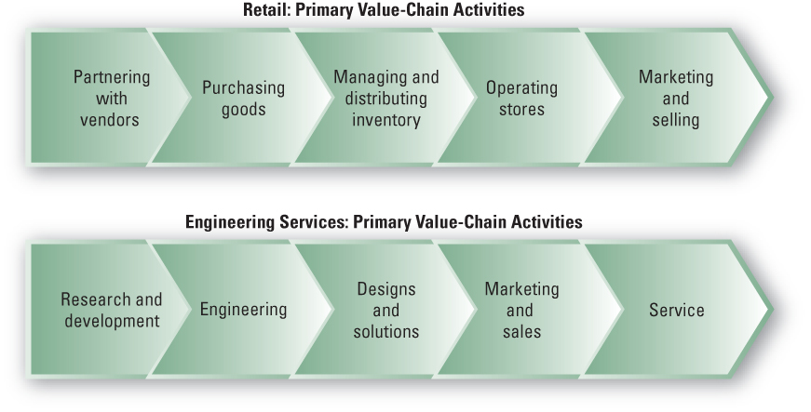
Value Chains in Service Industries

Slide 17


Building Blocks of
Resources
Tangible resources:
Can be actually seen, touched and quantified.
Culture
Intangible resources:
Difficult to see, touch, quantify, and imitate.
Reputation
The firm’s ability to combine, manage or exploit resources in a manner that provides value added and advantages over competitor.
Capabilities
Exists when a firm is skilled at continually updating its array of capabilities to keep pace with changes in its environment.
Dynamic Capability

Slide 18

Types of Resources
Tangible resources
organizational assets that are relatively easy to identify
include physical resources, financial resources, organizational resources and technological resources that an organization uses to create value for its customers
Notes:
18

Slide 19
Types of Resources: Tangible Resources
Financial resources
Firm’s cash accounts
Firm’s capacity to raise equity
Firm’s borrowing capacity
Physical resources
Modern plant and facilities
Favorable manufacturing locations
State-of-the-art machinery and equipment
Notes:
19

Slide 20
Types of Resources: Tangible Resources
Technological resources
Trade secrets
Innovative production processes
Patents, copyrights, trademarks
Organizational resources
Effective strategic planning processes
Excellent evaluation and control systems
Notes:
20

Slide 21



Types of Resources
Intangible resources
organizational assets that are more difficult to identify or imitate
are typically embedded in unique routines and practices that have evolved and accumulated over time
include human resources, innovation resources, and reputation resources
Notes:
21

Slide 22
Types of Resources: Intangible Resources
Human
Experience and capabilities of employees
Trust
Managerial skills
Firm-specific practices and procedures
Innovation and creativity
Technical and scientific skills
Innovation capacities
Reputation
Brand name
Reputation with customers
Reputation with suppliers
Notes:
22

Slide 23

Types of Resources
Organizational capabilities
the competencies and skills that a firm employs to transform inputs into outputs
capacity to combine tangible and intangible resources , using organizational processes to bring about a desired end
Innovativeness of products and services
Excellent product development capabilities
Ability to hire, motivate, and retain human capital
Outstanding customer service
Notes:
23

Slide 24
QUESTION
Gillette is able to combine several technologies to attain unparalleled success in the wet shaving industry. This is an example of their __________. A. Tangible resources B. Intangible resources D. Strong primary activities
C. Organizational capabilities

Slide 25
Characteristics of Strategic Resources
For a resource to provide a firm with the potential for a sustainable competitive advantage, it must have four attributes:
First, the resource must be __________.
Second, the resource must be ________among the firm’s current and potential competitors.
Third, the resource must be _____________________
____________________.
Fourth, the resource must have _________________
____________________.

Slide 26
Firm Resources and Sustainable Competitive Advantages
Is the resource or capability…
Valuable
Rare
Difficult to imitate
Difficult to substitute
Implications
Neutralize threats and exploit opportunities
Not many firms possess
Physically unique
Path dependency
Causal ambiguity
Social complexity
No equivalent strategic resources or capabilities

Slide 27
Is the Resource Valuable?
Organizational resources can be a source of competitive advantage only when they are valuable
Enable a firm to formulate and implement strategies that improve its efficiency or effectiveness

Slide 28
Is the Resource Rare?
Organizational resources also possessed by competitors are not sources of competitive advantage
Common strategies based on similar resources give no one firm an advantage
Competitive advantages are gained only from uncommon resources, resources that are rare to other competitors

Slide 29
Can the Resource be Imitated Easily?
Difficulty in imitating resources is key to value creation because it constrains competition
Profits generated from inimitable resources are more likely to be sustainable.
Sources of inimitability:
Physical uniqueness
Path dependency
Causal ambiguity
Social complexity
However, competitors will eventually discover a way to copy most valuable resources.

Slide 30
Are Substitutes Readily Available?
There must be no strategically equivalent valuable resources that are themselves not rare or inimitable
Two valuable resources (or two bundles of resources) are strategically equivalent when each one can be exploited separately to implement the same strategies.
Substitutability may take at least two forms
Competitor may be able to substitute a similar resource that enables it to develop and implement the same strategy
Very different firm resources can become strategic substitutes (such as e-business as a substitute for physical retail facility)

Slide 31
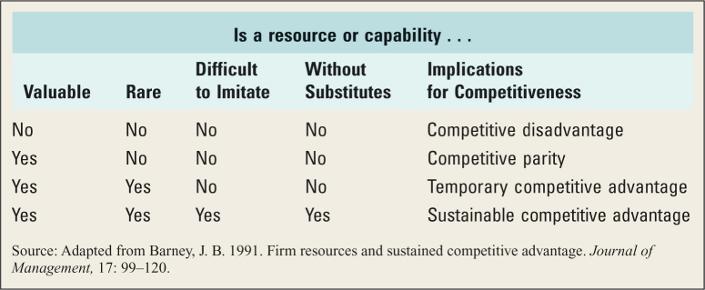
Criteria for Sustainable Competitive Advantage and Strategic Implications

