Slide 1
Recognizing a Firm’s Intellectual Assets: Moving beyond a Firm’s Tangible Resources
Strategic Management Part 1 - Strategic Analysis
BUS 4750
Instructor: Dr. Xiaodan “Abby” Wang
Western Michigan University

Slide 2
The Central Role of Knowledge in Today’s Economy
Knowledge Economy
wealth is increasingly created by effective management of knowledge workers instead of by the efficient control of physical and financial assets.

Slide 3
The Central Role of Knowledge in Today’s Economy
Intellectual capital
the difference between a firm’s market value and book value
a measure of the value of a firm’s intangible assets
includes reputation, employee loyalty and commitment, customer relationships, company values, brand names, and the experience and skills of employees

Slide 4
Human capital
individual capabilities, knowledge, skills, and experience of the company’s employees and managers
Social capital
the network of relationships that individuals have throughout the organization
Intellectual Capital
Knowledge
explicit knowledge
tacit knowledge

Slide 5
Proper set of skills
__________Human Capital
__________ Human Capital
Fulfill employees’ full potentials
Proper set of capabilities
Right values
Maximize employees’ joint contributions
Right attitudes
__________ Human Capital
Rewards and incentives
Working environment
Human Capital:
Three Interdependent Activities

Slide 6

Attracting Human Capital
Hire for attitude, train for skill
Sound recruiting approaches
Scanning pools of available candidates
Challenge becomes having the right job candidates, not the greatest number of them
Networking
Current employees may be best source of new ones
Incentives for referrals

Slide 7
Developing Human Capital
Encouraging widespread involvement
Requires the active involvement of leaders at all levels
It should not be viewed only as the responsibility of the human resource department
Transferring knowledge
Monitor progress and track development
Evaluate human capital

Slide 8
Retaining Human Capital
Firms must prevent the transfer of valuable and sensitive information outside the organization
Provide good work environment and incentives to keep productive employees from wanting to bail out
Use legal means such as employment contracts and noncompete clauses
Identifying with an organization’s mission and values
Challenging work and a stimulating environment
Financial and Nonfinancial Rewards and Incentives
Rewards are a vital organizational control mechanism
However, money may not be the most important reason why people take or leave jobs

Slide 9

Enhancing Human Capital: How Diversity Benefits the Organization
Enhance the social responsibility goals of an organization
Cost argument
Resource acquisition argument
Marketing argument
Creativity argument
Problem-solving argument
System flexibility argument

Slide 10
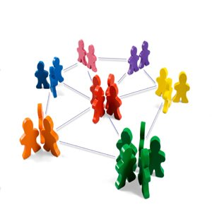
The Vital Role of Social Capital
Attraction, development and retention of talent is a necessary but not sufficient condition for creating competitive advantage
It is not the stock of human capital that is important, but the extent to which it is combined and leveraged.
Knowledge workers often are more loyal to their colleagues and profession than to their employer.

Slide 11

How Social Capital Helps Attract and Retain Talent
Hiring via personal (social) networks
Some job candidates may bring other talent with them
Emigration of talent from an organization to form start-up ventures
Can provide mechanism for obtaining resources and information from outside the organization

Slide 12
The Potential Downside of Social Capital
Groupthink
a tendency not to question shared beliefs
Tendency to develop dysfunctional human resource practices.
Can be expensive in terms of financial resources and managerial commitment

Slide 13
Using Technology to Leverage Human Capital and Knowledge
Sharing knowledge and information
Conserves resources
Develops products and services
Creates new opportunities
Technology can leverage human capital and knowledge
Within the organization
With customers
With suppliers

Slide 14

Electronic Teams: Using Technology to Enhance Collaboration
Electronic teams
team of individuals that completes tasks primarily through e-mail communication
enhance speed and effectiveness with which products are developed

Slide 15
Electronic Teams: Using Technology to Enhance Collaboration
Advantages of electronic teams
have the potential to acquire a broader range of “human capital”
can be very effective in generating “social capital”
Challenges of electronic teams
teams suffer processes loss because of low cohesion, low trust among members, a lack of appropriate norms or standard operating procedures, or a lack of shared understanding among team members about their tasks.
members are more geographically dispersed, and become more susceptible to the risk factors that can create process loss

Slide 16
Knowledge
Tacit knowledge
In the minds of employees
Based on personal experience and background
Shared only with the consent and participation of the individual
Explicit (codified) knowledge
Can be codified or documented
Can be widely distributed
Can be easily replicated
Can be reused many times at low cost

Slide 17


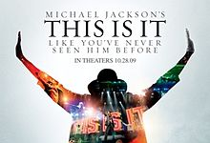

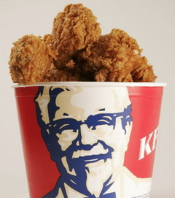
Intellectual Property
Creations of the mind, such as inventions, artistic products, and symbols.
Some forms of intellectual properties are protected by law while others can best be defended by surrounding them in secrecy.
Patents
Copyrights
Protect inventions from direct imitation for a limited period of time.
Provide exclusive rights to the creators
of original artistic works such as books, movies and songs.
Trademarks
Trade Secrets
Phrases, pictures, names or symbols used to identify a particular firm.
Formulas, practices, and designs that are central to a firm’s business and that remain unknown to competitors.

