Slide 1
Corporate-Level Strategy: Creating Value through Diversification 2
Strategic Management Part 2 - Strategic Formulation
BUS 4750
Instructor: Dr. Xiaodan “Abby” Wang
Western Michigan University

Slide 2

QUESTION
__________ reflect(s) the collective learning in organizations such as how to coordinate production skills, integrate multiple streams of technologies, and market and merchandise diverse products and services. A. Primary value chain activities B. Culture
D. Horizontal integration
C. Core competencies
Notes:
2

Slide 3
QUESTION
When management uses common production facilities or purchasing procedures to distribute different but related products, they are A. building on core competencies. C. achieving process gains. D. using portfolio analysis.
B. sharing activities.
Notes:
3

Slide 4
Unrelated Diversification
Little horizontal interaction between the different businesses of a firm.
Most benefits from unrelated diversification are gained from vertical(hierarchical) relationships – the creation of synergies from the interaction of the corporate office with the individual business units.
Two major sources of such synergies
Parenting and restrurcturing of business
Portfolio management

Slide 5
Corporate Parenting
Corporate office
Parenting – creating value within business units through
Experience/Expertise of the corporate office
Support of the corporate office
Plans
Budgets
Procurement
Legal functions
Financial functions
Human resource management
Business unit
Business unit
Business unit

Slide 6
Corporate Restructuring
Corporate office
“ Buy low, sell high. ”
Find poorly performing firms
With unrealized potential
In industries on the threshold of significant, positive change
Sell off parts
Reduce payroll
Change strategies
Change management
Infuse new technologies, processes, reward systems, etc.
Reduce unnecessary expenses
Business unit
Business unit
Business unit

Slide 7
Corporate Restructuring
Corporate management must
Have insight to detect undervalued companies or businesses with high potential for transformation
Have requisite skills and resources to turn the businesses around
Restructuring can involve changes in assets, capital structure or management
Asset restructuring – the sale of unproductive assets or peripheral lines of businesses
Capital restructuring – changing the debt-equity mix
Management restructuring – changes in the composition of the top management team, organizational structure, and reporting relationships.

Slide 8
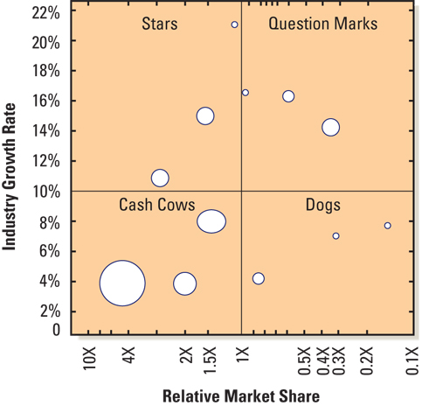
Portfolio Management
Each circle represents one of the firm’s business units
Size of circle represents the relative size of the business unit in terms of revenue
Allocate resources appropriately

Slide 9
Means to Achieve Diversification
______________________
Directly acquire other firms’ assets and competencies
______________________
Pooling resources of other firms with a firm’s own resource base
______________________
New products
New markets
New technology

