Slide 1
International Strategy - 2
Strategic Management Part 2 - Strategic Formulation
BUS 4750
Instructor: Dr. Xiaodan “Abby” Wang
Western Michigan University

Slide 2
Achieving Competitive Advantage in Global Markets
Two opposing pressures:
Reducing Costs
Locate manufacturing facilities where labor costs are low
Develop products that are highly standardized across multiple countries
Adapting to Local Markets
Differentiate offerings and strategies to reflect customer tastes and preferences
Make changes to reflect differences in distribution channels, human resource practices, and governmental regulations.

Slide 3
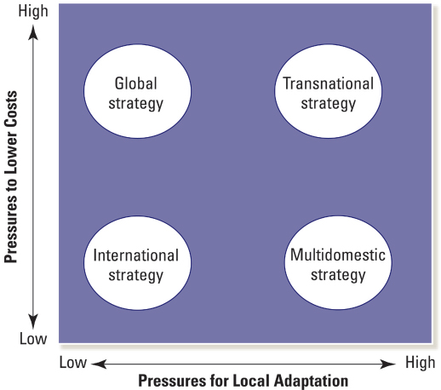
Opposing Pressures and Four Strategies

Slide 4
International Strategy
When pressures for both local adaptation and low costs are rather low (e.g. “orphan” drug industry)
Based on diffusion and adaptation of the parent company’s knowledge and expertise to foreign markets
Country units have less independence and autonomy
All sources of core competencies are centralized

Slide 5
International Strategy – risks and challenges
Different activities in the value chain have different optimal locations
The lack of local responsiveness may result in the alienation of local customers.

Slide 6
Global Strategy
Used when emphasis is on lowering costs
Competitive strategy is centralized and controlled largely by corporate office
Emphasize Economies of scale
Offer standardized products and services
Locate manufacturing, R&D, and marketing activities in only a few locations

Slide 7
Global Strategy
Advantages
Innovations that come about through efforts of either a business unit or the corporate office can be transferred more easily to other locations
Standard level of quality throughout the world
Disadvantages
Concentration on scale-sensitive resources and activities in one or few locations leads to higher transportation and tariff costs
Activity is isolated from targeted markets
The rest of the firm becomes dependent on that geographically isolated location

Slide 8
Multidomestic Strategy
Low pressures to lower cost + high pressures to adapt to local markets
Emphasis is on differentiating products and services to adapt to local markets
Authority is more decentralized
Risks include
Increased cost structure
Potential problems with local adaptations
Finding optimal degree of local adaptation is difficult

Slide 9
Transnational Strategy
Pressures to lower cost and to adapt to local market are high
Optimization of tradeoffs associated with Efficiency, local adaptation, and learning
Firm’s assets and capabilities are dispersed according to the most beneficial location for a specific activity
Avoids the tendency to either
Concentrate activities in a central location
Disperse them across many locations to enhance adaptation

Slide 10
Transnational Strategy
Unique risks and challenges
Choice of a seemingly optimal location cannot guarantee that the quality and cost of factor inputs will be optimal
Knowledge transfer can be a key source of competitive advantage, but it does not take place automatically

Slide 11
Strengths and Limitations of Various Strategies
Strategy Strengths Limitations
International
Leverage and diffuse parent’s knowledge and core competencies.
Lower costs because of less need to tailor products and services.
Greater level of worldwide coordination
Limited ability to adapt to local markets.
Inability to take advantage of new ideas and innovations occurring in local markets.
Global
Strong integration across various businesses.
Standardization leads to higher economies of scale which lowers costs.
Helps to create uniform standards of quality throughout the world.
Limited ability to adapt to local markets.
Concentration of activities may increase dependence on a single facility.
Single locations may lead to higher tariffs and transportation costs.

Slide 12
Strengths and Limitations of Various Strategies
Strategy Strengths Limitations
Multidomestic
Ability to adapt products and services to local market conditions.
Ability to detect potential opportunities for attractive niches in a given market, enhancing revenue.
Less ability to realize cost savings through scale economies.
Greater difficulty in transferring knowledge across countries.
May lead to “overadaptation” as conditions change.
Transnational
Ability to attain economies of scale.
Ability to adapt to local markets.
Ability to locate activities in optimal locations.
Ability to increase knowledge flows and learning.
Unique challenges in determining optimal locations of activities to ensure cost and quality.
Unique managerial challenges in fostering knowledge transfer.

Slide 13
Entry Modes of International Expansion
High
Low
Wholly Owned
Subsidiary
Joint Venture
Strategic Alliance
Extent of Investment Risk
Franchising
Licensing
Exporting
Low High
Degree of Ownership and Control

