Slide 1
Entrepreneurial Strategy and Competitive Dynamics
Strategic Management Part 2 - Strategic Formulation
BUS 4750
Instructor: Dr. Xiaodan “Abby” Wang
Western Michigan University

Slide 2

QUESTION
According to Michael Porter’ framework all of the following factors affect a nation’s competitiveness except A. factor conditions. B. demand characteristics. C. related and supported industries.
D. policies that protect the nation's domestic competitors.
Notes:
2

Slide 3
QUESTION
Rivalry is intense in nations with conditions of __________ consumer demand, __________ supplier bases, and __________ new entrant potential from related industries. A. weak; weak; high B. strong; strong; low D. weak; weak; low
C. strong; strong; high
Notes:
3

Slide 4
QUESTION
Pressures to “reduce costs” require that A. a company should not trade idiosyncratic preferences in product features for higher economic returns.
C. the manager should follow a multidomestic strategy to maximize the economic benefits to the company. D. the company needs to supplement the local foreign economy in a manner specified by the local government.
B. a company must pursue what is economically beneficial to the company including maximizing economies of scale and learning curve effects.
Notes:
4

Slide 5
QUESTION
High pressure for local adaptation combined with low pressure for lower costs would suggest what type of strategy in the global market? A. Global. C. Transnational. D. International.
B. Multidomestic.
Notes:
5

Slide 6
What is Entrepreneurship?
“New Value Creation”
An act of innovation that involves endowing existing resources with new wealth-producing capacity
The innovative acts that endow old resources with new value was labeled “new combinations”
Key dimensions of entrepreneurship: innovativeness, proactiveness and risk propensity.

Slide 7
Recognizing Entrepreneurial Opportunities
New value can be created in:
Start-up ventures
Major corporations
Family-owned businesses
Non-profit organizations
Established institutions
New venture creation - Entrepreneurship in the context of an entrepreneur or team of entrepreneurs launching a new business
Established firms with an orientation to acting entrepreneurially practice corporate entrepreneurship.

Slide 8
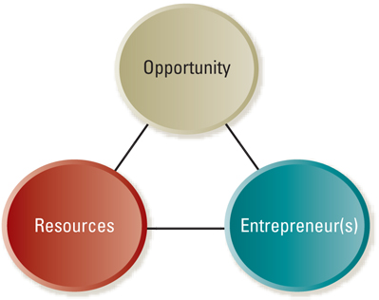
Opportunity Analysis Framework
Notes:
Opportunity
Necessary resources
entrepreneurs

Slide 9
Entrepreneurial Opportunities
Opportunities come from many sources
Start-ups
Current or past work experiences
Hobbies that grow into businesses or lead to inventions
Suggestions by friends or family
Chance events
Change
Established firms
Needs of existing customers
Suggestions by suppliers
Technological developments that lead to new advances
Changes in technology, sociocultural trend and consumer demand

Slide 10
Opportunity Recognition
The process of identifying, selecting and developing potential opportunities.
1. Discovery phase
Period when you first become aware of a new business concept
May be spontaneous and unexpected
May occur as the result of deliberate search for
New venture projects
Creative solutions to business problems

Slide 11
Opportunity Recognition
2. Opportunity phase
Can it be developed into a full-fledged new venture?
Talk to potential target customers
Discuss it with production or logistics managers
Conduct feasibility analysis
Market potential
Product concept testing
Focus groups
Trial runs with end users

Slide 12
Characteristics of Good Opportunities
Good Business Opportunity
Attractive
Value creating
Achievable
Durable
Before launching opportunity as a business
Consider the resources available to undertake it
Consider the characteristics of the entrepreneur pursuing it

Slide 13
Entrepreneurial Resources
The major challenge for entrepreneurial firms is lack of resources
Financial resources
Human capital
Social capital
Government resources

Slide 14
Entrepreneurial Resources
Financial Resources
Early-stage financing
Personal savings, family, and friends
Bank financing, public financing, venture capital
Debt
Equity
Later-stage financing
Angel investors
Venture capital
Equity financing
Commercial banks

Slide 15
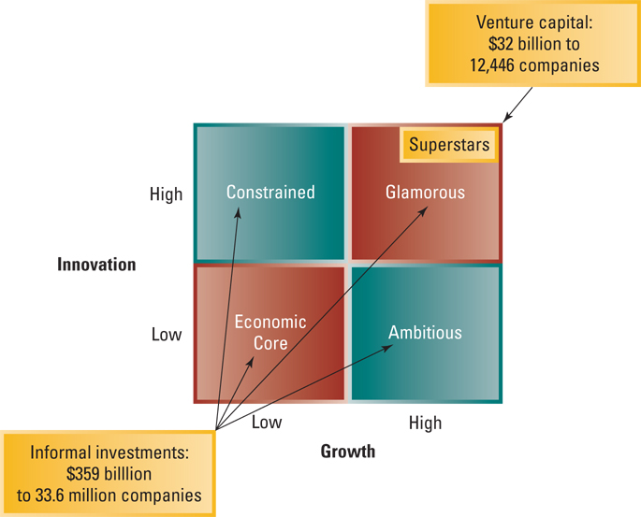
Financing New Ventures

Slide 16
Entrepreneurial Resources
Human capital
The most important asset of an entrepreneurial firm: strong and skilled management
Social capital
Social network such as strategic alliances
Government resources
Small Business Administration
Government contracting
State and local governments

Slide 17
Entrepreneurial Leadership
Launching a new venture requires a special kind of leadership
Courage
Belief in one’s convictions
Energy to work hard
Three characteristics
Vision
Dedication and drive
Commitment to excellence

Slide 18

10 Management Lessons
It’s all about perseverance
Understand the value of mentorship and teamwork
Stick to your niche
Stay on top of news that affects your clients
Communication is key
Capitalization is crucial
Communicate unwavering honesty and integrity
Stay on top of the curve
Take ownership in your clients’ success
Never stop marketing
Source: Pierce, Sarah. “10 Management Lessons From a Young Entrepreneur,” www.entrepreneur.com. December 17, 2003.

Slide 19
Entrepreneurial Strategy
Best strategy for the enterprise will be determined to some extent by
A viable opportunity, resources, and entrepreneur(s)
Other conditions in the business environment
Can use various tools and techniques to determine strategic choices
Five Forces analysis
Value chain analysis

Slide 20
Entrepreneurial Strategy – Entry Strategies
Getting a foothold in the market
Pioneering new entry
Creating new ways to solve old problems
Meeting customer’s needs in a unique new way
Imitative new entry
Strong marketing orientation
Introduce same basic product or service in another segment of the market
Adaptive new entry
Offer product or service that is “somewhat new and different”
Aware of marketplace conditions and conceive entry strategies to capitalized on current trends

Slide 21
Entrepreneurial Strategy – Generic Strategies
How new ventures can achieve competitive advantages
Overall cost leadership
Simple organizational structures
More quickly upgrade technology and integrate feedback from the marketplace
Make timely decisions that affect cost
Differentiation
Use new technology
Deploy resources in a radical new way
Focus
Niche strategies fit the small business mold

Slide 22
Entrepreneurial Strategy – Combination Strategies
Pursue combination strategies to achieve success
Combine the best features of low-cost, differentiation, and focus strategies
Often in a strong position to offer a combination strategy – not laden with layers of bureaucracy
flexibility to approach situations uniquely
ability to make decisions quickly

Slide 23
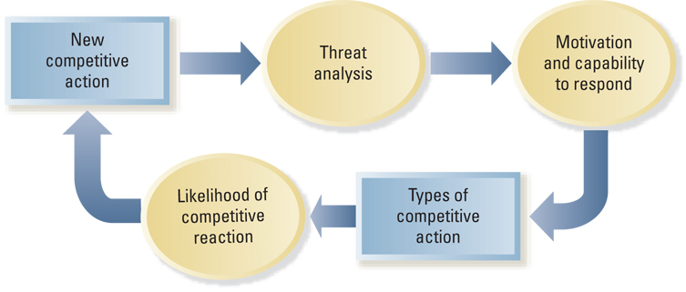
Model of Competitive Dynamics
Competitive Dynamics: intense rivalry, involving actions and responses, among similar competitors vying for the same customers in a market place.

Slide 24
New Competitive Action
New entry
Price cutting
Imitating successful products
Expanding production capacity
Purpose (why):
Improve market position
Capitalize on growing demand
Provide an innovative new solution
Obtain first mover advantages

Slide 25
Five “Hardball” Strategies
Devastate rivals’ profit sanctuaries
Plagiarize with pride
Deceive the competition
Unleash massive and overwhelming force
Raise competitors’ costs

Slide 26
Threat Analysis
Be aware of your competitors and cognizant of whatever threats they may pose
Determine how threatening a new competitive action is to your business
Market commonality
Resource similarity
Motivation and capability to respond
Minimize the damage caused by a competitive action
Enhance competitive position
A company must possess necessary capabilities to respond

Slide 27
Strategic and Tactical Competitive Actions
Entering new markets
New product introductions
Changing production capacity
Mergers/Alliances
Price cutting (or increases)
Product/service enhancements
Increased marketing efforts
New distribution channels
Strategic Actions
Tactical Actions

Slide 28
Likelihood of Competitive Reaction
How a competitor is likely to respond will depend on three factors
Market dependence
Competitor’s resources
The reputation of the firm that initiates the action (actor’s reputation)

Slide 29
Choosing Not to React
Forbearance
a firm’s choice of not reacting to a rival’s new competitive action.
Co-opetition
A firm’s strategy of both cooperating and competing with rival firms.

