Slide 1
Business-Level Strategy: Creating and Sustaining Competitive Advantages - 2
Strategic Management Part 2 - Strategic Formulation
BUS 4750
Instructor: Dr. Xiaodan “Abby” Wang
Western Michigan University

Slide 2
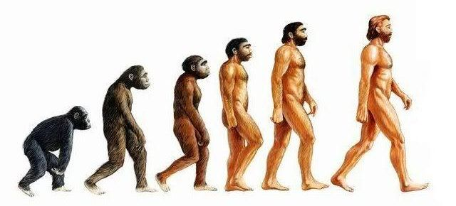
A Third Dimension
Time
(Life cycle of an industry)
Emphasis on strategies, functional areas, value-creating activities, and overall objectives varies over the course of an industry life cycle.
decline
maturity
growth
introduction
Uniqueness
Cost
Broad
Differentiation
Cost leadership
Narrow
Focused differentiation
Focused cost leadership
Notes:
Third dimension is time
Four stages
introduction
growth
Maturity
Peak of development
Market fully saturated
Decline
Market begins to decline

Slide 3
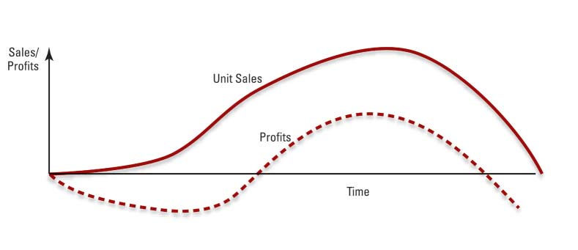
Stages of the Industry Life Cycle

Slide 4
Stages of the Industry Life Cycle
Stage
Introduction Growth Maturity Decline
Factor
Market growth rate
Low Very large Low to Negative
moderate
Number of segments
Very few Some Many Few
Intensity of competition
Low Increasing Very intense Changing
Emphasis on product design
Very high High Low to Low
moderate
Emphasis on process design
Low Low to High Low
moderate
Notes:
1 of 2 most important slides

Slide 5
Stages of the Industry Life Cycle
Stage
Introduction Growth Maturity Decline
Factor
Major functional area(s) of concern
Research and Sales and Production General
Development marketing management
and finance
Overall objective
Increase Create Defend Consolidate,
market share consumer market share maintain,
awareness demand and extend harvest, or product life exit
cycles
Generic strategies
Differentiation Differentiation Differentiation Overall cost
Overall cost leadership
leadership Focus
Notes:
2nd of 2 slides that are most important

Slide 6
Strategies in the Introduction Stage
Products are unfamiliar to consumers
Market segments not well defined
Product features not clearly specified
Competition tends to be limited
Strategies
Develop product and get users to try it
Generate exposure so product becomes “standard”

Slide 7
Strategies in the Growth Stage
Characterized by strong increases in sales
Attractive to potential competitors
Primary key to success is to build consumer preferences for specific brands
Strategies
Brand recognition
Differentiated products
Financial resources to support value-chain activities

Slide 8
Strategies in the Maturity Stage
Aggregate industry demand slows
Market becomes saturated, few new adopters
Direct competition becomes predominant
Marginal competitors begin to exit
Strategies
Efficient manufacturing operations and process engineering
Low costs (customers become price sensitive)

Slide 9
Strategies in the Decline Stage
Industry sales and profits begin to fall
Strategic options become dependent on the actions of rivals
Strategies
Maintaining
Exiting the market
Harvesting
Consolidation

Slide 10
Turnaround Strategies in the Life Cycle
Turnaround strategy
a strategy that reverses a firm’s decline in performance and returns it to growth and profitability
Asset and cost surgery
Selective product and market pruning
Piecemeal productivity improvements

Slide 11

QUESTION
The most likely time to pursue a harvest strategy is in a situation of A. High growth B. Strong competitive advantage C. Mergers and acquisitions
D. Decline in the market life cycle
Notes:
11

