Slide 1
Creating Effective Organizational Designs - 1
Strategic Management Part 3 - Strategic Implementation
BUS 4750
Instructor: Dr. Xiaodan “Abby” Wang
Western Michigan University

Slide 2

QUESTION
The “traditional” approach to strategic control is sequential. Which of the following is not one of the steps in the sequence? B. Performance is measured against the predetermined goal. C. Strategies are implemented. D. Strategies are formulated and top management sets goals.
A. Action plans are submitted by lower level managers.
Notes:
2

Slide 3
QUESTION
Informational control systems ask A. is the organization “doing things right”? C. are rules and regulations being followed as information is processed? D. is the organization's environment a necessary and sufficient condition for success?
B. is the organization “doing the right things”?
Notes:
3

Slide 4
QUESTION
Culture, rewards and boundaries are the three levers for behavior control. Which of the following statements about these levers is NOT true? A. Rewards refer to the use of performance-based incentive systems to motivate while boundaries refer to written and explicit guidelines that provide external constraints on behavior. B. Rewards are most appropriate in organizations pursuing unrelated diversification strategies C. Culture refers to a system of unwritten rules that forms an internalized influence over behavior
D. Rules are associated with high autonomy and often found in professional organizations.
Notes:
4

Slide 5
The Building Blocks of Organizational Structure
Division of Labor
– process of splitting up a task into a series of smaller tasks
Organizational Chart
– diagram depicting a firm’s structure
Vertical and Horizontal Linkages
Informal Linkages
– unofficial relationships such as personal friendships and rivalries.

Slide 6
Organizational Structure
Formalized patters of interactions that link a firm’s tasks, technologies and people
Structure provides a means of balancing two conflicting forces
Need for the division of tasks into meaningful groupings (differentiation)
Need to integrate the groupings for efficiency and effectiveness (intergration)

Slide 7
Vertical Differentiation
Specify the reporting relationships that link people, tasks, and functions at all levels of a firm.
Tall structure vs. Flat structure (number of hierarchical levels and span of control)
Centralization vs. Decentralization (distribution of decision-making authority)
Command
1
Reporting
2
1
3
1
4
2
5
3

Slide 8

Horizontal Differentiation
Group people and tasks into functions and divisions
Simple structure
Functional structure
Divisional structure
Matrix structure

Slide 9
Simple Structure
Simple structure is the oldest and most common organizational form
Staff serve as an extension of the top executive’s personality
Highly informal
Coordination of tasks by direct supervision
Decision making is highly centralized
Little specialization of tasks, few rules and regulations, informal evaluation and reward system

Slide 10
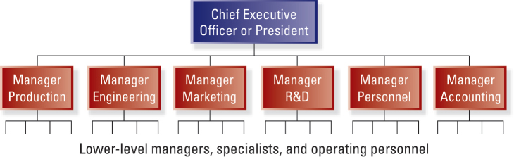
Functional Structure
Found where there is a single or closely related product or service, high production volume, and some vertical integration.

Slide 11
Functional Structure
Advantages
Enhanced coordination and control
Centralized decision making
Enhanced organizational-level perspective
More efficient use of managerial and technical talent
Facilitated career paths and development in specialized areas
Disadvantages
Impeded communication and coordination due to differences in values and orientations
May lead to short-term thinking (functions vs. organization as a whole)
Difficult to establish uniform performance standards

Slide 12
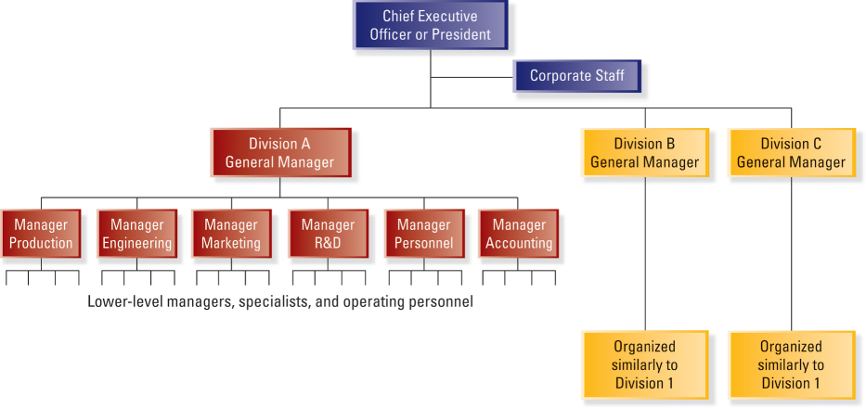
Divisional Structure

Slide 13
Divisional Structure
Organized around products, projects, or markets
Each division includes its own functional specialists typically organized into departments
Divisions are relatively autonomous and consist of products and services that are different from those of other divisions
Division executives help determine product-market and financial objectives

Slide 14
Divisional Structure
Advantages
Separation of strategic and operating control
Quick response to important changes in external environment
Minimal problems of sharing resources across functional departments
Development of general management talent is enhanced
Disadvantages
Can be very expensive
Can be dysfunctional competition among divisions
Can be a sense of a “zero-sum” game that discourages sharing ideas and resources among divisions
Differences in image and quality may occur across divisions
Can focus on short-term performance

Slide 15
Variations of Divisional Structure
Strategic business unit (SBU) structure
Divisions with similar products, markets, and/or technologies are grouped into homogenous SBUs to achieve some synergies
Task of planning and control at corporate office is more manageable
Greater decentralization of authority
May be difficult to achieve synergies across SBUs
Additional level of management increases the number of personnel and overhead expanses
Holding company structure
Appropriate when the businesses in a corporation’s portfolio do not have much in common (the potential for synergy is limited)
Lower expenses and overhead, fewer levels in the hierarchy
Inherent lack of control and dependence of CEO-level executives on divisional executives

Slide 16
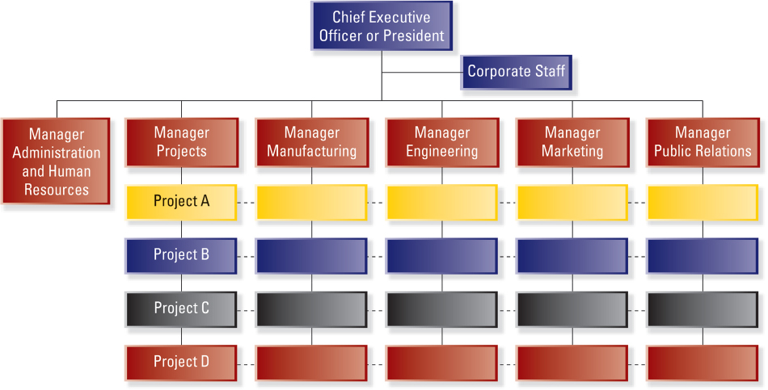
Matrix Structure

Slide 17
Matrix Structure
A combination of the functional and divisional structures
Individuals who work in a matrix organization become responsible to two managers
The project manager
The functional area manager
Advantages
Facilitates the use of specialized personnel, equipment and facilities
Provides professionals with a broader range of responsibility and experience
Disadvantages
Can cause uncertainty and lead to intense power struggles
Working relationships become more complicated
Decisions may take longer

Slide 18
Structure for International Operations
Contingencies influencing choice of structure
The type of strategy that is driving a firms’ foreign operations
Product diversity
The extent to which a firms is dependent on foreign sales
Primary types or structure for international operations
International division
Geographic-area division
Worldwide functional
Worldwide product division
Worldwide matrix
CEO
Function 1
Function 2
International Division
CEO
Area 1
Area 2
Area 3

Slide 19
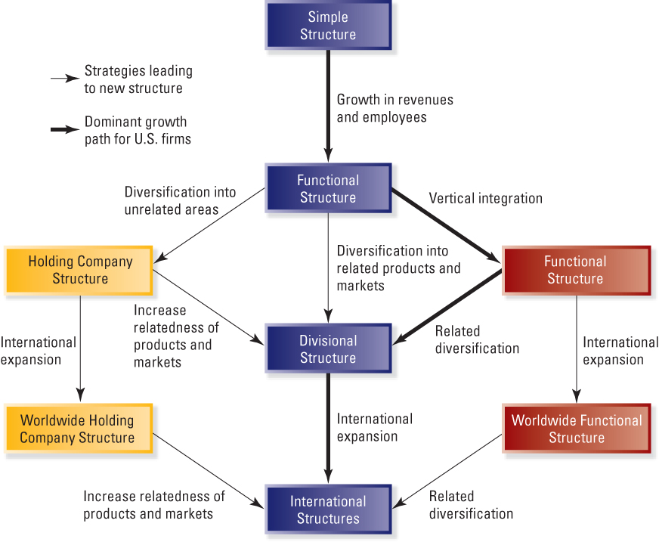
Strategy-Structure Relationships
Growth in revenues and employees
Unrelated diversification
Vertical Integration
Related diversification
International expansion
Increase relatedness
Related diversification
International expansion
International expansion
Increase relatedness
Related diversification

Slide 20
Organizational Structure Design
Exercise
For a firm selling product in the U.S. with low level of diversification
For a firm selling product in the U.S. with high level of diversification (a large number of unrelated products)
For a firm selling its products in both North America and Europe and narrow lines of products
For a firm having subsidiaries in North America, Latin America, Asia and Europe and broad lines of products (unrelated diversification)

