Slide 1
Strategic Control and Corporate Governance
Strategic Management Part 3 - Strategic Implementation
BUS 4750
Instructor: Dr. Xiaodan “Abby” Wang
Western Michigan University

Slide 2
Strategic Control
Strategic control - the process of monitoring and correcting a firm’s strategy and performance.
Informational control – the ability to respond effectively to environment change.
whether or not the organization is “doing the right things”
Behavioral control – the appropriate balance and alignment among a firm’s culture, rewards, and boundaries
whether or not the organization is “doing things right” in the implementation of its strategy
Both types of control are necessary conditions for success

Slide 3
Informational Control
Deals with internal environment and external strategic context
Key question
“Do the organization’s goals and strategies still ‘fit’ within the context of the current strategic environment?”
Two key issues
Scan and monitor external environment (general and industry)
Continuously monitor the internal environment

Slide 4
Two Types of Control Systems
Traditional control system
Based largely on the feedback approach
Little or no action taken to revise strategies, goals and objectives until the end of the time period
Contemporary control system
Continually monitoring the environments (internal and external)
Identifying trends and events that signal the need to revise strategies, goals and objectives

Slide 5
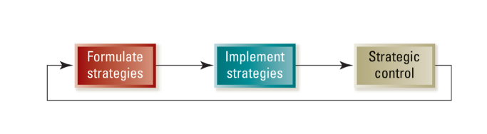
Traditional Approach to Strategic Control
Traditional approach is sequential
Strategies are formulated and top management sets goals
Strategies are implemented
Performance is compared to the desired standard and measured against the predetermined goal set

Slide 6
Traditional Approach to Strategic Control
Control is based on a feedback loop from performance measurement to strategy formulation
Typically involves lengthy time lags, often tied to the annual planning cycle
Little or no action is taken to revise strategies, goals and objectives until the end of the time period
This “single-loop” learning control system simply compares actual performance to a predetermined goal
Most appropriate when
Environment is stable and simple
Goals and objectives can be measured with certainty
Little need for performance

Slide 7
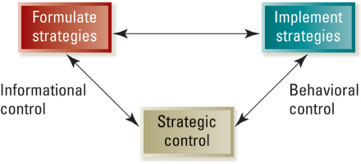
Contemporary Approach to Strategic Control
Relationships between strategy formulation, implementation and control are highly interactive
Includes both the informational and behavior components of strategic control

Slide 8
Benefits of Continuous Monitoring
Time lags are dramatically shortened
Changes in the competitive environment are detected earlier
The organization’s ability to respond with speed and flexibility is enhanced

Slide 9
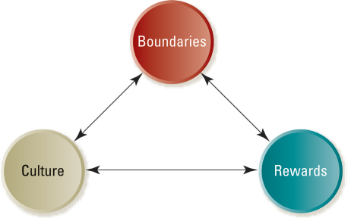
Behavioral Control
Behavioral control is focused on implementation - doing things right
Three key control “levers”

Slide 10
Approach Some Situational Factors
Rules: Written and explicit guidelines that provide external constraints on behavior.
Associated with standardized output
Tasks are generally repetitive and routine
Little need for innovation or creative activity
Culture: A system of unwritten rules that forms an internalized influence over behavior.
Often found in professional organizations
Associated with high autonomy
Norms are the basis for behavior
Rewards: The use of performance-based incentive systems to motivate.
Measurement of output and performance is rather straightforward
Most appropriate in organizations pursuing unrelated diversification strategies
Rewards may be used to reinforce other means of control

Slide 11
Building a Strong and Effective Culture
Organizational culture is a system of
Shared values (what is important)
Beliefs (how things work)
Organizational culture shapes a firm’s
People
Organizational structures
Control systems
Organizational culture produces
Behavioral norms (the way we do things around here)

Slide 12
The Role of Culture
Culture sets implicit boundaries (unwritten standards of acceptable behavior)
Dress
Ethical matters
The way an organization conducts its business
Culture encourages individual identification with the organization and its objectives
Culture acts as a means of reducing monitoring costs

Slide 13
Motivating with Rewards and Incentives
Rewards and incentive systems
Represent a powerful means of influencing an organization’s culture
Focus efforts on high-priority tasks
Motivate individual and collective task performance
Can be an effective motivator and control mechanism

Slide 14
Motivating with Rewards and Incentives – potential downside
Subcultures may arise in different business units with multiple reward systems
Shared values may emerge in subculture in opposition to patterns of the dominant culture
The multiple reward systems reinforce behavioral norms, attitudes, and belief systems in the subcultures of different business units
Reduce organizational cohesiveness
Impotent information may be hoarded rather than shared
Individuals begin working at cross-purpose
Lose sight of overall goals and objectives

Slide 15
Agency Theory
Deals with the relationship between
Principals – who are owners of the firm (stockholders), and the
Agents – who are the people paid by principals to perform a job on their behalf (management)

Slide 16
Agency Theory: Two Problems
Goals of principals and agents may conflict (short-term vs. long-term)
Difficult or expensive for the principal to verify what the agent is actually doing
Hard for board of directors to confirm that managers are actually acting in shareholders’ interests
Managers may opportunistically pursue their own interests
Principal and agent may have different attitudes and preferences toward risk

Slide 17
Governance Mechanisms: Aligning the Interests of Owners and Managers
Two primary means of monitoring behavior of managers
Committed and involved board of directors – act in the best interests of the shareholders to create long term value for shareholders
Active, critical participants in setting strategies
Ensure that strategic plans undergo rigorous scrutiny
Evaluate managers against high performance standards
Take control of succession process
Director independence
A minimum of “insiders” should serve on the board
Directors are not doing consulting, legal or other work for the company
Directors own significant stock in the company they oversee

Slide 18
Governance Mechanisms: Aligning the Interests of Owners and Managers
Two primary means of monitoring behavior of managers
Shareholder activism – actively engage in the governance of the corporation
Right to sell stock
Right to vote the proxy
Right to sue for damages if directors or managers fail to meet their obligations
Right to certain information from the company
Certain residual rights following company’s liquidation
Collectively, shareholders have the power to direct the course of corporations.

Slide 19
Governance Mechanisms: Aligning the Interests of Owners and Managers
Another way to help solve the agency problem:
Managerial incentives (contract-based outcomes)
Reward and compensation
Align rewards of management to the long-term performance of the corporation (e.g. stock options)
Allow creation of executive wealth that is reasonable in view of the creation of shareholder wealth

Slide 20
Creating Effective Organizational Designs
Strategic Management Part 3 - Strategic Implementation
BUS 4750
Instructor: Dr. Xiaodan “Abby” Wang
Western Michigan University

Slide 21

QUESTION
The “traditional” approach to strategic control is sequential. Which of the following is not one of the steps in the sequence? B. Performance is measured against the predetermined goal. C. Strategies are implemented. D. Strategies are formulated and top management sets goals.
A. Action plans are submitted by lower level managers.
Notes:
21
A

Slide 22
QUESTION
Informational control systems ask A. is the organization “doing things right”? C. are rules and regulations being followed as information is processed? D. is the organization's environment a necessary and sufficient condition for success?
B. is the organization “doing the right things”?
Notes:
22
B

Slide 23
QUESTION
Culture, rewards and boundaries are the three levels for behavior control. Which of the following statements about these levers is NOT true? A. Rewards refer to the use of performance-based incentive systems to motivate while boundaries refer to written and explicit guidelines that provide external constraints on behavior. B. Rewards are most appropriate in organizations pursuing unrelated diversification strategies C. Culture refers to a system of unwritten rules that forms an internalized influence over behavior
D. Rules are associated with high autonomy and often found in professional organizations.
Notes:
23
D

Slide 24
Organizational Structure
Formalized patterns of interactions that link a firm’s tasks, technologies and people
Structure provides a means of balancing two conflicting forces
Need for the division of tasks into meaningful groupings (differentiation)
Need to integrate the groupings for efficiency and effectiveness (integration)

Slide 25
Vertical Differentiation
Specify the reporting relationships that link people, tasks, and functions at all levels of a firm.
Tall structure vs. Flat structure (number of hierarchical levels and span of control)
Centralization vs. Decentralization (distribution of decision-making authority)
Command
1
Reporting
2
1
3
1
4
2
5
3

Slide 26

Horizontal Differentiation
Group people and tasks into functions and divisions
Simple structure
Functional structure
Divisional structure
Matrix structure

Slide 27
Simple Structure
Simple structure is the oldest and most common organizational form
Staff serve as an extension of the top executive’s personality
Highly informal
Coordination of tasks by direct supervision
Decision making is highly centralized
Little specialization of tasks, few rules and regulations, informal evaluation and reward system

Slide 28
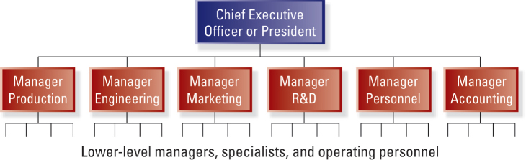
Functional Structure
Found where there is a single or closely related product or service, high production volume, and some vertical integration.

Slide 29
Functional Structure
Advantages
Enhanced coordination and control
Centralized decision making
Enhanced organizational-level perspective
More efficient use of managerial and technical talent
Facilitated career paths and development in specialized areas
Disadvantages
Impeded communication and coordination due to differences in values and orientations
May lead to short-term thinking (functions vs. organization as a whole)
Difficult to establish uniform performance standards

Slide 30
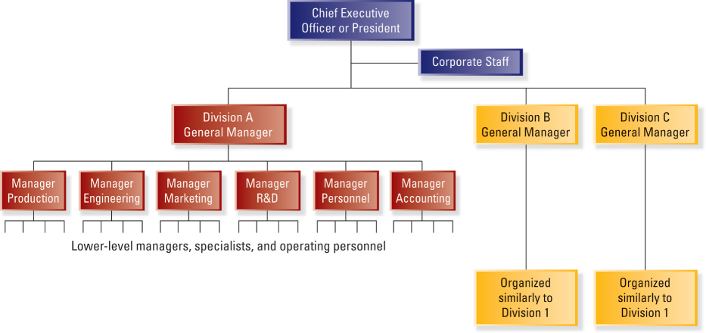
Divisional Structure

Slide 31
Divisional Structure
Organized around products, projects, or markets
Each division includes its own functional specialists typically organized into departments
Divisions are relatively autonomous and consist of products and services that are different from those of other divisions
Division executives help determine product-market and financial objectives

Slide 32
Divisional Structure
Advantages
Separation of strategic and operating control
Quick response to important changes in external environment
Minimal problems of sharing resources across functional departments
Development of general management talent is enhanced
Disadvantages
Can be very expensive
Can be dysfunctional competition among divisions
Can be a sense of a “zero-sum” game that discourages sharing ideas and resources among divisions
Differences in image and quality may occur across divisions
Can focus on short-term performance

Slide 33
Variations of Divisional Structure
Strategic business unit (SBU) structure
Divisions with similar products, markets, and/or technologies are grouped into homogenous SBUs to achieve some synergies
Task of planning and control at corporate office is more manageable
Greater decentralization of authority
May be difficult to achieve synergies across SBUs
Additional level of management increases the number of personnel and overhead expenses
Holding company structure
Appropriate when the businesses in a corporation’s portfolio do not have much in common (the potential for synergy is limited)
Lower expenses and overhead, fewer levels in the hierarchy
Inherent lack of control and dependence of CEO-level executives on divisional executives

Slide 34
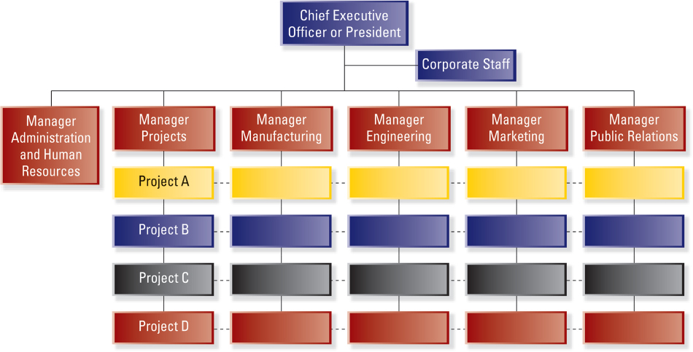
Matrix Structure

Slide 35
Matrix Structure
A combination of the functional and divisional structures
Individuals who work in a matrix organization become responsible to two managers
The project manager
The functional area manager
Advantages
Facilitates the use of specialized personnel, equipment and facilities
Provides professionals with a broader range of responsibility and experience
Disadvantages
Can cause uncertainty and lead to intense power struggles
Working relationships become more complicated
Decisions may take longer

Slide 36
Integration
A fundamental truth about structure:
If the parts that make up a firm do not work together, the firm is likely to fail.
Integration is the means by which a company seeks to coordinate people and functions to accomplish organizational tasks.
Direct contact
Interdepartmental liaison roles
Temporary task forces
Permanent teams
Integrating roles

Slide 37
Boundaryless Organizations
Boundaries that place limits on organizations
Vertical boundaries between levels in the organization’s hierarchy
Horizontal boundaries between functional areas
External boundaries between the firm and its customers, suppliers, and regulators
Geographic boundaries between locations, cultures and markets
Boundaryless organizations
Remove the usual barriers between parts of the organization as well as barriers between the organization and others
More flexible and responsive

Slide 38
Strategic Leadership: Creating a Learning Organization and an Ethical Organization
Strategic Management Part 3 - Strategic Implementation
BUS 4750
Instructor: Dr. Xiaodan “Abby” Wang
Western Michigan University

Slide 39

QUESTION
The relationship between strategy and structure can be best described as A. strategy determines structure but structure does not determine strategy. B. structure determines strategy but strategy does not determine structure. D. a third force determines both strategy and structure.
C. strategy and structure influence each other.
Notes:
39

Slide 40
QUESTION
Which of the following statements about organizational structure is NOT true? A. Simple structure is the oldest and most common organizational form
C. In divisional structure, divisions are relatively autonomous and consist of products and services that are different from those of other divisions
D. Individuals who work in a matrix organization become responsible to both the project manager and the functional area manager.
B. Functional structure is often found where there are multiple unrelated products or services, low production volume, and some vertical integration.
Notes:
40
B

Slide 41
What is Leadership?
Leadership is the process of transforming organization from what they are to what the leader would have them become
Leadership is
Proactive
Goal-oriented
Focused on the creation and implementation of a creative vision

Slide 42
Leadership: Three Interdependent Activities
Successful leaders must recognize three interdependent activities
Setting a directions
Designing the organization
Nurturing culture dedicated to excellence and ethical behavior

Slide 43









A Leader’s Bases of Power

Slide 44
Emotional Intelligence:
A Key Leadership Trait
Successful traits of leaders at the highest level
Accounting, business planning, etc.
Ability to work with others, passion for work, etc.
Technical skills
Cognitive abilities
Emotional intelligence
Accounting, business planning, etc.
Analytical reasoning, quantitative analysis, etc.
Ability to work with others, passion for work, etc.

Slide 45
Emotional Intelligence
Five components of emotional intelligence
Self-awareness
Self-regulation
Motivation
Empathy
Social skill

Slide 46
Developing a Learning Organization
Successful learning organizations
Create a proactive, creative approach to the unknown
Actively solicit the involvement of employees at all levels
Enable all employees to use their intelligence and apply their imagination

Slide 47
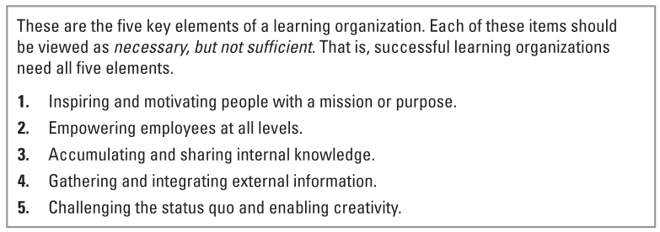
Developing a Learning Organization

Slide 48
Inspiring and Motivating People with a Mission or Purpose
A Learning environment involves:
Organization-wide commitment to change
An action orientation
Applicable tools and methods
Guiding philosophy
Inspired and motivated people with a purpose

Slide 49
Managing Innovation and Fostering Corporate Entrepreneurship
Strategic Management Part 3 - Strategic Implementation
BUS 4750
Instructor: Dr. Xiaodan “Abby” Wang
Western Michigan University

Slide 50

QUESTION
According to the text, effective leadership is like a three-legged stool consisting of all of the following except B. nurturing a culture dedicated to excellence and ethical behavior. C. determining a direction. D. designing the organization.
A. dedication to maintaining the status quo.
Notes:
50
A

Slide 51
QUESTION
All of the following constitute organizational bases of a leader's power except A. legitimate power. B. reward power. D. coercive power.
C. referent power.
Notes:
51
C

Slide 52
QUESTION
The three broad sets of capabilities that a leader should possess include all of the following except A. technical skills. B. cognitive abilities. D. emotional intelligence.
C. calculative abilities.
Notes:
52
C

Slide 53
QUESTION
Which of the following is NOT a characteristic of a successful learning organization? A. They create a proactive, creative approach to the unknown. B. They actively solicit the involvement of employees at all levels.
D. They enable everyone to use their intelligence and apply their imagination.
C. They regularly engage in activities to reinforce the status quo.
Notes:
53
C

Slide 54
Managing Innovation
Innovation involves using new knowledge to transform organizational processes or create commercially viable products and services
Innovation occurs when _________________________ ______________________
Sources of new knowledge
Latest technology
Results of experiments
Creative insights
Competitive information

Slide 55
Types of Innovation
Degree of innovativeness
Radical innovation
Fundamental changes and breakthroughs
Evoke major departures from existing practices
Can be highly disruptive
Can transform or revolutionize a whole industry
Incremental innovation
Enhance existing practices
Small improvements in products and processes
Evolutionary applications within existing paradigms
Notes:
In terms of degree of innovativeness, we can divide innovation into radical innovation and incremental innovation.

Slide 56
Continuum of Radical and Incremental Innovations
Fiber-optic cable
Internet browser
Online auction exchanges
Bubble wrap
Radical Innovation
Incremental Innovation
Laparoscopic “keyhole” surgery
Speech recognition software
Polyester
Enterprise resource planning (ERP)
Frozen yogurt

Slide 57
Types of Innovation
Product and process innovations
Product innovation
Refers to efforts to create product designs and applications of technology to develop new products for end users
More radical and common during common of an industry’s life cycle
Associated with differentiation strategies

Slide 58
Types of Innovation
Product and process innovations
Process innovation
Associated with improving the efficiency of an organizational process, especially manufacturing systems and operations
Firms can
Improve materials utilization
Shorten cycle time
Increase quality
More likely to occur in later stages of an industry’s life cycle
Associated with leadership strategies

Slide 59
Challenges of Innovation
Seeds versus weeds
Experience versus initiative
Internal versus external staffing
Building capabilities versus collaborating
Incremental versus preemptive launch

Slide 60
Corporate Entrepreneurship
Two primary aims:
Pursuit of new venture opportunities
Strategic renewal
Blue Ocean vs. Red Ocean
Companies that are willing to venture into market spaces where there is little or no competition – labeled “blue oceans” – will outperform those firms that limit growth to incremental improvements in competitively crowded industries – labeled “red oceans”

Slide 61
Corporate Entrepreneurship – Two Approaches
Focused approaches
Separate the corporate venturing activity from the other ongoing operations of the firm
Corporate entrepreneurship is usually the domain of autonomous work groups that pursue entrepreneurial aims independent of the rest of the firm
Advantage: free entrepreneurial team members to think and act without the constraints imposed by existing organizational norms and routines.
Disadvantage: isolate from the corporate mainstream, may fail to obtain the resources or support needed

Slide 62
Corporate Entrepreneurship – Two Approaches
Dispersed approaches
A dedication to the principle and practices of entrepreneurship is spread throughout the organization
Two related aspects: entrepreneurial cultures and product champions
Advantages:
Organizational members don’t have to be reminded to think entrepreneurially or be willing to change (the ability to change – core capability)
Stakeholders can bring new ideas or venture opportunities to anyone in the organization and expect them to be well-received
Disadvantage:
Firm may feel they must change for the sake for change, causing them to lose vital competencies or spend to much on R&D

Slide 63
Entrepreneurial Orientation
EO refers to the strategy-making practices that businesses use in identifying and launching corporate ventures
Represents a frame of mind and a perspective toward entrepreneurship that is reflected in a firm’s ongoing processes and corporate culture
Has five dimensions

Slide 64
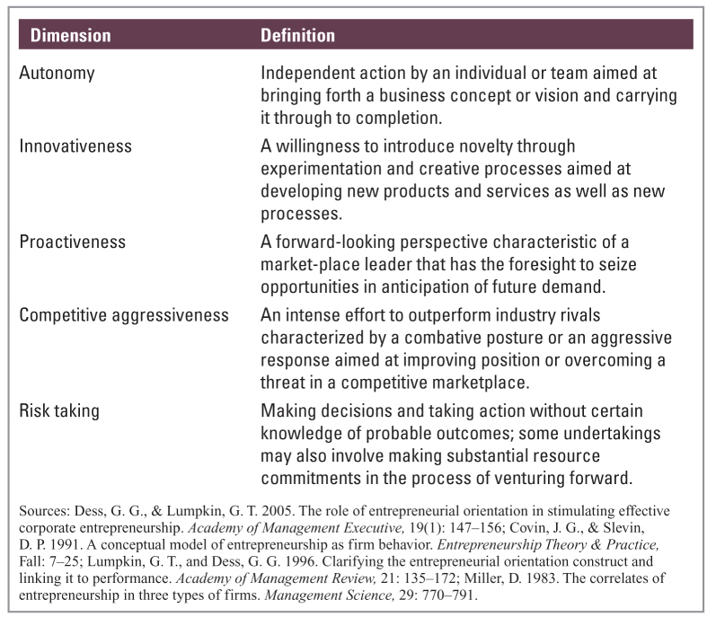
Entrepreneurial Orientation

