Slide 1
Strategic Leadership: Creating a Learning Organization and an Ethical Organization
Strategic Management Part 3 - Strategic Implementation
BUS 4750
Instructor: Dr. Xiaodan “Abby” Wang
Western Michigan University

Slide 2

QUESTION
The relationship between strategy and structure can be best described as A. strategy determines structure but structure does not determine strategy. B. structure determines strategy but strategy does not determine structure. D. a third force determines both strategy and structure.
C. strategy and structure influence each other.
Notes:
2

Slide 3
QUESTION
Which of the following statements about organizational structure is NOT true? A. Simple structure is the oldest and most common organizational form
C. In divisional structure, divisions are relatively autonomous and consist of products and services that are different from those of other divisions
D. Individuals who work in a matrix organization become responsible to both the project manager and the functional area manager.
B. Functional structure is often found where there are multiple unrelated products or services, low production volume, and some vertical integration.
Notes:
3
D

Slide 4

What is Leadership?
Leadership is the process of transforming organization from what they are to what the leader would have them become.
Leadership is
Proactive
Goal-oriented
Focused on the creation and implementation of a creative vision

Slide 5
Leadership: Three Interdependent Activities
Successful leaders must recognize three interdependent activities
Setting a direction
Designing the organization
Nurturing culture dedicated to excellence and ethical behavior

Slide 6
Setting a Direction
Scan environment to develop
Knowledge of all stakholders
Knowledge of salient environmental trends and events
Integrate that knowledge into a vision of what the organization could become
Required capacities
Solve increasingly complex problems
Be proactive in approach
Develop viable strategic options

Slide 7
Designing the Organization
Difficulties in implementing the leaders’ vision and strategies
Lack of understanding of responsibility and accountability among managers
Reward systems that do not motivate individuals and groups toward desired organizational goals
Inadequate or inappropriate budgeting and control systems
Insufficient mechanisms to coordinate and integrate activities activities across the organization

Slide 8
Nurturing a Culture
In nurturing a culture dedicated to excellence and ethical behavior, managers and top executives must
Accept personal responsibility for developing and strengthening ethical behavior
Consistently demonstrate that such behavior is central to the vision and mission
Develop and reinforce
Role models
Corporate credos
Codes of conduct
Reward and evaluation systems
Policies and procedures

Slide 9
Overcoming Barriers to Change and the Effective Use of Power
Reasons why organizations and managers at all levels are prone to inertia and are slow to learn, adapt, and change
Vested in the status quo
Systemic barriers
Behavioral barriers
Political barriers
Personal time constraints
Requires effective use of power to overcome barriers to change

Slide 10









A Leader’s Bases of Power

Slide 11
Emotional Intelligence:
A Key Leadership Trait
Successful traits of leaders at the highest level
Accounting, business planning, etc.
Ability to work with others, passion for work, etc.
Technical skills
Cognitive abilities
Emotional intelligence
Accounting, business planning, etc.
Analytical reasoning, quantitative analysis, etc.
Ability to work with others, passion for work, etc.

Slide 12
Emotional Intelligence
Five components of emotional intelligence
Self-awareness
Self-regulation
Motivation
Empathy
Social skill

Slide 13
Five Components of Emotional Intelligence at Work
Definition Hallmarks
Self-management skills:
The ability to recognize and understand your moods, emotions, and drives, as well as their effect on others.
Self-confidence
Realistic self-assessment
Self-deprecating sense of humor
Self-awareness
The ability to control or redirect disruptive impulses and moods.
The propensity to suspend judgment—to think before acting.
Trustworthiness and integrity
Comfort with ambiguity
Openness to change
Self-regulation

Slide 14
Five Components of Emotional Intelligence at Work
Definition Hallmarks
Self-management skills:
A passion to work for reasons that go beyond money or status.
A propensity to pursue goals with energy and persistence.
Strong drive to achieve
Optimism, even in the face of failure
Organizational commitment
Motivation
Managing relationships:
Empathy
The ability to understand the emotional makeup of other people.
Skill in treating people according to their emotional reactions.
Expertise in building and retaining talent
Cross-cultural sensitivity
Service to clients and customers

Slide 15
Five Components of Emotional Intelligence at Work
Definition Hallmarks
Social skill
Managing relationships:
Proficiency in managing relationships and building networks.
An ability to find common ground and build rapport.
Effectiveness in leading change
Persuasiveness
Expertise in building and leading teams
Social skills

Slide 16
Developing a Learning Organization
Successful learning organizations
Create a proactive, creative approach to the unknown
Actively solicit the involvement of employees at all levels
Enable all employees to use their intelligence and apply their imagination

Slide 17
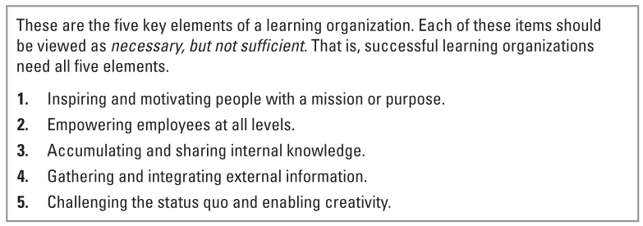
Developing a Learning Organization

Slide 18
Inspiring and Motivating People with a Mission or Purpose
A Learning environment involves:
Organization-wide commitment to change
An action orientation
Applicable tools and methods
Guiding philosophy
Inspired and motivated people with a purpose

Slide 19
Empowering Employees at All Levels
Top-down perspective – about delegation and accountability
Start at the top
Clarify the organization’s mission, vision, and values
Clearly specify the tasks, roles, and rewards for employees
Delegate responsibility
Hold people accountable for results
Notes:
Senior management has developed a clear vision and has communicated specific plans to the rest of the organization. This strategy for empowerment encompasses the following:
Top management determine the right things to do
Employees are empowered to decide how to do things right

Slide 20
Empowering Employees at All Levels
Bottom-up perspective – about risk taking, growth and change
Start at the bottom by understanding needs of employees
Teach employees self-management skills and model desired behaviors
Build teams to encourage cooperative behavior
Encourage intelligent risk taking
Trust people to perform
Notes:
Senior management has developed a clear vision and has communicated specific plans to the rest of the organization. This strategy for empowerment encompasses the following:
Top management determine the right things to do
Employees are empowered to decide how to do things right

Slide 21
Accumulating and Sharing Internal Knowledge
“Open book” management
Numbers reflecting each employee’s work performance and production costs are generated daily
This information is aggregated once a week and shared from top level to bottom level
Employees receive extensive training in how to use and interpret the numbers – how to understand balance sheets, cash flows and income statements

Slide 22
Gathering and Integrating External Information
Awareness of environmental trends and events
Internet accelerates the speed with which useful information can be located
“Garden variety” traditional sources for acquisition of external information
Benchmarking
Focus directly on customers for information

Slide 23
Challenging the Status quo and Enabling Creativity
Challenging the status quo
Create a sense of urgency
Establish a “culture of dissent”
Foster a culture that encourages risk taking
Cultivate culture of experimentation and curiosity

Slide 24
Creating an Ethical Organization
Organizational ethics
the values, attitudes, and behavioral patterns that define an organization’s operating culture and that determine what an organization holds as acceptable behavior.
Ethical orientation
the practices that firms use to promote an ethical business culture, including ethical role models, corporate credos and codes of conduct, ethically-based reward and evaluation systems, and consistently enforced ethical policies and procedures.
Ethical values
Shape the search for opportunities, the design organizational systems and the decision-making process used by individuals and groups
Provide a common frame of reference that serves as a unifying force

Slide 25
Integrity-Based vs. Compliance-Based Approaches
Compliance-based ethics programs
programs for building ethical organizations that have the goal of preventing, detecting, and punishing legal violations.
Integrity-based ethics programs
programs for building ethical organizations that combine a concern for law with an emphasis on managerial responsibility for ethical behavior.

Slide 26
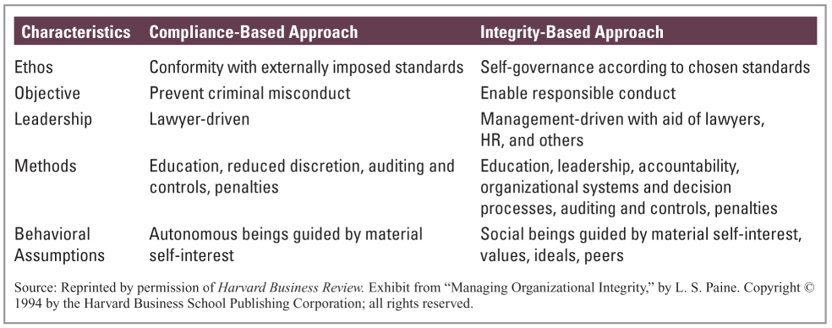
Approaches to Ethics Management

Slide 27
Key Elements of Highly Ethical Organizations
Role models
Corporate credos and codes of conduct
Reward and evaluation systems
Policies and procedures

