Slide 1


Slide 2
Introdcuntion
Ansible is a configuration management and provisioning tool, similar to Chef and Puppet
Written in Python.
Ansible uses YAML syntax.

Slide 3
Benefits
Ansible is agent less.
Written in python.
Easy to learn.
Deploy infrastructure in record time.

Slide 4
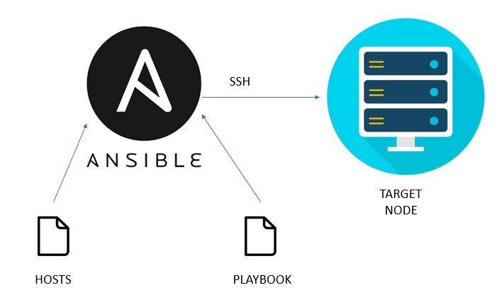
Ansible work flow

Slide 5
Playbook Components
Inventories
Variables
Vault
Tasks
Roles

Slide 6
Inventory
sudo vi /etc/ansible/hosts
[web]
ip-address/hostname
…..
[db]
ip-address/hostname
……
Tasks
vi playbook.yaml
---
- hosts: db
tasks:
copy:
src: /file/path
dest: /file/path

Slide 7
Variables
In the playbook
In the inventory file
Using group_vars
Ansible modules
The module is a command or set of similar commands which is executed on the client-side.

Slide 8
Ansible Roles
The role is the primary mechanism for breaking a playbook into multiple files
Ansible-galaxy init role-name
Role-name/
readme.md
defaults/
Files/
handlers/
handlers
meta/
tasks/
templates/
Tests/
vars/

Slide 9
Thank You

