Slide 1


Slide 2

Topic 1 Cassandra Architecture
Class 1 - Introduction to Cassandra :A blazingly fast NoSQL Database
Notes:
Do we know the topic number for this?

Slide 3

AGENDA
Hadoop
Limitations of MapReduce?
Introduction to Spark
Batch Analysis Vs Real time Analysis?
Streaming Vs In-memory Analysis?
History of Spark
Benefits of Spark
Core components of Spark
Spark core
SparkSQL, SparkStreaming,SparkMLLib
SparkGraphX and Spark-R
Spark use cases in Real time
Yahoo, Conviva and Uber

Slide 4

Introduction to Cassandra
Cassandra is a distributed, fault tolerant, scalable, column oriented data store.
The data model and on disk storage are inspired by Google Big Table
The distributed cluster is inspired by Amazon Dynamo.

Slide 5
Introduction to Cassandra
Snitches
A snitch determines which data centers and racks nodes belong to.
They inform Cassandra about the network topology so that requests are routed efficiently and allows Cassandra to distribute replicas by grouping machines into data centers and racks.
Cassandra does its best not to have more than one replica on the same rack (which is not necessarily a physical location).

Slide 6
Introduction to Cassandra
Snitches
Dynamic snitching
By default, all snitches also use a dynamic snitch layer that monitors read latency and, when possible, routes requests away from poorly-performing nodes
The dynamic snitch is enabled by default and is recommended for use in most deployments

Slide 7
Introduction to Cassandra
Snitches
Simple snitching
The SimpleSnitch (default) is used only for single-data center deployments. It does not recognize data center or rack information
It and can be used only for single-data center deployments or single-zone in public clouds.
It treats strategy order as proximity, which can improve cache locality when disabling read repair

Slide 8
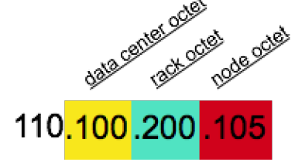
Introduction to Cassandra
Snitches
Rack Inferring snitching
The RackInferringSnitch determines the proximity of nodes by rack and data center, which are assumed to correspond to the 3rd and 2nd octet of the node's IP address, respectively.
This snitch is best used as an example for writing a custom snitch class (unless this happens to match your deployment conventions).

Slide 9
Introduction to Cassandra
Snitches
Simple snitching
This snitch determines proximity as determined by rack and data center. It uses the network details located in the cassandra-topology.properties file. When using this snitch, you can define your data center names to be whatever you want.
Make sure that the data center names correlate to the name of your data centers in the keyspace definition. Every node in the cluster should be described in the cassandratopology. properties file, and this file should be exactly the same on every node in the cluster

Slide 10
BUMPER

