Slide 1
DNS Domain Name System

Slide 2
Domain names and IP addresses
People prefer to use easy-to-remember names instead of IP addresses
Domain names are alphanumeric names for IP addresses e.g., neon.cs.virginia.edu, www.google.com, ietf.org
The domain name system (DNS) is an Internet-wide distributed database that translates betweem domain names and IP addresses
How important is DNS?
Imagine what happens when the local DNS server is down.

Slide 3
Before there was DNS ….
…. there was the HOSTS.TXT file
Before DNS (until 1985), the name-to-IP address was done by downloading a single file (hosts.txt) from a central server with FTP.
  Names in hosts.txt are not structured.
  The hosts.txt file still works on most operating systems. It can be used to define local names.

Slide 4
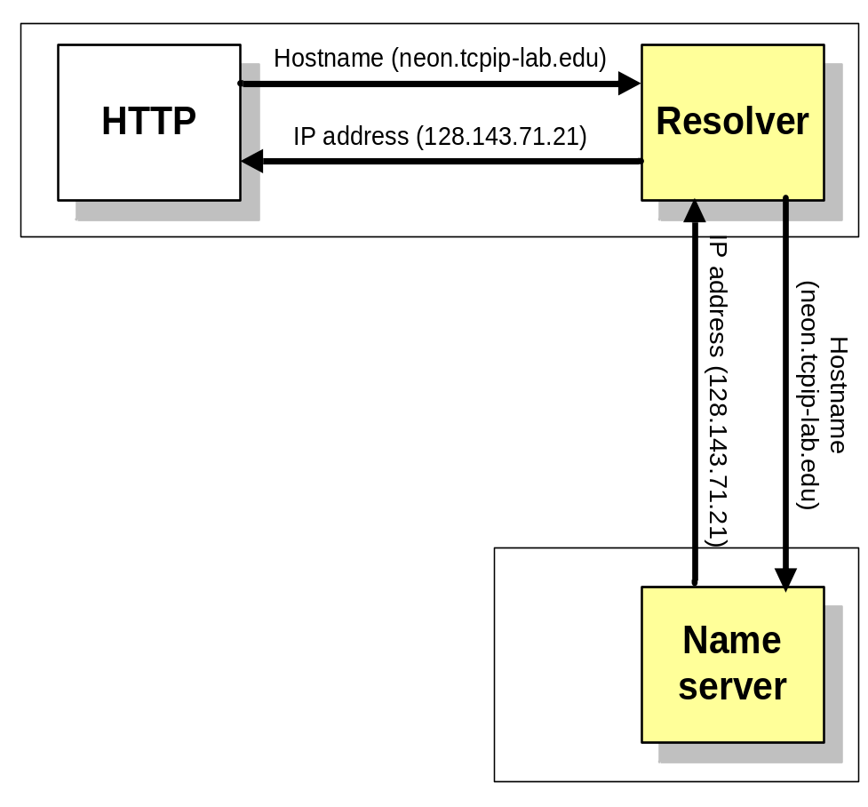
Resolver and name server
An application program on a host accesses the domain system through a DNS client, called the resolver
Resolver contacts DNS server, called name server
DNS server returns IP address to resolver which passes the IP address to application
Reverse lookups are also possible, i.e., find the hostname given an IP address

Slide 5
Design principle of DNS
The naming system on which DNS is based is a hierarchical and logical tree structure called the domain namespace.
An organization obtains authority for parts of the name space, and can add additional layers of the hierarchy
Names of hosts can be assigned without regard of location on a link layer network, IP network or autonomous system
In practice, allocation of the domain names generally follows the allocation of IP address, e.g.,
  All hosts with network prefix 128.143/16 have domain name suffix virginia.edu
  All hosts on network 128.143.136/24 are in the Computer Science Department of the University of Virginia

Slide 6
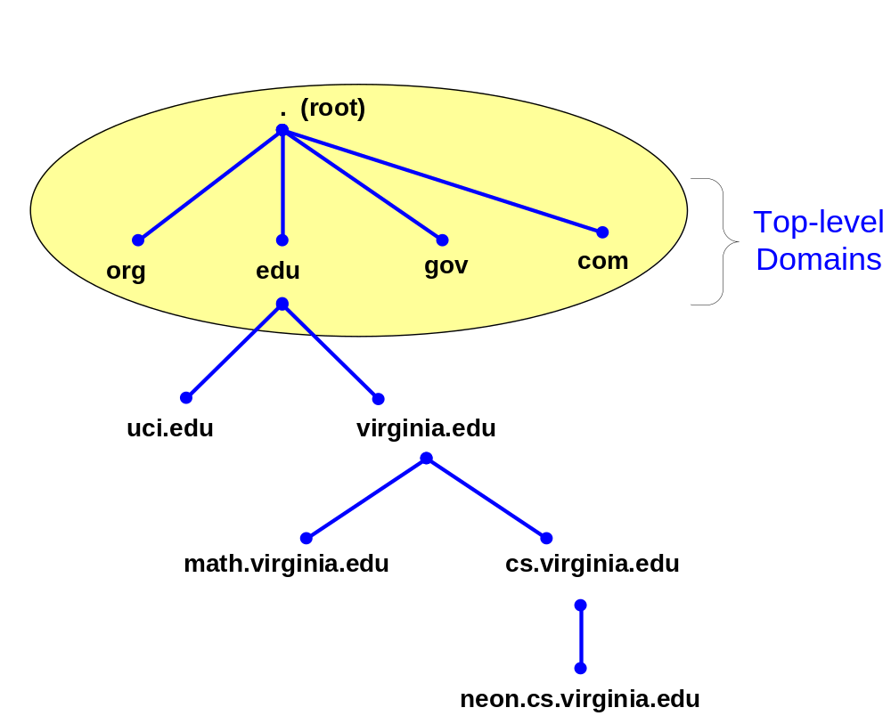
DNS Name hierarchy
DNS hierarchy can be represented by a tree
Below top-level domain, administration of name space is delegated to organizations
Each organization can delegate further
Managed
by UVA
Managed by
CS Dept.

Slide 7
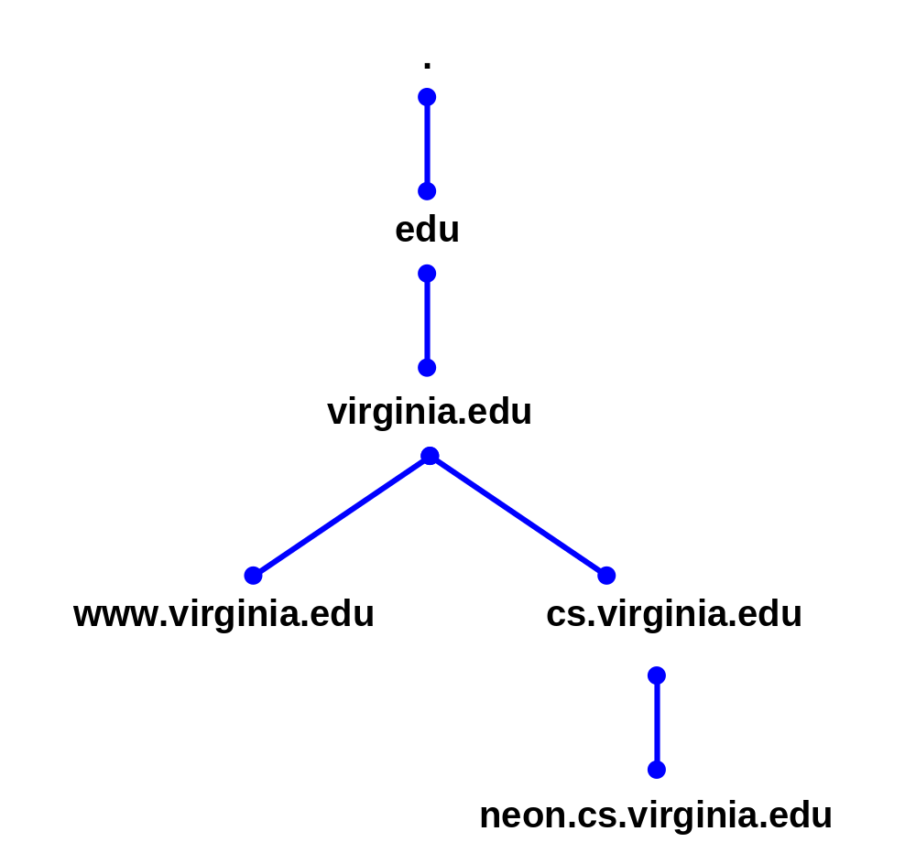
Domain name system
Each node in the DNS tree represents a DNS name
Each branch below a node is a DNS domain.
  DNS domain can contain hosts or other domains (subdomains)
Example:
DNS domains are
., edu, virginia.edu, cs.virginia.edu

Slide 8
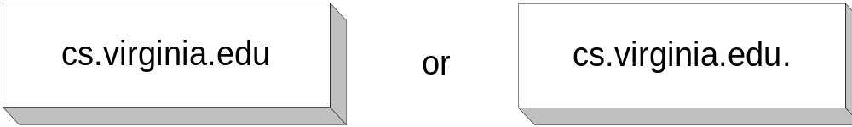
Domain names
Hosts and DNS domains are named based on their position in the domain tree
Every node in the DNS domain tree can be identified by a unique Fully Qualified Domain Name (FQDN). The FQDN gives the position in the DNS tree.
A FQDN consists of labels (“cs”,“virginia”,”edu”) separated by a period (“.”)
There can be a period (“.”) at the end.
Each label can be up to 63 characters long
FQDN contains characters, numerals, and dash character (“-”)
FQDNs are not case-sensitive

Slide 9

DNS IN THE INTERNET

Slide 10
Top-level domains
Three types of top-level domains:
  Generic Top Level Domains (gTLD): 3-character code indicates the function of the organization
    Used primarily within the US
    Examples: gov, mil, edu, org, com, net
  Country Code Top Level Domain (ccTLD): 2-character country or region code
    Examples: us, va, jp, de
  Reverse domains: A special domain (in-addr.arpa) used for IP address-to-name mapping
There are more than 200 top-level domains.

Slide 11

Generic domains

Slide 12

Generic Top Level Domains (gTLD)
gTLDs are authoritatively administered by the Internet central name registration authority ICANN

Slide 13

Country domains

Slide 14

Inverse domain

Slide 15
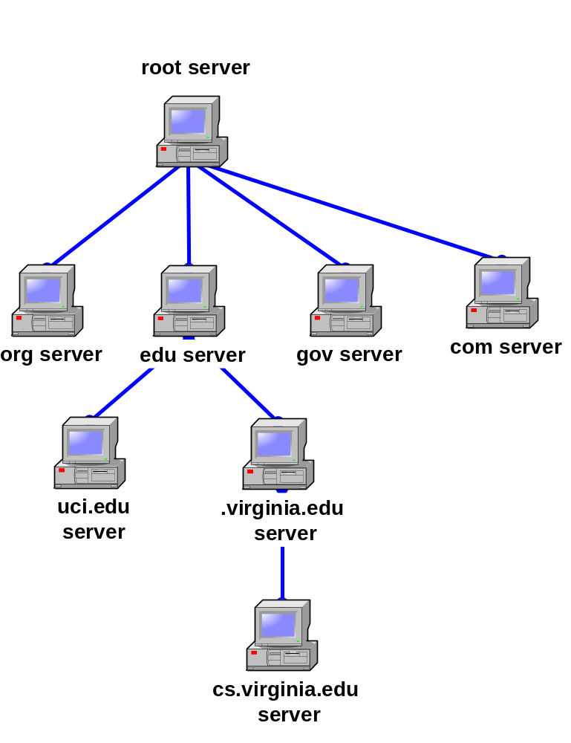
Hierarchy of name servers
The resolution of the hierarchical name space is done by a hierarchy of name servers
Each server is responsible (authoritative) for a contiguous portion of the DNS namespace, called a zone.
DNS server answers queries about hosts in its zone

Slide 16
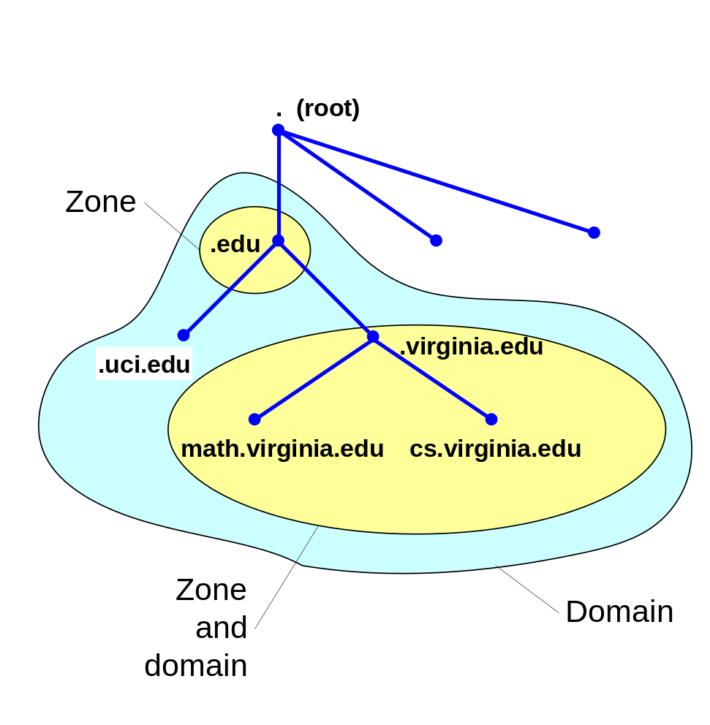
DNS domain and zones
Each zone is anchored at a specific domain node, but zones are not domains.
A DNS domain is a branch of the namespace
A zone is a portion of the DNS namespace generally stored in a file (It could consists of multiple nodes)
A server can divide part of its zone and delegate it to other servers

Slide 17
Primary and secondary name servers
For each zone, there must be a primary name server and a secondary name server
  The primary server (master server) maintains a zone file which has information about the zone. Updates are made to the primary server
  The secondary server copies data stored at the primary server.
Adding a host:
When a new host is added (“gold.cs.virginia.edu”) to a zone, the administrator adds the IP information on the host (IP address and name) to a configuration file on the primary server

Slide 18
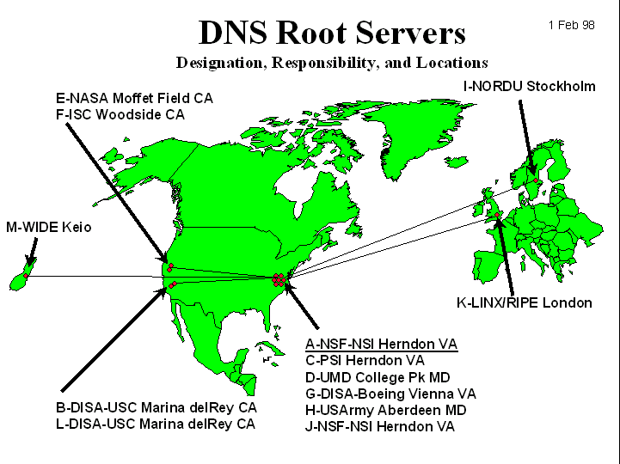
Root name servers
The root name servers know how to find the authoritative name servers for all top-level zones.
There are only 13 root name servers
Root servers are critical for the proper functioning of name resolution

Slide 19
Addresses of root servers (2004)
A.ROOT-SERVERS.NET. (VeriSign, Dulles, VA) 198.41.0.4
B.ROOT-SERVERS.NET. (ISI, Marina Del Rey CA) 192.228.79.201
C.ROOT-SERVERS.NET. (Cogent Communications) 192.33.4.12
D.ROOT-SERVERS.NET. (University of Maryland) 128.8.10.90
E.ROOT-SERVERS.NET. (Nasa Ames Research Center) 192.203.230.10
F.ROOT-SERVERS.NET. (Internet Systems Consortium) 192.5.5.241
G.ROOT-SERVERS.NET. (US Department of Defense) 192.112.36.4
H.ROOT-SERVERS.NET. (US Army Research Lab) 128.63.2.53
I.ROOT-SERVERS.NET. (Autonomica/NORDUnet) 192.36.148.17
J.ROOT-SERVERS.NET. (Verisign, multiple cities) 192.58.128.30
K.ROOT-SERVERS.NET. (RIPE,Europe multiple cities) 193.0.14.129
L.ROOT-SERVERS.NET. (IANA, Los Angeles) 198.32.64.12
M.ROOT-SERVERS.NET. (WIDE, Tokyo, Seoul, Paris) 202.12.27.33

Slide 20
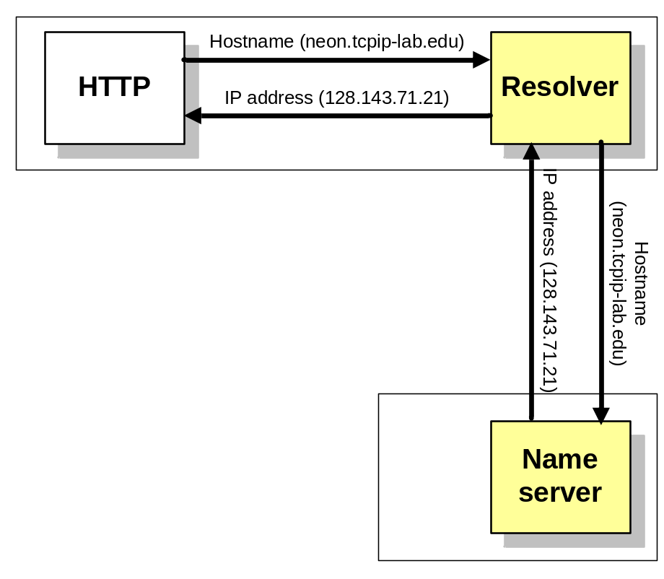
Domain name resolution
User program issues a request for the IP address of a hostname
Local resolver formulates a DNS query to the name server of the host
Name server checks if it is authorized to answer the query.
  If yes, it responds.
  Otherwise, it will query other name servers, starting at the root tree
When the name server has the answer it sends it to the resolver.

Slide 21
Recursive and Iterative Queries
There are two types of queries:
  Recursive queries
  Iterative (non-recursive) queries
The type of query is determined by a bit in the DNS query
Recursive query: When the name server of a host cannot resolve a query, the server issues a query to resolve the query
Iterative queries: When the name server of a host cannot resolve a query, it sends a referral to another server to the resolver

Slide 22
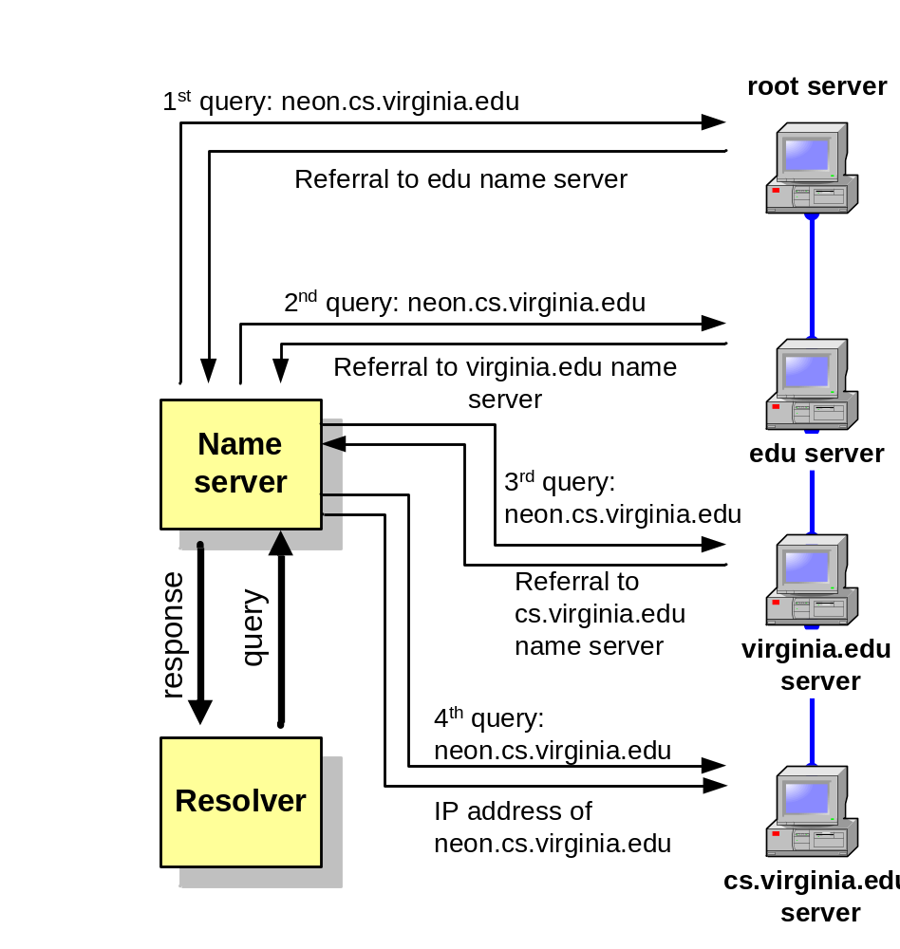
Recursive queries
In a recursive query, the resolver expects the response from the name server
If the server cannot supply the answer, it will send the query to the “closest known” authoritative name server (here: In the worst case, the closest known server is the root server)
The root sever sends a referral to the “edu” server. Querying this server yields a referral to the server of “virginia.edu”
… and so on

Slide 23
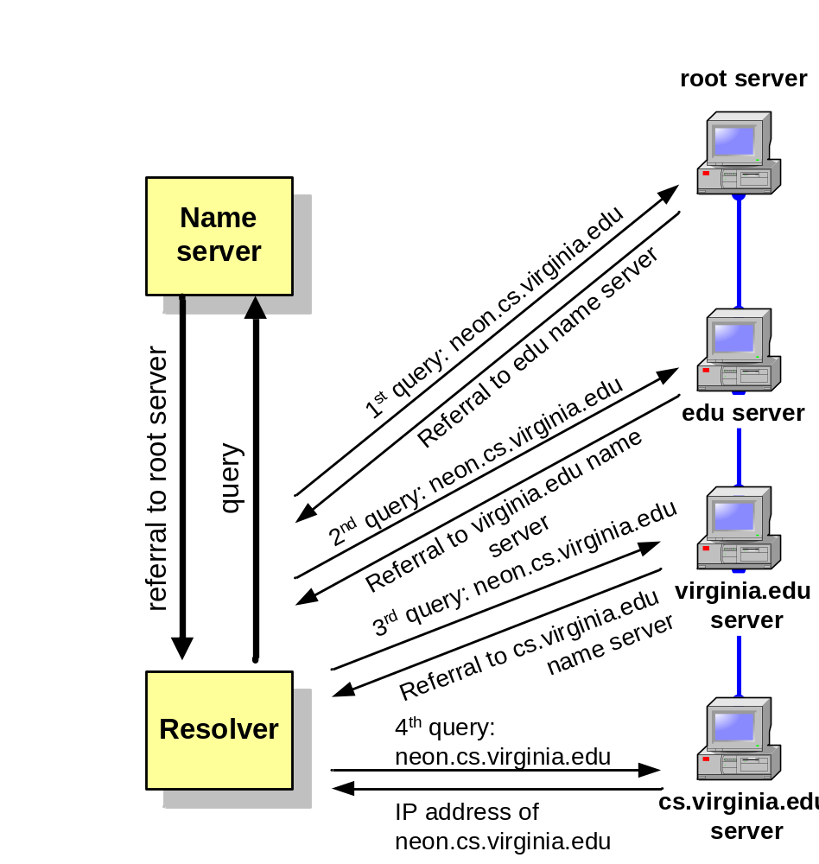
Iterative queries
In an iterative query, the name server sends a closest known” authoritative name server the a referral to the root server.
This involves more work for the resolver

Slide 24
Caching
To reduce DNS traffic, name servers caches information on domain name/IP address mappings
When an entry for a query is in the cache, the server does not contact other servers
Note: If an entry is sent from a cache, the reply from the server is marked as “unauthoritative”

Slide 25
DNS MESSAGES
DNS has two types of messages: query and response. Both types have the same format. The query message consists of a header and question records; the response message consists of a header, question records, answer records, authoritative records, and additional records.

Slide 26
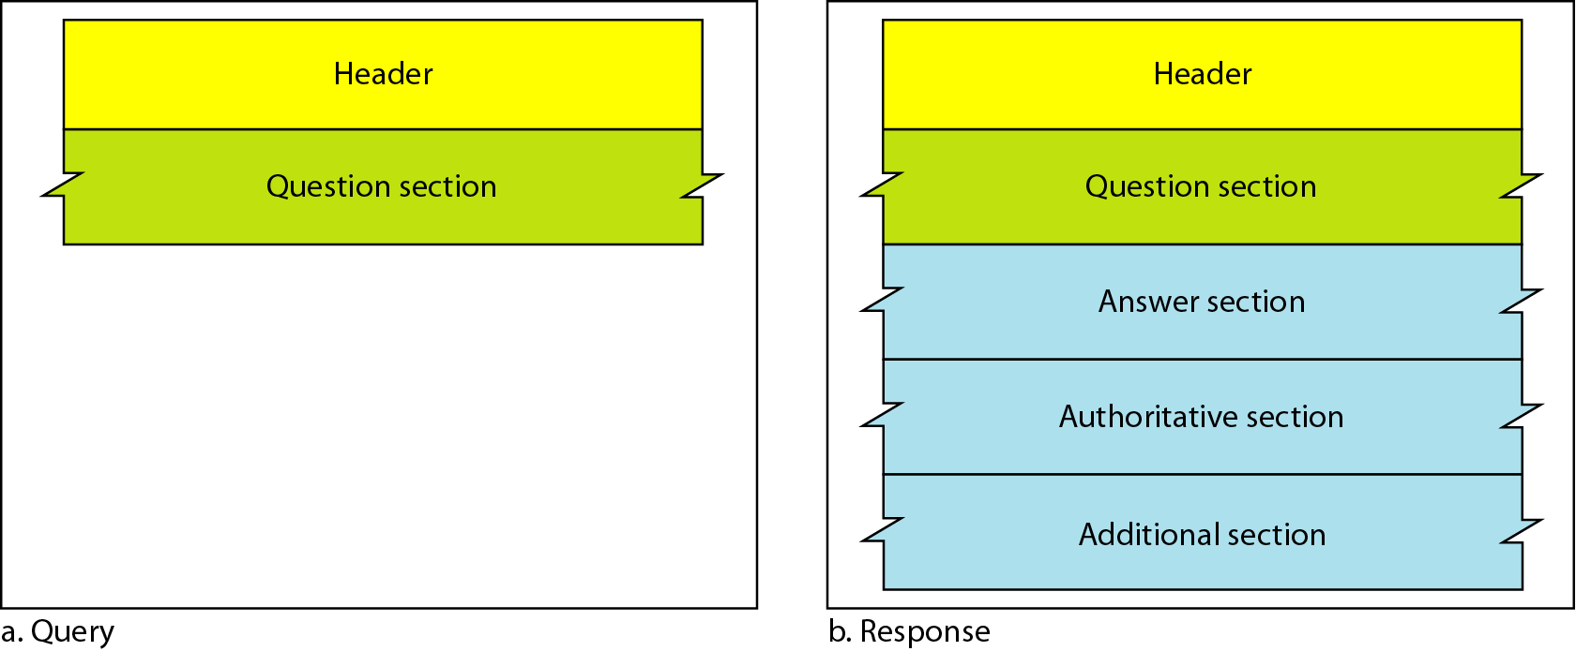
Query and response messages

Slide 27
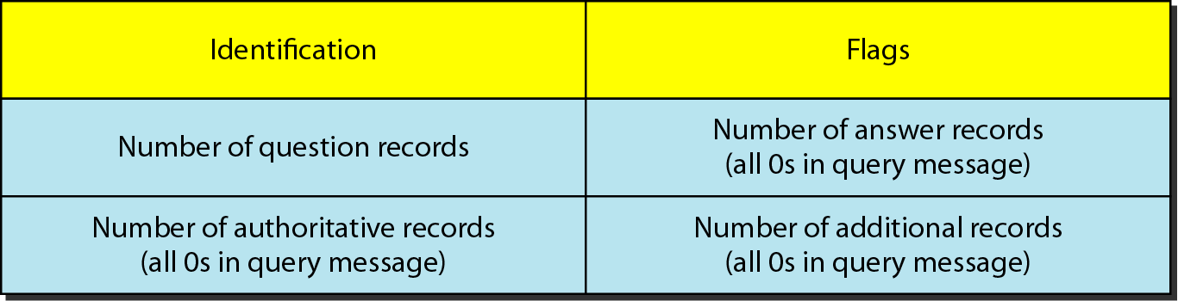
Header format

Slide 28
TYPES OF RECORDS
Two types of records are used in DNS. The question records are used in the question section of the query and response messages. The resource records are used in the answer, authoritative, and additional information sections of the response message.

Slide 29
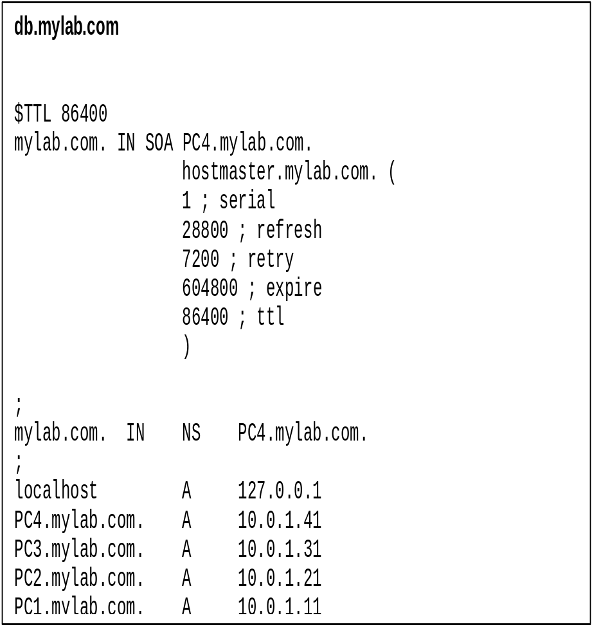
Resource Records
The database records of the DNS distributed data base are called resource records (RR)
Resource records are stored in configuration files (zone files) at name servers.
Resource records for a zone→

Slide 30
Resource Records
db.mylab.com
$TTL 86400
mylab.com. IN SOA PC4.mylab.com. hostmaster@mylab.com. (
1 ; serial
28800 ; refresh
7200 ; retry
604800 ; expire
86400 ; ttl
)
;
mylab.com. IN NS PC4.mylab.com.
;
localhost A 127.0.0.1
PC4.mylab.com. A 10.0.1.41
PC3.mylab.com. A 10.0.1.31
PC2.mylab.com. A 10.0.1.21
PC1.mylab.com. A 10.0.1.11
Max. age of cached data
in seconds
Start of authority (SOA) record.
Means: “This name server is
authoritative for the zone
Mylab.com”
PC4.mylab.com is the
name server
hostmaster@mylab.com is the
email address of the person
in charge
Name server (NS) record.
One entry for each authoritative
name server
Address (A) records.
One entry for each hostaddress

Slide 31
REGISTRARS
How are new domains added to DNS? This is done through a registrar, a commercial entity accredited by ICANN. A registrar first verifies that the requested domain name is unique and then enters it into the DNS database. A fee is charged.

Slide 32
DYNAMIC DOMAIN NAME SYSTEM (DDNS)
The DNS master file must be updated dynamically. The Dynamic Domain Name System (DDNS) therefore was devised to respond to this need. In DDNS, when a binding between a name and an address is determined, the information is sent, usually by DHCP to a primary DNS server. The primary server updates the zone. The secondary servers are notified either actively or passively.

Slide 33
ENCAPSULATION
DNS can use either UDP or TCP. In both cases the well-known port used by the server is port 53. UDP is used when the size of the response message is less than 512 bytes because most UDP packages have a 512-byte packet size limit. If the size of the response message is more than 512 bytes, a TCP connection is used.

