Slide 1
UDP

Slide 2
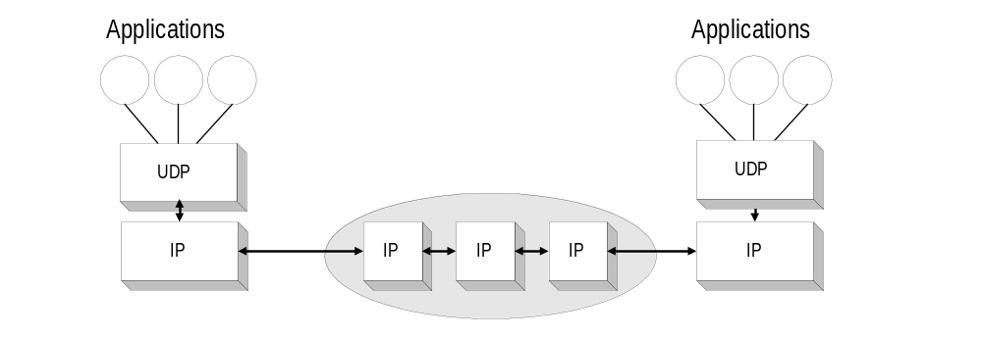
UDP - User Datagram Protocol
UDP is connectionless
UDP supports unreliable transmissions of datagrams
UDP merely extends the host-to-to-host delivery service of IP datagram to an application-to-application service
The only thing that UDP adds is multiplexing and demultiplexing

Slide 3
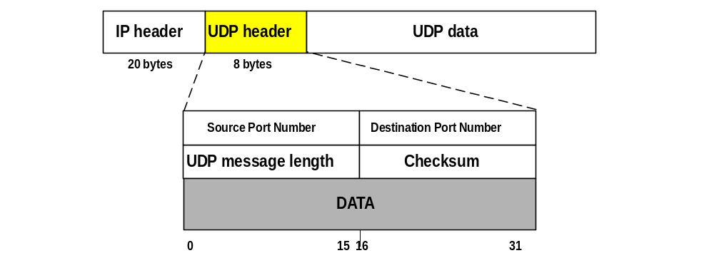
UDP Format
Port numbers identify sending and receiving applications (processes). Maximum port number is 2¹⁶-1= 65,535
Message Length is at least 8 bytes (I.e., Data field can be empty) and at most 65,535
Checksum is for header (of UDP and some of the IP header fields)

Slide 4
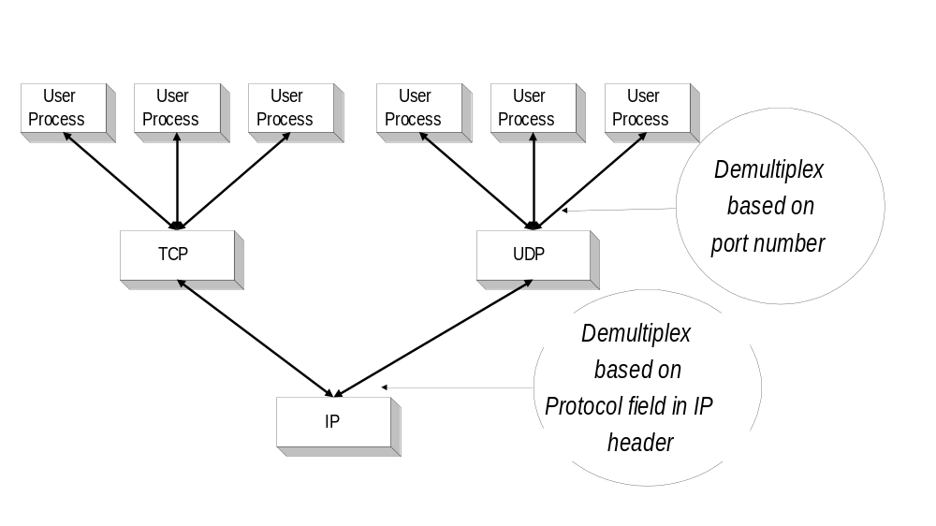
Port Numbers
UDP (and TCP) use port numbers to identify applications
A globally unique address at the transport layer (for both UDP and TCP) is a tuple <IP address, port number>
There are 65,535 UDP ports per host.

Slide 5

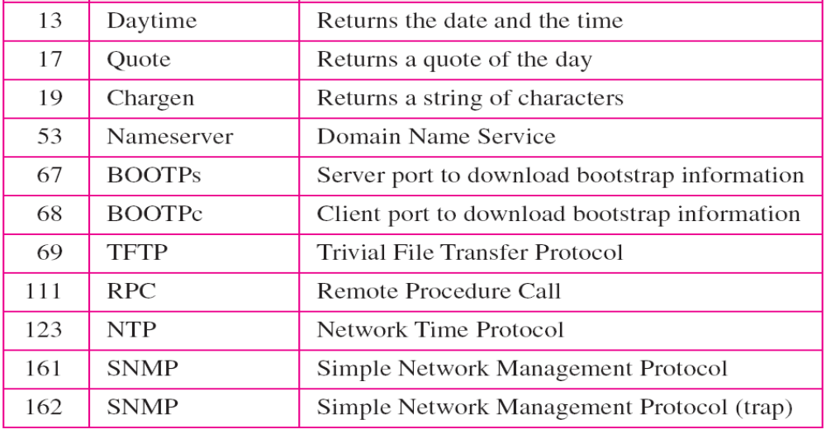
Well-known ports used with UDP

Slide 6
UDP Datagram Format
Port numbers identify sending and receiving applications (processes). Maximum port number is 2¹⁶-1= 65,535
Message Length is at least 8 bytes (I.e., Data field can be empty) and at most 65,535
Checksum is for header (of UDP and some of the IP header fields)

Slide 7

Pseudoheader for checksum calculation

Slide 8

Checksum calculation of a simple UDP user datagram
Figure shows the checksum calculation for a very small user datagram with only 7 bytes of data. Because the number of bytes of data is odd, padding is added for checksum calculation. The pseudoheader as well as the padding will be dropped when the user datagram is delivered to IP.

Slide 9

Queues in UDP

